Slide 1
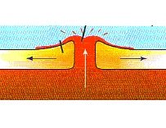
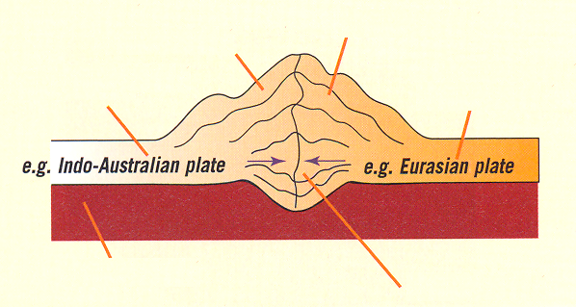
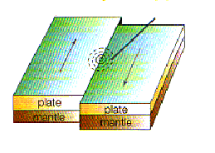
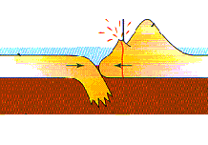
Plate Movement
A plate boundary is where 2 plates meet
There are 4 ways in which the earth’s plates can move...
Constructive
Collisional
Conservative
Destructive

Slide 2
The following slides have the content covered in school
Below are some additional sources of information:
Video showing the boundaries - https://www.bbc.co.uk/teach/class-clips-video/geography-ks3-plate-tectonics/zrc992p
https://www.bbc.co.uk/bitesize/guides/zt9y2p3/revision/3

Slide 3
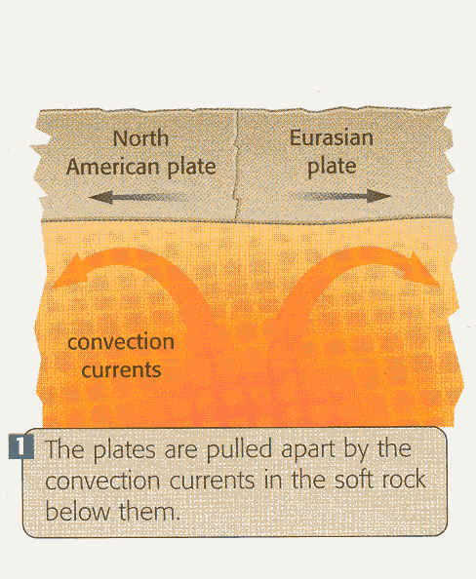
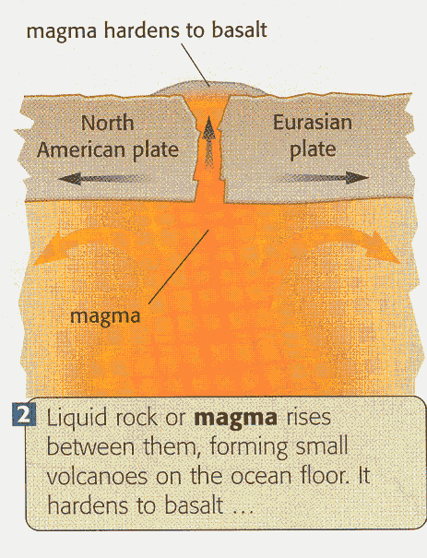
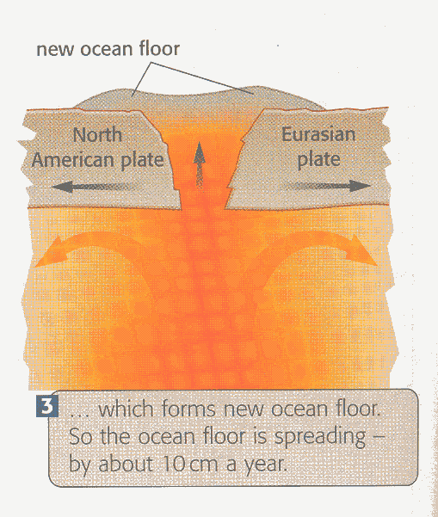
Constructive Plate Margins

Slide 4
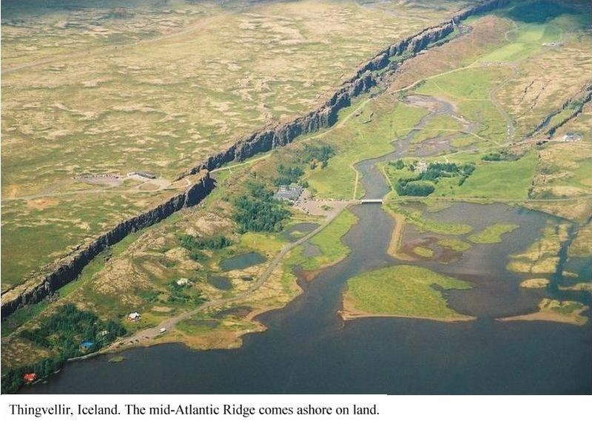

Slide 5
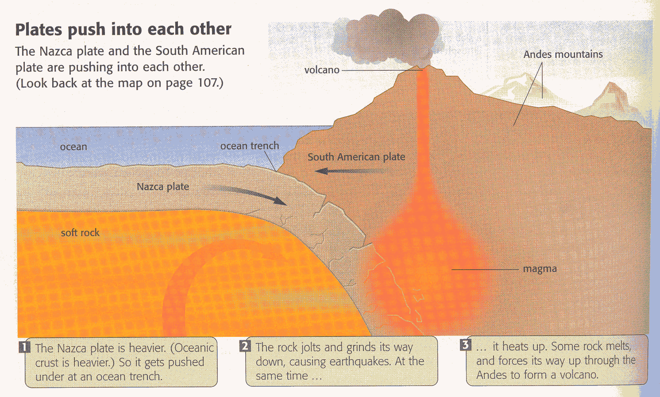
Destructive margins

Slide 6
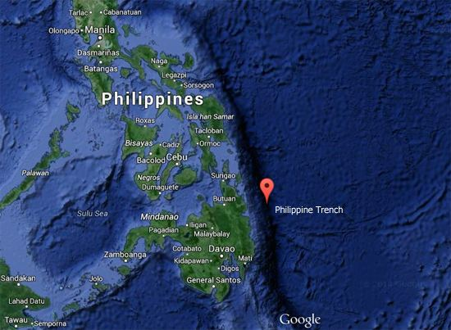

Slide 7
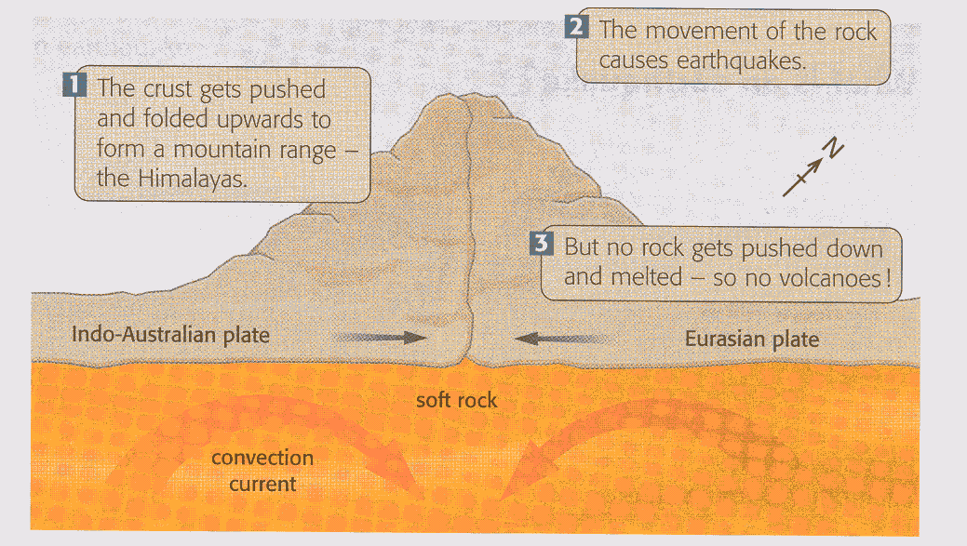
Collision plate margins

Slide 8
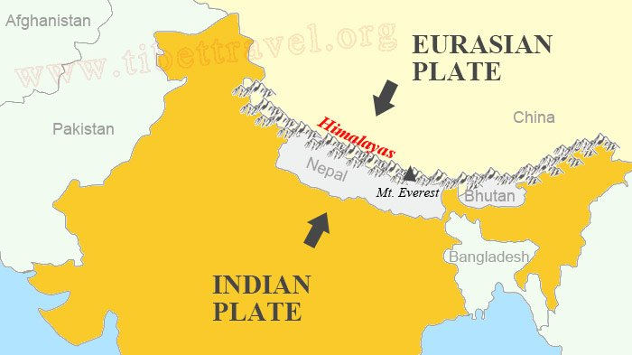
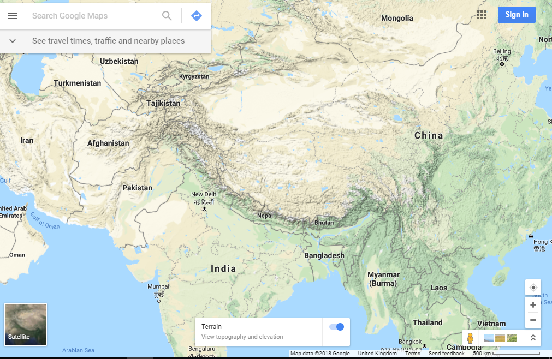

Slide 9
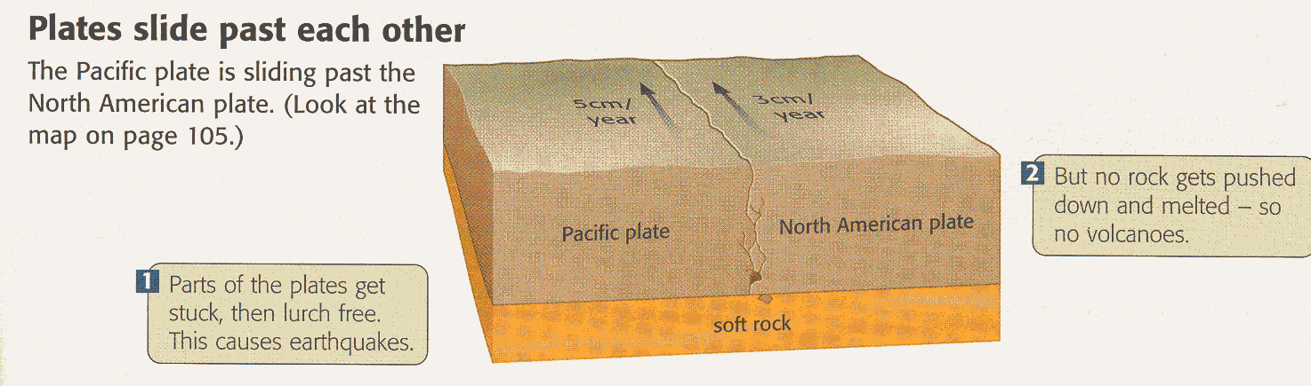
Conservative Plate Margins

Slide 10
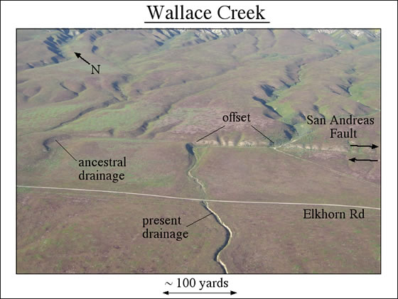
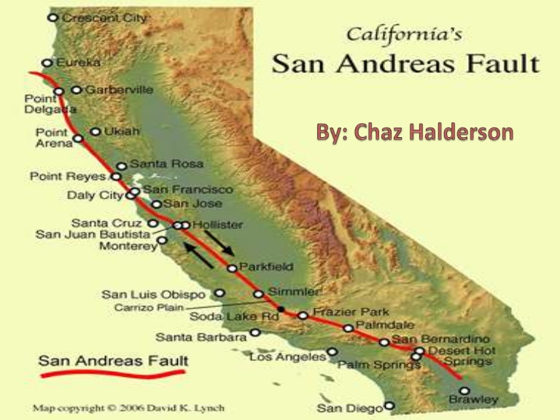
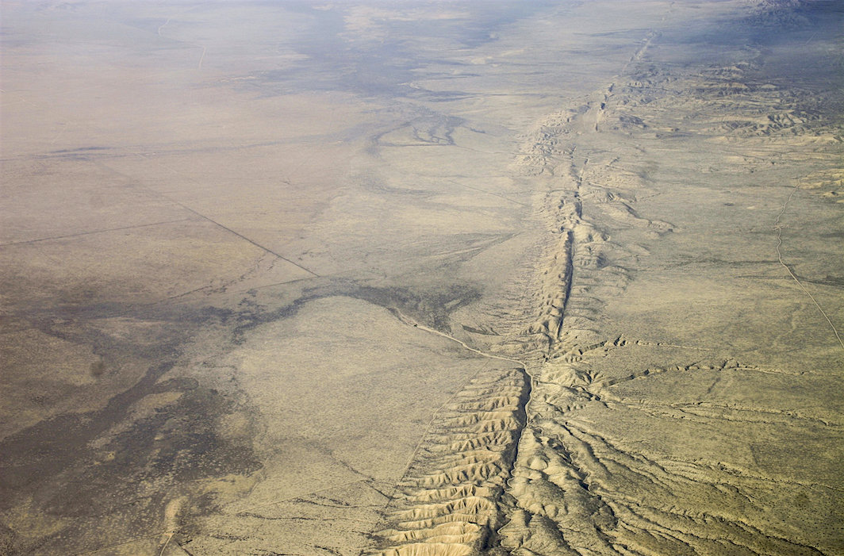

Slide 11
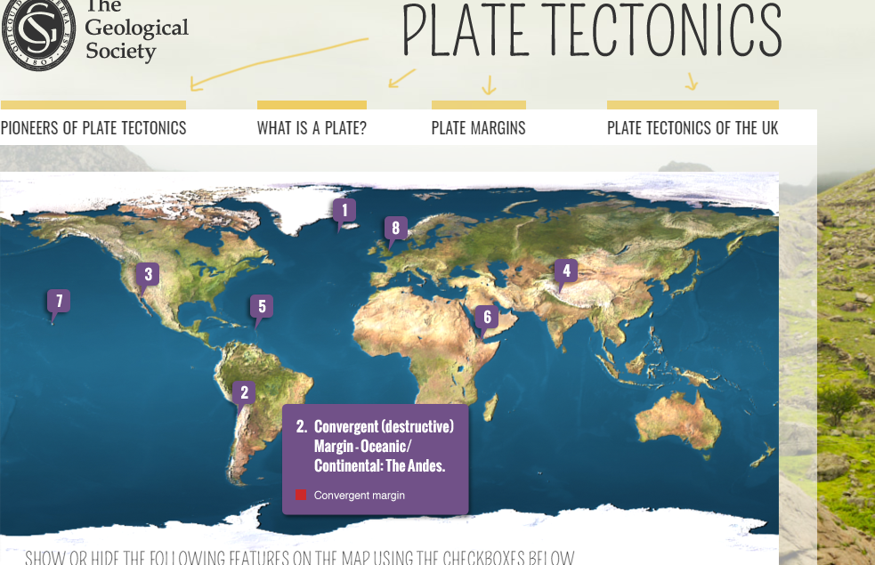
Explore some of the world’s plate margins using this link
https://www.geolsoc.org.uk/Plate-Tectonics

