Slide 1
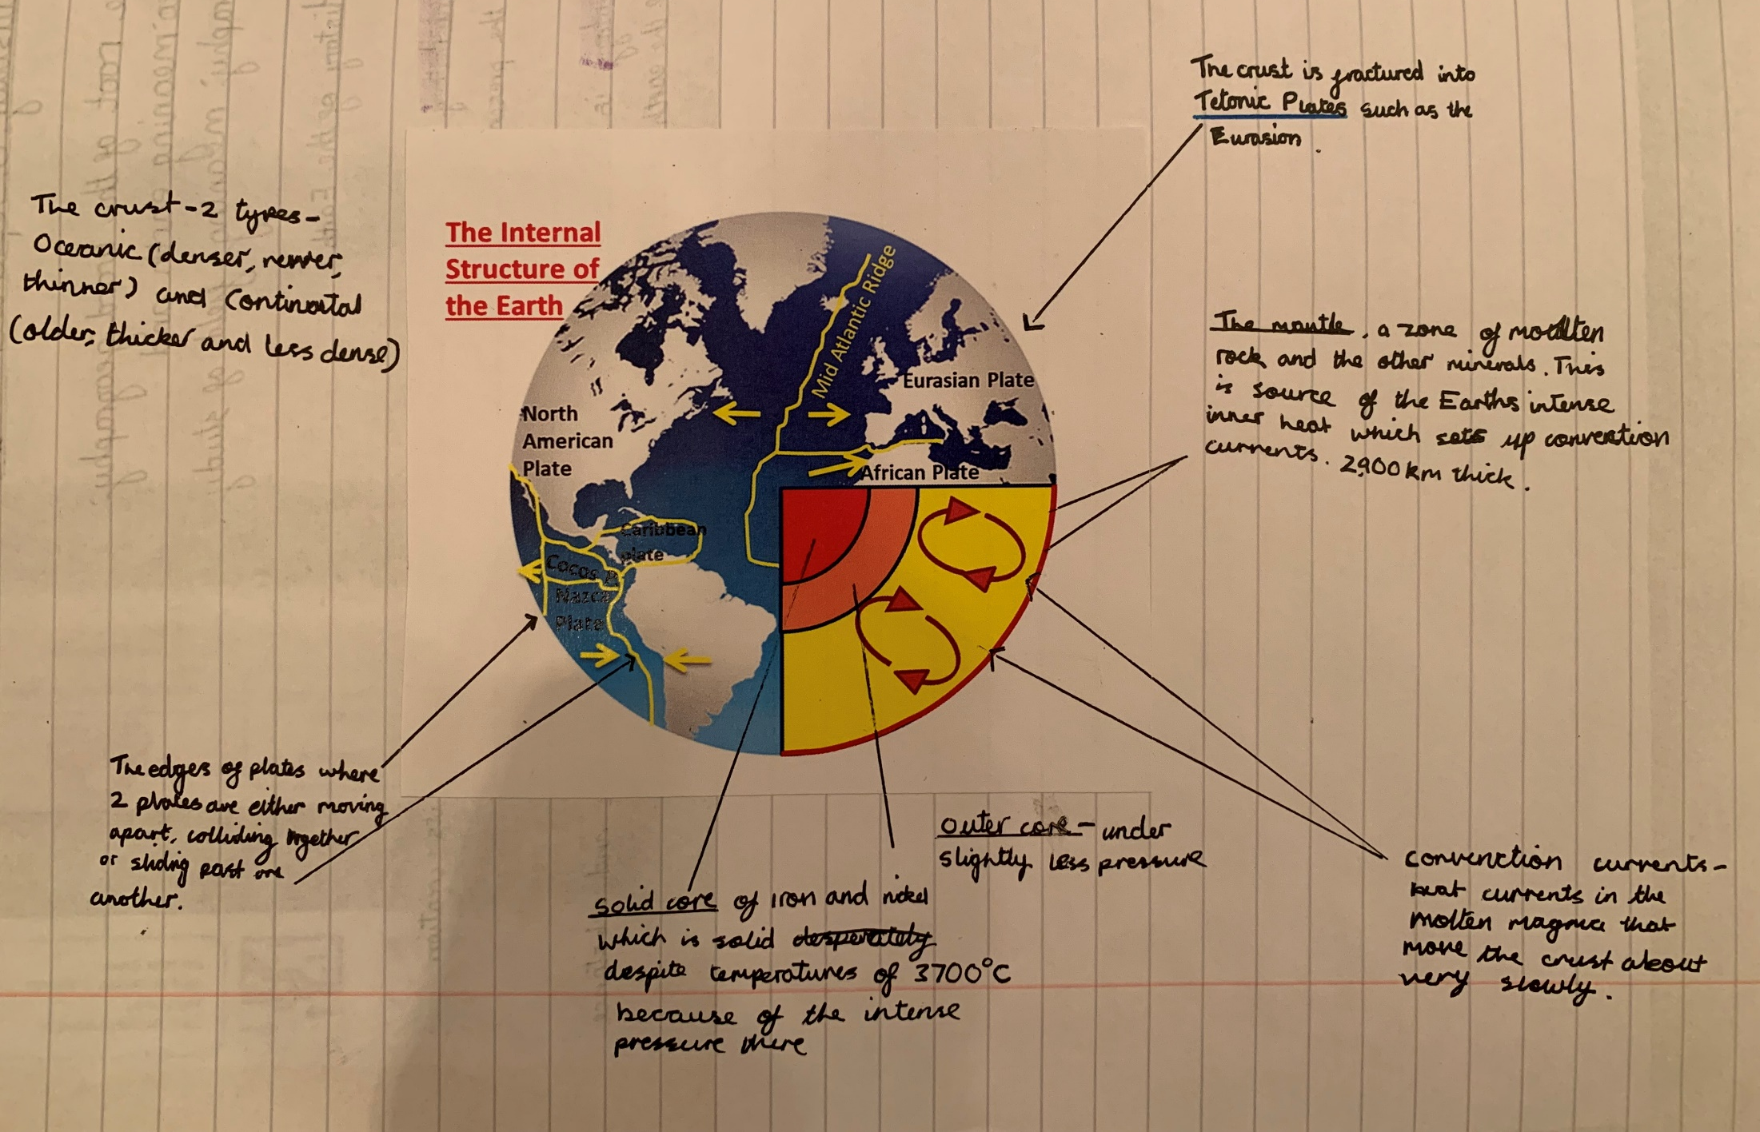
Examples of Year 7 Tectonics work
Each layer is labelled with a clear description of its characteristics

Slide 2
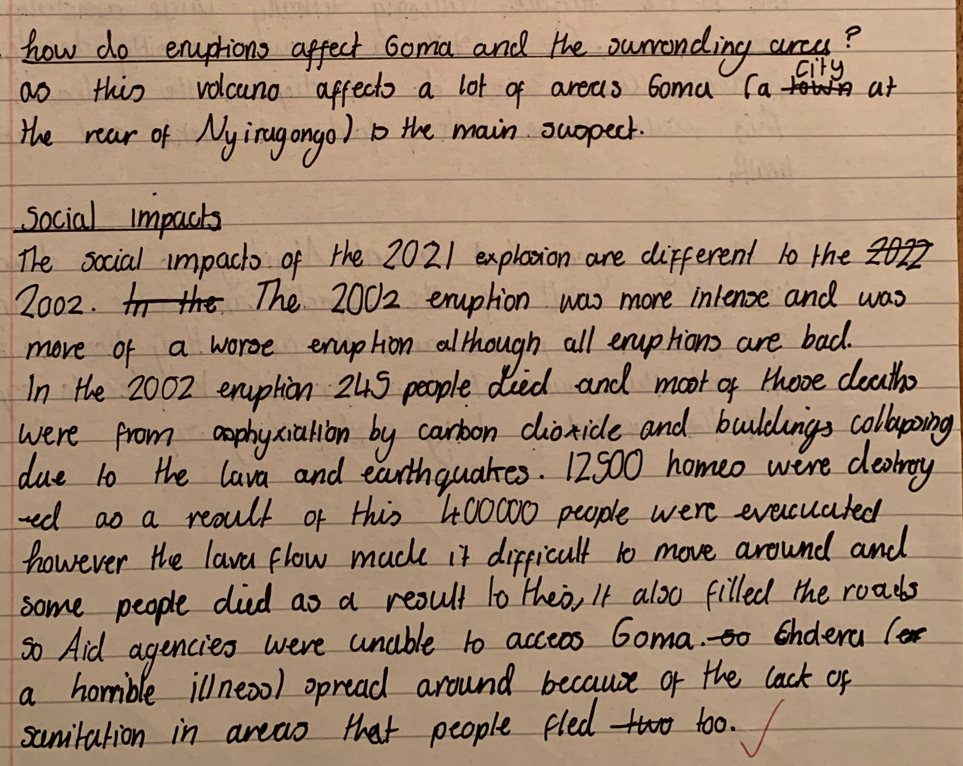
Impacts of volcanic eruptions
First point introduced and mentions that it is a social point.
Evidence is used to support points throughout
The point is then explained – how did the volcanic eruption cause the deaths.
In this part of the explanation the student has explained why evacuation and aid, which should have limited the impacts have not been successful.

Slide 3
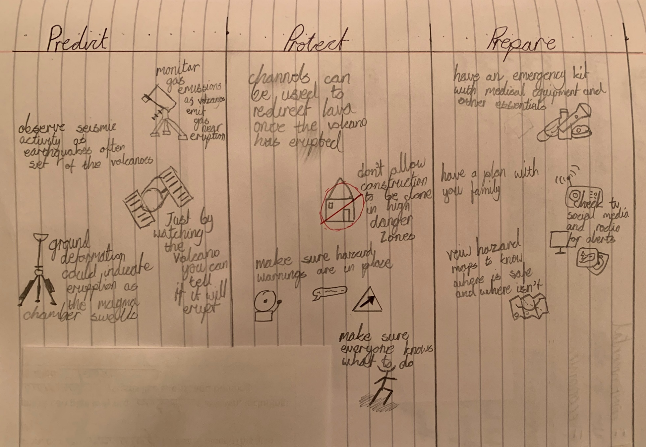
Managing volcanic eruptions
3 areas of how to limit damage from volcanic eruptions are covered using diagrams to make it more memorable

