Slide 1
Exemplar work Y7 French

Slide 2
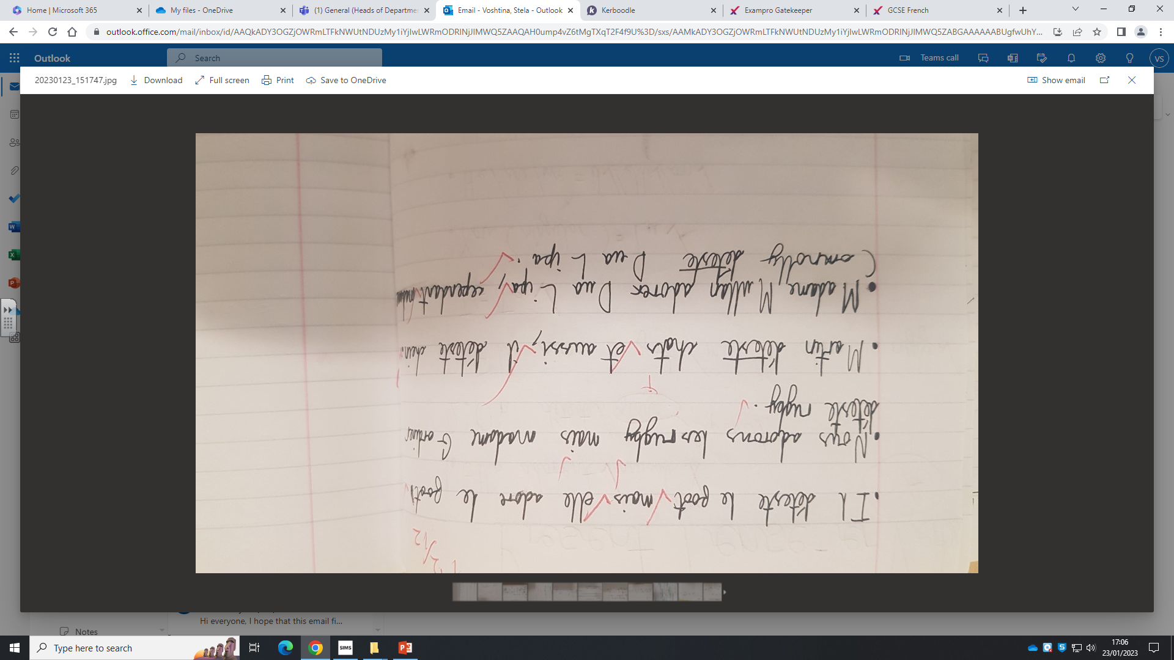
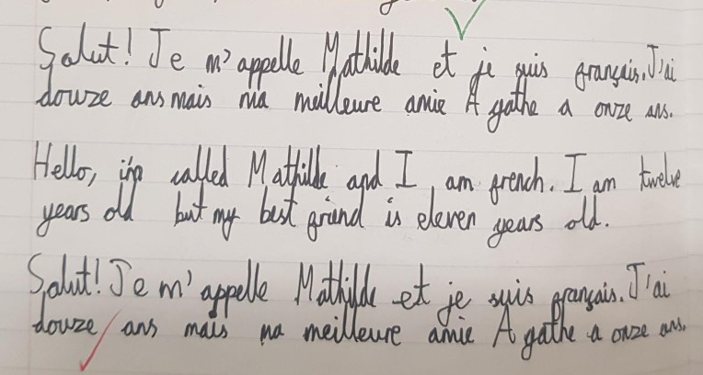
Very accurate writing, introducing themselves and others. Excellent greeting and using 'j'ai/ je suis' accurately. Great connectives and very accurate translation also.
Accurate spelling and formation of verbs in the present tense, first and third person. Accurate negatives as well and using connectives to link sentences together.

Slide 3
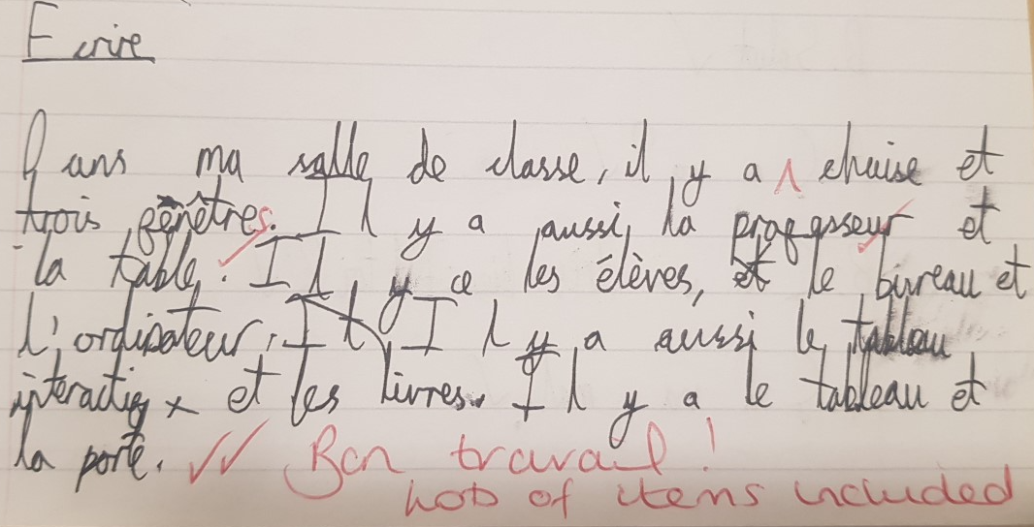
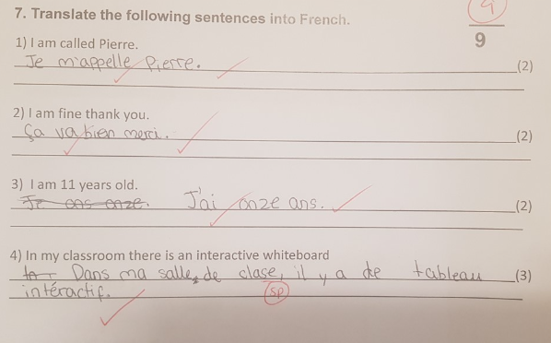
Accurate spelling in French. Excellent use of connectives and detail given.
Very accurate translation into French. Accurate spelling and very good knowledge of classroom items, introducing themselves and expressing how they are.

Slide 4
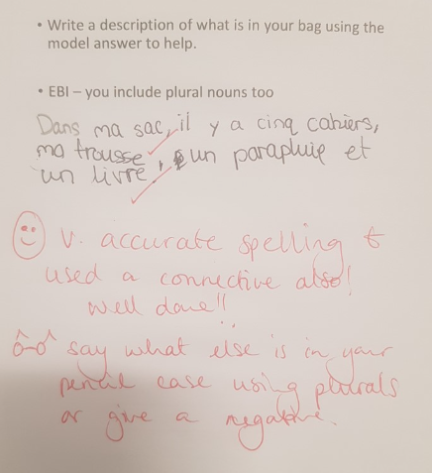
Can use verbs accurately to describe what is in their pencil case. Accurate spelling also.

