Slide 1

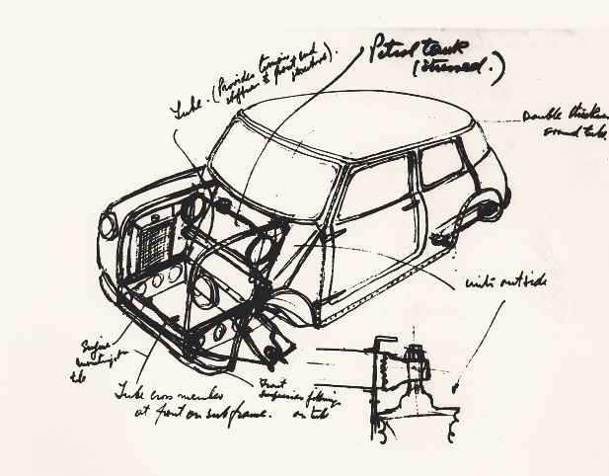
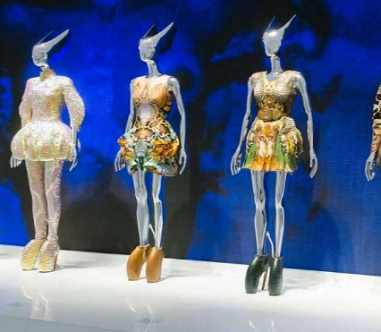
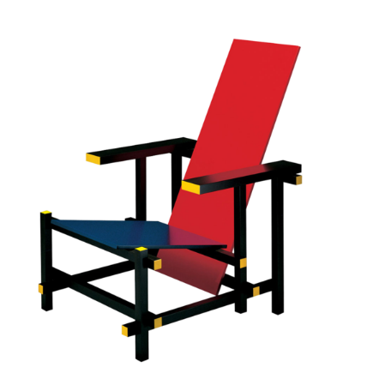
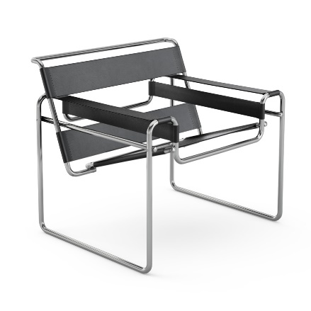
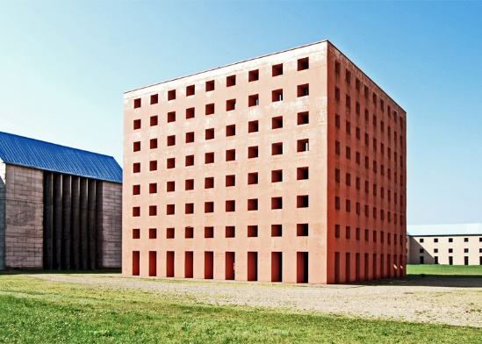

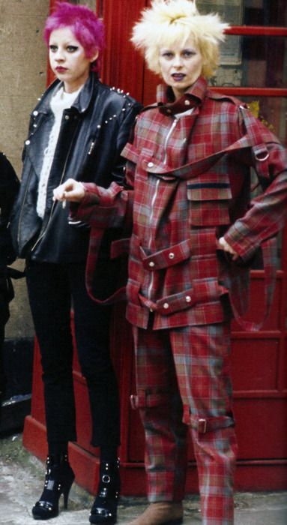
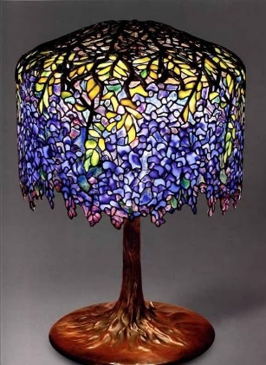
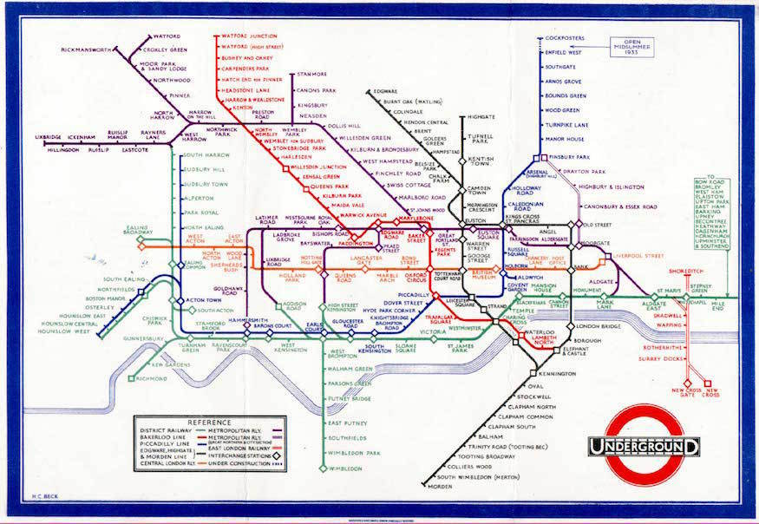

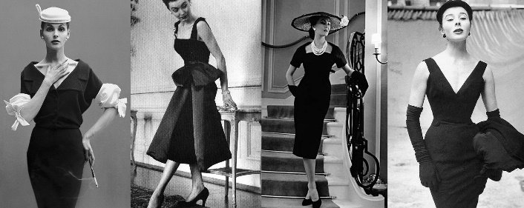
The Work Of Others -
Why do designers look at the work of others?
Why is it useful for designers to look at iconic designers?

Slide 2
The Work Of Others -
Task 1:
Use the information slides to research a new iconic designer. After looking at the options, choose 1 which you would like to investigate in detail. You can use the information provided and add to it with your own research from the internet.
Task 2:
Create a designer research page about the designer which you have researched. You should do this on an A4 or A3 page so that you have lots of room to showcase your research and their work.
What to include:
Images of their work which you find interesting
Pieces of coloured card, paper and other materials which will form collage back grounds for your work (refer to the examples on slides 3-4 for inspiration)
Creative and imaginative sketches and patterns which are inspired by the designer’s style or products.
Detailed and fully explained responses to the following questions:
Who is the designer and what type or products or designs do they create?
Name 5 designs or products they have made and explain why you like each of them.
What do you think has influences or inspired the designers work and where can you see these influences in their designs?
If you could meet the designer, what questions would you ask them?
How could the work of this designer inspire your own designs for your ‘Think Outside The Box’ project or the design of a sky scraper in your Graphics project?

Slide 3
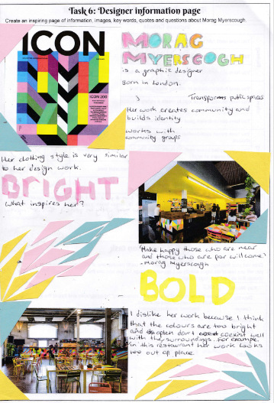
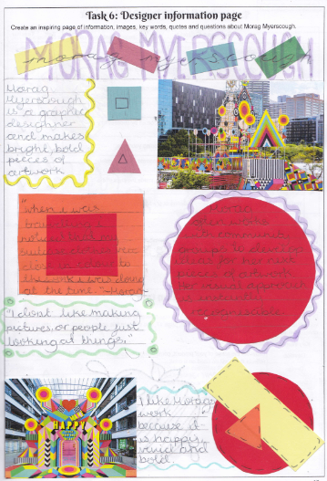

Slide 4
