Slide 1
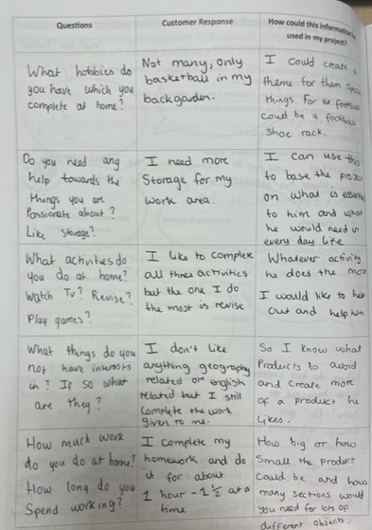
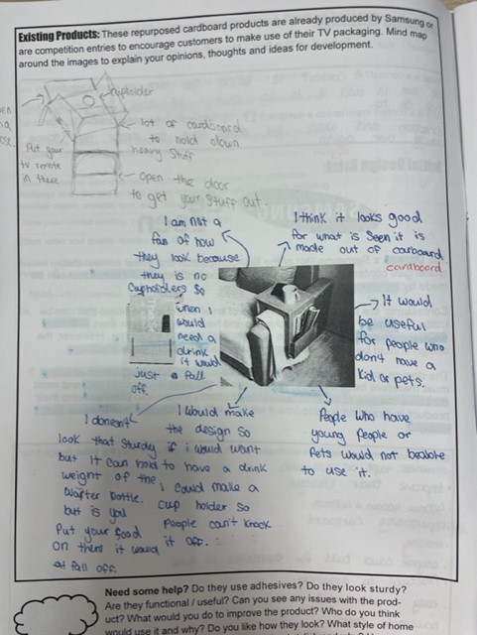
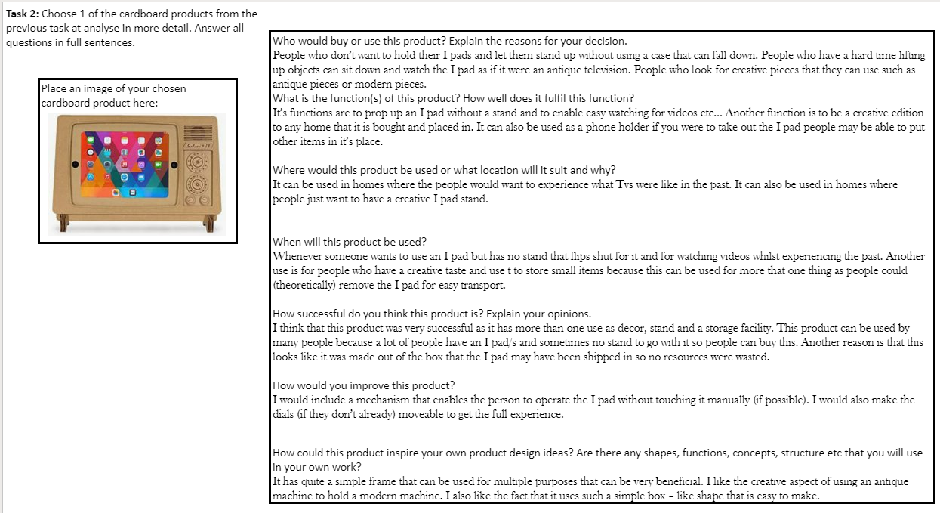
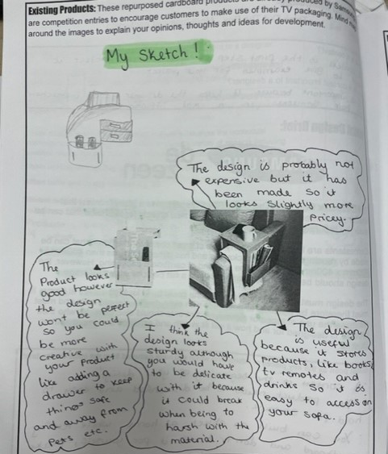
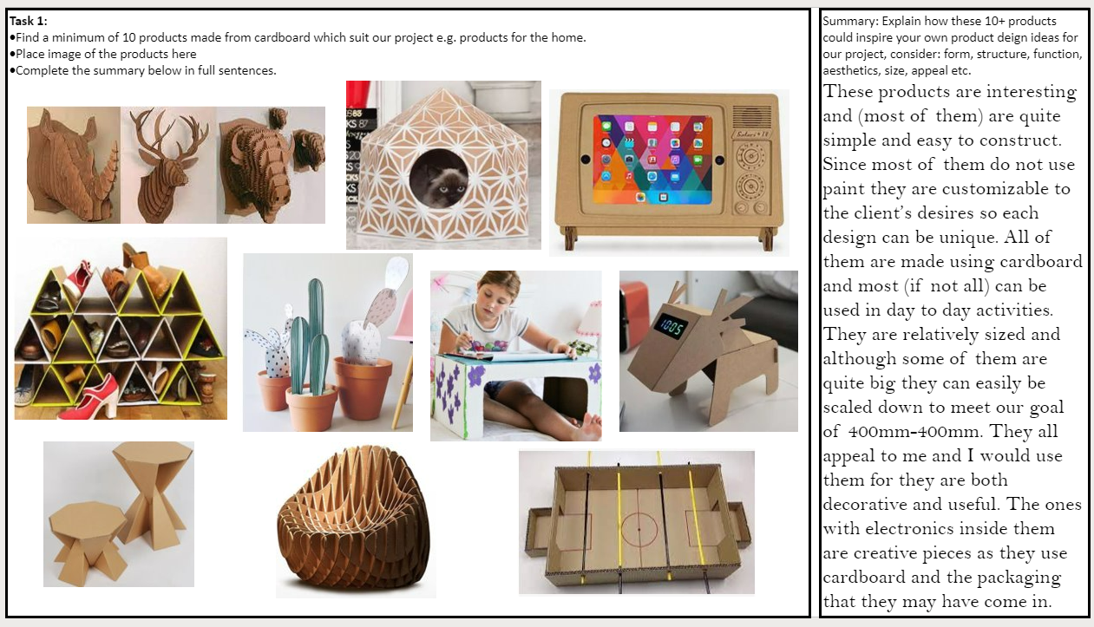
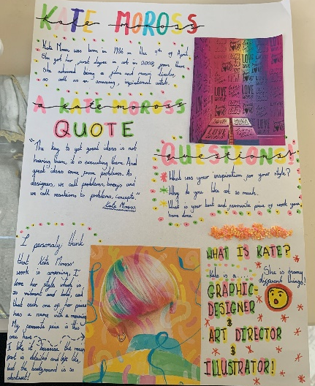
In year 7, students conduct several forms of market research to help them understand their customer and the market which their product will fit into.
Students will:
Look an existing products for the design competition which their ‘Think Outside The Box’ project is based on.
Investigate the work of iconic or key designers
Research and evaluate inspirational products which are already on sale.
Plan and conduct a customer interview
Analyse the responses from their customer interview to identify design possibilities.

Slide 2
Existing Product Analysis
Sketches have been added to show further developments to the existing product. These design decisions are based upon the analysis of the product.
A variety of points have been discussed e.g. functionality, aesthetics, customer / users, design features, positives and developments.
All responses are explained or justified.
Students have shown a clear understanding of the product and been able to draw conclusions from their understanding.

Slide 3
Existing Product Analysis
One product has been selected to analyse in further detail. Factual information as well as subjective opinion has been used to respond to the provided questions.
The students has responded in full sentences and all responses are fully explained / justified.
A wide variety of existing products have been found. The products selected are exciting and should provide inspiration for the students own product developments.
The collection of products have been evaluated to explain why they have been selected and how they could inspire the student’s own product ideas.

Slide 4
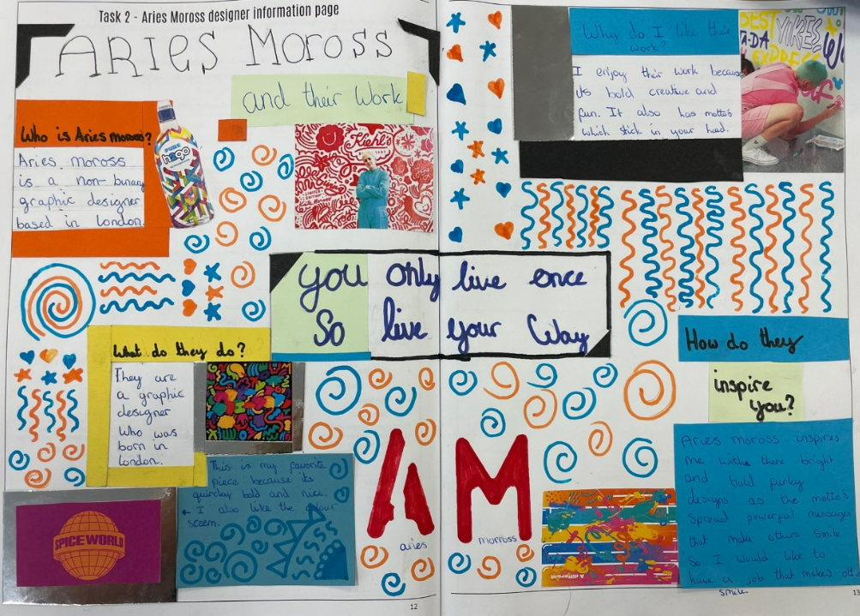
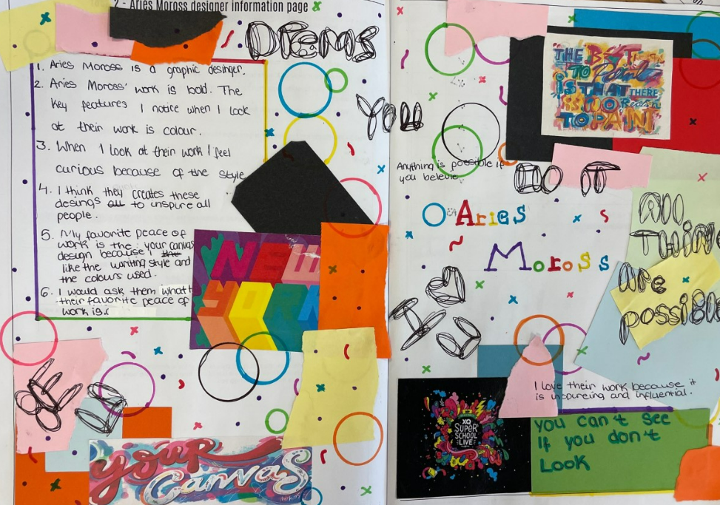
The Work of Others – Designer Research
Without copying the work of the designer, students have been able to represent the style of the designer in their own work.
Students have shown a creative flare for presenting their work. Different materials, collage techniques and additional pattern have been added to create an exciting page.
High quality vocabulary has been used in their work.
Students have carried out detailed research at home to explore the work of Aries Moross. This knowledge has been used to answer questions about the designer.
Students have responded to the provided questions about the designer in detail, explaining and justifying their comments.

Slide 5
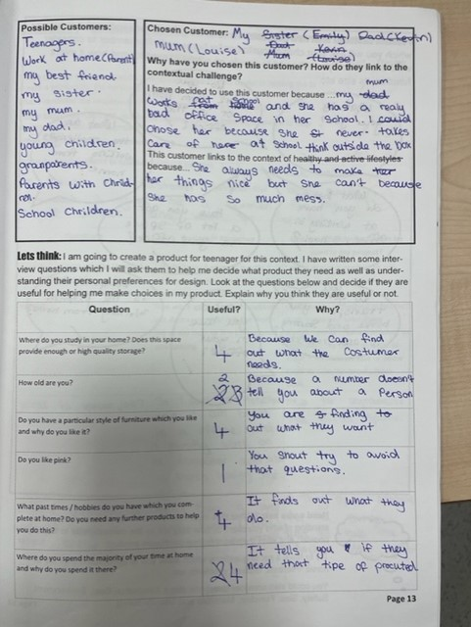
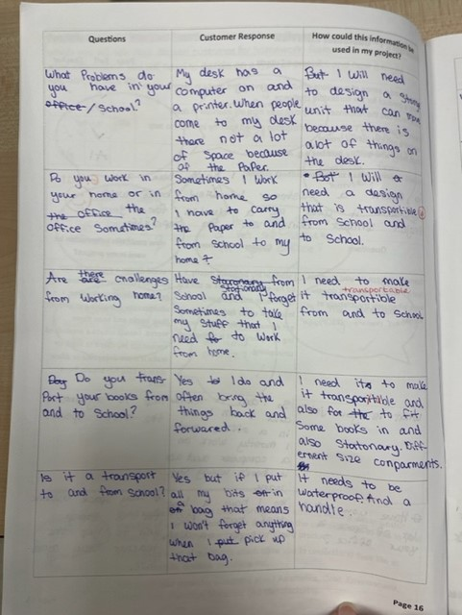
Plan & Conduct A Client Interview
A wide variety of possible customers or demographics have been identified.
A single customer has been selected and detailed justification has been given for their selection. Links have been made to the context of ‘Think Outside The Box’.
Relevant and useful questions have been planned. The student has considered what information they need to find out and how useful the questions will be to their project.
The customer’s responses have been recorded in detail.
The student has been able to analyse the responses given and draw design possibilities from their responses. Possible products and product features have been identified.
Students will use this information to guide the development of a design brief, specification and product ideas.

Slide 6
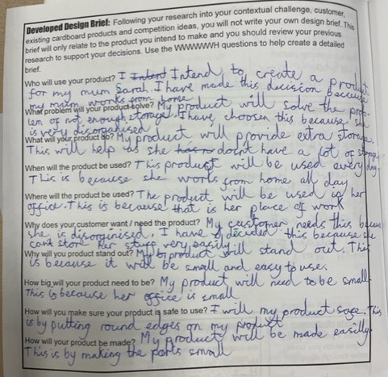
Writing a Design Brief
In year 7, students work with a live design challenge. This allows them to select a customer and design a product for that specific person. After they have carried out market research, they can then develop their own brief and specification. The design brief should state their intentions for their designs and the specification should give guiding rules to ensure the products meet the customer’s and contextual requirements.
All the WWWWWH questions have been responded to, this allows the brief to be comprehensive and thorough.
The questions have been responded to in full sentences.
All decisions link to the previous research e.g. customer interview, existing product analysis, contextual analysis.
All decisions are explained or justified, the justification will link to the customer’s needs or requirements and the previous market research.

Slide 7
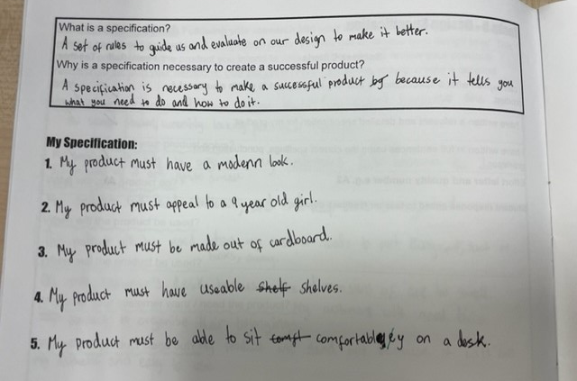
In year 7, students work with a live design challenge. This allows them to select a customer and design a product for that specific person. After they have carried out market research, they can then develop their own brief and specification. The design brief should state their intentions for their designs and the specification should give guiding rules to ensure the products meet the customer’s and contextual requirements.
Writing a Design Specification
5 rules have been written to guide the development of a product which will meet the customer’s needs.
All decisions are based upon previous research, such as the customer interview and existing product analysis.
All rules are focused and distinct.

