Slide 1
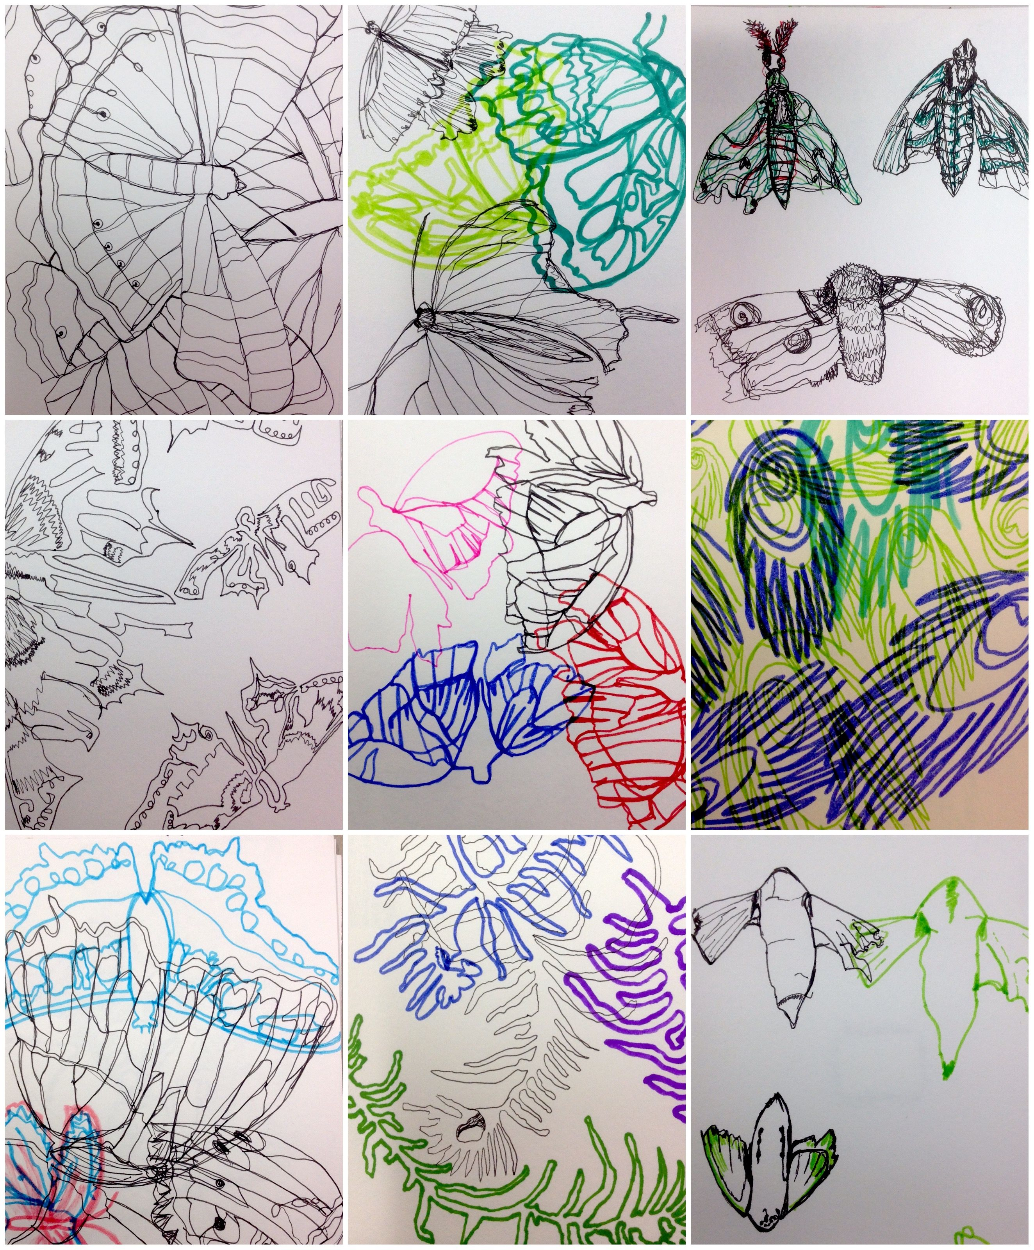
Building up line drawings with accuracy exercises
Task Warm Up
Find a natural object. You can look at the list for suggestions.
1/ Spend some time carefully looking at the shape and outline of the object. Where does the shape get wider or narrower?
2/Place your pen/pencil on the paper and without removing it begin to draw the outline.
Rule: You must look continuously at the object and only glance at the page. Don’t remove the pen from the page. You drawings might look like this.
Natural Objects:
House Plant
Fruit
Leave
Bug/insect
Flower

Slide 2
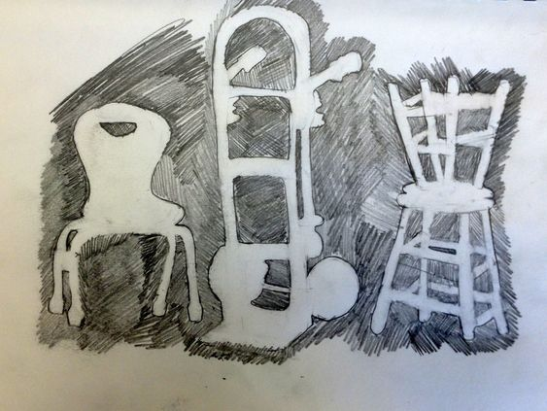
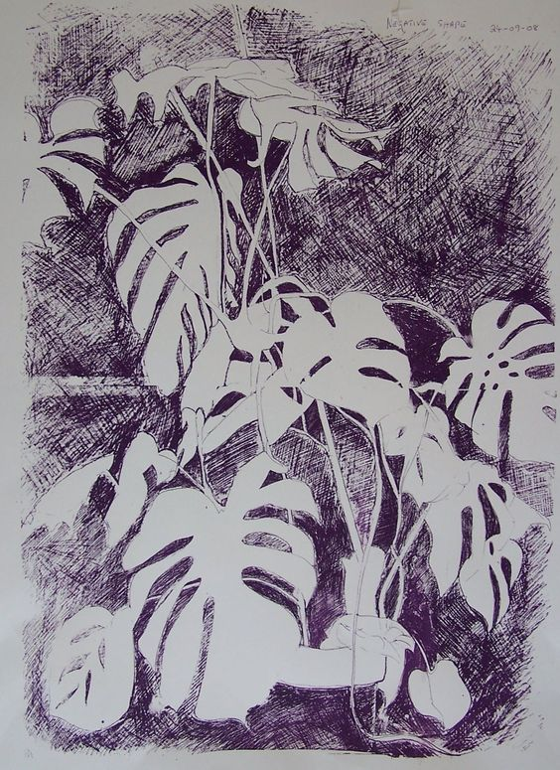
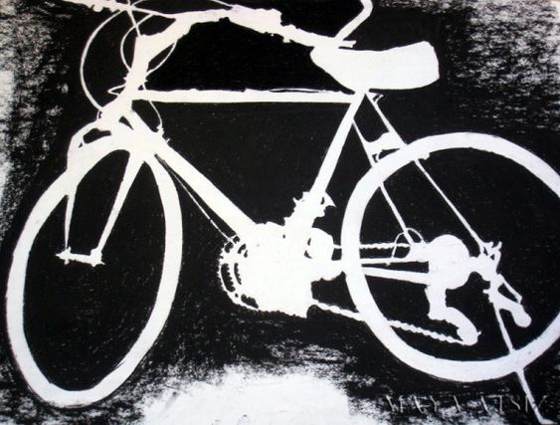
Task 2 CHOOSE AN OBJECT AND DRAW THE NEGATIVE SPACE AROUND THAT OBJECT. THIS IS AN ALTERNATIVE WAY OF SEEING WHAT YOU ARE DRAWING RATHER THAN CONCENTRATING ON THE OBJECT ITSELF
Negative space
Positive space ( The object itself)

Slide 3
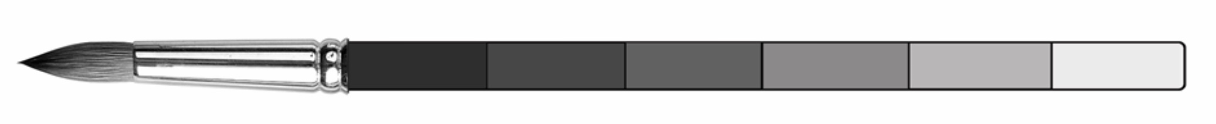
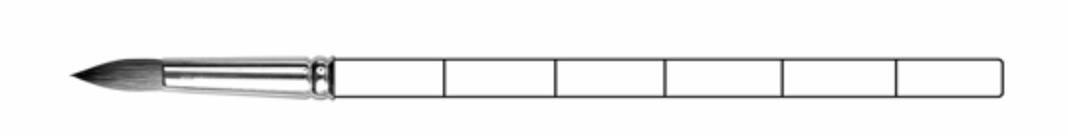
COMPLETE THE FOLLOWING PAINTBRUSH. CREATE DIFFERENT TONES BY VARYING THE PRESSURE APPLIED TO YOUR PENCIL.
EXAMPLE
Dark Tonal Shades
Medium Tonal Shades
Lighter Tonal Shades

Slide 4

CREATE A TONAL STRIP BY BLENDING FROM ONE SIDE OF YOUT PAGE TO THE OTHER GOING FROM LIGHT TO DARK. MAKE THE TRANSITION BETWEEN TONES GRADUAL & SMOOTH.

Slide 5
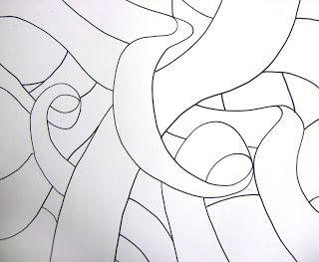
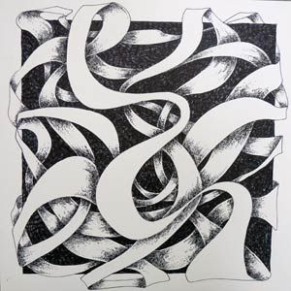
1 DRAW A LONG OVERLAPPING RIBBON OR USE THE ONE BELOW
2 ADD VERY DARK TONES IN THE BACKGROUND
ADD MEDIUM TONES TO THE UNDERNEATH RIBBON AS SHOWN IN THE EXAMPLE. THINK
ABOUT THE DRECTION OF YOUR LINE WHEN APPLYING YOUR TONE.

