Slide 1
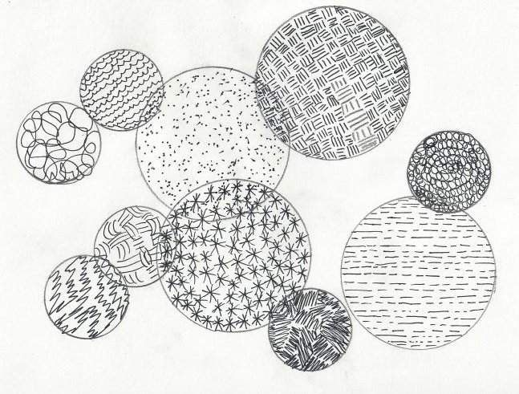
Aim: Developing Controlled textures in your observational drawings.
What is mark-making?
Mark-making describes the different marks (lines, dots, patterns, and textures) we create in a work of art.
Practicing Variety
Fill the page with intersecting circles of different sizes by tracing around the edge of circular objects. Change the size of the circular objects.
Now fill in the circles varying the mark as you go from circle to circle.
Here are a variety of mark-making suggestions
Broken Lines
Scalloped Lines
Loops and Scribbles
Jagged Zigzags
Close Clusters
Loose Lines
Interlocking Lines
Dots

Slide 2
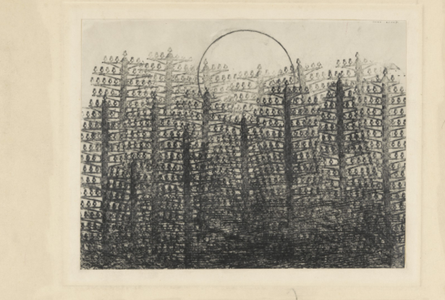
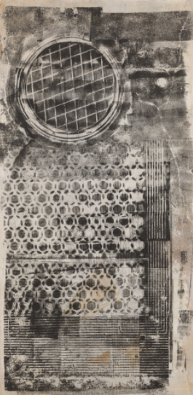
Creating texture rubbings from found objects
Max ErnstForest and Sun1931
Graphite frottage on paper
Frottage
A technique that involves rubbing pencil, graphite, chalk, crayon, or another medium onto a sheet of paper that has been placed on top of a textured object or surface. The process causes the raised portions of the surface below to be translated to the sheet. The term is derived from the French frotter, which means “to rub.”
Sari DienesSoho Sidewalkc. 1953–55
Ink rubbing on Webril

Slide 3
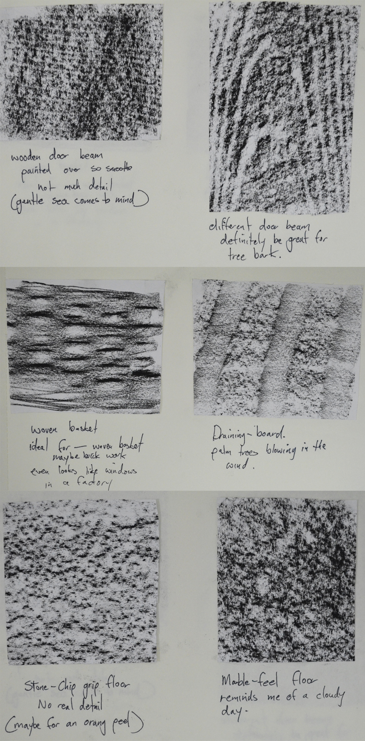
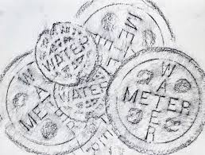
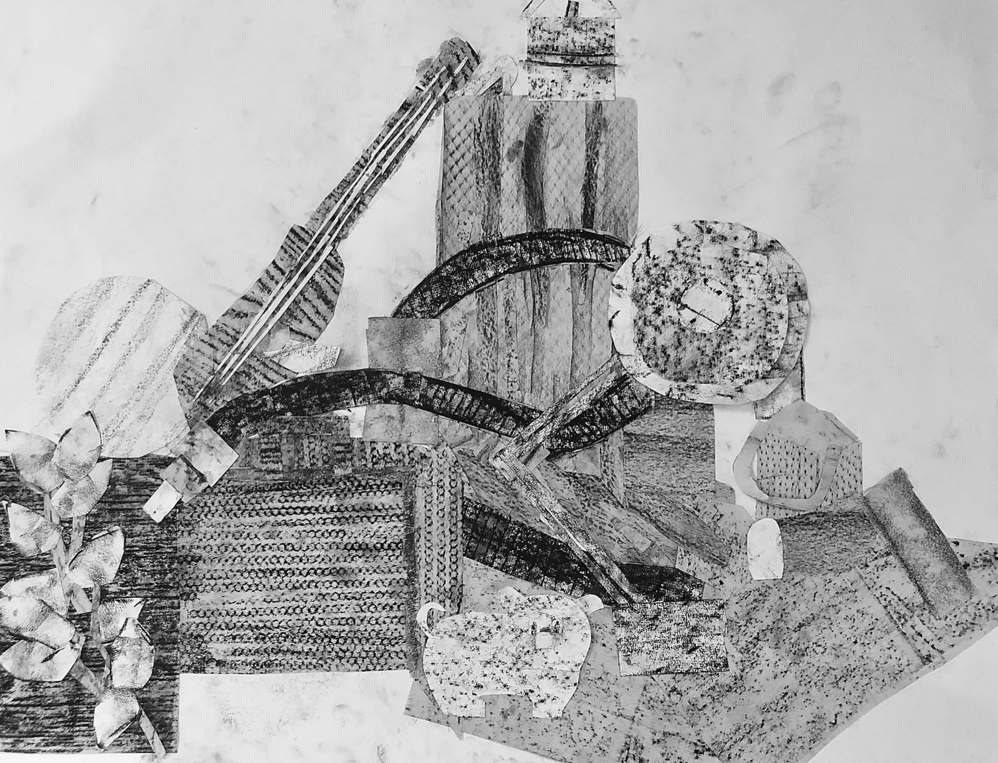
Create a series of surface rubbings (frottage technique from previous slide)
Experiments can be cut up and rearranged together if you wish.
Materials:
Oil pastel
Charcoal stick
Crayon
Textures Suggested:
Tin cans
Fabrics
Wall papers
Bark
Trees
Coins

