Slide 1
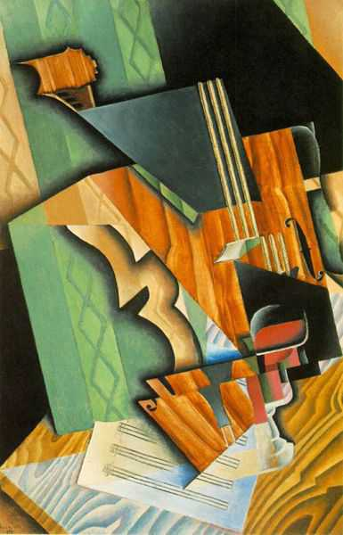
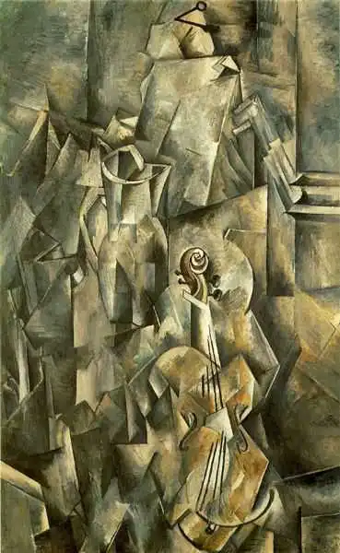
Exploring an Artist
Task 1: Take a look at the video to build up a greater understanding of the Cubist movement.
TATE VIDEOS: Cubism and how it was born
https://www.youtube.com/watch?v=UhB0U6OUPIM
Extra Sources Videos.
Pablo Picasso
https://www.youtube.com/watch?v=GRTsMJNcHFw
George Braque
https://www.google.com/search?safe=active&rlz=1C1GCEV_enGB999GB999&source=lnms&tbm=vid&sa=X&ved=2ahUKEwi35aHR9tX8AhVQQ8AKHeq_D90Q_AUoA3oECAEQBQ&q=georges%20braque%20videos&biw=1366&bih=657&dpr=1#fpstate=ive&vld=cid:a4f37455,vid:72MCQWzyD4E
249 Artworks by Braque.
https://www.google.com/search?safe=active&rlz=1C1GCEV_enGB999GB999&source=lnms&tbm=vid&sa=X&ved=2ahUKEwi35aHR9tX8AhVQQ8AKHeq_D90Q_AUoA3oECAEQBQ&q=georges%20braque%20videos&biw=1366&bih=657&dpr=1#fpstate=ive&vld=cid:6510d548,vid:41lwD-mx4ws
Georges Braque-1882-1963-violin-and-jug-1910

Slide 2


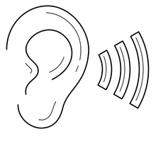

ARTIST QUESTIONS
What do you see?
Start by using your senses to note down what you feel. Use your imagination! ☺
1.Describe what do you see in the piece of art? Is there a clear style? Use the keywords to help.
2.What do you feel when looking at the artworks? (mood/atmosphere) e the keywords to help.
3. Does the artist give any clues about the subject? (e.g. the character of the model; type of place )
4. How does the artist apply the materials? (e.g. colours, brush strokes, detail, line, loose, composition)
5. Why did you select this particular artist for your project? And how could you use their style or techniques in your own work?
Can you tell what it feels like? Use your imagination
Does this piece of art make a sound? What can you hear?
Does it remind you of something you’ve experienced before? (use your memory)

Slide 3
LINE
Short; flowing; scribble; loose; sweeping; tight; broken; faint; heavy, confident; angular; continuous; cross hatched; diagonal; horizontal, vertical; spiral; energetic.
COMPOSITION
Background; Space; Mid-ground; foreground; extreme foreground; Near; blurred; complex; overlap; confused; eye-line; focus; frame;
Perspective; proportion; layout; scale; Symmetry; lines
TYPE
Realistic
Photorealism
Abstract
Distort
Emotional
Exaggerated
Cartoon/ Caricature
Fantasy
Figurative
Landscape
Seascape
Portrait
Interior
Architectural
Still Life
Impressionist
Surreal
Illusions
Pop Art
Fauvism
Stylised
Expressionists
Drawing
Painting
Printing making
Collage
Sculpting (3D)
Carving
Ceramic
Digital
Street Art
Textiles
Photography
Installation
Architecture
Fashion
Mixed Media
Land Art (Using the landscape)
Assemblages
Shape Angular; body figure; form; frame; model; Organic/natural ; precise; accurate; rough; Sculpted; sharp; uniform ; distorted
Tone & Light
Shading; tonal blending; Shadow; light; highlight; tint; dark; bleach; bright; contrast; crisp; faded; graduated; harsh intense; smooth; gentle; haze; softened natural & artificial light; dramatic; soft.
FORM & SPACE
Scale & size, Proportion; Perspective; Vanishing points; Angles; Viewpoint;
Carved; cast; decorate; human form; woven; motif; natural; pointed/sharp; rounded; scattered; stacked; ordered; chaotic.
Colour
Blend; harmonious; Contrasting; intense mixed; opaque; matt; gloss; bright; surreal; pale; pastel; primary; pure; saturated; secondary; exaggerated; clash; soft; tint; translucent; transparent; vibrant; cold; warm; deep; dull; glowing; luminous; neon; earthy
PATTERN
Embellish; flowing; fluid; geometric; repeat; ornamental; overlap; simple;
Symmetric; irregular; natural; stamp;
Uniform & ordered; stencil; structured
Texture
Coarse; cross hatched; dots/ pointillism; fine; flat; smooth; glaze; impasto; jagged matt; glossy; rough; crumple; shiny; splatter; thick; thin; wash; bubbled; worn; aged

Slide 4
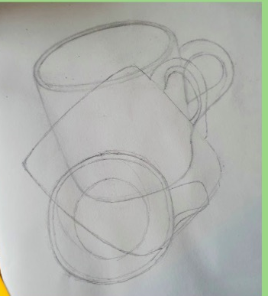

Task: Now show your understanding of the Cubist movement by creating a strong visual piece. This piece should reflect the characteristics of the Cubist movement, but it may also have some of your own design ideas too.
Suggested:
1/ Choose an object or group of objects to draw (deconstruct just like the Cubist painters!) Have those objects in front of you. You may want to pick objects with interesting shapes/curves/lines.
2/ Carefully draw the outline of the object. Move the Object and draw the object outline from a new viewpoint. You can repeat this step as many times as you like!
Tip: Overlap each drawing ☺
3/ You may want to add extra lines to break your composition even further.
Examples on the next slides.
Different viewpoints

Slide 5
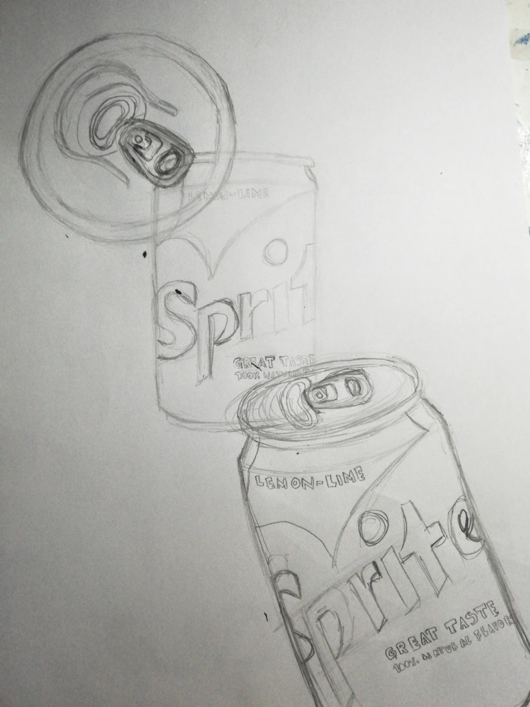
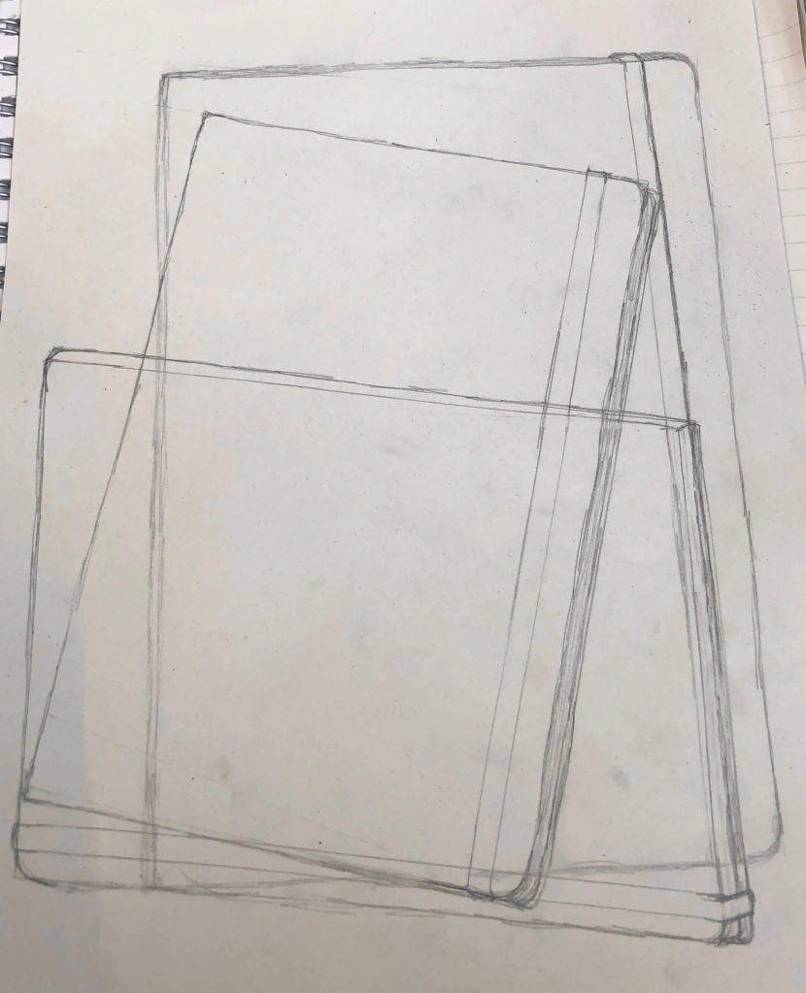
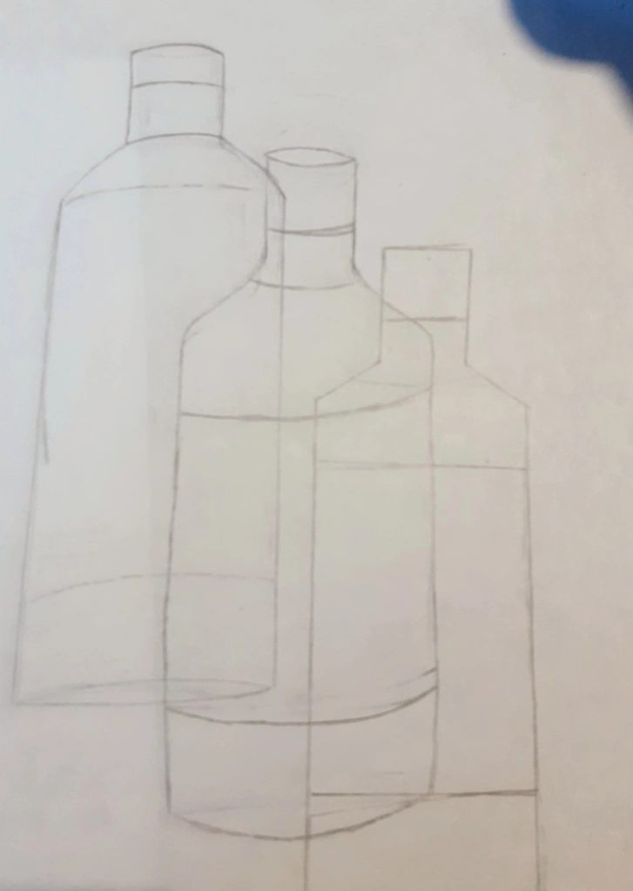
Examples

Slide 6
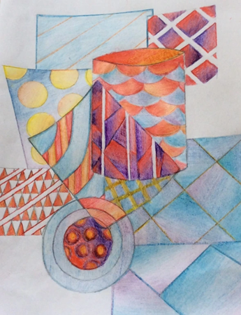
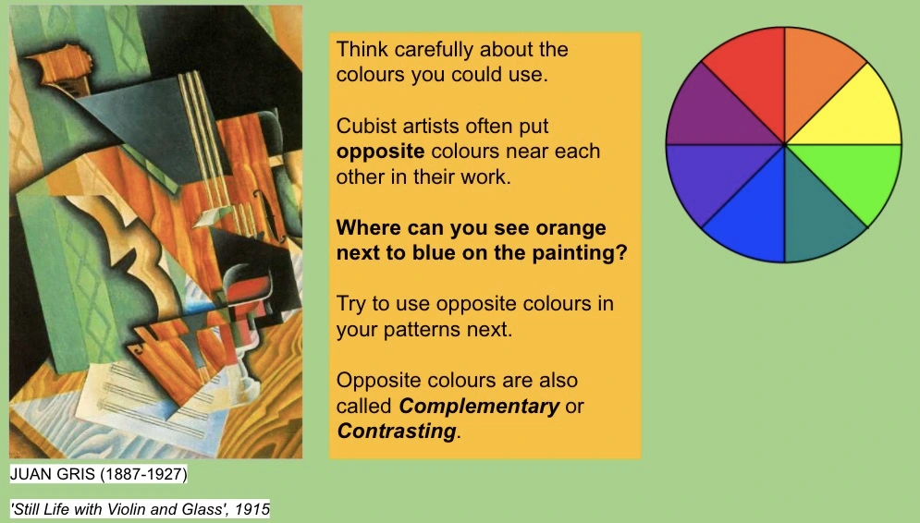
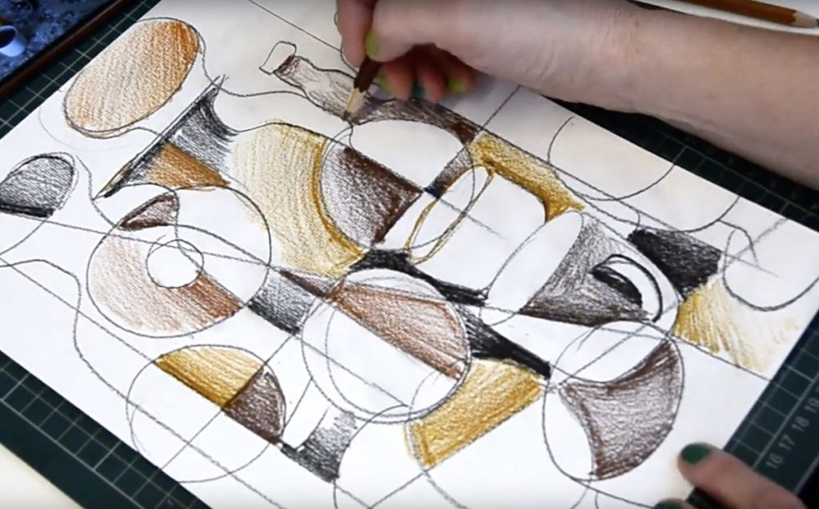
Next think carefully about adding depth to your composition.
This can be done using your drawing pencil or you could introduce some colour to your work.

Slide 7
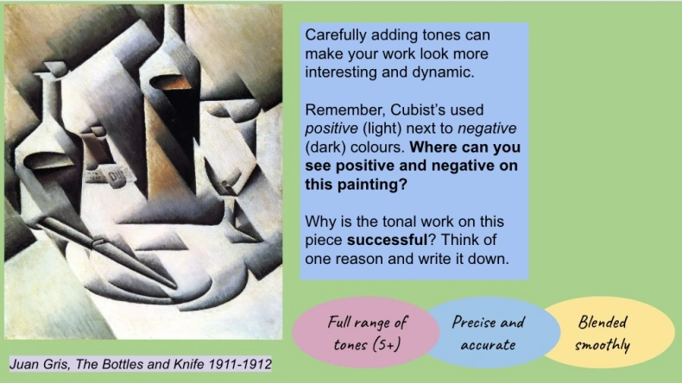
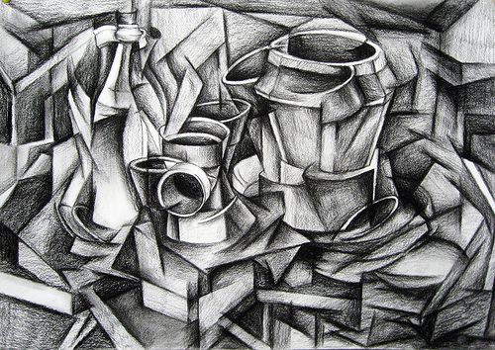
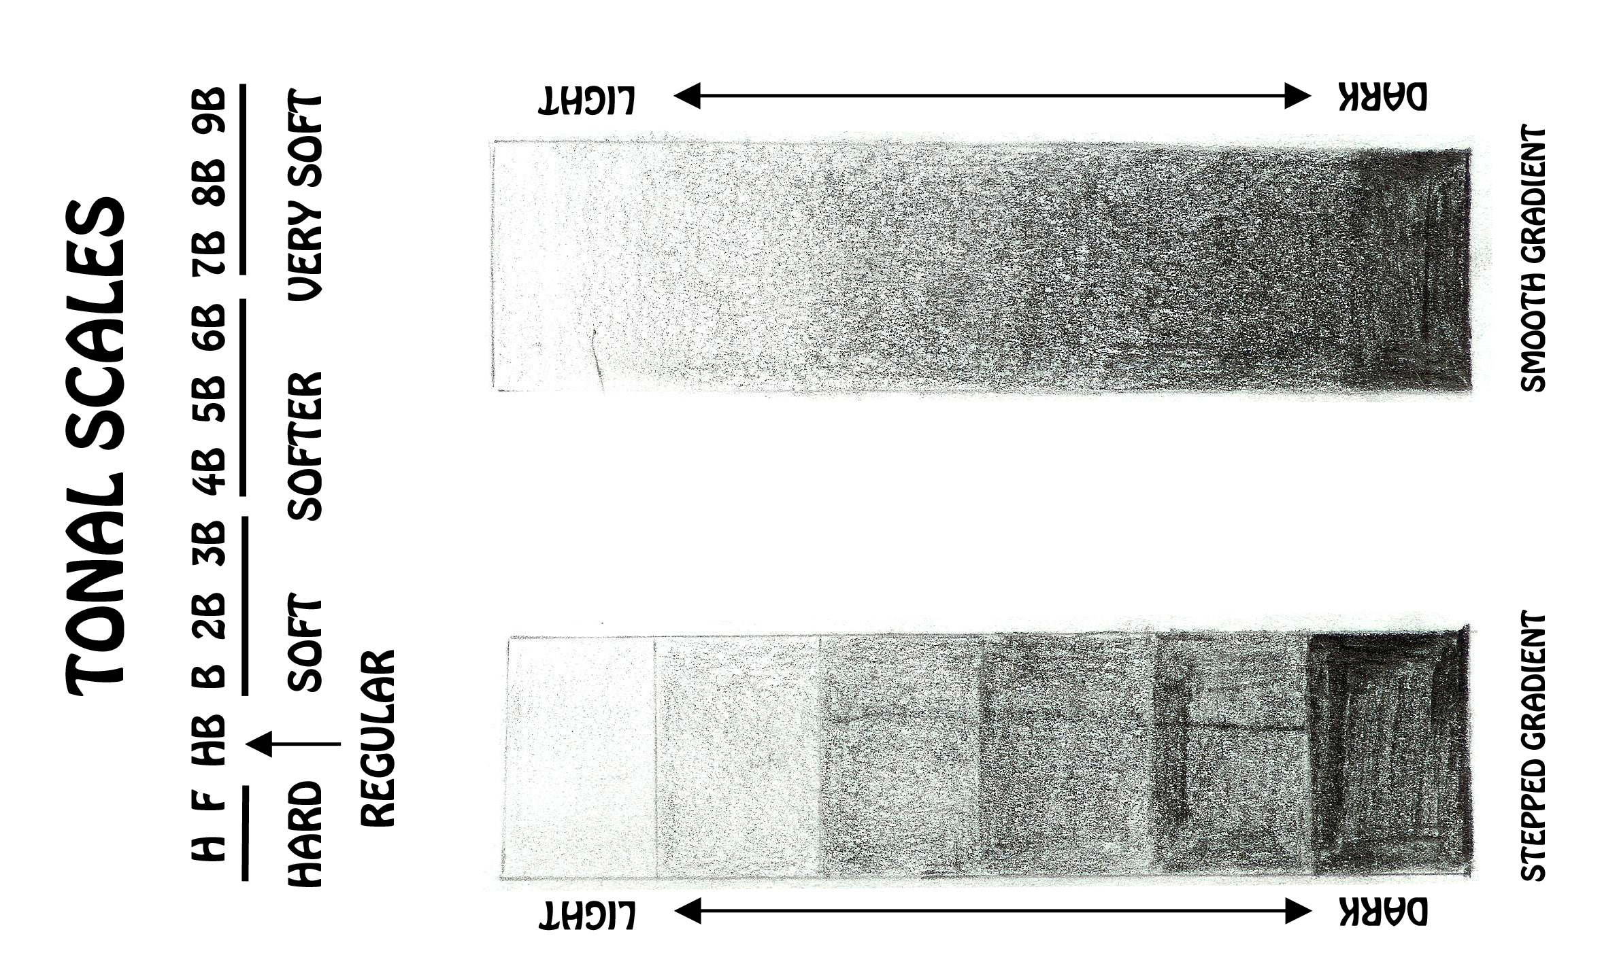

Slide 8
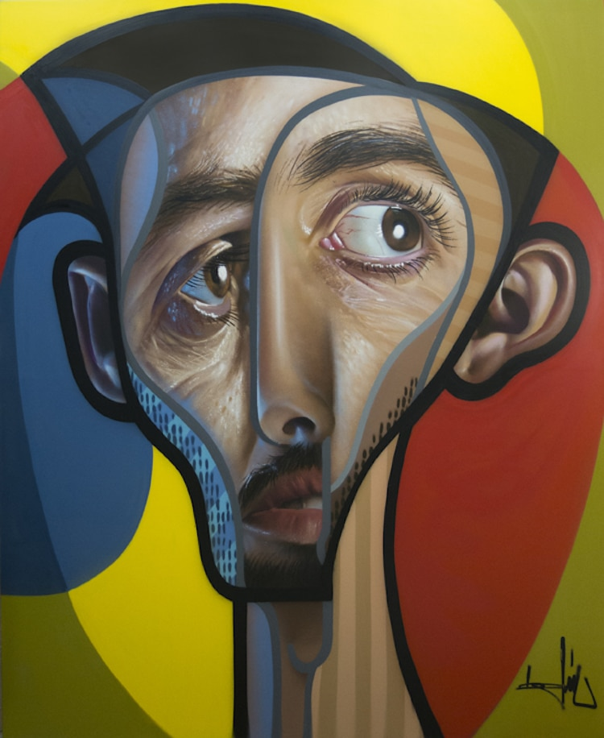
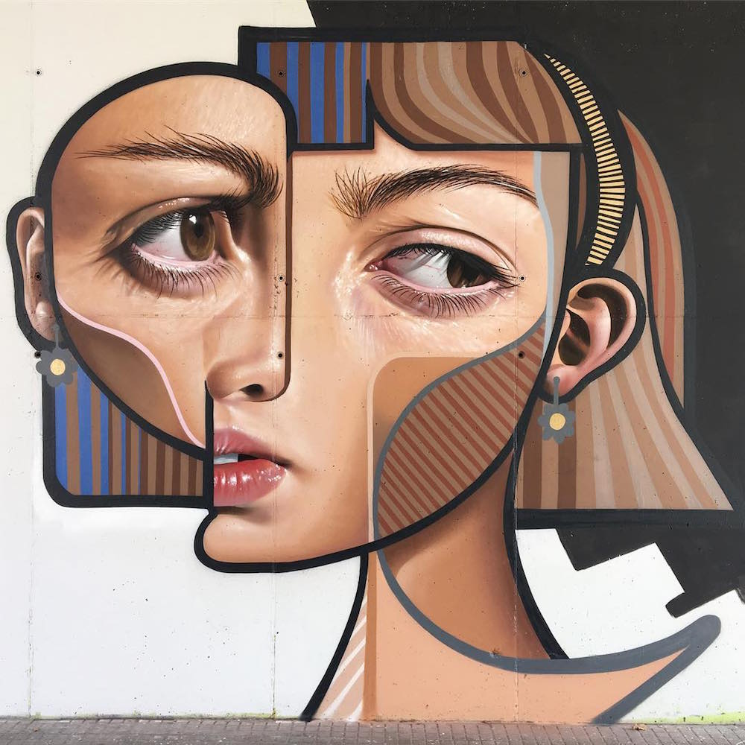
Postneocubismo
https://www.thisiscolossal.com/2017/01/murals-and-paintings-by-belin/
Spanish artist Miguel Ángel Belinchón Bujes, or Belin, has long been known in the graffiti world for his photorealistic murals. After a recent trip to Pablo Picasso’s birthplace however, his work has begun to adopt elements of cubism—now producing creative portraits in a style he’s dubbed postneocubismo. His works are often based on loved ones, breaking up elements of their faces in order to recompose eyes, ears, and mouths into distorted configurations.

