Slide 1
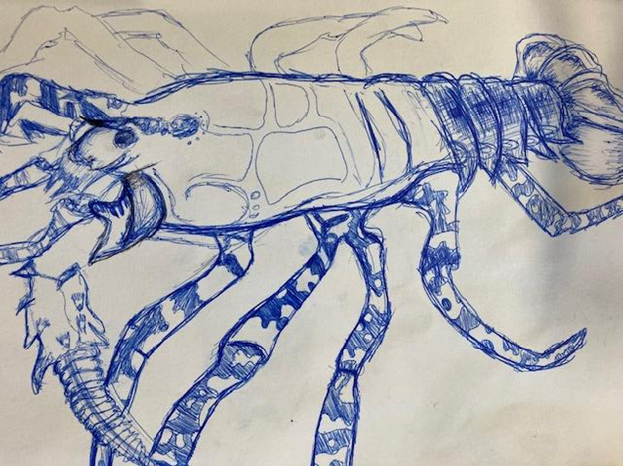
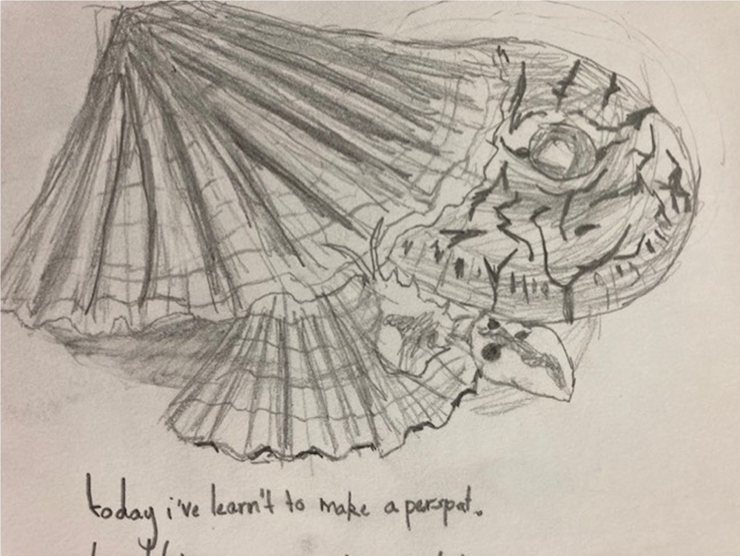
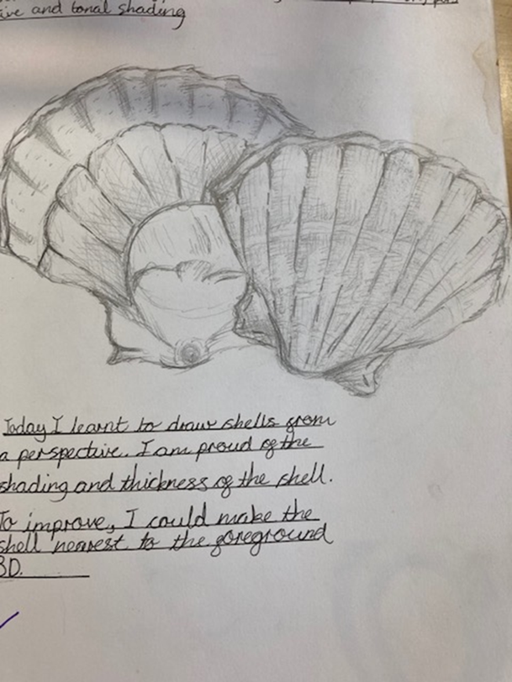
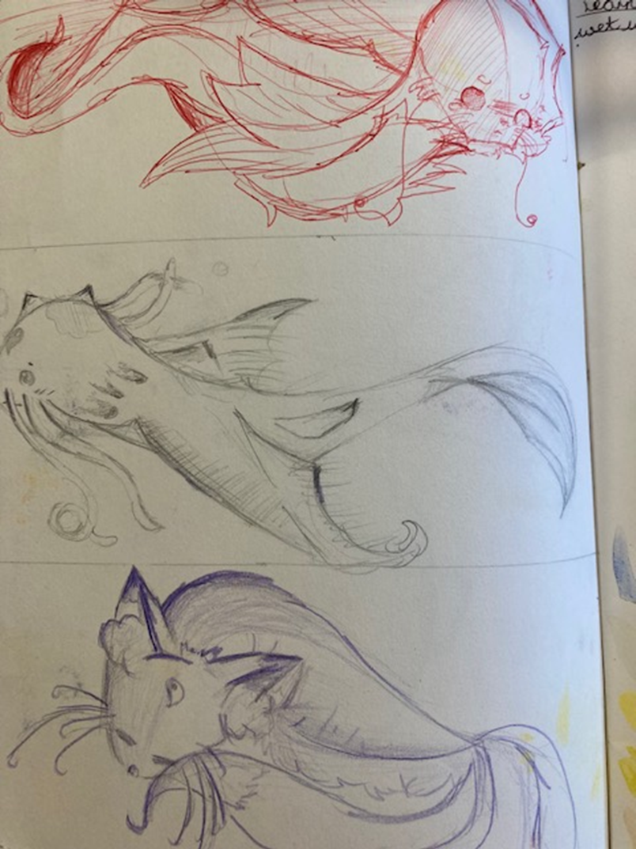
Drawing
The shape of the lobster is carefully observed with a mix of dark block shading and cross hatching pen techniques to add interest and depth to the surface.
Confident use of pencil techniques to create a high level of detail and depth in the work.
A mixture of heavy and more subtle line and tonal shading add to the quality of the work.
The student has clearly worked closely from the shells in front of them.
Shadows are used to add depth to the fish drawings. The student worked closely from secondary images while creating this page. Subtle pen and pencil marks create the illusion of movement.

Slide 2
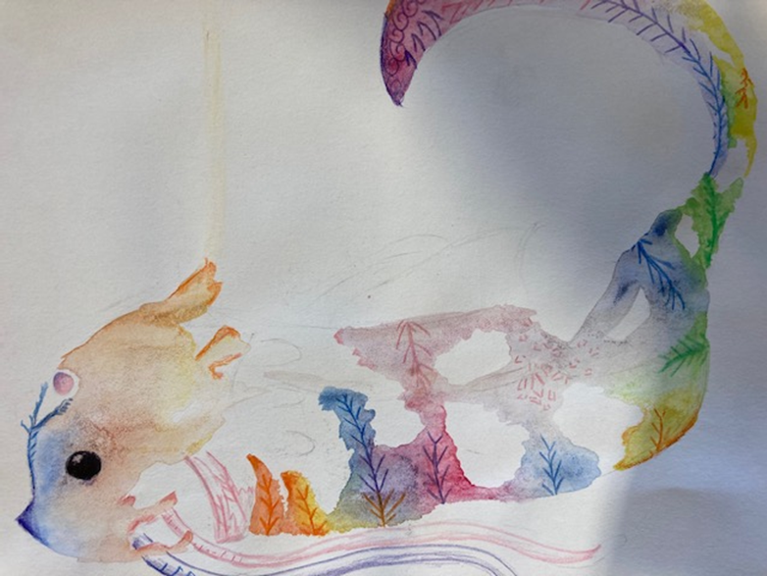
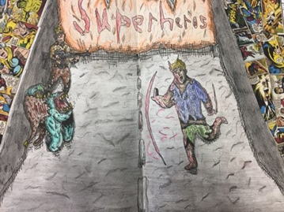
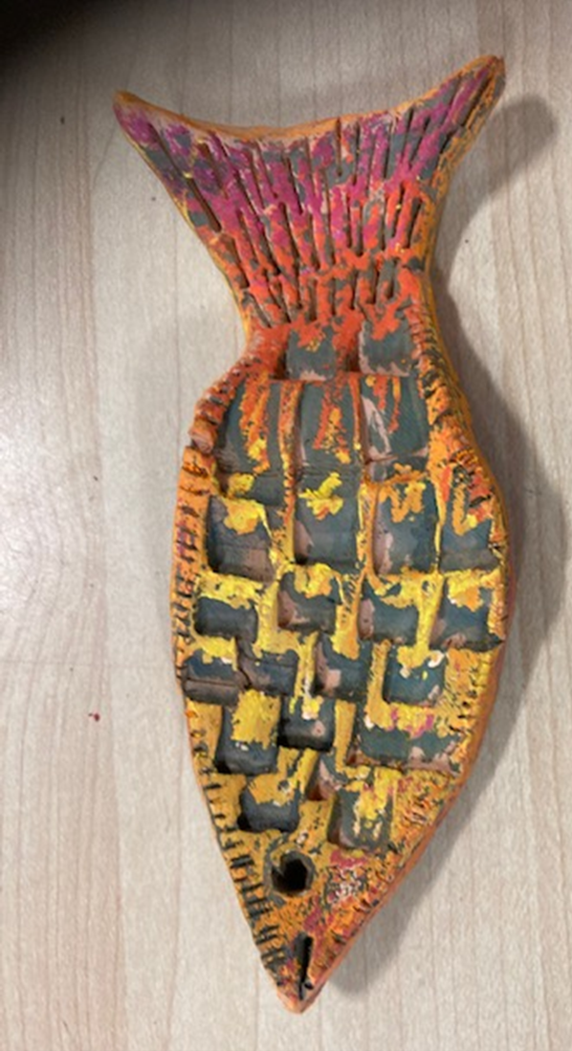
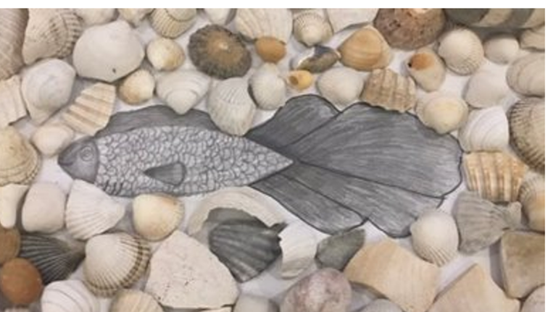
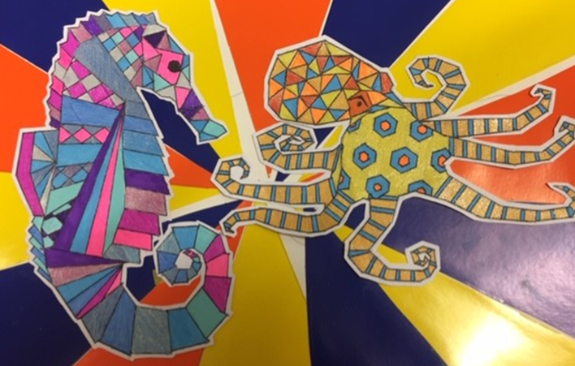
Painting
The Student has developed this painting from their chosen artist’s style. They have used fine brush work to create fine line textures.
Very controlled brush control.
A broad range of tones used in the red and orange colour palette with subtle changes across the fish.
After exploring different painting application techniques, the student successfully used the brush to create an interesting surface design.
The student has developed this painting from a sea life image. The subtle tone changes add depth to the block areas. Confident ability to mix tonal shades and control pen work is demonstrated.

Slide 3
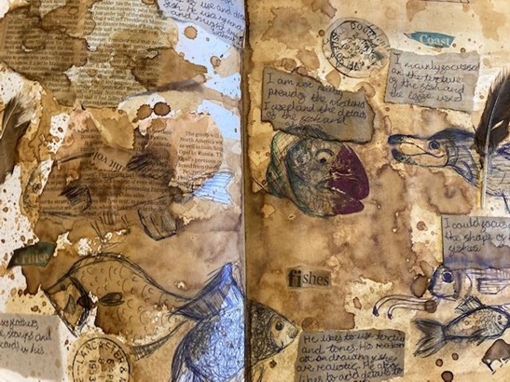
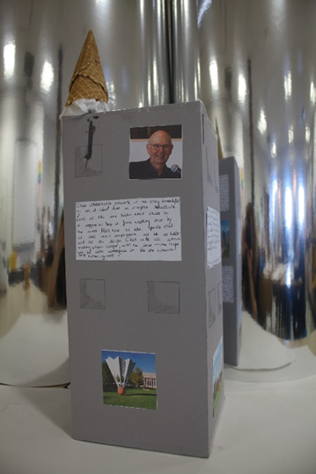
Artist Research
Students have imitated their chosen artist’s style, selecting similar application techniques, themes and compositions.
Written analysis also demonstrated the students in depth knowledge of the artist’s work.
Key elements of the artist’s work is clearly documented in the written and visual communication.
The student chose to create their artist research on a tower structure. This was in keeping with the artist’s use of the city to inform ideas.

Slide 4
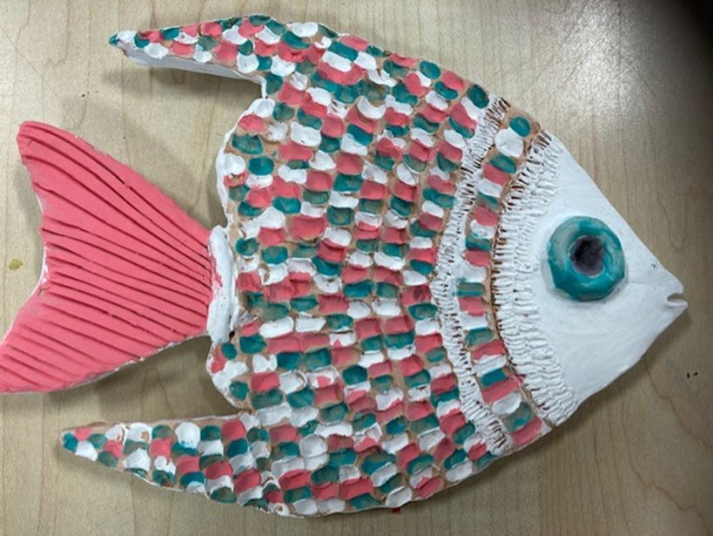
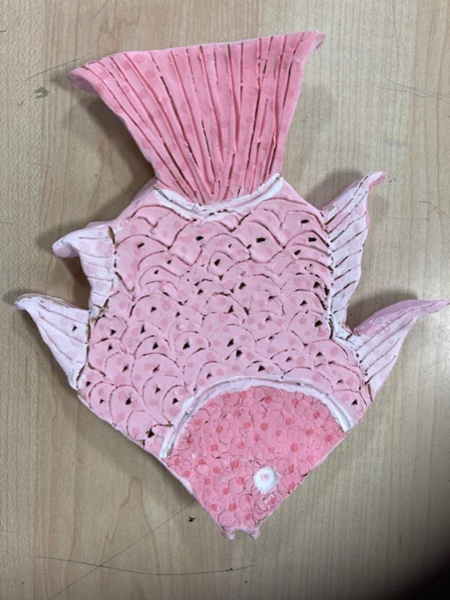
Sculpture
A mixture of applied and incise techniques made using different types of tools. Student have clearly manipulated the clay to suit their design drawings.
Shape, details and textures have been added to each piece.
Students have worked closely from sea life images while forming the shapes.
The process has been followed closely to ensure each part of the sculpture is secured in place and can withstand the firing process.
Colour work has been adapted to suit the theme Coastal .

