Slide 1
TA1: Characteristics, risk and reward for enterprise
What you will learn:
the characteristics of successful entrepreneurs
potential rewards for risk-taking
potential drawbacks for risk-taking.
Notes:
Use the image as a stimulus to ask students what the unit might be about. What risks might the entrepreneur behind the counter have taken to set up his business? For example, he might have taken financial risks.

Slide 2
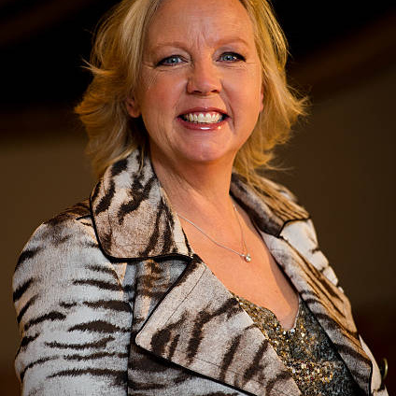



Quick-fire entrepreneurs
Can you name any of these people?
What are they famous for?
For two of the people,
write down three words
that describe them.
Let’s get started
Characteristics of successful entrepreneurs
Rewarding enterprise
Drawbacks
Notes:
Display the slide and ask students to name any of the famous faces. Can they explain what they are famous for, or why they are considered to be an entrepreneur?
From left to right:
Levi Roots – famous for developing Reggae Reggae sauce, which he famously pitched on Dragons’ Den (you could download a clip of his pitch from YouTube to show students)
Deborah Meaden – one of the ‘dragons’ from Dragons’ Den
Mark Zuckerberg – founder of Facebook
Simon Cowell – music entrepreneur and creator of X Factor and Britain’s Got Talent.
After identifying them, students should write down three words that describe them, e.g. characteristics such as innovative and confident. Probe students’ answers and ask them to explain why these characteristics support their success.

Slide 3
Critical characteristics
Characteristics of successful entrepreneurs
Creativity
Risk-taking
Communication
Confidence
Innovation
Negotiation
Determination
Do you have the characteristics to become a successful entrepreneur?
Rate yourself on each of the characteristics in the spider diagram!
1 – very weak
2 – weak
3 – satisfactory
4 – good
5 – very strong
Let’s get started
Characteristics of successful entrepreneurs
Rewarding enterprise
Drawbacks
Notes:
Introduce the various characteristics shared by successful entrepreneurs. Some of the characteristics may have been identified by students during the discussion of the well-known entrepreneurs on the previous slide.
The characteristics are:
Creativity – using imagination to create or invent something or find new solutions to a problem
Innovation – creating a new or different product/service or making a business more productive/efficient
Risk-taking – being prepared to take risks in order to have a successful business
Communication – being able to share ideas clearly with others
Negotiation – being able to discuss ideas or objectives with others in order to reach an agreement
Confidence – believing in themselves and their business idea
Determination – sticking at it despite rejections or setbacks.
Explain what each characteristic means via a class discussion as some students may not be familiar with the terms.
Ask students to consider each one in turn and rate themselves according to the characteristic on the scale of 1 to 5 with 1 being very weak and 5 being very strong. They should initially reflect independently.
Then ask students to share their ratings with another student. Does the other student agree with the ratings? How might the results affect their potential success as an entrepreneur? Why is this?

Slide 4
Rewards for enterprise
Financial
Independence
Self-satisfaction
Making a difference/change
  Making a profit
  Having enough money
  to live off and to grow
  the business
  Becoming wealthy
  Working for themselves
  Ability to make their
  own decisions
  Responsibility for decisions
  Flexibility
  (e.g. the schedule and nature of the business)
  Having a sense
  of achievement
  Receiving positive customer feedback
  if products meet
  their needs
  Growing the business
  Winning awards
  Satisfied and
  loyal customers
  Gaining the credit if the business is successful
  Meeting a need that
  was not previously met
  Sustainability
  Supporting young entrepreneurs
Let’s get started
Characteristics of successful entrepreneurs
Rewarding enterprise
Drawbacks
Notes:
Explain the different potential ‘rewards’ for enterprise. Several students will automatically think of the financial rewards, but use this slide to reinforce the fact that many entrepreneurs establish a business for different rewards.
Ask students to think about which potential reward appeals to them the most and why.

Slide 5
Drawbacks to risk-taking
Think about each of the drawbacks and complete the table.
Drawbacks to risk-taking | Description of the drawback | Do you think this drawback is very common for new entrepreneurs? Why/why not?
Financial | If the business is not financially viable, an entrepreneur may lose the money used to set it up. They may find themselves in debt. If they run out of money or do not make a profit they may end up owing money to lenders and suppliers. | Very common. Some new entrepreneurs have never run a business before and lack financial skills and experience. They may have carried out limited or no market research.
Health/well-being
Work–life balance
Personal relationships
Let’s get started
Characteristics of successful entrepreneurs
Rewarding enterprise
Drawbacks
Notes:
Consolidate learning about the potential drawbacks to risk-taking using the table above.
Recreate an editable version of this table for students and ask them to complete the answers for the final three drawbacks:
Health/well-being – some people may suffer from stress and anxiety as a result of taking risks, and this can result in poor mental and physical health and well-being. As entrepreneurs work alone this is quite common as often they do not have the opportunity to talk through their problems
Work–life balance – setting up a business takes a lot of time and commitment and involves working long hours. Work may take up a lot of an entrepreneur’s time, which can reduce the amount of time they have for relaxation and hobbies
Personal relationships – long working hours and stress can negatively impact a person’s character. Long hours and commitment to work may impact time spent with families and friends, and so personal relationships may suffer.
Ensure that all students understand each drawback and how they might relate to an entrepreneur. You could do this via questioning when identifying the various drawbacks.
When the students have completed the table, ask them to share their answers as a class. Students should add any answers suggested by peers so that they have a comprehensive set of notes for their revision.

