Slide 1
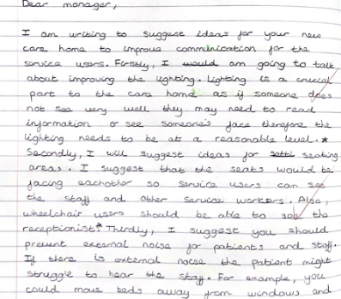
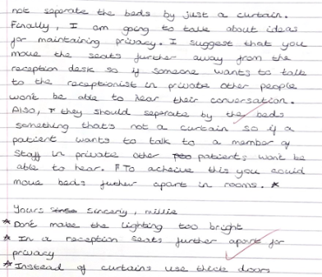
Communication
Identification of barriers to communication
Application of knowledge to a given health and social care setting
Application of knowledge to a given health and social care setting

Slide 2
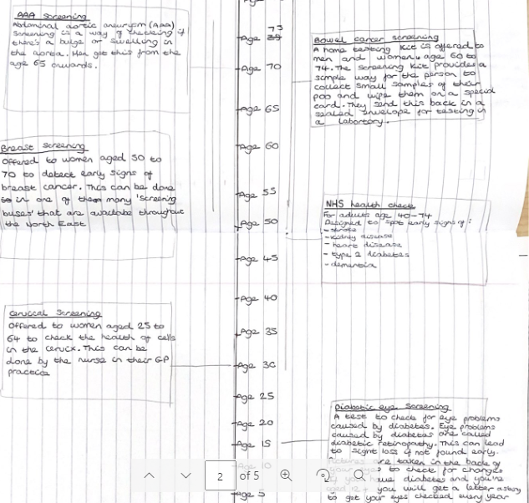
Health Promotion
This student has provided a detailed explanation of the health screening that is available to service users through different ages
They have identified:
  Name of screening programme
  Purpose of screening programme
  Professionals that carry out screening

Slide 3
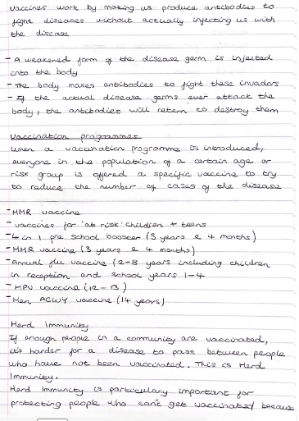

Health Promotion
Vaccinations are an example of ways to protect the health of the public (a part of the health promotion topic)
This piece of work shows
  How health promotion works in the UK
  An example of a vaccine programme
  An understanding of the importance of health promotion
Understanding of new technical language

Slide 4
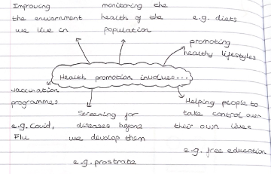
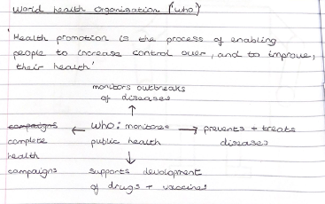
Technical Language & Health Promotion
Key term definition
Technical language identified in pink

