Slide 1




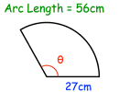
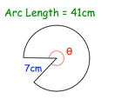
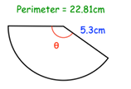
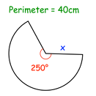

Finding Sector areas and Arc Lengths
Follow these links to watch two videos on “Finding sector areas and arc lengths, extending this to working backwards problems involving missing lengths”
https://corbettmaths.com/2013/03/26/arc-length/
https://corbettmaths.com/2012/08/02/area-of-a-sector-video/
Work through the questions below to check your understanding (solutions on next page):
The arc length or perimeter of each sector has been given. Calculate x or the angle. Give your answers to one decimal place and include suitable units.
Question 2:

Slide 2
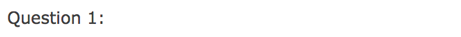

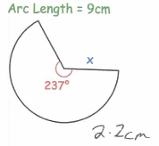
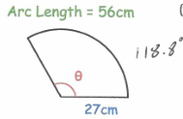
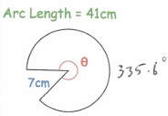
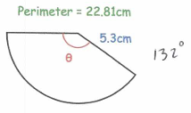
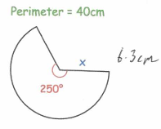
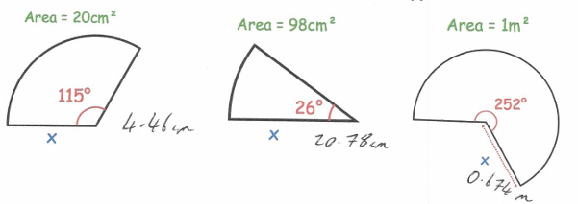
Question 2:

