Slide 1



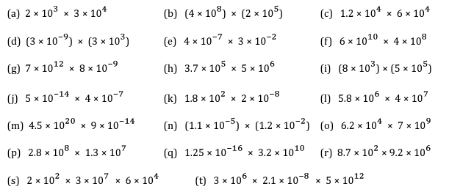
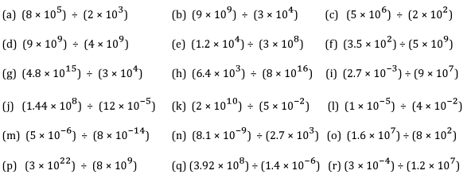
Performing Calculations with numbers in standard form
Follow these links to watch two videos on “Performing calculations with numbers written in standard form”
https://corbettmaths.com/2013/04/29/standard-form-multiplication/
https://corbettmaths.com/2013/05/03/standard-form-division/
Work through the questions below to check your understanding (solutions on next page):
Question 2:

Slide 2
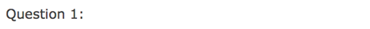
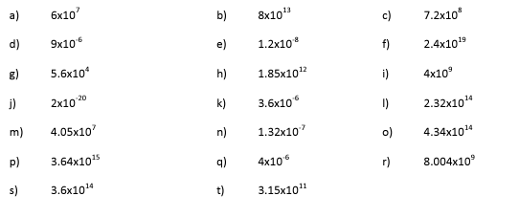
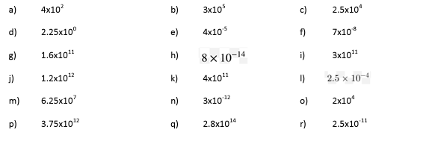
Question 2:

