Slide 1


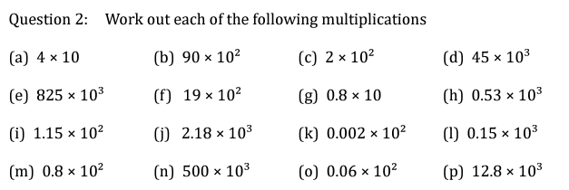

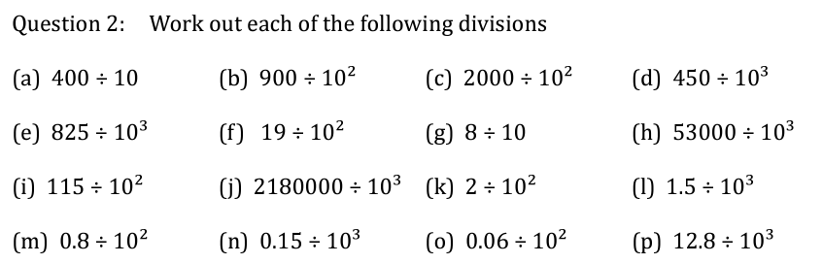
Multiplying and Dividing by Powers of Ten
Follow these links to watch two videos on “multiplying and dividing by powers of ten”
https://corbettmaths.com/2013/06/06/multiplication-by-powers-of-ten/
https://corbettmaths.com/2013/05/19/division-by-powers-of-10/
Work through the questions below to check your understanding (solutions on next page):

Slide 2
