Slide 1


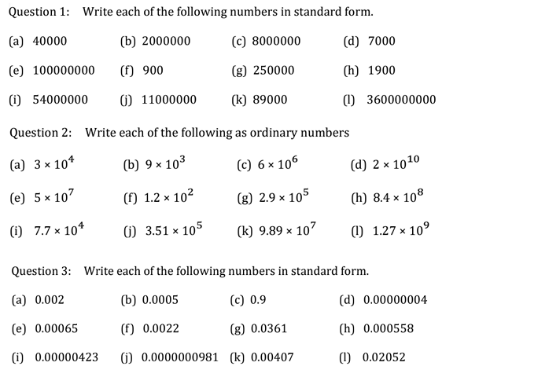
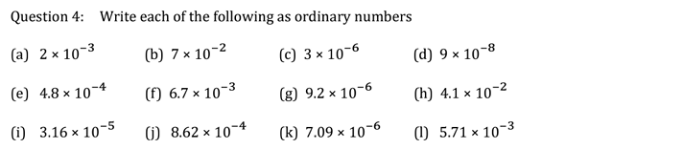
Writing Large and Small numbers in standard form
Follow this links to watch a video on “standard form”
https://corbettmaths.com/2013/04/28/standard-form/
Work through the questions below to check your understanding (solutions on next page):

Slide 2
