Slide 1


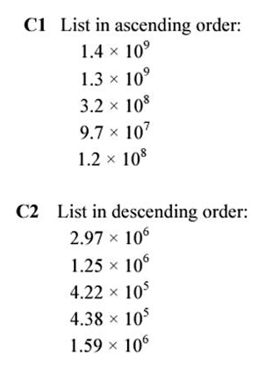
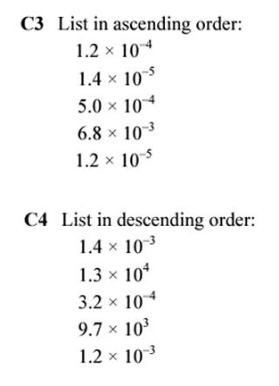
Comparing numbers written in standard form
Follow this links to watch a video on “comparing numbers in standard form”
https://www.youtube.com/watch?v=mvZqTdkakmA
Work through the questions below to check your understanding (solutions on next page):

Slide 2
