Slide 1
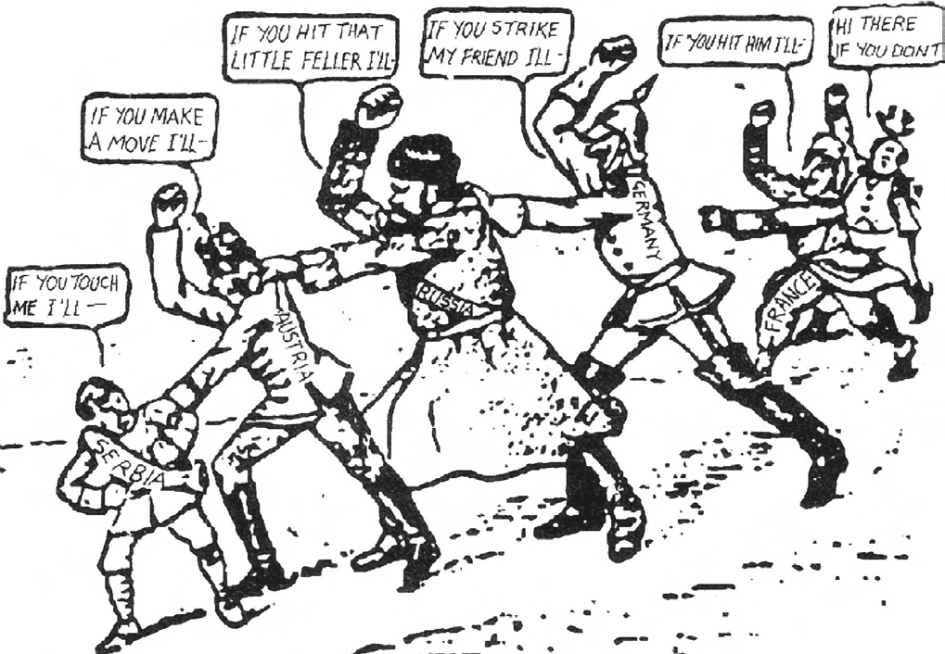
The causes of the First World War: was war inevitable in 1914? (adapted from: https://storysourcescholarship.wordpress.com/20th-century/)
Story (Task One) Read through the key information on causes and complete the titles and summaries in each column
Source
Create a title for each paragraph. | Below is an article examining: The long term causes of the First World War | Summarise each paragraph in one or two bullet points.
 | In the nineteenth century, international relations had been dominated by two forces – nationalism (the belief that your nation is superior to others) and imperialism (the belief that nations had the right to conquer other lands and build up an empire). The British – who genuinely believed that ‘Britannia ruled the waves’ – had an empire which covered a fifth of the globe. The French, too, had a huge colonial empire (referring to an empire with overseas territories), and yearned (longed for) for revenge on the new nation of Germany, who had defeated them in war and taken the provinces of Alsace and Lorraine. Russia ruled an Empire stretching across all of Asia. Even so, these nineteenth century nations believed that they ought to co-operate to keep the peace, and the presence of huge areas of the globe which they could easily conquer (especially in Africa), gave them an alternative outlet (another place to look) for their ambitions. The arrival of Germany onto the world stage as a new nation in 1871, destabilised (made unstable) international relations. The new Germany was an economic and military superpower and it frightened the other nations. One way they responded was by forming alliances, seeking safety by making defensive agreements with other countries. The idea behind these alliances was that no one would dare to attack you because they knew it would involve war, not just with you, but with all your allies as well. In the years up to 1914, tensions increased. Germany resented Britain’s navy and empire. In the years after 1898 Germany built up a powerful navy to challenge Britain. In 1905, and again in 1911, France and Germany clashed in Morocco. New Slav nation states – such as Serbia, Bulgaria and Romania – had seized independence following the decline of the Turkish Empire. Austria-Hungary, which itself ruled many Slav peoples, was terrified by the development and wary of the new Slavic nations, especially Serbia. Austro-Hungarian generals regularly asked to go to war. Looking back, what seems remarkable is not that war broke out in 1914, but that it had not broken out sooner. The years 1870–1914 saw Europe stacking up resentments and tensions, like a fireworks manufacturer stuffing a rocket with gunpowder.
This cartoon – ‘A Chain of Friendship’ - appeared in the American newspaper the Brooklyn Eagle in July 1914. The caption read: “If Austria attacks Serbia, Russia will fall upon Austria, Germany upon Russia, and France and England upon Germany”.
A
”I no longer have any doubt that Britain, Russia and France have agreed among themselves to wage war to destroy us. The encirclement of Germany has already been achieved.” Kaiser Wilhelm speaking in 1914 before the outbreak of war.
B
Task Two Look at source A and B write a paragraph about what you can learn from each source about if WW1 was inevitable (always going to happen). (Source A shows… This tells me that the First World War was/was not inevitable as…) Using the knowledge from the story on the causes of WWI think about how useful the content of the sources are… complete the sentences below. Source A is useful as it shows a chain of friendship in the cartoon. The chain of friendship is shown in the cartoon as the image shows……..(describe the image and what it means). This is useful as it is referring to one of the causes of WWI being _ _ _ _ _ _ _ _ _ Source B is useful as it suggests that……… It states….. This is useful as it is matches my own knowledge of….. (use the information from the article to help. 3. What is the provenance of the two sources? Who wrote them? What type of sources are they? Does this make them more or less useful? Source A was written in….. This makes it _______________ Source A is a cartoon and its purpose is…….. This makes it _____________ Source B is written by the German Kaiser……….This makes it _______________ Source B is written in ______________ This makes it ________________
Notes:
Print A3

