Slide 1
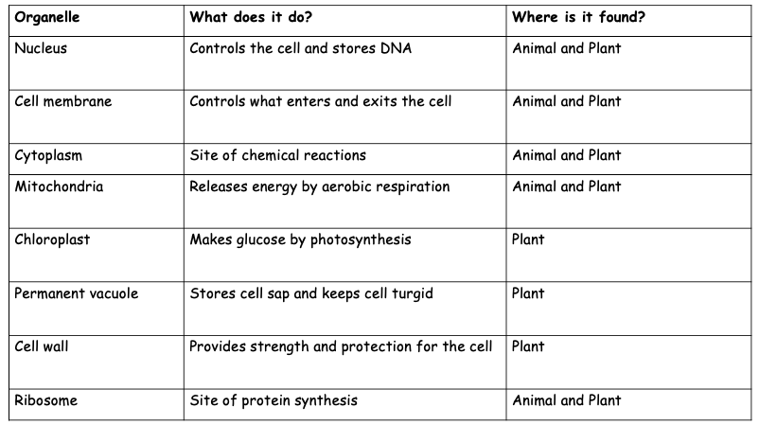
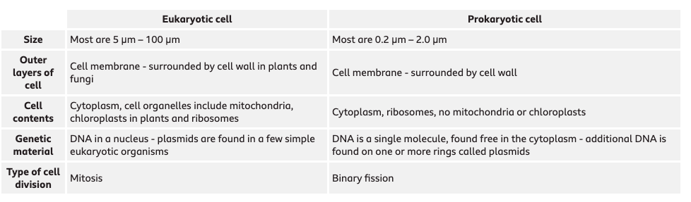
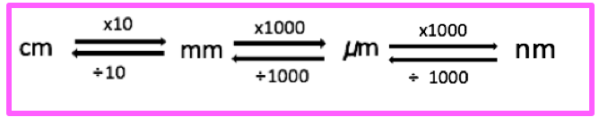
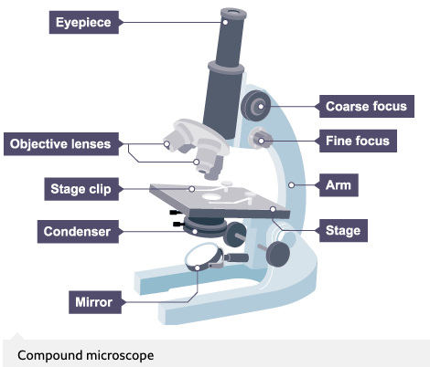
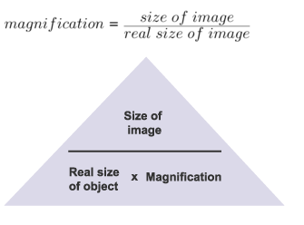
Aqa trilogy Gcse Biology: 4.1 cell biology Graphic Organiser
Organelles | Prokaryotic cells
Eukaryotes include animals, plants and fungi. Animals and plants have the following organelles. Make sure you know which are exclusive to plant cells! | Prokaryotic cells possess fewer organelles compared to eukaryotic cells. Bacteria and archaea are prokaryotes. Their structure is more simplistic compared to eukaryotes, and they do not have a membrane bound nucleus!
Magnification and microscopes | Specialsied cells
 | There are many different types of cells in animals, each is specialized for a role.
Cell | How is it adapted to its function?
Sperm cell | Long tail which whips from side to side to help move the sperm through water or the female reproductive system. Middle section is full of mitochondria which transfer the energy needed for the tail to work.
Muscle cell | Contain many mitochondria to transfer the energy needed for the chemical reactions that take place as the cells contract and relax.
Red blood cell | No nucleus to more room for oxygen and biconcave dis shape increases the surface area to volume ratio to help carry more oxygen to respiring tissues.
Leaf palisade cell | They contain specialised green structures – chloroplast – that contain chlorophyll. Chlorophyll is the green pigment in plants, that traps light energy for photosynthesis. They are usually positioned at the top of the leaf so they absorb as much light as possible.
Root hair cell | The hair like projections greatly increase the surface area available for water to move into the cell. Lots of mitochondria for the active transport of ions from soil into plant.
The image size and actual size must be in the same units!
The compound microscope uses two lenses to magnify the specimen – the eyepiece and an objective lens.
Electron microscopes can be used to view smaller organisms and have a higher magnification and resolving power.
Increasing the power of the objective lens increases the magnification.
The focus dials improve the resolution.
What do power and magnification mean?

Slide 2
Aqa trilogy Gcse Biology: 4.1 cell biology Graphic Organiser
Organelles | Prokaryotic cells
Eukaryotes include animals, plants and fungi. Animals and plants have the following organelles. Make sure you know which are exclusive to plant cells! | Prokaryotic cells possess fewer organelles compared to eukaryotic cells. Bacteria and archaea are prokaryotes. Their structure is more simplistic compared to eukaryotes, and they do not have a membrane bound nucleus!
Magnification and microscopes | Specialsied cells
 | There are many different types of cells in animals, each is specialized for a role.
Cell | How is it adapted to its function?
Sperm cell | Long tail which whips from side to side to help move the sperm through water or the female reproductive system. Middle section is full of mitochondria which transfer the energy needed for the tail to work.
Muscle cell | Contain many mitochondria to transfer the energy needed for the chemical reactions that take place as the cells contract and relax.
Red blood cell | No nucleus to more room for oxygen and biconcave dis shape increases the surface area to volume ratio to help carry more oxygen to respiring tissues.
Leaf palisade cell | They contain specialised green structures – chloroplast – that contain chlorophyll. Chlorophyll is the green pigment in plants, that traps light energy for photosynthesis. They are usually positioned at the top of the leaf so they absorb as much light as possible.
Root hair cell | The hair like projections greatly increase the surface area available for water to move into the cell. Lots of mitochondria for the active transport of ions from soil into plant.
The image size and actual size must be in the same units!
The compound microscope uses two lenses to magnify the specimen – the eyepiece and an objective lens.
Electron microscopes can be used to view smaller organisms and have a higher magnification and resolving power.
Increasing the power of the objective lens increases the magnification.
The focus dials improve the resolution.

Slide 3
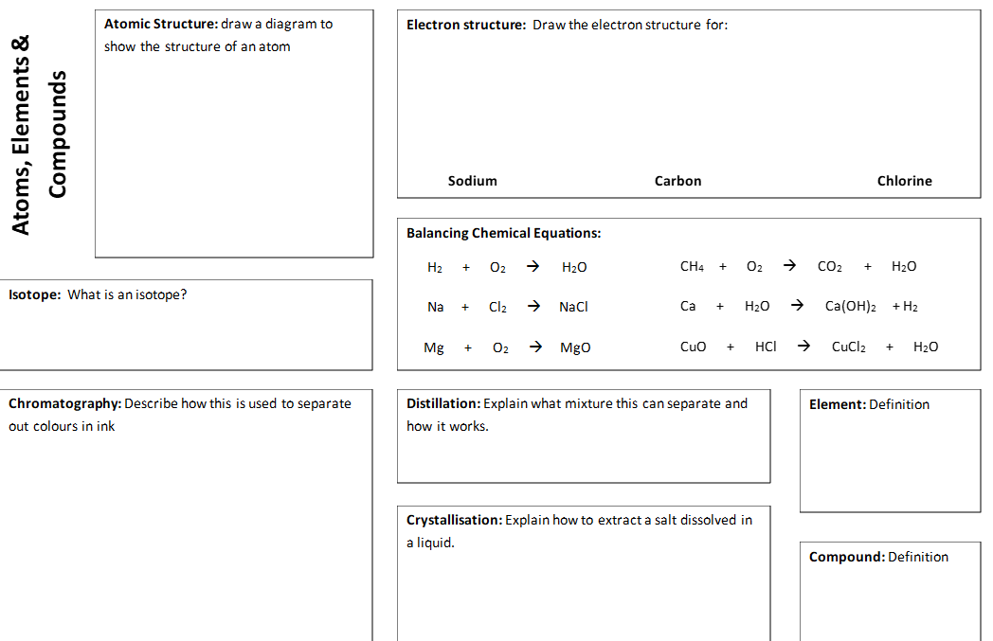

Slide 4
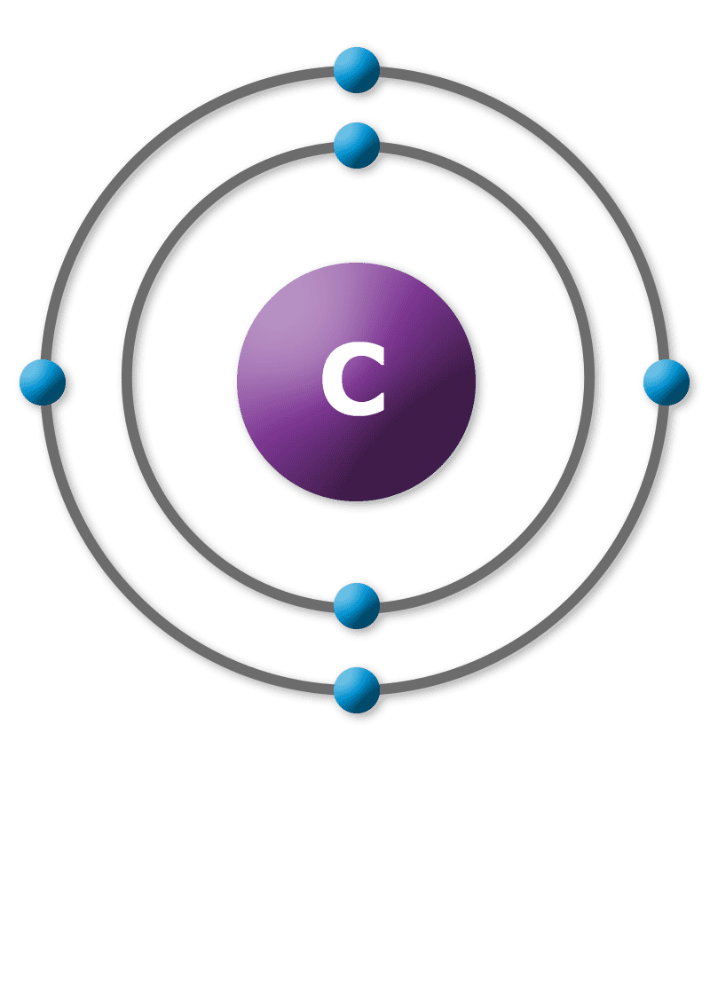
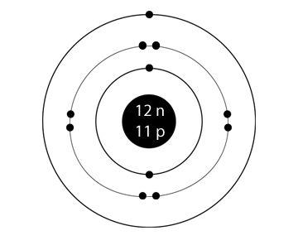
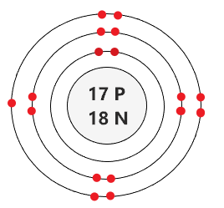
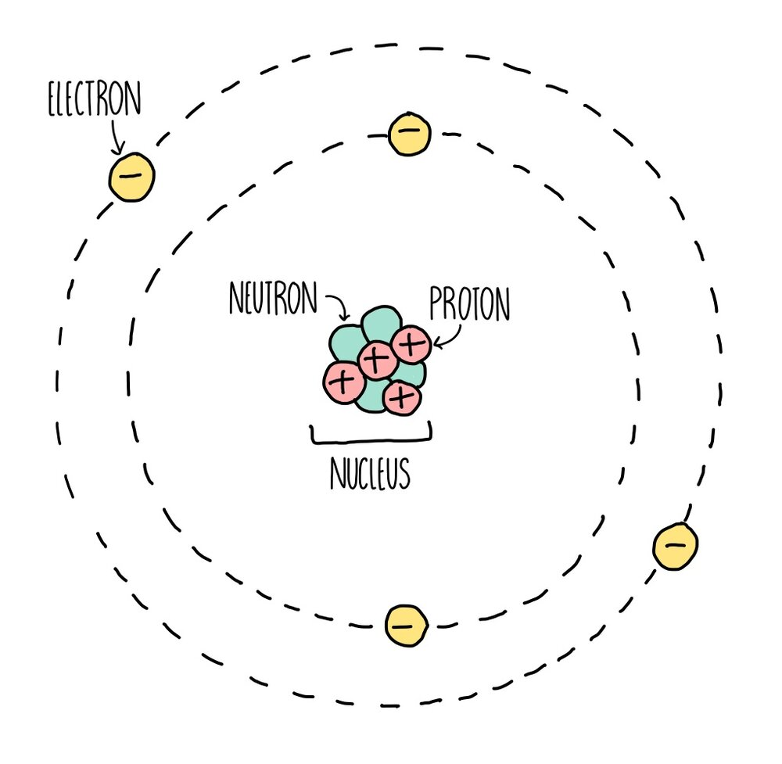
2
2
2
2
Isotope =each of two or more forms of the same element that contain equal numbers of protons but different numbers of neutrons in their nuclei, and hence differ in relative atomic mass but not in chemical properties; in particular, a radioactive form of an element.
2
2
2
2
2
2
Chromatography can be used to separate mixtures of coloured compounds. Mixtures that are suitable for separation by chromatography include inks, dyes and colouring agents in food. Simple chromatography is carried out on paper. A spot of the mixture is placed on a pencil line near the bottom of a piece of chromatography paper – the line must be in pencil because pencil is insoluble in water and so will not move as the chromatography progresses. The paper is then placed upright in a suitable solvent, such as water.
As the solvent soaks up the paper, it carries the mixtures with it. Different components of the mixture will move at different rates. This separates the mixture out.
Distillation separates a liquid from a solution. For example, water can be separated from salty water by simple distillation. This method works because the water evaporates from the solution, but is then cooled and condensed in a condenser and collected in a separate container. The salt does not evaporate and so it stays behind.
An element is a substance that cannot be broken down into any other substance. Every element is made up of its own type of atom
One way to separate a soluble solid from its solution is to make crystals. This involves evaporating the solution to a much smaller volume and then leaving it to cool. As the solution cools, crystals form, and these can be obtained by filtration.
A compound is a substance that contains two or more elements that are chemically combined

Slide 5
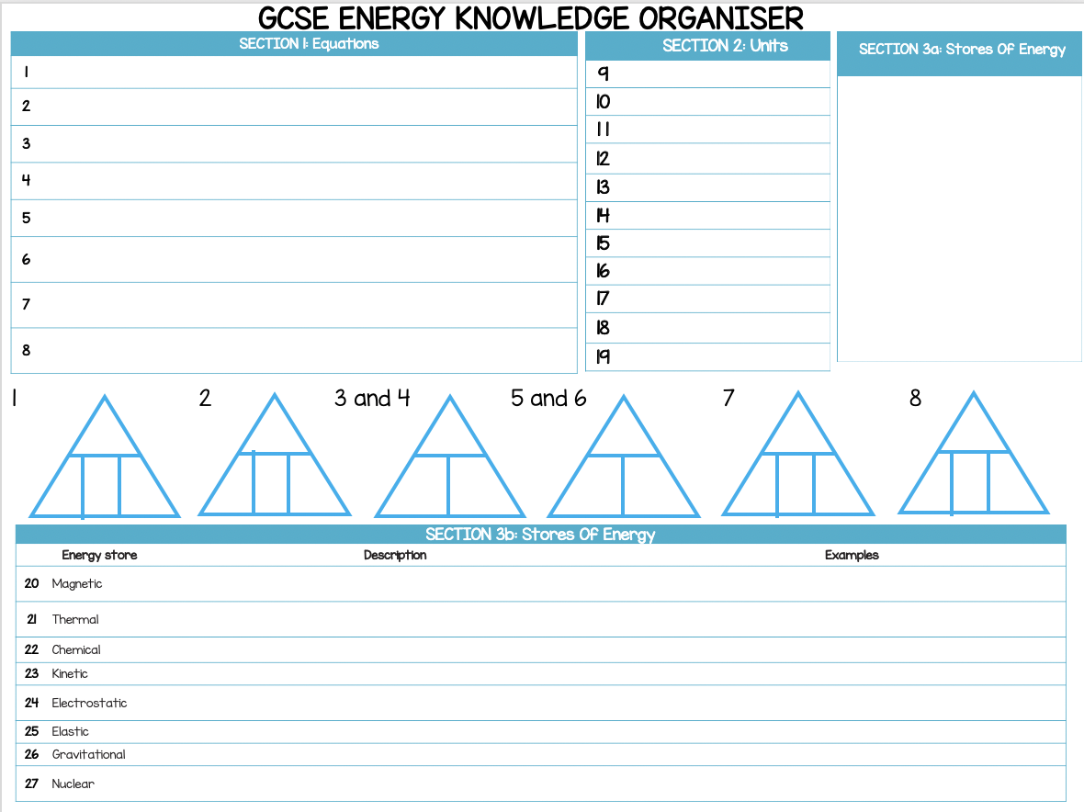

Slide 6
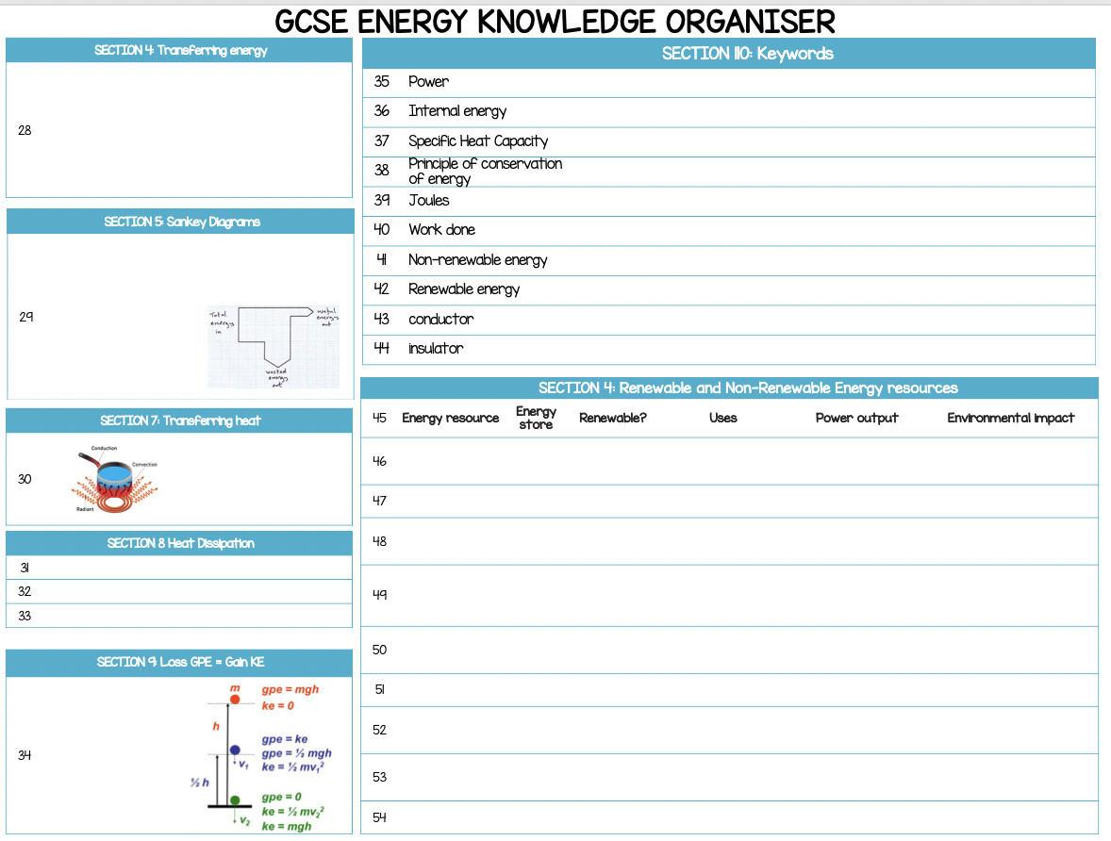

Slide 8
