Slide 1
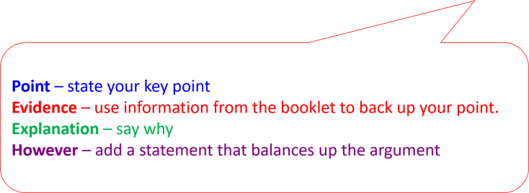

How to structure your paragraph points
Example Question: “Do you think the proposed housing development go ahead?” Yes or No. Use evidence from the booklet and your own knowledge. (9m + 3m SPAG)
Example answer

Slide 2
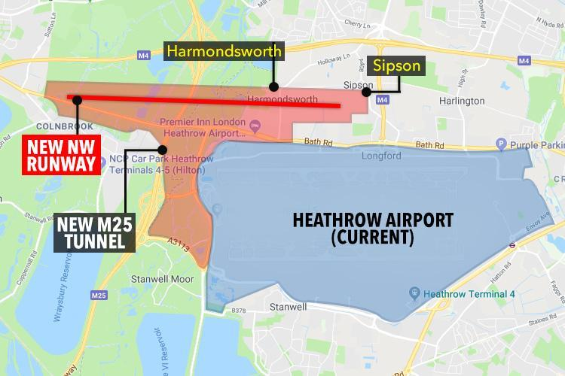
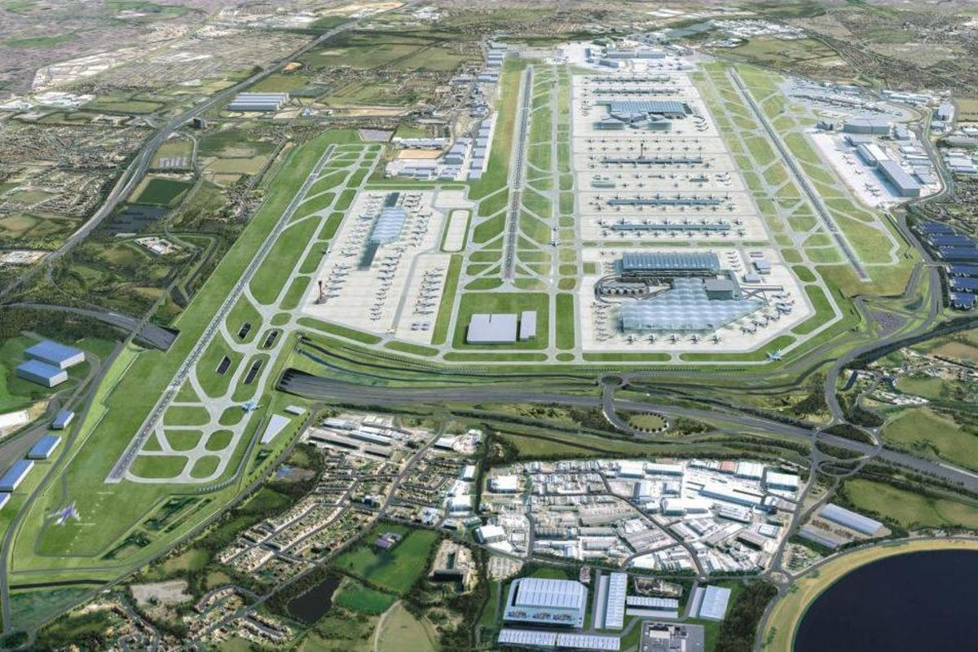
Should the expansion go ahead?
What makes a good answer to this?
It doesn’t matter whether you chose “yes” or “no”, it’s how you justify yourself that matters!
Start your answer being clear about whether you are choosing yes or no. e.g. I believe the proposed housing development should go ahead….
You should then try to make 3 clear PEE paragraph points to support what you have stated
You should the come to a clear conclusion.

Slide 3
Should the expansion go ahead? Example paragraph
Point | The expansion should go ahead to keep Heathrow's status as a hub airport.
Evidence | If it does not expand it won't be able to keep up with other competitive airports like Schiphol which has 6 runways. Heathrow is already at maximum capacity with 80.1 million passengers and air freight to 200 destinations.
Explain (with stakeholders) and link back to the question. | This means that it could lose hub status and some of the current £100billion of imports and exports could go to other airports. This would cause job losses for local people, such as Hounslow, and reduced income for airport companies like British Airways. The loss of money would mean less investment in the airport and surrounding area further reducing the quality of Heathrow. Some airlines might stop flights from Heathrow reducing the number of destinations available to the UK public. This would bring considerable social and economic problems to the south-east and potentially wider areas of the UK supporting the idea of expansion.
However | However, there is not a guarantee that Heathrow would lose its hub status and it would still be a major airport in the UK so these impacts could just be minor.

