Slide 1
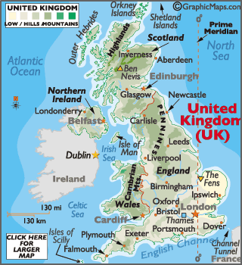
UK Geographical features
The website below has a very detailed overview of UK geography covering the key aspects of physical and human UK geography
  https://www.geographyinthenews.org.uk/issues/issue-25/the-united-kingdom/ks3/
Here are some games to test your locational knowledge of UK landforms
  https://www.geoguessr.com/seterra/en/vgp/3248
  https://www.jetpunk.com/tags/british-geography

