Slide 1
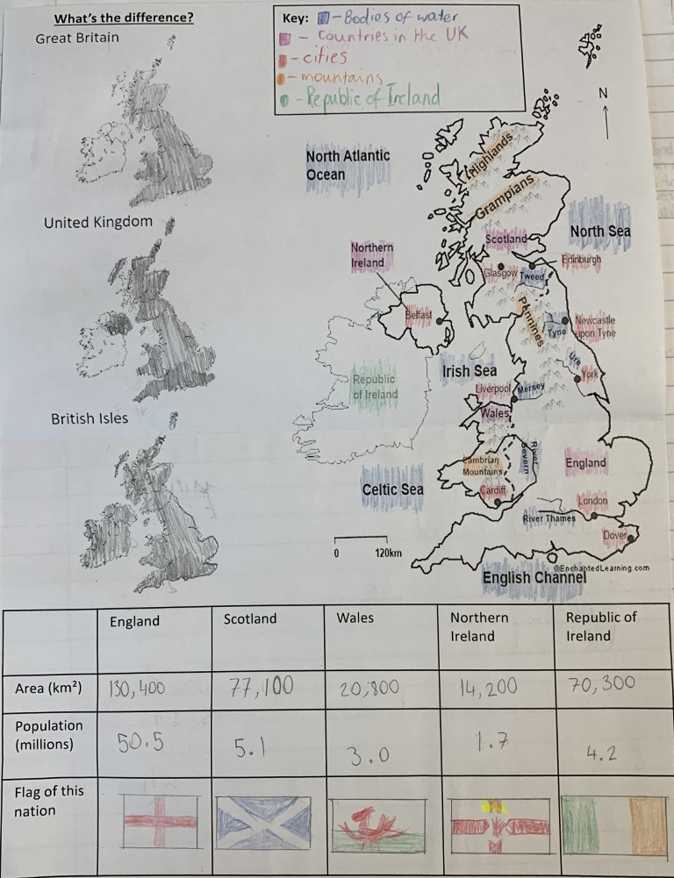
Completed map of the major Geographic features of UK such as cities, mountain ranges and rivers
Maps shaded to show the different regions for Great Britain, the United Kingdom and the British Isles.
Table with some key facts and information for the United Kingdom and the Republic of Ireland

Slide 2
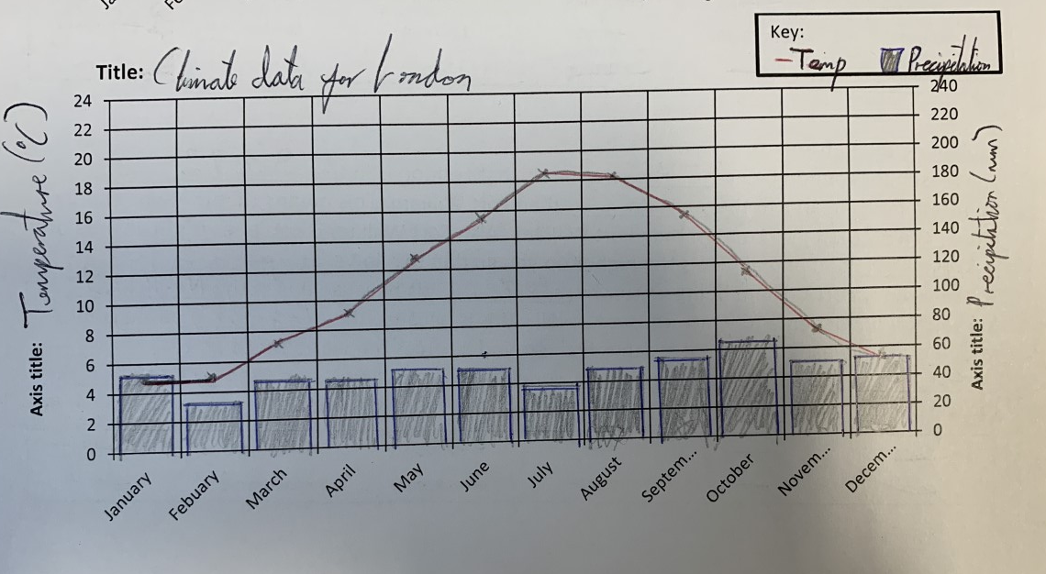
Climate graph example
Key is completed with symbols
Sensible title is added to the graph with the location for the data.
Axis are labelled correctly
Axis are labelled correctly
Temperature is plotted as a line graph. Points are in the middle of the month and a ruler is used to connect the points together and it does not connect to the axis
Precipitation is plotted as a bar graph and a ruler is used so the lines are straight and accurate. These are shaded in to make it even clearer the location of the bar

Slide 3
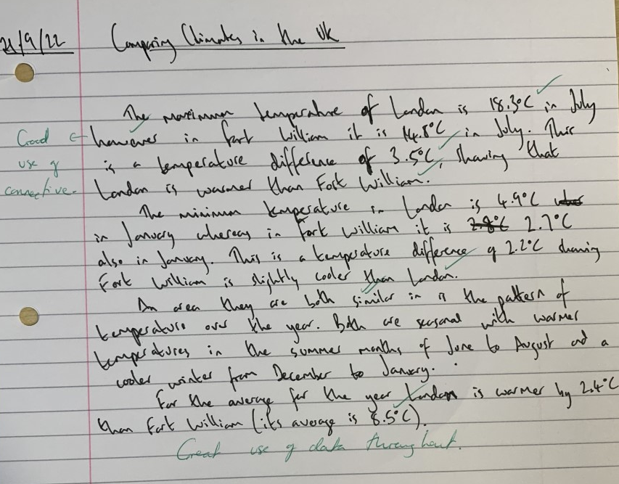
Comparing climates example
Data is manipulated – a difference is calculated to emphasise the variation in the climates
Comparison connectives are used to show that a comparison is being made e.g. however or similar
Data is used from the climate graph throughout the answer

Slide 4
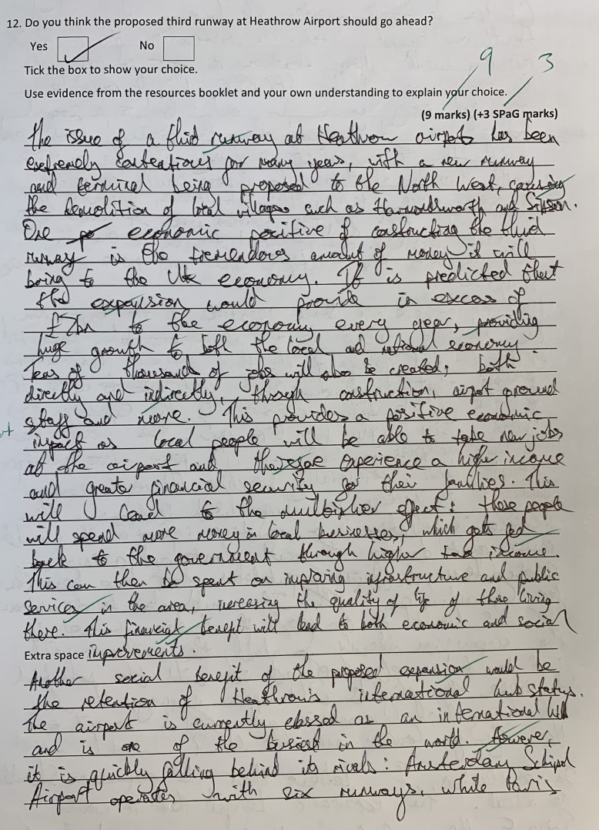
Writing an evaluation
Introduction to the answer with some flair in their writing
First point introduced and mentions that it is an economic point.
Evidence is used to support the point
The point is then explained in detail – why will it bring benefits to the economy and the wider impacts this has.
Stakeholders are also mentioned – who will be affected by the expansion
Second point introduced and mentions that it is a social point.
Evidence is used to support the point

Slide 5
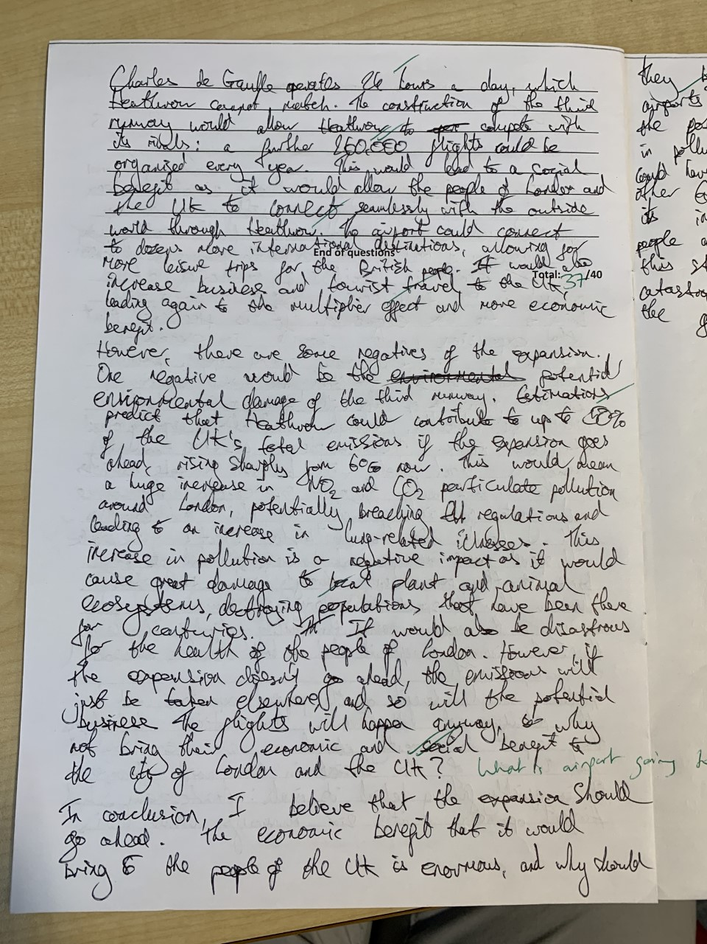
Evidence is used to support the point
Another strong explanation using evidence throughout
Other side of view (negatives of expansion) is given to provide balance to the argument. This shows the student has considered both sides before coming to their decision.
Point is made, mentioning that it is an environmental point.
Evidence is used to support the point
Explanation of the point with who is affected by this (stakeholders)
This point is counter argued to again support students decision that Heathrow should be expanded.

Slide 6
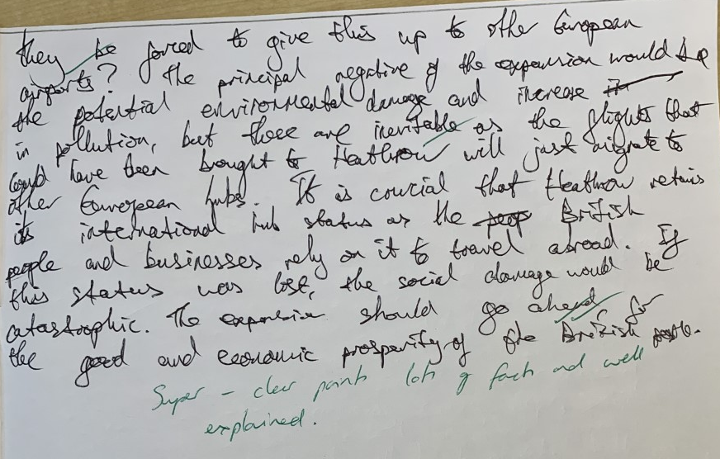
Conclusion is included to finish the answer re-stating the students opinion to the issue.
No new information is added. The key points from the answer are summarised well.
Rhetorical question is used showing flair of writing
Lots of key geographic terminology is used throughout the answer.

