Slide 1
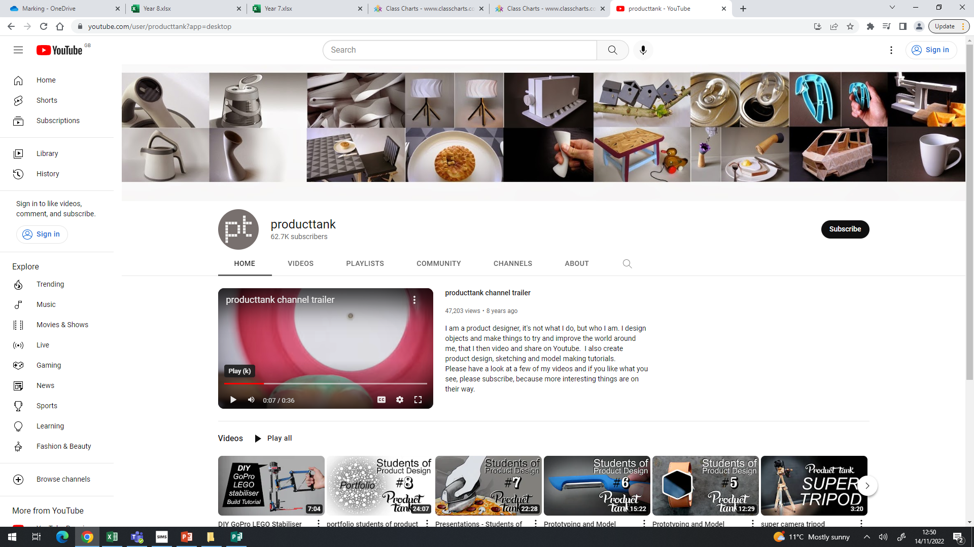
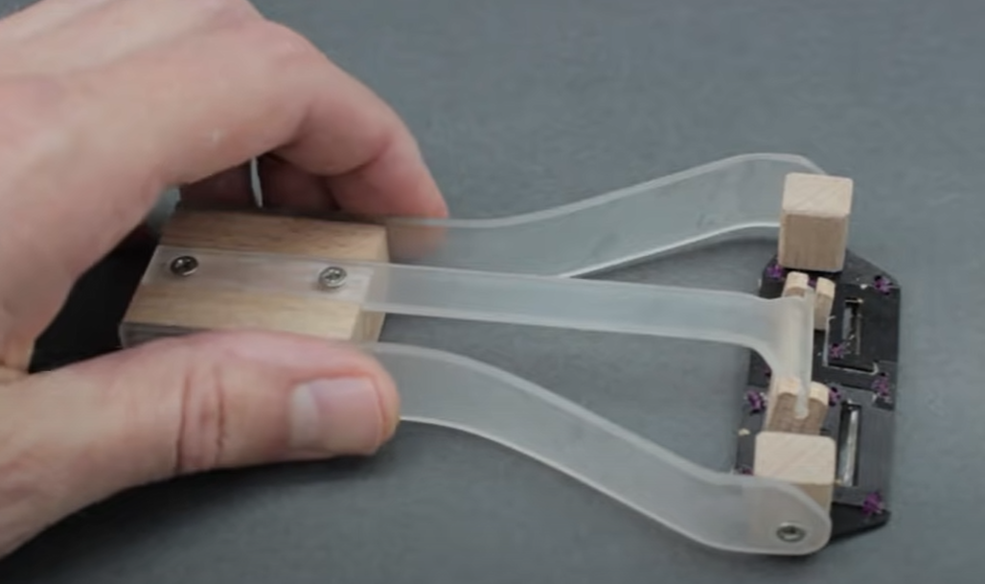
Product Tank is a YouTube channel which has been created by a Product Designer and aims to educate young designers in methods of design, prototyping, portfolio creation and product testing.
There are some fantastic videos which discuss why designers prototype, how to prototype successfully and methods of prototype manufacture. To support Year 9 students in our prototyping project I suggest they watch the 2 video links below, making notes about techniques, tips and ideas as well and reasons for the use of different forms of prototypes, this could be done as an extended mind map.
https://www.youtube.com/watch?v=Oee8VfjR1CE
https://www.youtube.com/watch?v=gWk6br5Ngkc

