Slide 1
St Mary’s Catholic Sixth Form
Information for Parents of
Students in Year 12
Mr McKeating, Assistant Headteacher
Notes:
DM welcomes

Slide 2
Applying to University
Why go to University?
Increase potential earnings*
Improve career prospects
Benefit the wider community
Social and cultural reasons
More independence, self-confidence and responsibility
Personal / Academic challenge
Broadens interests and knowledge
It can be immense fun!
*Source: Pricewaterhouse Coopers LLP, 2006, in Universities UK, Research Report, The Economic Benefits of a Degree
Notes:
RSP

Slide 3
Progress So Far
Pros and cons of going to university.
Types of universities and courses.
An insight into the student experience.
How to apply to university: the process
Encouragement to begin exploring potential courses and universities.
What makes an effective personal statement.
Time to begin to plan and gather initial ideas.

Slide 4
Applying to University
June/ July 2021
Registered with UCAS – Set up Apply
Finalising Personal Statement
Students continue to research potential options and courses
Attending virtual Open Days where they are offered
Teachers write references and suggest predicted grades
Summer holidays 2021
Finalise choices
Finalise / final amendments to personal statement
Some students to receive AS-level results – input into Apply
Revision – entrance tests, where relevant
September 2021
1st September applications open – students encouraged to send ASAP thereafter.
Ensure entry for admissions tests
October 2021
Early Applicants Deadline – 15 October
St Mary’s UCAS application deadline – all non-early entrants to have submitted by October half-term
Notes:
RSP

Slide 5
Applying to University
Sign up to the monthly UCAS Parents Newsletter.
www.ucas.com/parents
Download the 2021 UCAS Parent Guide from the UCAS website.
Notes:
RSP

Slide 6
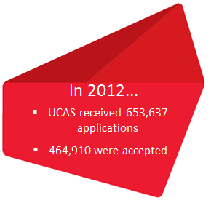
Applying to University
The basics
Your son or daughter can make up to five choices in one application.
The 2021 applicant fee is: £20 for one choice/ £26 for up to five choices.
‘Invisibility’ – universities cannot see where else students have applied.
Notes:
The only exception where students can not make five choices is for medicine, veterinary science/medicine and dentistry courses, where students can only make 4 choices.
Students can also only apply to study one course at either Oxford and Cambridge – not both.
RSP

Slide 7
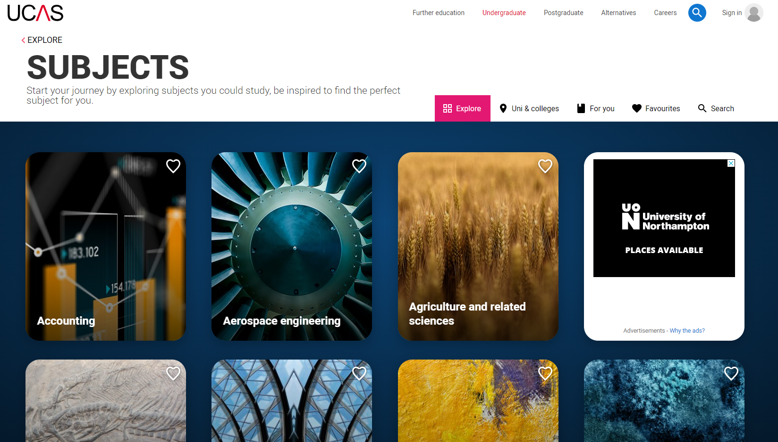
Choosing a Course
https://www.ucas.com/explore/subjects
https://digital.ucas.com/search
https://www.ucas.com/understanding-apprenticeships/what-types-of-apprenticeships-are-there/degree-apprenticeships

Slide 8
How to Choose A Course
Compare course content – what will be most appealing
Entry requirements
Types of learning – lectures / seminars / tutorials / practical work / placements
Types of Assessment – exams v coursework
Tutors
Reviews and Ratings
Speaking to tutors / students

Slide 9
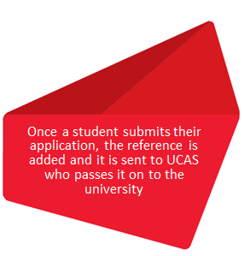
Applying to University
Making the application
Apply is the UCAS online application system.
Every applicant has six sections to complete:
Personal details
Student finance (UK and EU only)
Choices
Education
Employment
Personal statement.
Notes:
RSP

Slide 10
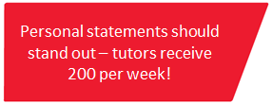
Applying to University
Personal Statements: how you can help
Personal statements are so important, make sure your son or daughter includes:
academic achievements, past and present
interests in the chosen subject area
knowledge of the subject and enthusiasm to go beyond the syllabus
what they enjoy about studying
details of their independent study skills.
The questions universities and colleges will ask:
have they chosen the right subject for the right reasons?
do they have a range of interests?
does the personal statement confirm their interest in the subject?
have they studied independently?
are they motivated and committed?
do they possess good numeracy and literacy skills?
Notes:
DM
4000 character limit
What we do to support

Slide 11
Applying to University
Similarity Detection Service
Personal statements are checked against a library of those already in the system, and from a variety of websites and paper publications
Each new statement is added to the library after processing
Notes:
DM

Slide 12
Applying to University
Decisions
Universities and colleges will review:
Personal statement
Reference
Qualifications
Admissions test results
Interviews
Portfolios
Auditions.
An admissions tutor may make one of three decisions:
Unconditional offer
Conditional offer
Unsuccessful.
Notes:
DM

Slide 13
Predicted Grades
Central to the process for determining offers
Balance – aspirational and realistic
Teachers suggest aspirational grades to Head of Sixth Form.
Head of Sixth Form will determine the final predicted grades on the UCAS form.
Transparency at all times.

Slide 14
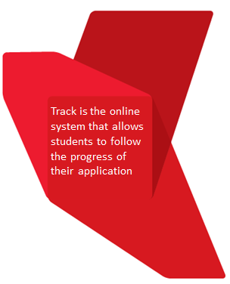
Applying to University
Tracking applications
Track will allow your son or daughter to:
follow the progress of their application 24/7
see their choices and personal information
display their offers
reply to offers online.
Notes:
RSP

Slide 15
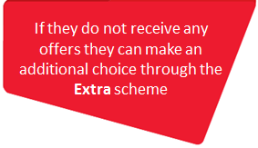
Applying to University
Replying to offers
When your son or daughter receives decisions from all of their choices they will need to make their replies by a set date.
They can now hold a maximum of two offers:
Firm - their first choice. If they meet the conditions of the offer they will be placed.
Insurance – acts as a back-up choice and only comes into play if they are not placed with their firm choice.
If your son or daughter fails to reply to their offers by the deadline date, all offers will be automatically declined.
Notes:
RSP

Slide 16
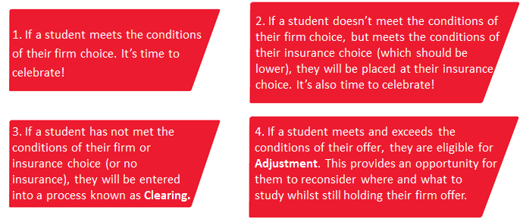
Applying to University
Confirmation
Exam results are published – many are passed electronically to universities by UCAS before results’ day.
Admissions staff check if the applicant has met the conditions of the offer. There are four possibilities:
Notes:
RSP

Slide 17
Applying to University
Parental support is vital
Don’t book holidays at key times e.g. results day
Engage with the school – find out opening times and key contacts, use opportunities provided
Support your son or daughter’s management of their application.
Make sure they read everything they are sent carefully!
Prepare them for living away from home:
Cost of living – paying bills
Independent living skills – cooking and washing.
Notes:
DM

Slide 18
Applying to University
Key dates
June
25 June 2021 – Personal Statement in draft submitted on Teams
Summer
Final drafts of personal statements written
September
10 September 2021 – Final Personal Statements
Enter for admissions tests where necessary. Dates TBC https://www.admissionstesting.org/for-test-takers/
Notes:
DM

Slide 19
Applying to University
Not applying to Uni?
Not forgotten about!
Employability support (advice, research, applications, interview preparation, work experience etc)
Tracked, supported and encouraged.
Notes:
RSP

Slide 20
Applying to Oxford or Cambridge
Students can apply to one
Mostly GCSE grades 7-9
AS-level Thinking Skills / EPQ
Researching potential colleges
Individual Guidance
Summer to prepare for admissions tests
Mock tutorial interviews from September 2021
Working to ensure A-level grades meet entry requirements

