Slide 1
Recap
Write down 5 things that will help you succeed in geography at A level

Slide 2
Water and Carbon cycles
Objectives
Outcomes
To know what open and closed systems are
To be able to APPLY open and closed systems to the water and carbon cycle
To understand how positive and negative feedback loops work
2 diagrams showing what closed and opens systems are
Completed mix and match definitions of key systems terms
2 completed feedback loops – one positive and one negative

Slide 3
Mind map- Why are water and carbon important to us?
In all forms of life
Health
Prosperity
Life on earth
Climate
Climate
In physical features
Global system
They are both systems

Slide 4
Systems in Geography
COPY - A system can be defined as any set of interrelated components or objects which are connected together to form a working unit or uniﬁed whole. In geography it is usual to recognise two general types of systems: closed and open. They tend to have inputs, processes and stores and outputs.
Can you think of any systems? Make a list then explain how they are a system

Slide 5
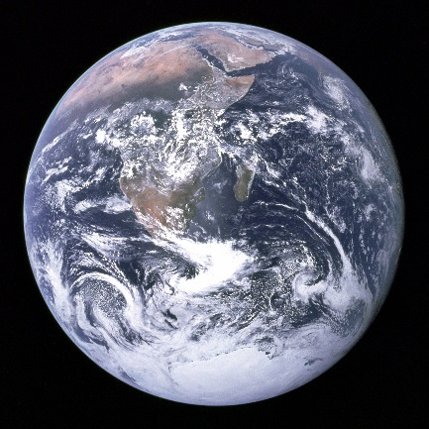
Closed Systems - There is transfer of energy, but not matter, between the system and its surroundings.
Open Systems Where systems receive inputs and transfer outputs of energy and/or matter across the boundaries between them. Most natural systems are open ones.
Energy
Energy
Energy
Energy
Stores & processes
Stores & processes
System Boundary
System Boundary
Inputs
Inputs
Outputs
Outputs
Why is planet Earth considered a Closed system?
Can you think of any Open Systems you have already studied?
There are also Isolated systems: these have no interactions with anything outside the system boundary. There is no input or output of energy or matter. Many controlled laboratory experiments are this type of system and they are rare in nature

Slide 6
System |  | 1. This occurs when inputs balance outputs so that the overall system does not change.
Inputs |  | 2. A part of the system where energy/mass is stored or transformed.
Outputs |  | 3. Change in the state of a system that counteracts or dampens that change.
Energy |  | 4. This is made up of a chain of open systems where the output from one open system forms the input into another. Rivers are a classic example of open cascade systems.
Store/component |  | 5. the addition of matter or energy to a system
Flow/transfer |  | 6. a set of interrelated components working towards some kind of process
System boundary |  | 7. Outer edge of system; the interface between one system and another.
Dynamic equilibrium |  | 8. are the kinds of things or substances composing the system. They may be atoms or molecules, or larger bodies of matter, e.g. sand grains, rain drops etc.
Positive feedback |  | 9. the removal of energy or matter from a system
Negative feedback |  | 10. What powers the system e.g. what causes the water to circulate within water cycle.
System element |  | 11. Change in the state of a system that causes the initial change to increase.
Cascading system |  | 12. A form of linkage between one store/component that involves movement of energy or mass.
Match up the definition with the key word

Slide 7
The Earth has 4 major subsystems:
The Atmosphere
The Lithosphere
The Hydrosphere
The Biosphere
Each of these are considered to be an open system
That forms part of a chain; a Cascading System.
Each of these interact and their relationships have a
Significant effect on the earth’s climate and climate change.

Slide 8
Dynamic equilibrium
When there is a balance between the inputs and outputs then the system is said to be in a state of dynamic equilibrium.
This means that the stores stay the same
If one of the elements of the system changes e.g. one of the inputs increases without any corresponding change in the outputs, then the stores change and the equilibrium is upset.
This is called feedback. There are two types of feedback positive and negative.

Slide 9
Example of a positive feedback in a system
More CO₂
to act as a
greenhouse gas
More CO₂ in
the atmosphere
You each have a template for positive feedback in the system.
You need to use the text boxes opposite to complete your sheet
CO₂ back
into the
atmosphere
Global
temperature
rise
Warms
the oceans
Dissolved CO₂
released by
warmer oceans
Warm water
less able to
dissolve gas
Increased
oceanic
temperatures
Positive feedback where the effects of an action are amplified or multiplied by subsequent ‘knock-on’ or secondary effects.

Slide 10
Example of a positive feedback in a system
Positive feedback where the effects of an action are amplified or multiplied by subsequent ‘knock-on’ or secondary effects.

Slide 11
Example of a positive feedback in a system
Global
temperature
rise
More CO₂
to act as a
greenhouse gas
Warms
the oceans
More CO₂ in
the atmosphere
Increased
oceanic
temperatures
Dissolved CO₂
released by
warmer oceans
Warm water
less able to
dissolve gas
CO₂ back
into the
atmosphere
Positive feedback where the effects of an action are amplified or multiplied by subsequent ‘knock-on’ or secondary effects.

Slide 12
Example of Negative Feedback
(Reduced CO₂ has a
‘dampening’ effect
and reduces
global temperatures)
Increase in
atmospheric CO₂
You each have a template for negative feedback in the system.
You need to use the text boxes opposite to complete your sheet
(Global temperature
Increase)
Reduces
atmospheric CO₂
(Increased take
up of CO₂)
More plant
growth
Negative feedback where the effects of an action are cancelled out or reduced by its subsequent knock-on effects.

Slide 13
Example of Negative Feedback
Start: Increased use of fossil fuels
negative feedback where the effects of an action are cancelled out by its subsequent knock-on effects.

Slide 14
Example of Negative Feedback
Start: Increased use of fossil fuels
Increase in
atmospheric CO₂
(Reduced CO₂ has a
‘dampening’ effect
and reduces
global temperatures)
(Global temperature
Increase)
Reduces
atmospheric CO₂
More plant
growth
(Increased take
up of CO₂)
Negative feedback where the effects of an action are cancelled out by its subsequent knock-on effects.

Slide 15
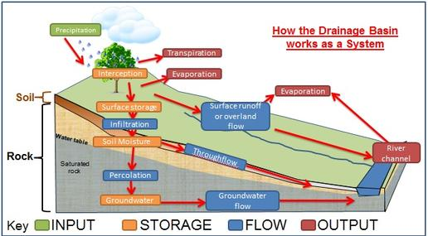
Discuss - Are the water and carbon cycles closed or open systems?
Closed systems on a global scale
Open sub-systems on a smaller scale (drainage basin or workings of a tropical rainforest)

Slide 16
What is the concept of dynamic equilibrium in relation to the water cycle?
Dynamic equilibrium refers to the tendency towards a natural state of balance within the hydrological cycle. Balance between inputs and outputs so the stores stay the same.
The water cycle is a closed system as no water enters or leaves the system; it is simply recycled around the system.
The drainage basin element of the hydrological cycle is an open system where the inputs and outputs can change.
The dynamic equilibrium is easily upset by extreme events such as storms or droughts.
Human activity can also cause disruption to the dynamic equilibrium, e.g. by modifying the drainage basin.
Such events and processes cause sudden changes in the state of the system and disrupt or interfere with dynamic equilibrium as is the case with flooding.

Slide 17
Review – what have you discovered today?
OTHER TRANSITION work this week:
Reading work – page 5 to 6 – Water cycle processes
Using theconversation.com exercise - https://theconversation.com/water-underground-source-for-billions-could-take-more-than-a-century-to-respond-fully-to-climate-change-110551

Slide 18
Dad joke
How do mountains see?

