Slide 1
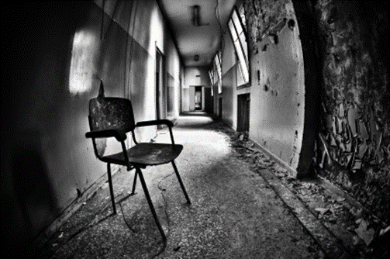
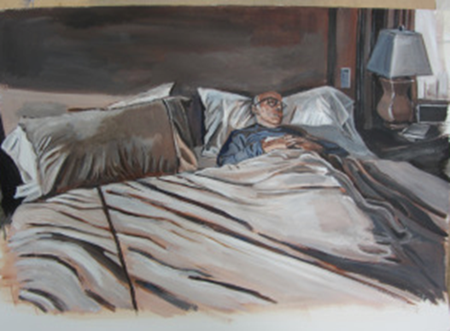
Recap
WHAT IS THE STRONGEST IDEA FROM YOUR MIND MAP FROM WEEK 1? Which strand of your mind map interests you most? Is there anything from this week’s news you could add to your mind map? Remember you are documenting your time in lockdown.
Photography Challenge Last week you focused on photographing your subject from different angles & using a variety of light sources. Look at the artist examples. How have the painter and photographer used: Light Space Composition What do you think the artists are trying to say with their images? Do they create a mood in their work?

Slide 2
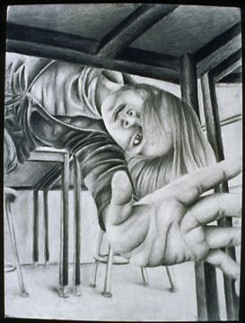
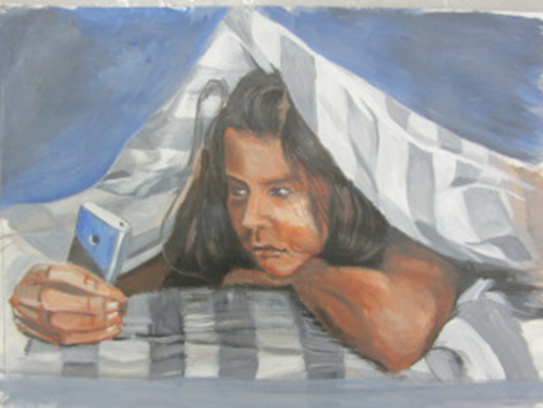
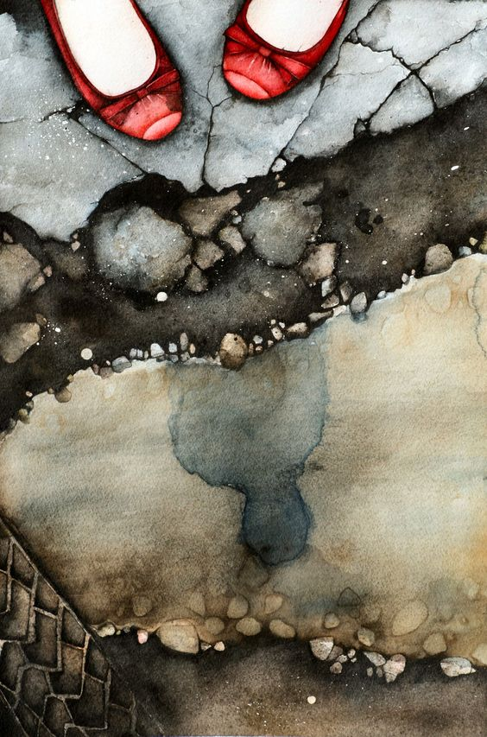
Week 2 FINE ART Outline
This week you will make use of your photography experiments from last week to draw or paint from a different viewpoint. You will challenge yourself to work from an unfamiliar angle. You will see examples of fine artists working from unusual perspectives and consider what effect this has on the audience/viewer. You will use this week to practise perspective and proportion in your work. Working from a completely different angle can be tricky, so we will allow you to select the scale/size of your work. You will experiment with unconventional materials you might have around the house and build them up to create depth in your work.

Slide 3
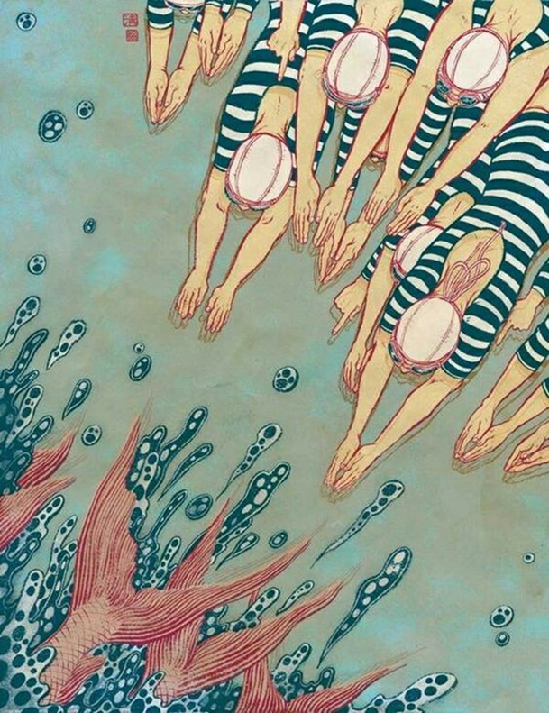
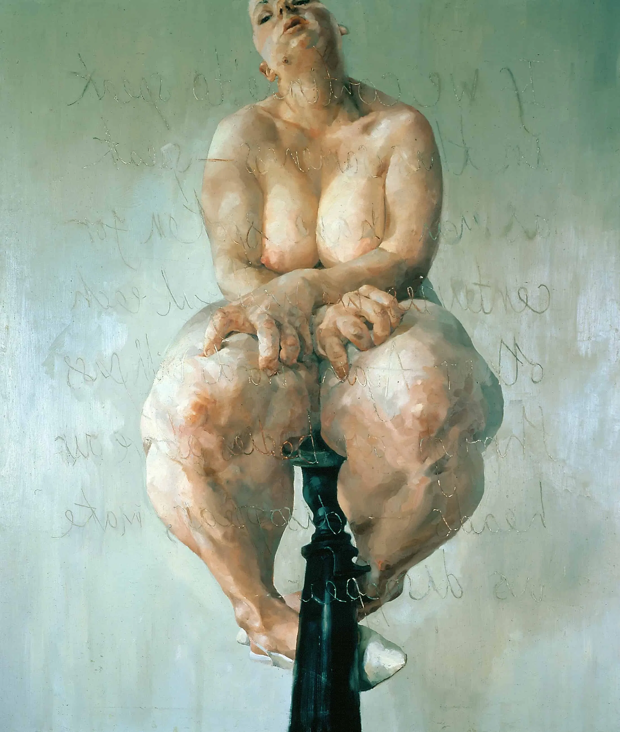
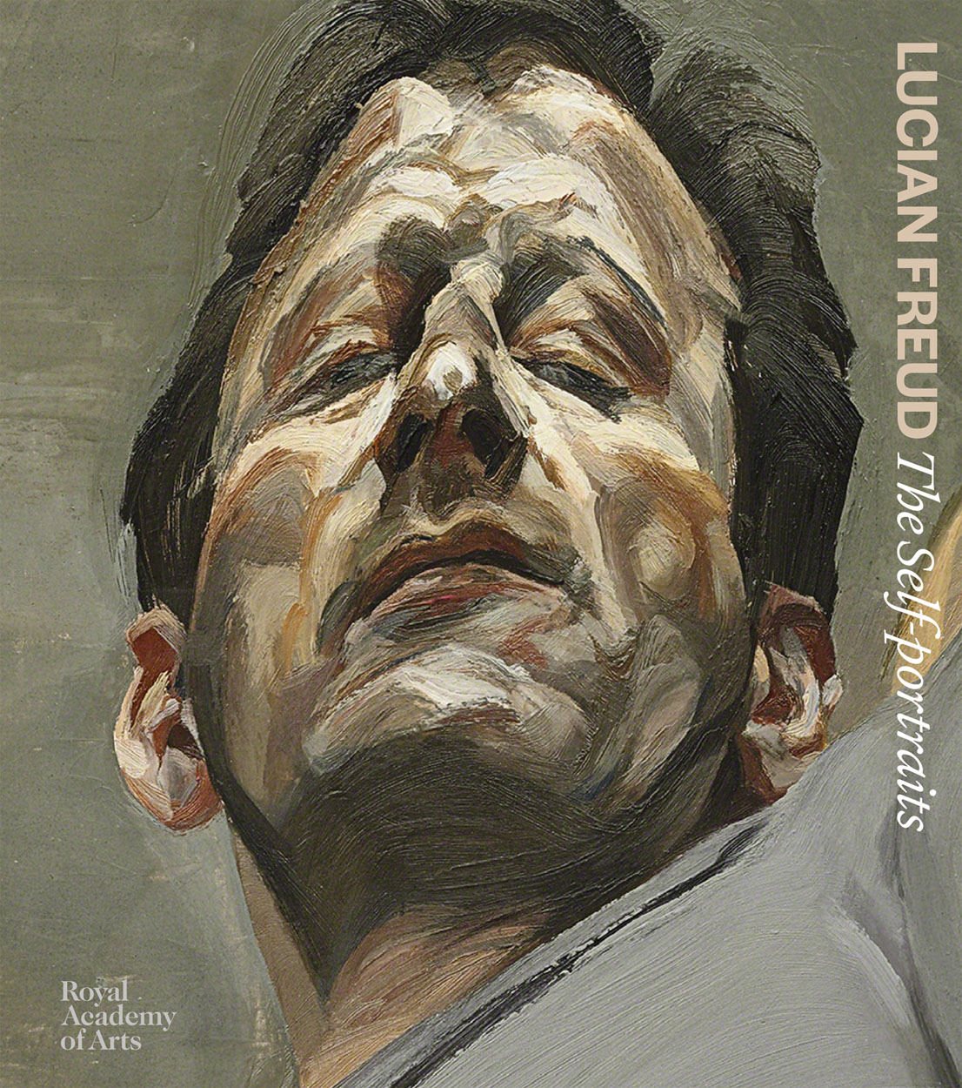
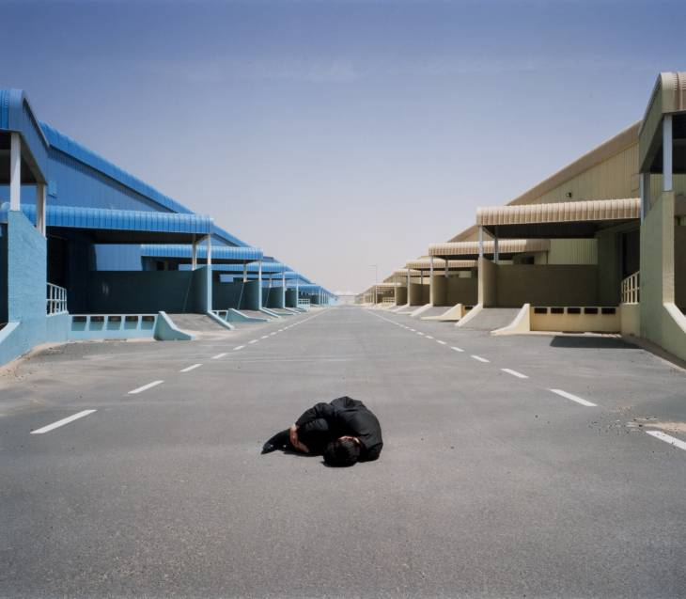
Artists & Perspective
Swimmers by Yuko Shimizu
Jenny Saville
Lucien Freud
TASK 1 How have the artists each used viewpoint/perspective in their work?
How do they want the audience to feel?
What ideas do they express about the subject in the painting/photograph?
Carey Young Body Techniques (after Sculpture II, Kirsten Justesen, 1969) 2007 Tate

Slide 4
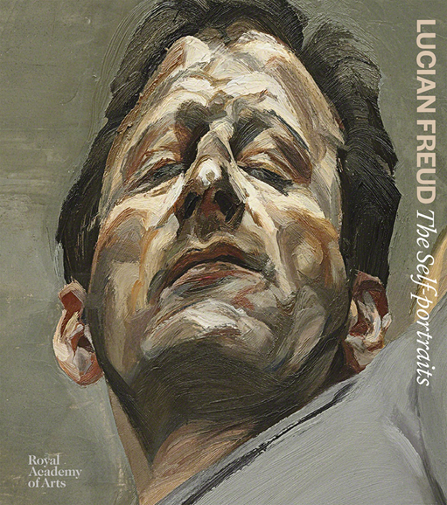
Perspective & Viewpoint
INTRODUCTION
Perspective in art usually refers to the representation of three-dimensional objects or spaces in two dimensional artworks. Artists use perspective techniques to create a realistic impression of depth, 'play with' perspective to present dramatic or disorientating images.
Perspective can also mean a point of view – the position from which an individual or group of people see and respond to, the world around them. You might, for example, hear people saying 'from my perspective' or referring to the point of view of a particular group or set of beliefs: 'the youth perspective' or 'the feminist perspective'.
The Tate
Read more about the different types of perspective https://www.tate.org.uk/art/student-resource/exam-help/perspective

Slide 5
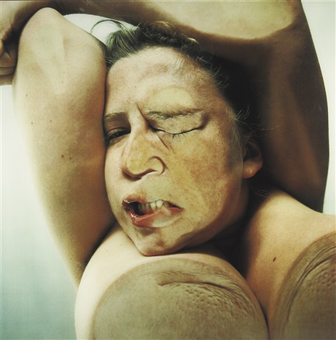
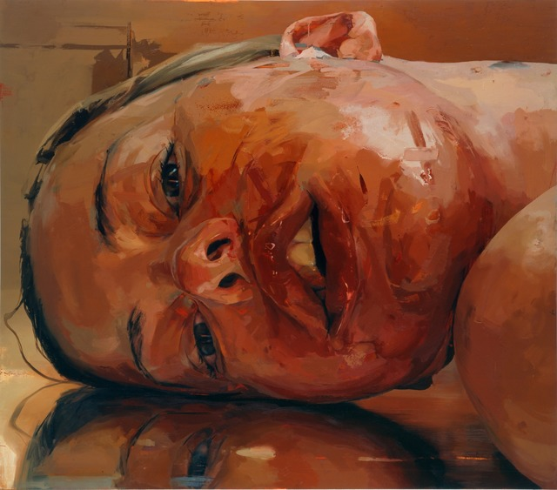
Jenny Saville
Jenny Saville is a contemporary British painter whose stylized nude portraits of voluminous female bodies have brought her international acclaim. Among her best-known works, is the large-scale self-portrait Branded (1992), in which the artist distorts her own torso and breasts through painting, making both body parts pendulous and imposing. Saville’s luscious yet grotesque treatment of painted bodies have elicited comparisons to Lucian Freud. “I paint flesh because I’m human,” she has said. “If you work in oil, as I do, it comes naturally. Flesh is just the most beautiful thing to paint.”
https://www.youtube.com/watch?v=MgXNp8ToVHk
Watch this short video with Jenny Saville talking about her work.

Slide 6
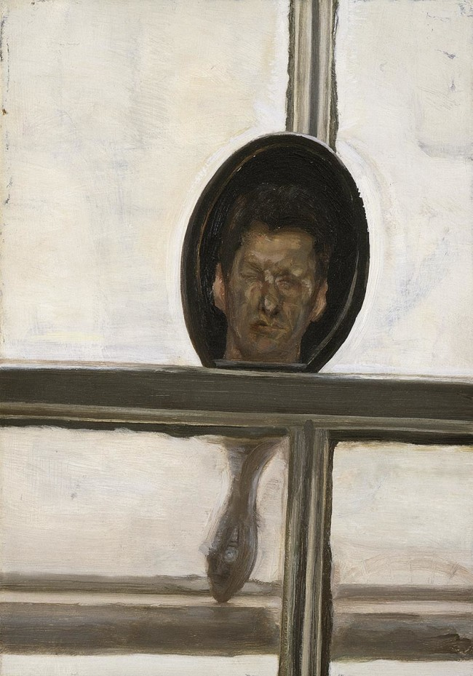
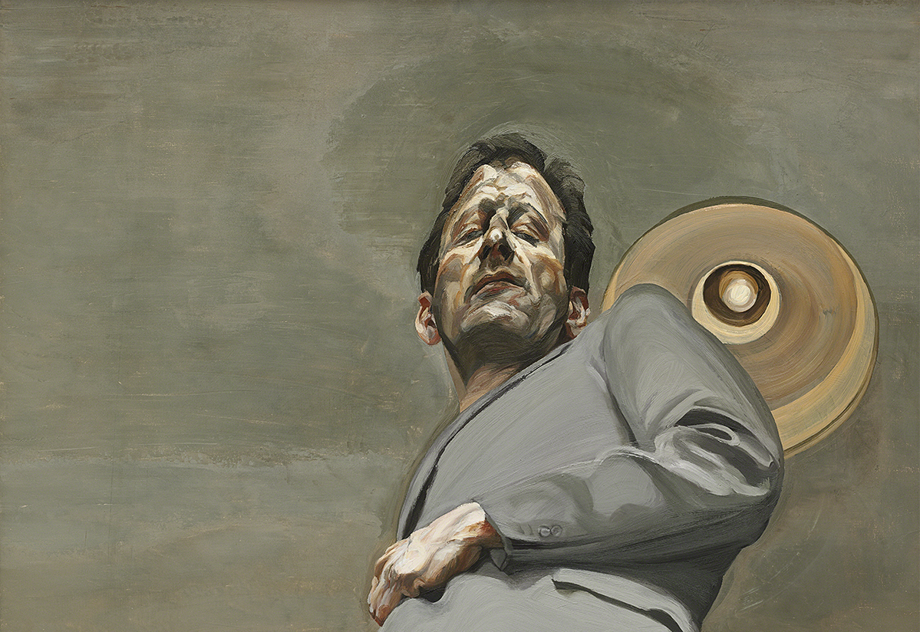
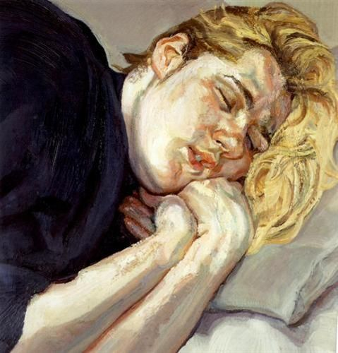
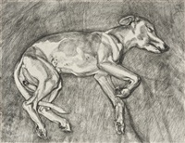
Lucien Freud
Lucien Freud Self portrait
Susie 1988 Oil
Lucian Freud,Interior with Hand Mirror (Self-Portrait), 1967.
Lucian Freud was one of the major figurative painters of the 20th century. Working in an uncompromisingly confrontational style, his portraits and nudes were rendered with a thickly laden brush. Often painting himself, as well as family and friends his works are imbued with a distinctive psychological space. Painted under intense direct observation, usually over the course of many sittings, Freud observed of his practice: “The longer you look at an object, the more abstract it becomes and, ironically, the more real.”
Eli, 2002
https://www.royalacademy.org.uk/article/lucian-freud-five-self-portraits-martin-gayford

Slide 7
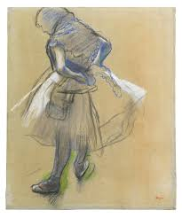
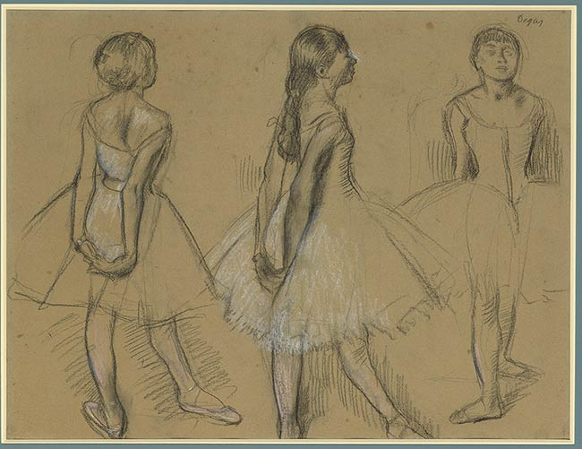
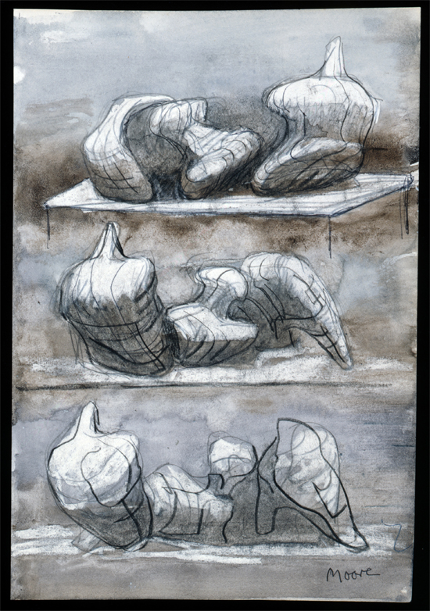
TASK 2
Artists practise plotting out their compositions through a series of sketches. It is an excellent way to work out correct sizes, proportion, perspective for a finished composition. Sometimes the sketches become more interesting than the final piece of work.
1/ Select a few of your most challenging photographs from Week 1’s Photography Challenge. You could have them displayed on your phone or print them out.
2/ Create initial sketches of your most challenging viewpoints across a page. Don’t worry if they don’t look perfect, choose an angle you’ve never drawn from.
Materials: Pencil & Pen.
Washes of watercolour or coffee could be added in and around your sketches if you wish.
Approx. 1 hour
Edgar Degas
Studies of dancers
Henry Moore
Three Reclining Figures 1975 HMF 75(8) watercolour wash, charcoal, chalk, gouache on blotting paper 263 x 217mm photo: The Henry Moore Foundation archive, Michel Muller

Slide 8
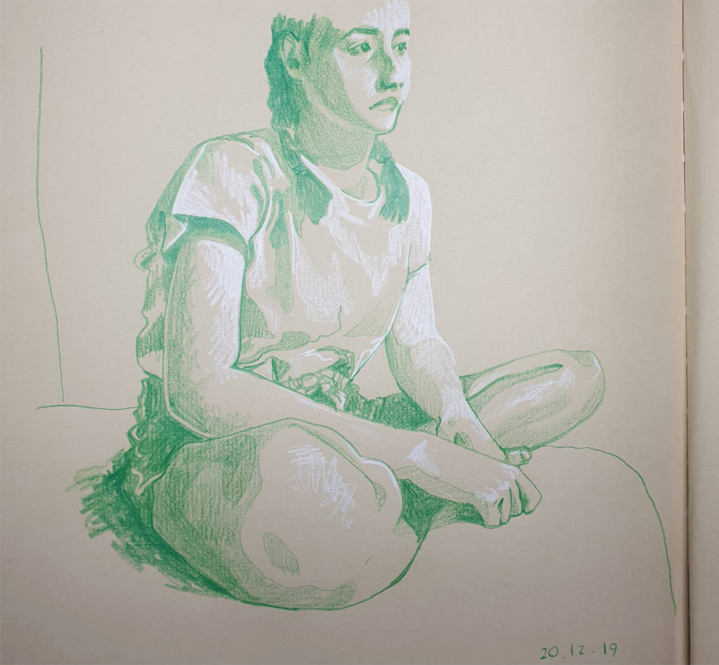
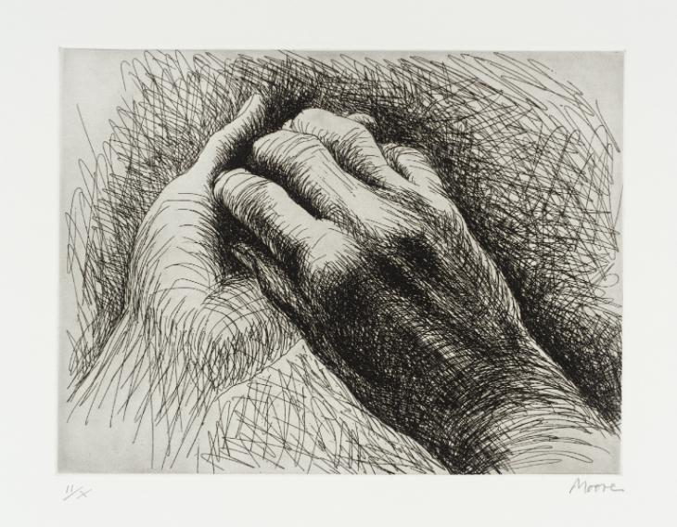
Task 3: Refine your sketches and adding depth Approx. 2 hours Now that you have created initial sketches and practised drawing your subject from a different angle, we would like you to refine one of your most successful sketches into a finished drawing. You can select the material you would like to use or you could try one of the suggested. Consider: 1/ Your surface ( paper, cardboard box (flattened or 3D), envelopes, piece of wood) 2/ Plotting out shape and proportion in pencil first. Be careful not to shorten proportions just to fit it onto your surface. 3/ Build up layers (watercolour, coffee washes, paint, white acrylic and biro, white pen, biro, pencil, colour pencil) 4/ Put some pencil or brush marks around the figure or object to ground it.

Slide 9
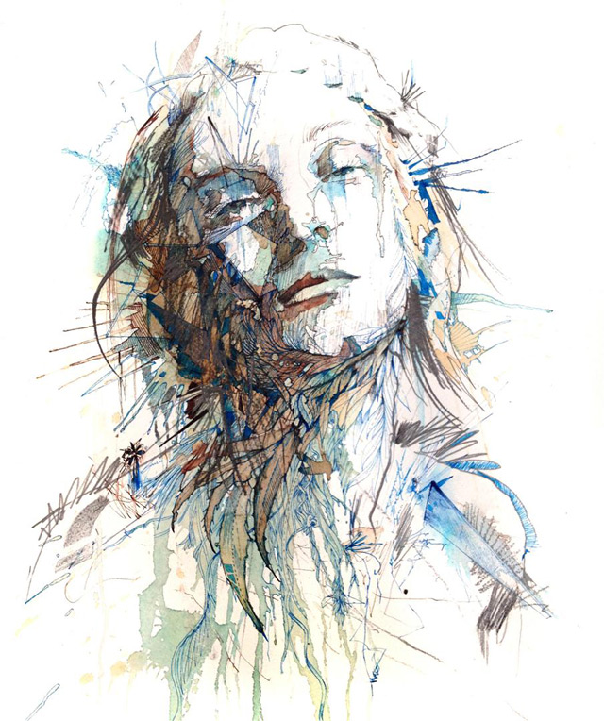
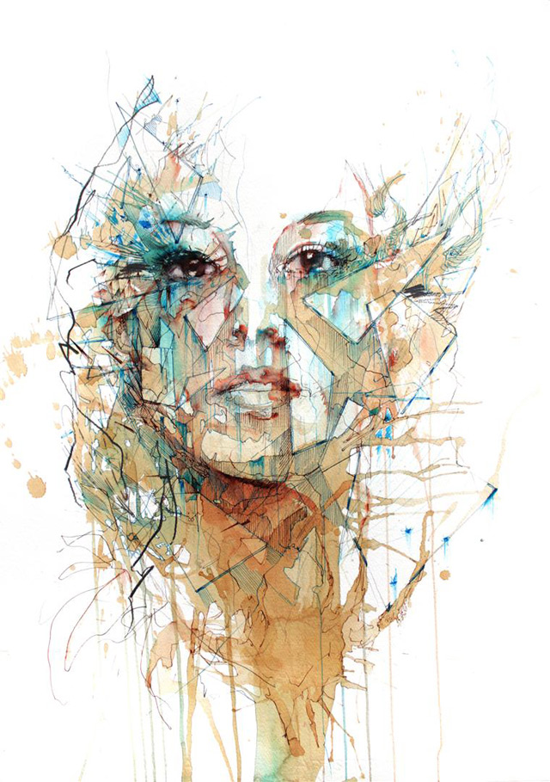
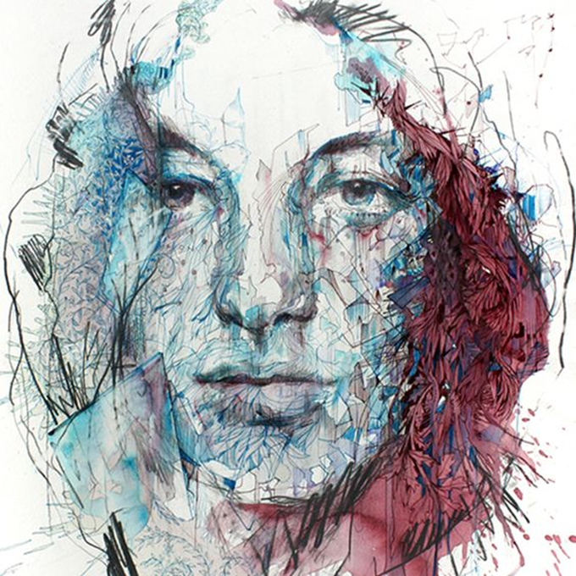
Task 4 Unconventional Materials
UK-based illustrator Carne Griffiths creates these striking portraits with uncommon mediums such as tea brandy, vodka, whiskey, graphite and calligraphy ink. His drawings most frequently explore human and floral forms, as says he’s “fascinated by the flow of line and the ‘invisible lines’ that connect us to the natural world.”
This is colossal.com

Slide 10
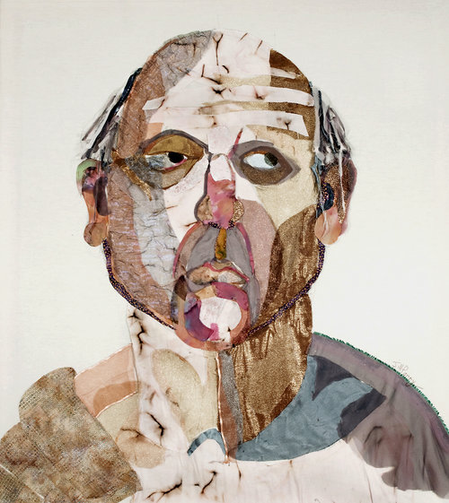
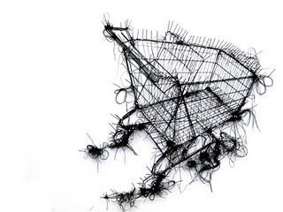
Task 4 Unconventional Materials
FIBER PORTRAITS by jill parry
In my fiber portraits I use fiber to further my development of portraiture. I am interested in exploring the surface qualities created by the fibers and utilizing the characteristics of the fabrics to create a painterly effect. Fibers are torn, cut, fused and sewn into the canvas surface.
Debbie Smyth – drawing with thread

Slide 11
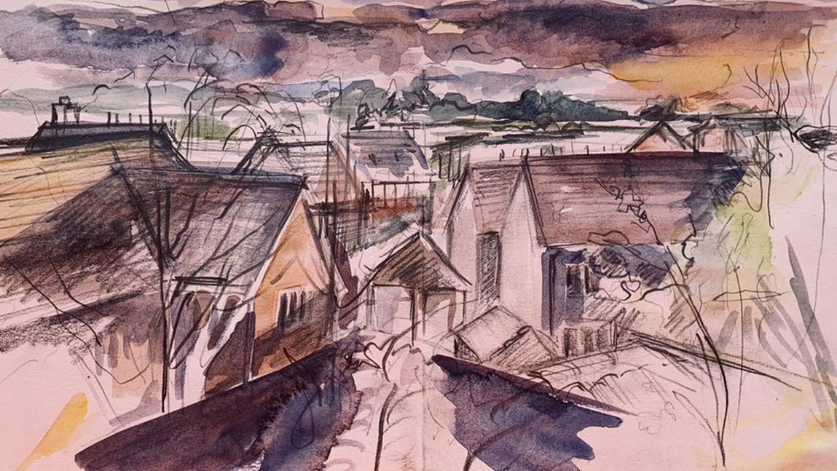
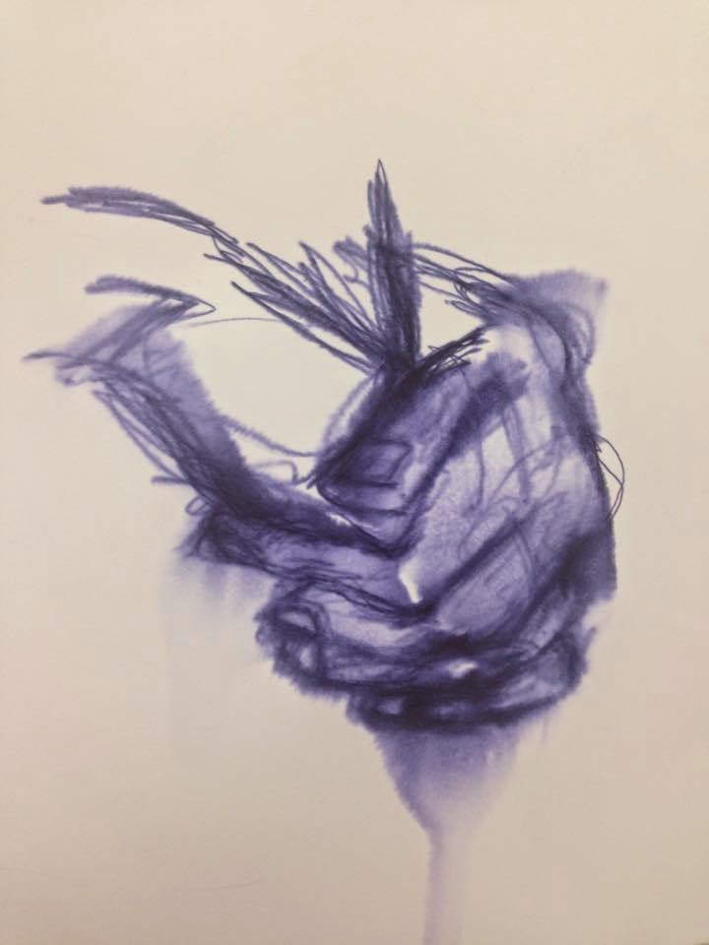
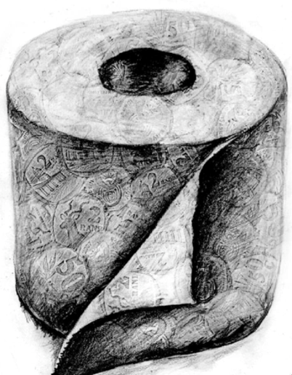
Task 4 Drawing with unconventional materials.
For this task you could work from one of your photographs or an object around you. Create 2-3 studies using some of the suggested materials. If you don’t have any of the listed materials, swap them for materials you do have. The most important thing is to practise your recording skills.
Suggested Materials
Tumeric Paste & Water
https://www.youtube.com/watch?v=b9Ff6lOVZFw
Coffee & beetroot juice with biro pen.
Chalk/ Chalk Pastel & Water
Biro and hairspray

Slide 12
Look Out For
ART COMPETITION FROM THE NEWBRIDGE PROJECT
It's great to see so many young people getting creative during #lockdown - i've been tagged into so many wonderful things across various channels. If you're a young person who has been getting creative during this period or know someone who has; don't forget the call out for Takeover Open Exhibition in association with The NewBridge Project is still open! If you're a young artist or creative - or know someone who fits that bill - this may be of interest!
This exhibition will form an important part of The Takeover; an annual week-long arts festival at Customs House that is produced by, with and for young people to develop and showcase their leadership skills. The festival is led, planned, marketed, delivered and evaluated by our Takeover Team, a group of 12-18 year olds.
They are open to paintings, prints, graphic design, typography, 2D pieces, by young people in the region. Submission details are featured on the graphic below....
Learning & Participation at The Customs House
Best Art Gallery Virtual Tours
https://www.theguardian.com/travel/2020/mar/23/10-of-the-worlds-best-virtual-museum-and-art-gallery-tours
Virtual Tours coming soon at
https://greatnorthmuseum.org.uk/ The Great North Museum & The Hancock gallery.
National Portrait Gallery
https://www.npg.org.uk/whatson/exhibitions/2001/mirror-mirror-self-portraits-by-women-artists/virtual-tour.php
https://npg.si.edu/home/national-portrait-gallery
Smithsonian, Washington, USA

