Slide 1
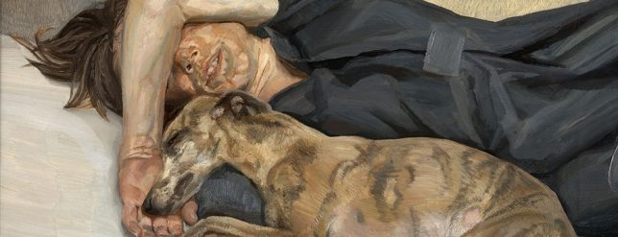
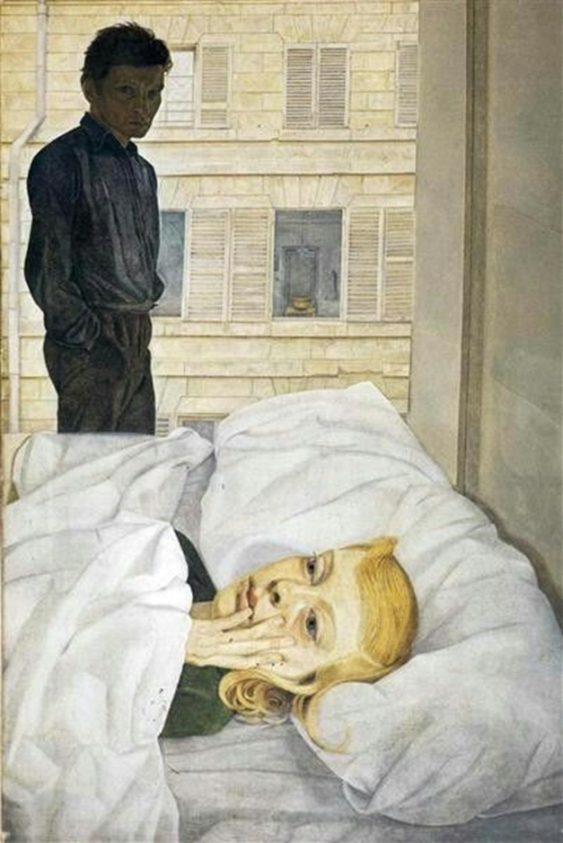
Recap
What decisions has Lucien Freud made about his compositions?
And what messages do they portray to the viewer?

Slide 2
Recap
Hotel Bedroom, 1954, shows Lucien Freud with Caroline Blackwood, the newly-weds not enjoying their poky, shared accommodation in the Hotel La Louisiane, rue de Seine, she shivering in bed, he standing over her, his darkening presence transposed from the image he studied in the bevelled mirror on an unseen wardrobe door. Caroline complained about being made to look older than she was, but the bitten nails and the little finger lodged on her lower lip are telling. The marriage was soon over.
The angle Freud has painted from makes the viewer feel like they are in the room standing over the models.
The natural light from the window creates highlight.
You get the impression the subjects are a little fed up!

Slide 3
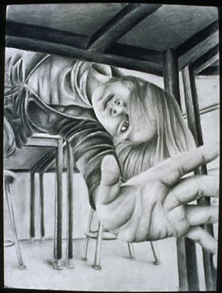
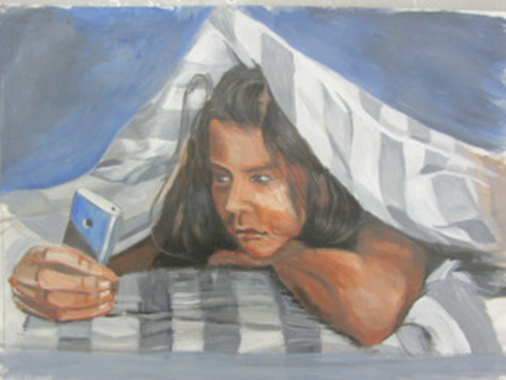
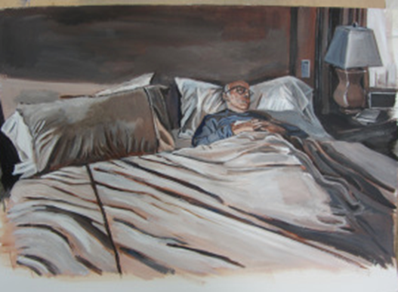
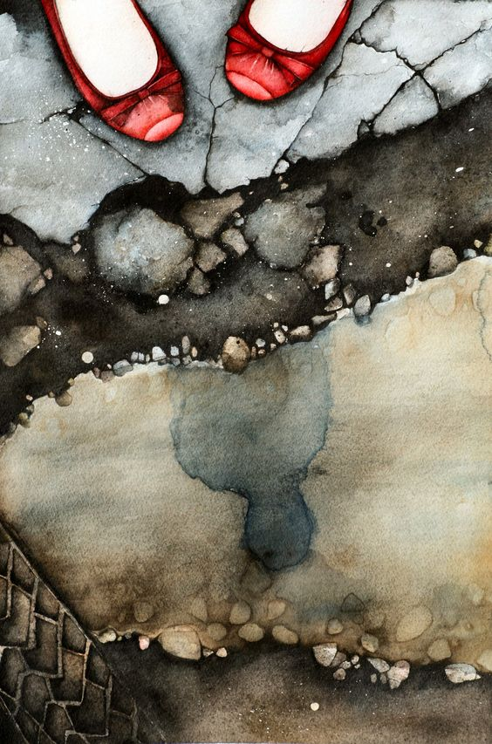
Week 3 FINE ART Outline
This week you will analyse the work of artists/photographers and craftspeople who are responding to a similar theme . You will continue to consider audience when talking about artwork and planning your work. You will think about the many ways in which curators display work and perhaps consider them for your own work. You will make a personal response to your chosen artist’s work and begin to plan a final outcome.

Slide 4
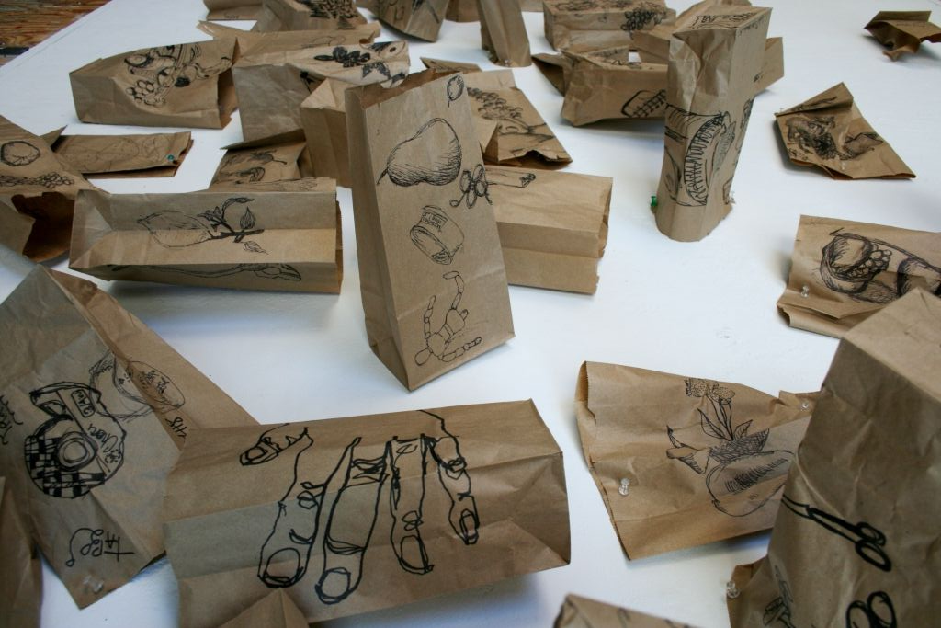
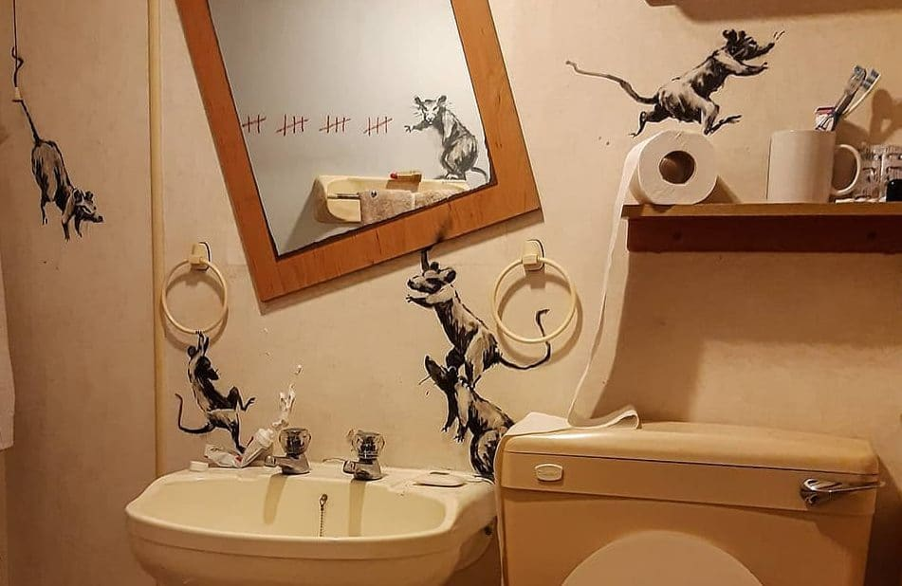
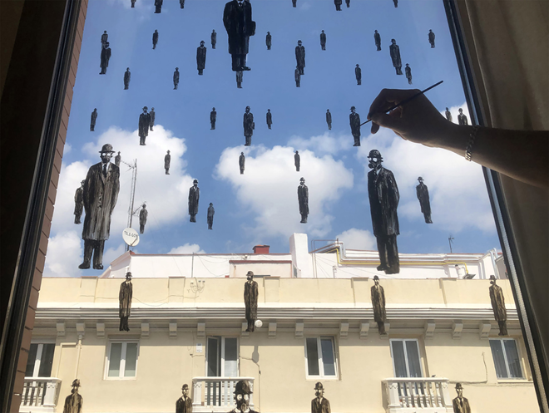
What is Fine Art?
https://www.youtube.com/watch?v=sIsN9_TsQgI
It is so much bigger than we think!

Slide 5
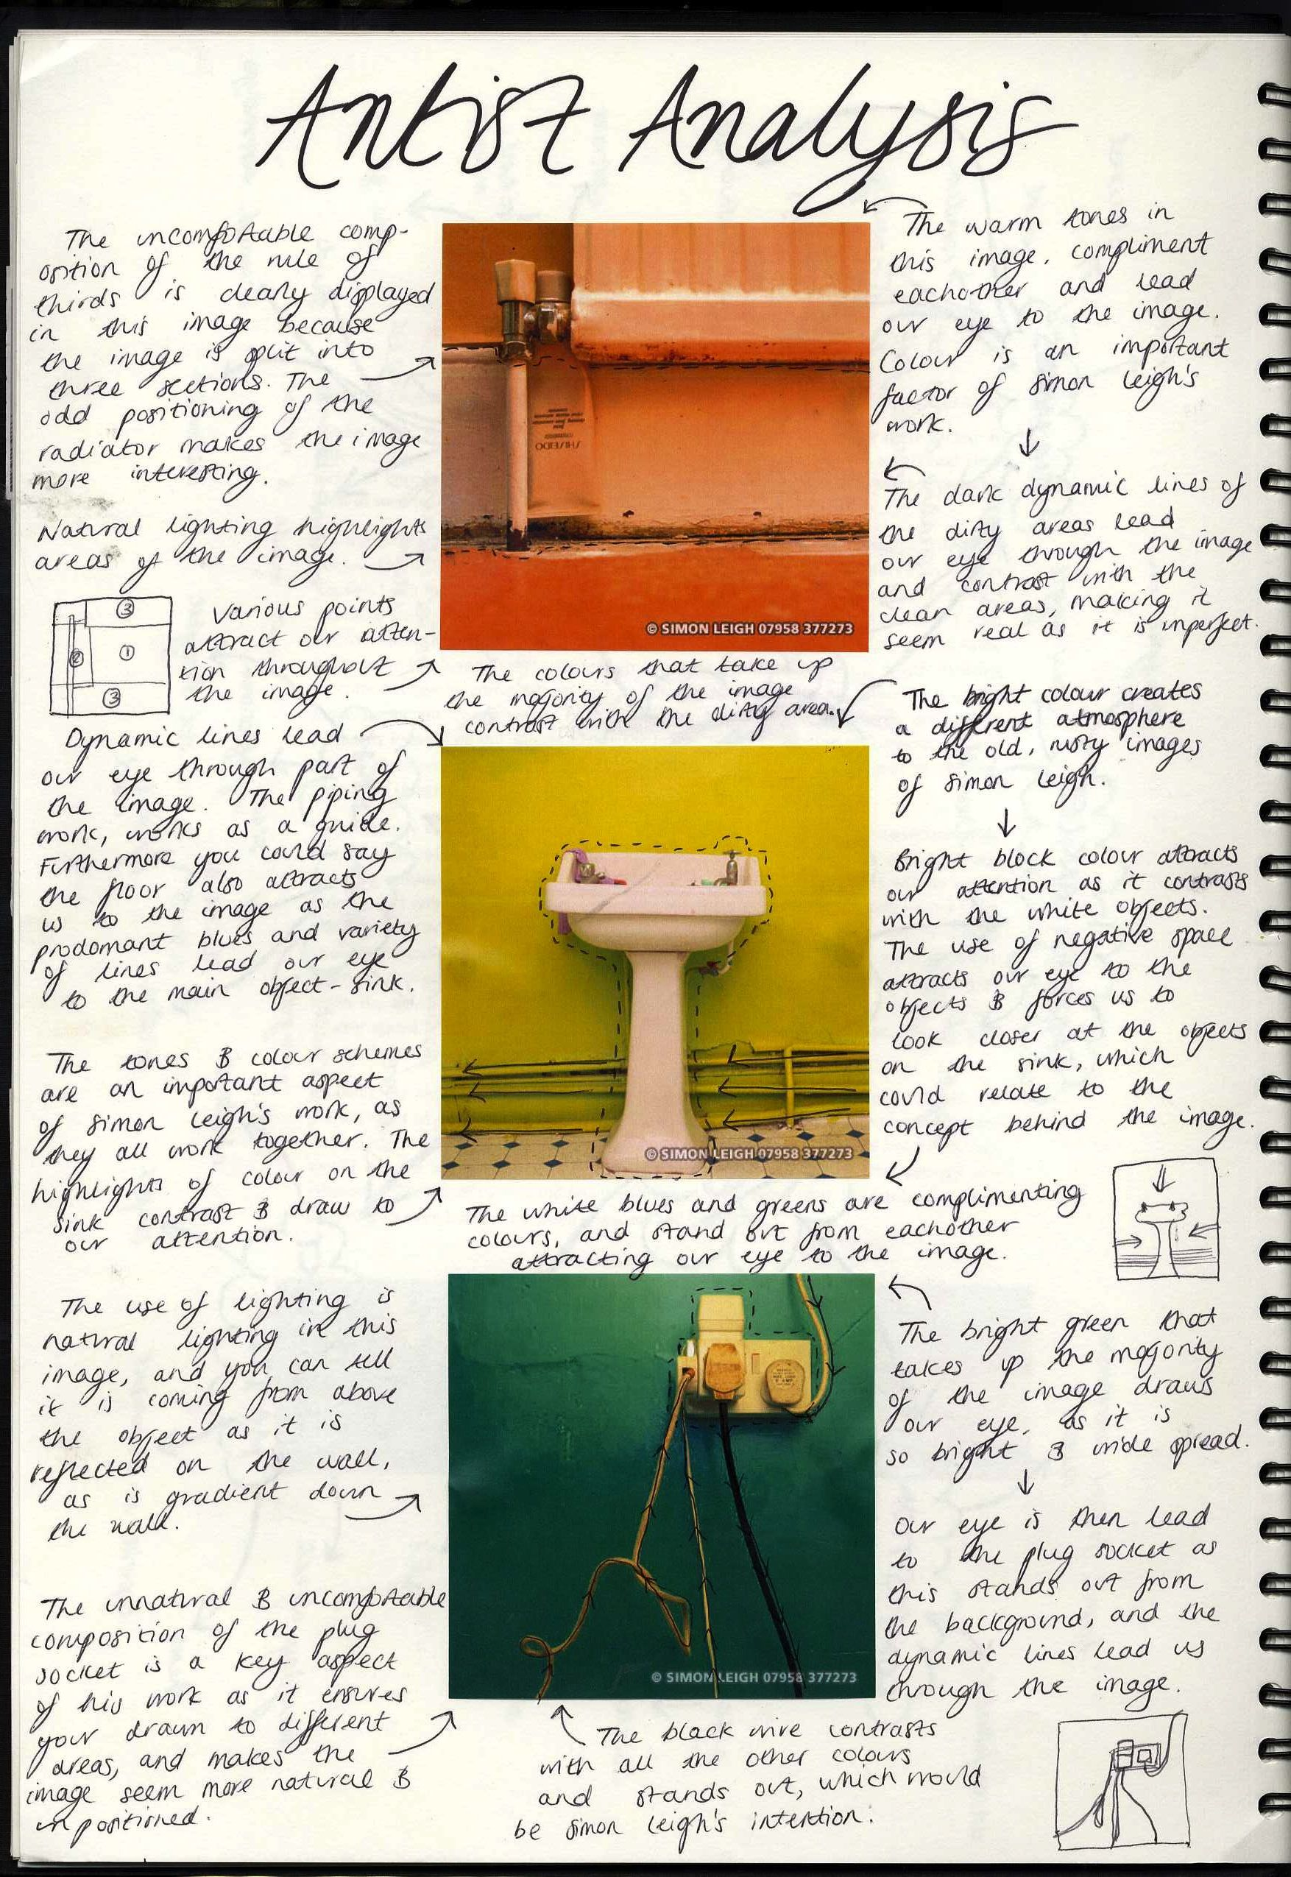
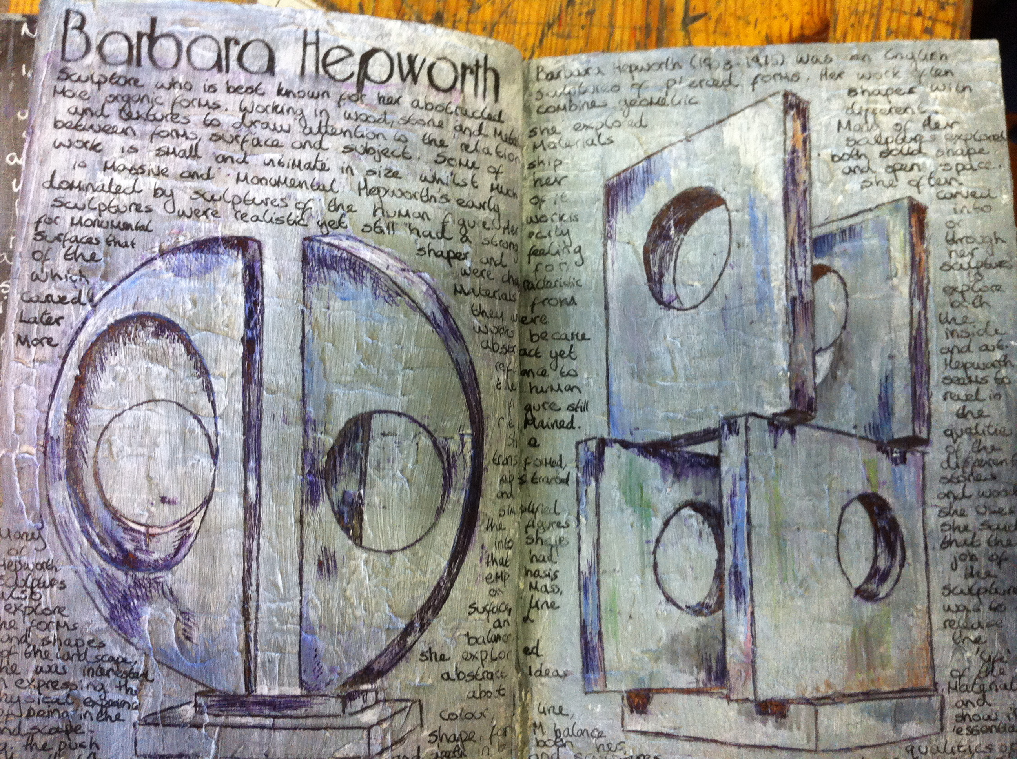
Task 1
Select one of the artists from the following slides or find your own who respond to the theme ISOLATION.
Carry out extra reading about your chosen artists. Finding interviews with your chosen artist is always useful to have.
Use the next slide to write an analysis of your chosen artist’s work. You could type up your analysis or handwrite it.
If you have access to a printer you could print out images of the artist’s work.

Slide 6
WRITING ABOUT ARTISTS
Who is the artist?
Where are they from?
When were they making their artwork?
Are they a contemporary artist?
Are the associated with any particular art movement?
Are they linked with other artist?
Why are you looking at this artist? Why does this interest you? What do you think?
How do they relate to your theme?
How do they relate to your work?
What materials, techniques/ processes do they use?
How do they use them?
Remember always to include the name of the artwork, the date it was made and the materials used.
Lines, tones, textures, colours, shapes, marks, composition, quality of light, viewpoint, composition, scale, proportion, movement.
Meaning & Mood
Message What do you think the work is about? How does it make you feel? What is the mood? Calm, sad, happy, confused? Does the work mean many things to you? What are they? What does the work remind you of? Does it link with other images, objects you have seen? What is the artist trying to say through their work? Is there a message?

Slide 7
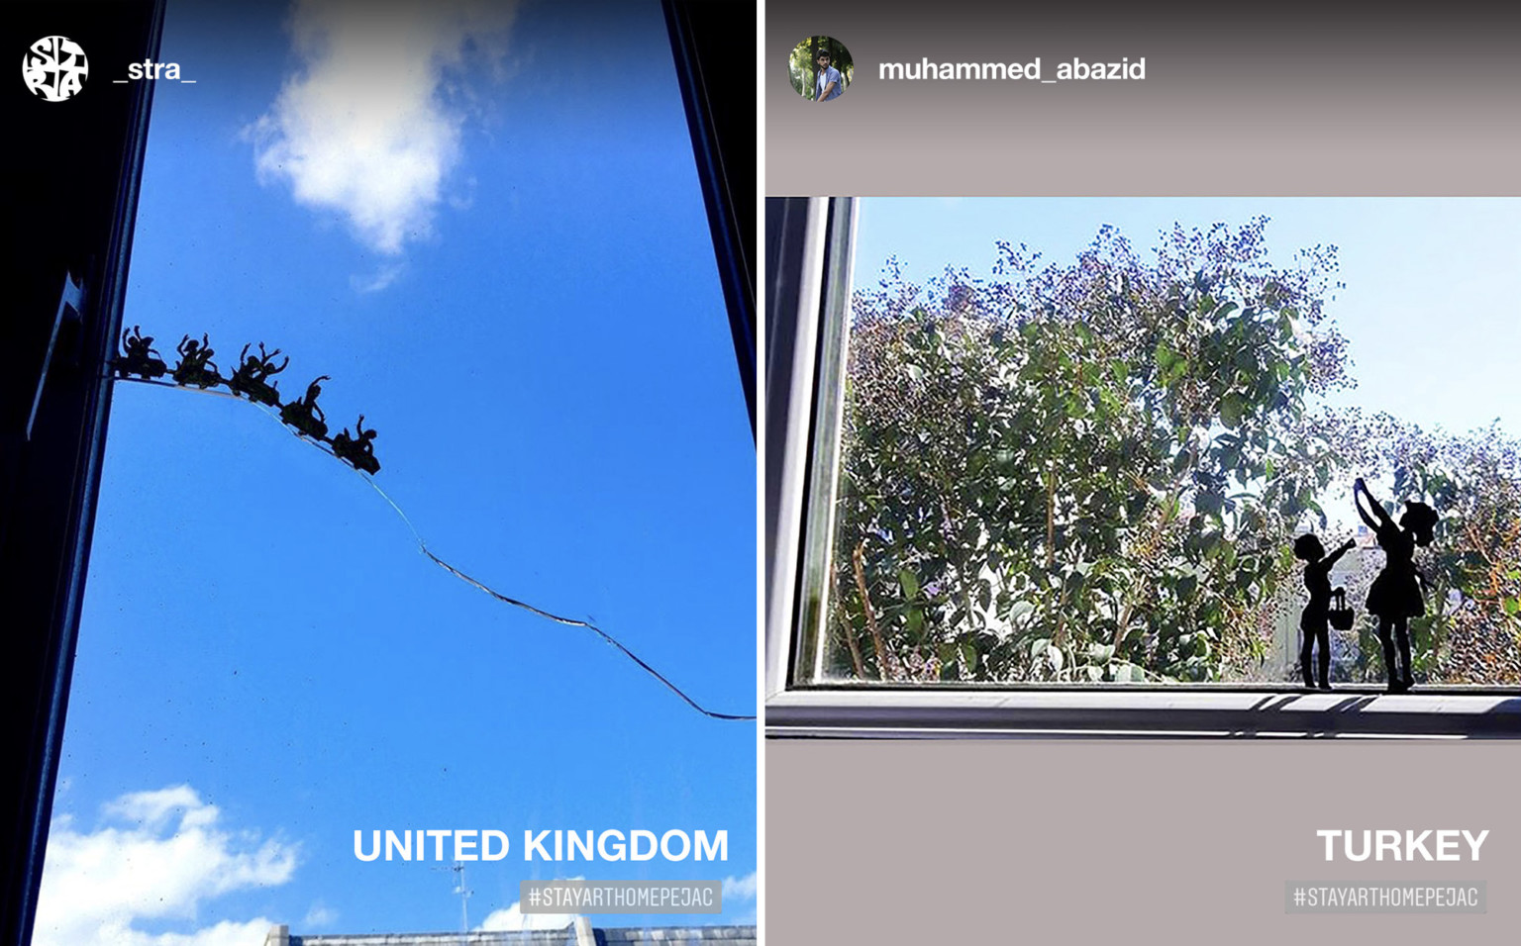
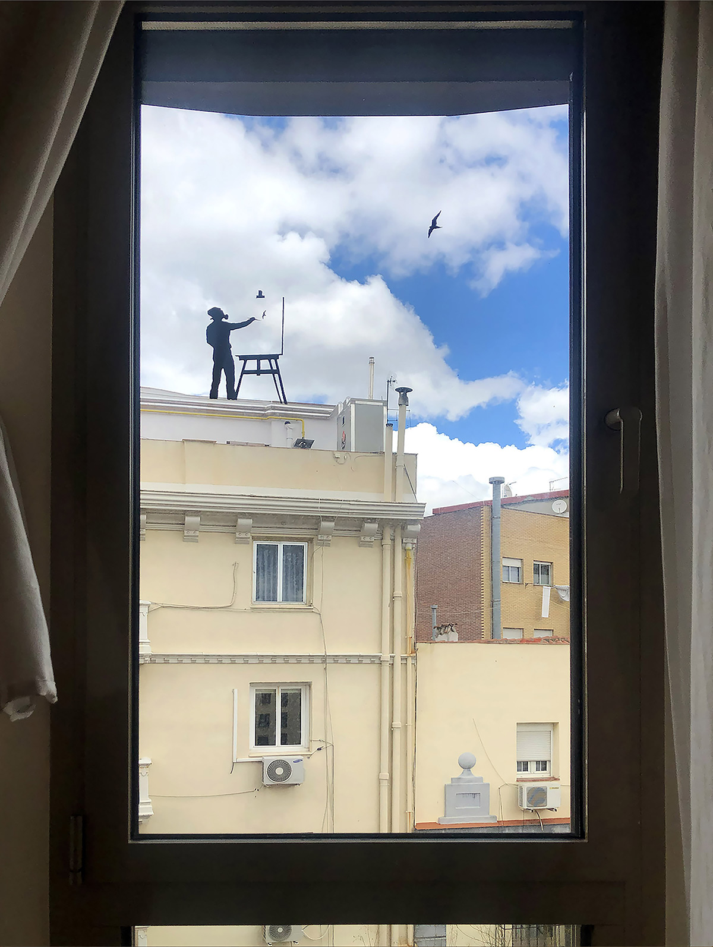
PEJAC STAY AT HOME
The burgeoning initiative is an attempt to inspire interaction with urban environments from indoors, while also providing a creative and collaborative public art initiative. “I always believed that everyone has an artist hidden inside and that if you give them a good reason they are capable of doing wonderful things, and in these strange days of global lockdown, I believe that creativity can be one of the best therapies to fight anxiety and boredom,” says the artist, who’s been positioning figures atop airplane contrails and telephone poles since 2011.
https://www.thisiscolossal.com/2020/04/pejac-window-silhouettes/

Slide 8
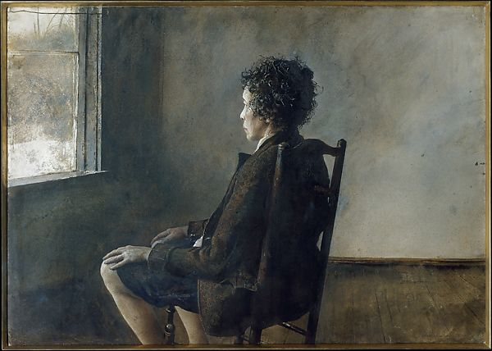
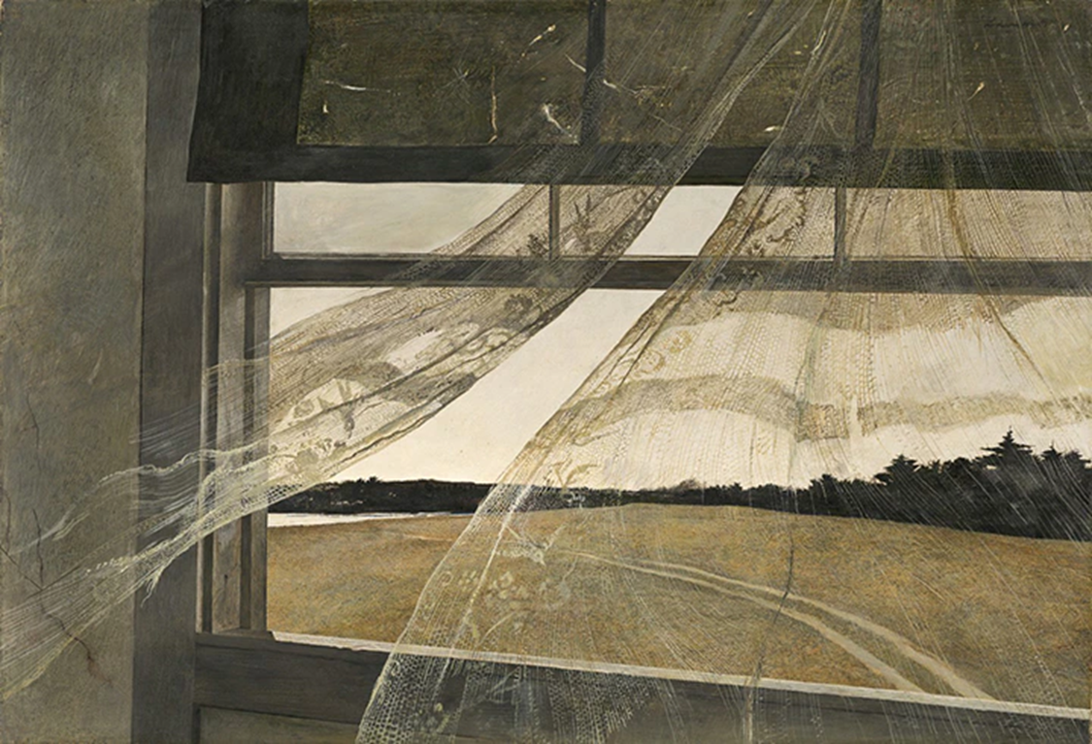
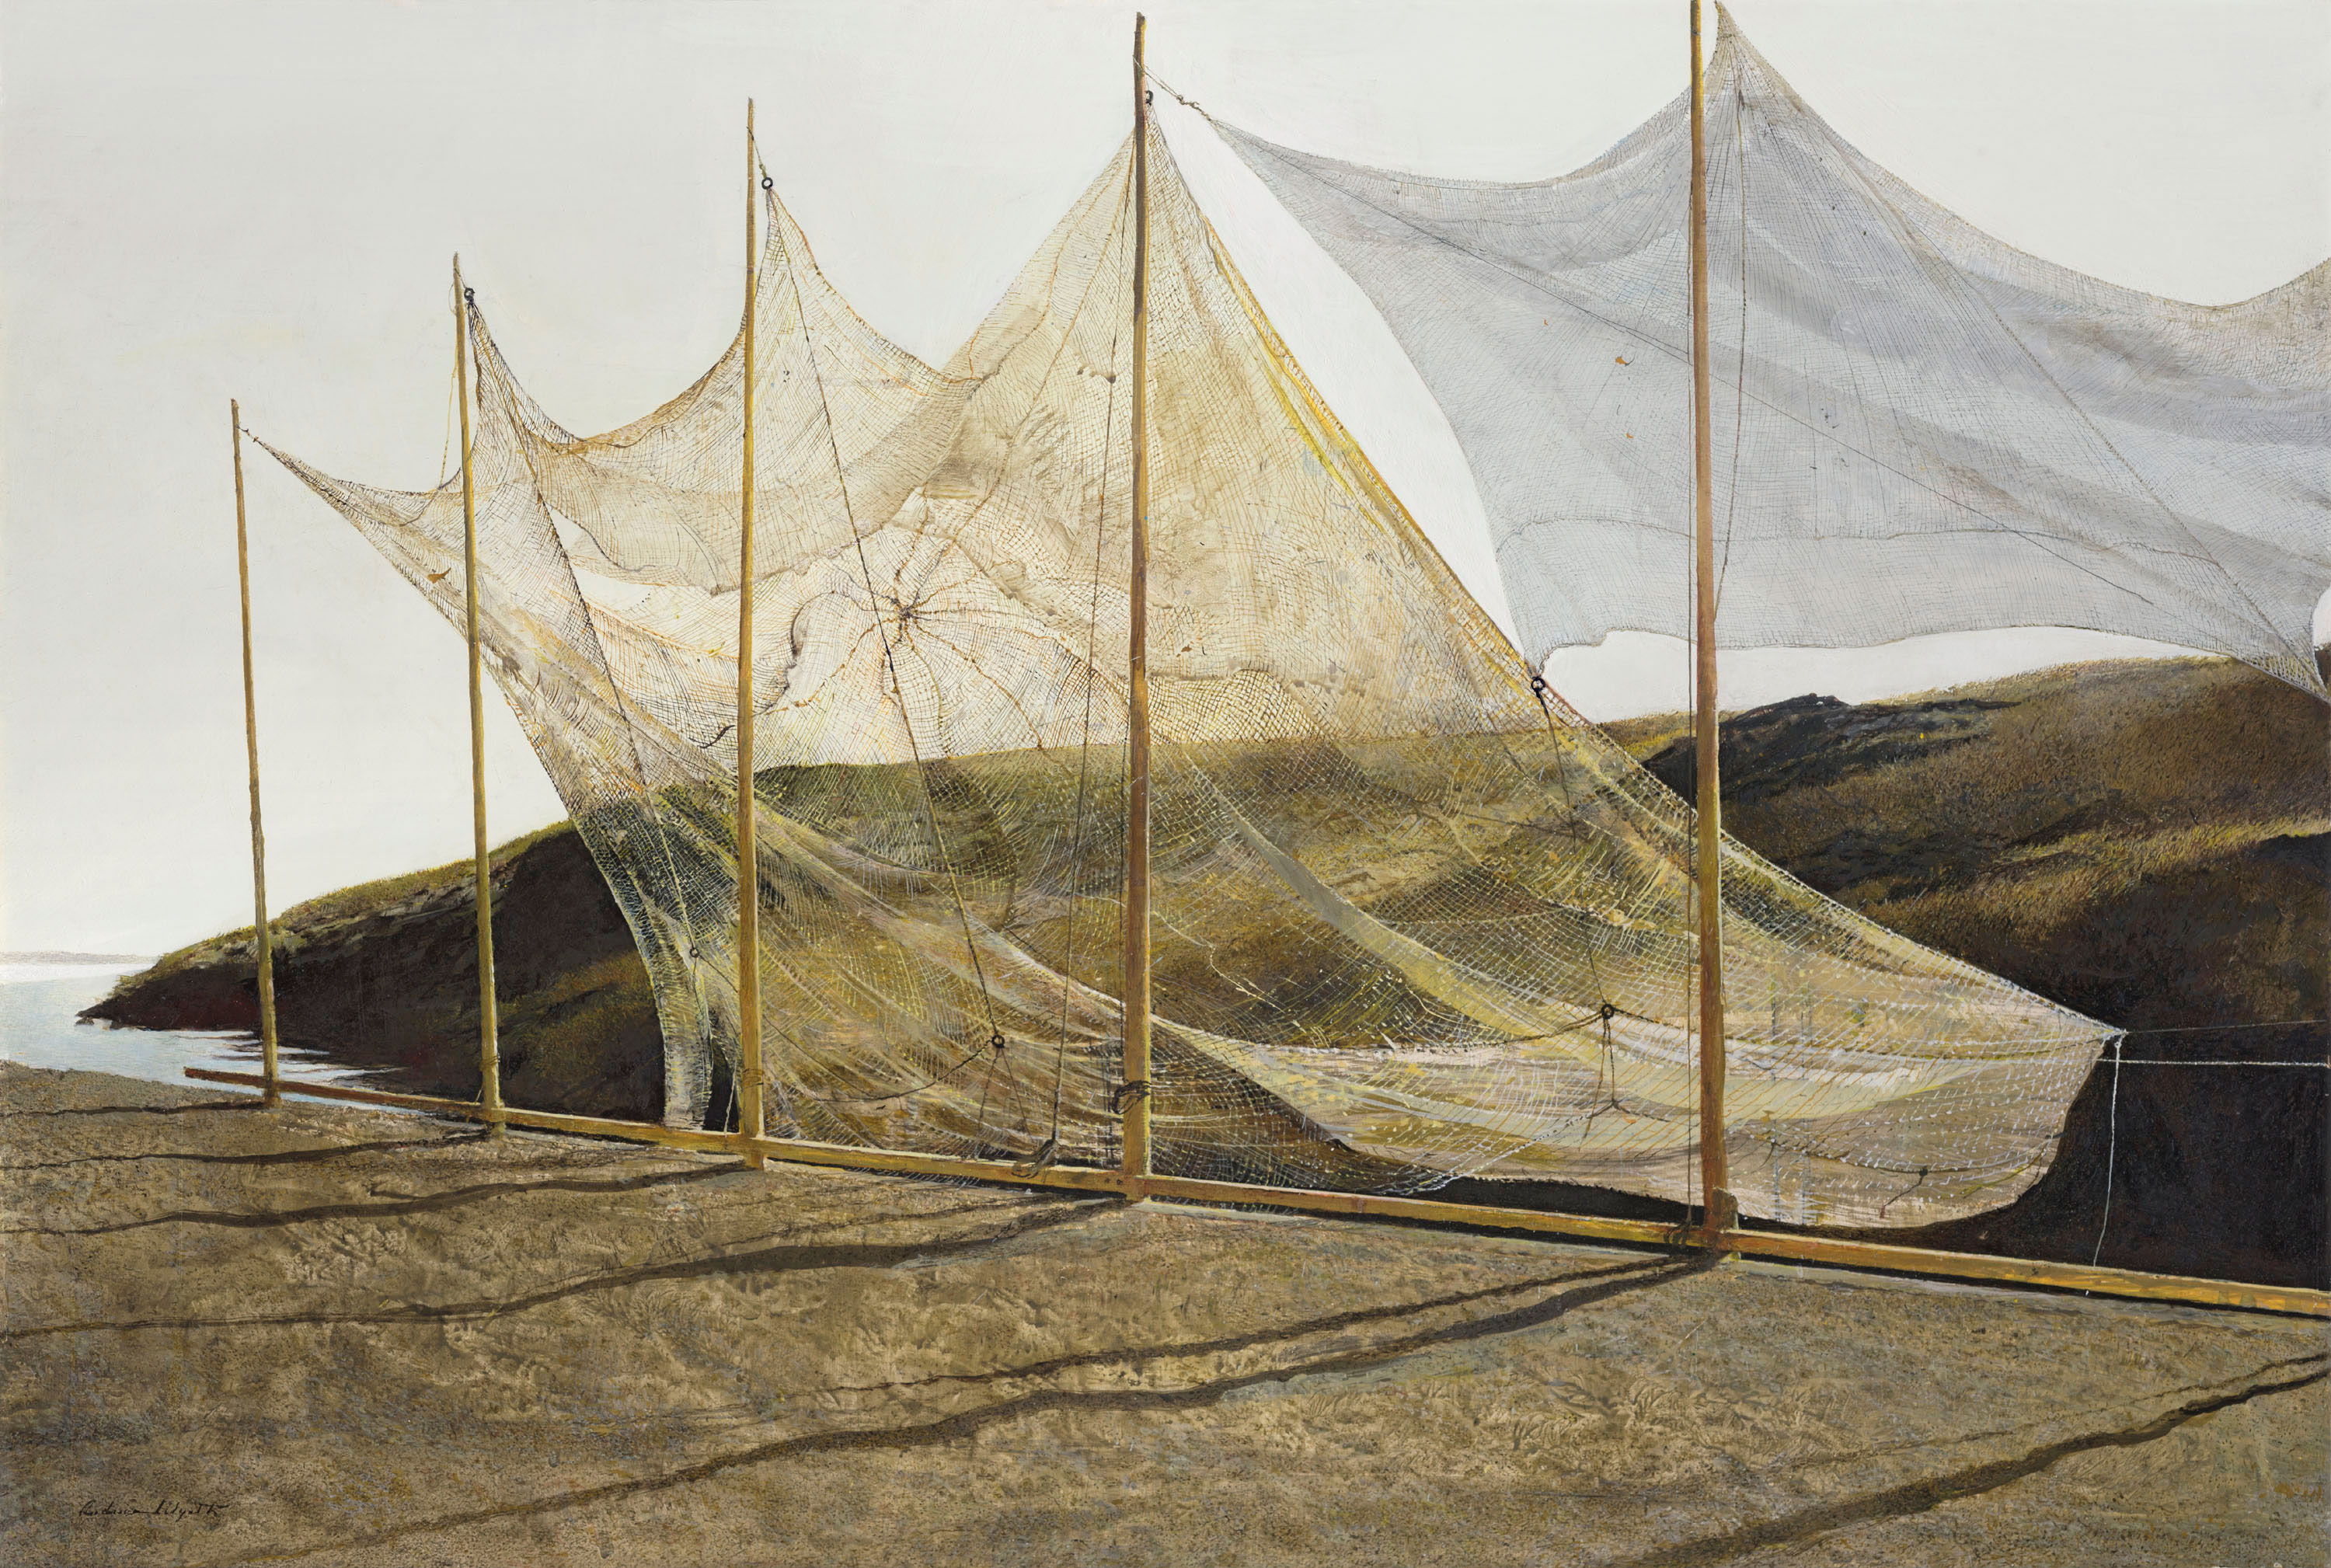

Slide 9
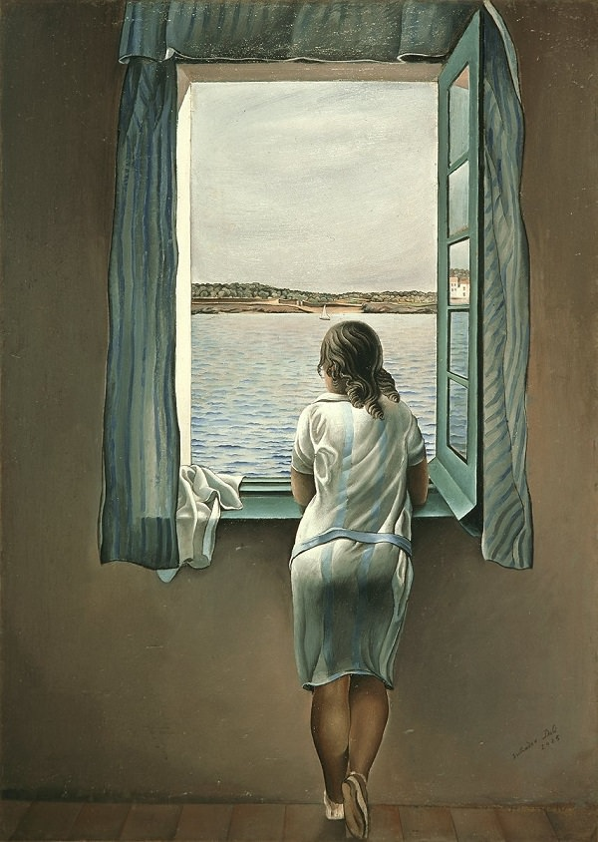
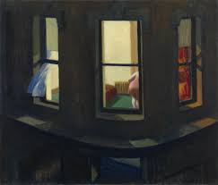
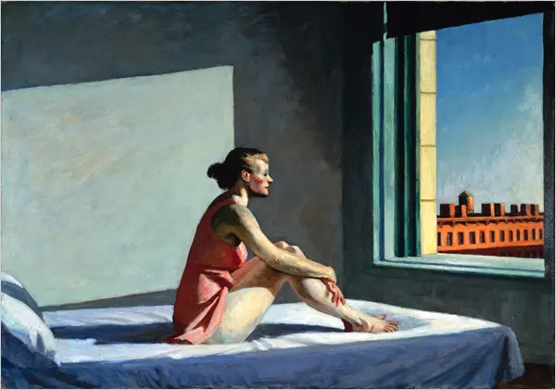
Artists Using Windows
Edward Hopper
1928
Night Windows
Classic Salvador Dali – Figure at the Window

Slide 10
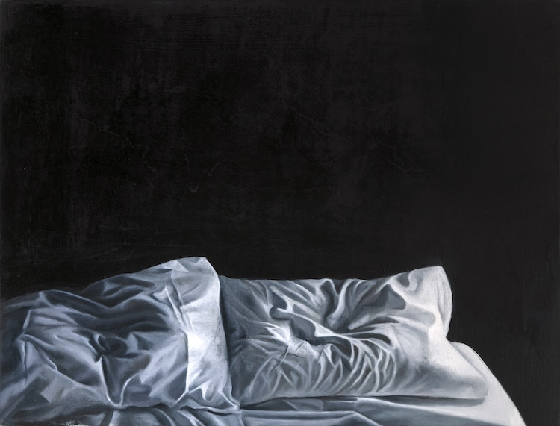
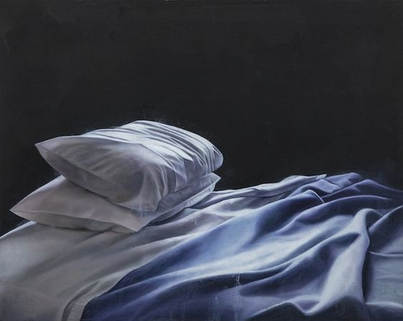
Stephanie Serpick
When you’re feeling down, sometimes the only place you want to be is in your own bed. Even if you aren’t sleeping, there’s something comforting and restorative about spending time wrapped up in bed sheets, hidden from the world. Artist Stephanie Serpick’s photorealistic oil paintings of empty, unmade beds are a personal expression of her own grief, depression, and isolation.
“The work speaks to our shared feeling of grief, with the understanding that while we all suffer in our individual ways, suffering is universal.”

Slide 11
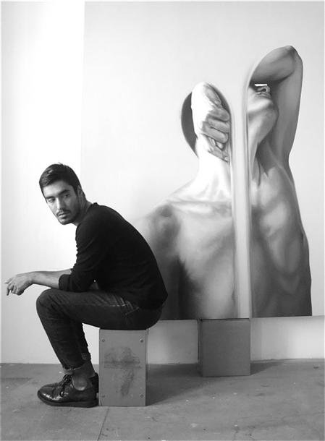
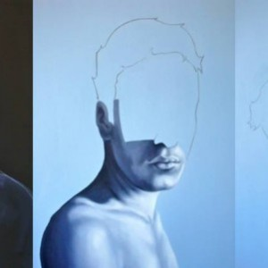
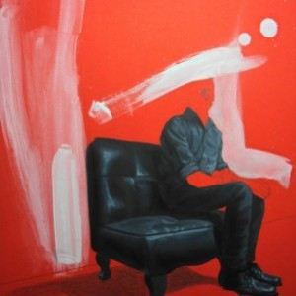
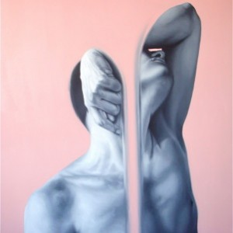
EDUARDO MATA ICAZA
Eduardo’s work looks for the essence of the human being, its inherent characteristics of existence, as well as the contrasts of life. He plays with light and shadows, black and white, as well as finished and unfinished compositions, as a means of exploring the game between life, death, all or nothing, being or not being.

Slide 12
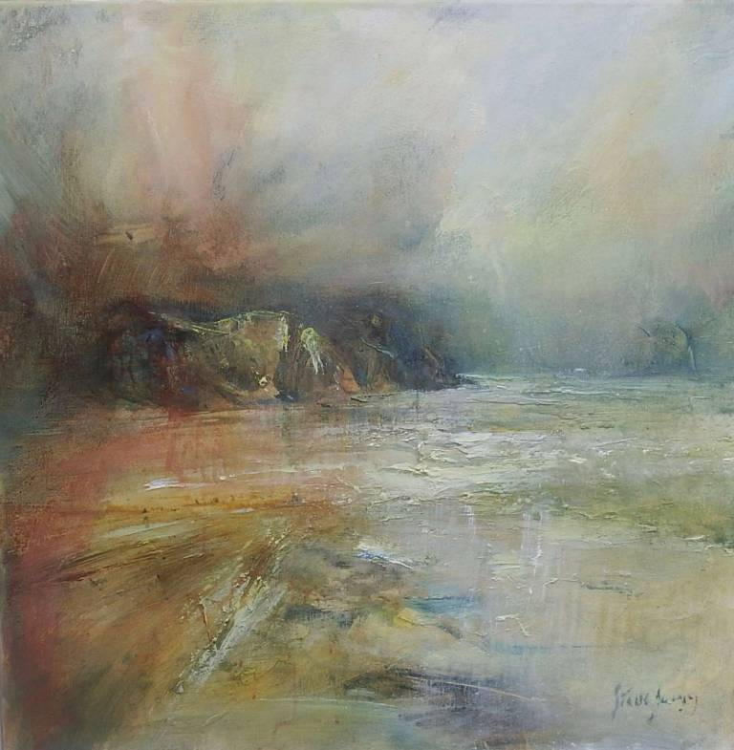
Steve Slimm is from The Black Country in West Midlands. He later lived in the Cotswolds and attended Cheltenham Grammar School. Moving to Cornwall, in 1970, he joined an art group under John Miller for a brief period. Painting began to feature as a main interest in his life, with periodic encouragement from John through the next two decades.
Steve has been producing and exhibiting paintings in Cornwall since 1979 and has developed his art along very personal lines that both absorb and transcend tradition. He has become recognised as a noteworthy Cornish landscape painter, especially for his use of light. For this reason he was featured in the national UK art a-level syllabus for 2009-2010.
Turner was an obvious influence during the early years. Many atmospheric watercolours found their way into collections worldwide. The Landscape of Cornwall remains the prime inspiration for his work which is now far from realism, with an emotional intensity that is self-evident. He now works mainly in mixed media - emulsions, acrylic and oils.

Slide 13
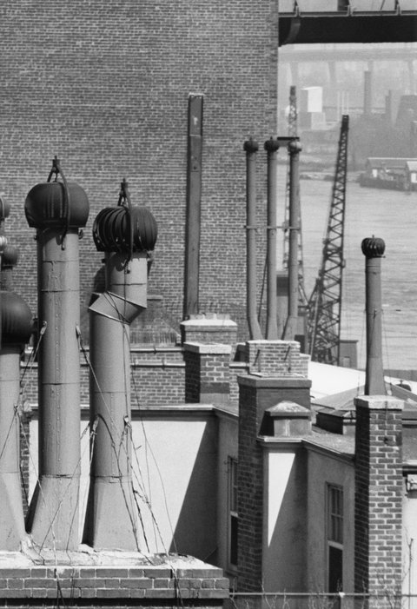
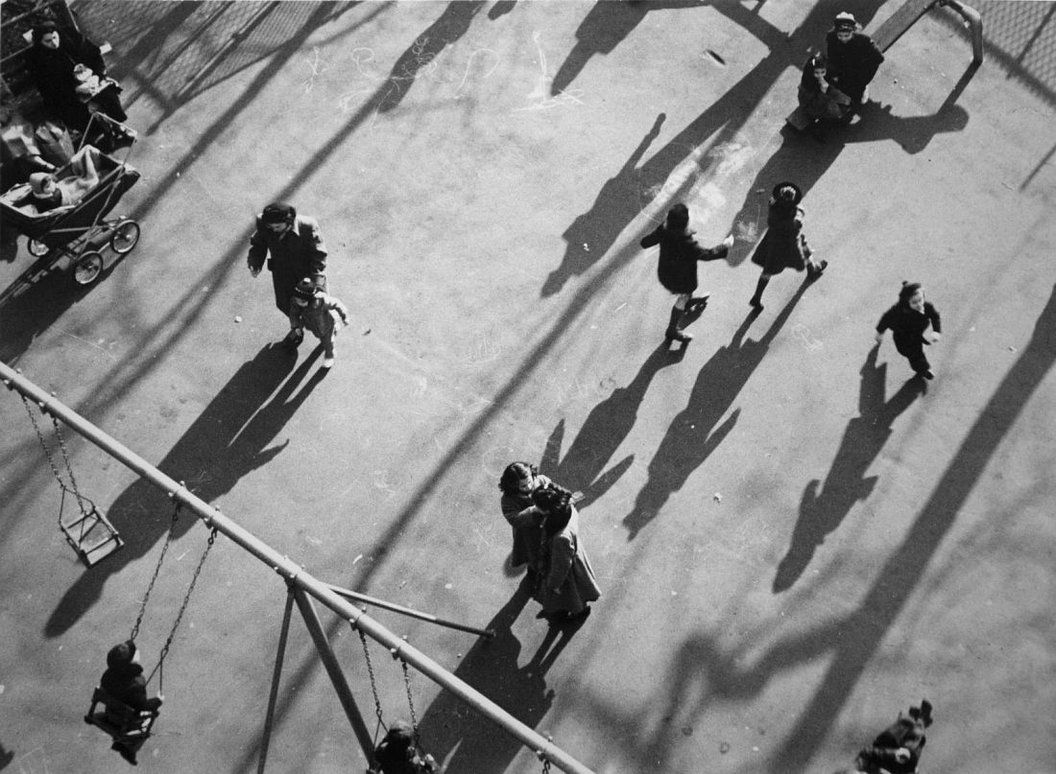
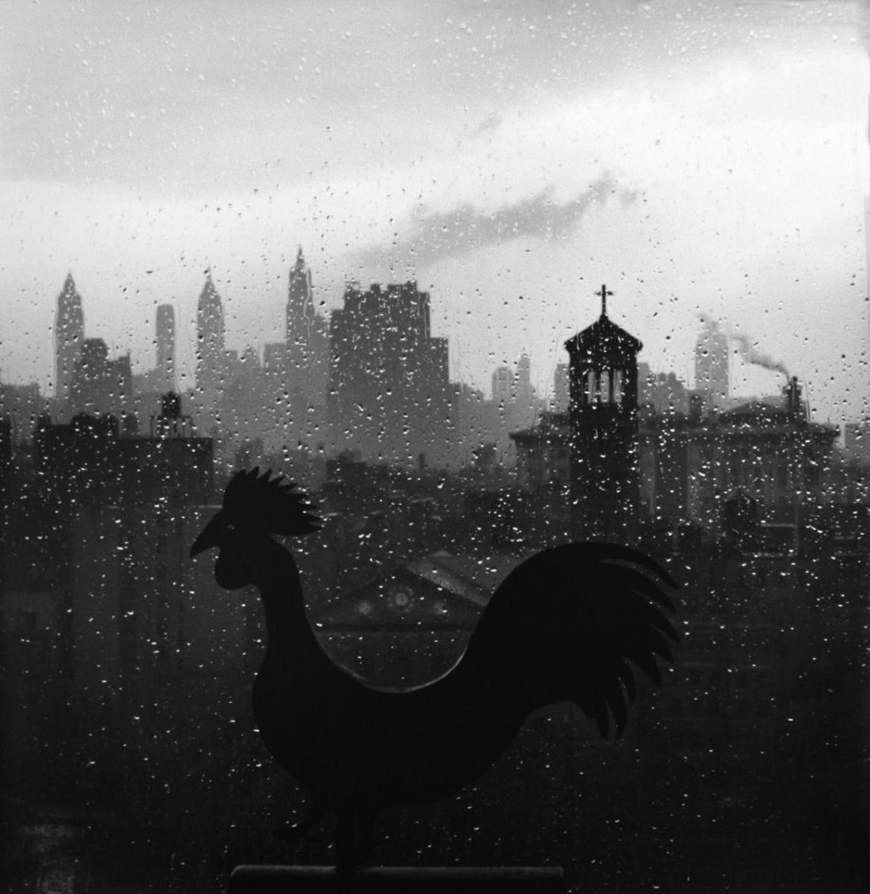
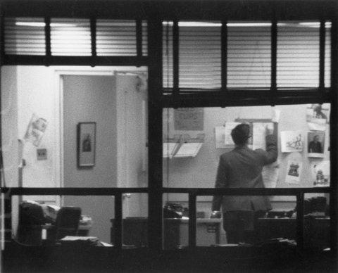
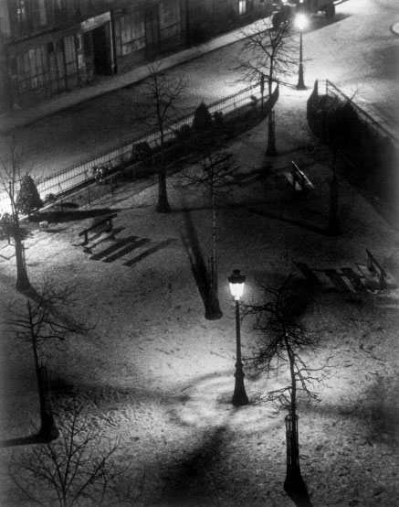
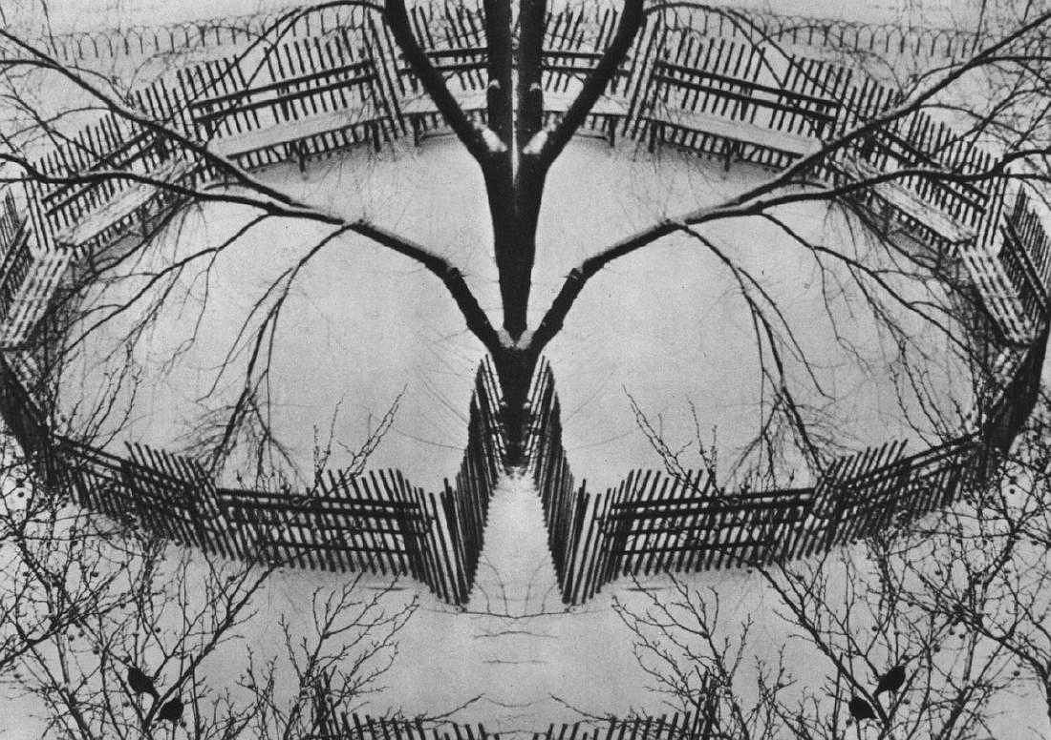
MASTERS OF PHOTOGRAPHY
Andre Kertesz BBC Master Photographers (1983)
Capturing the world around him, often photographing subjects from his window or front door.
The camera was a sketchbook to him. Shooting with the camera and making mistakes. Learning from each mistake.
André Kertész: Window Views

Slide 14
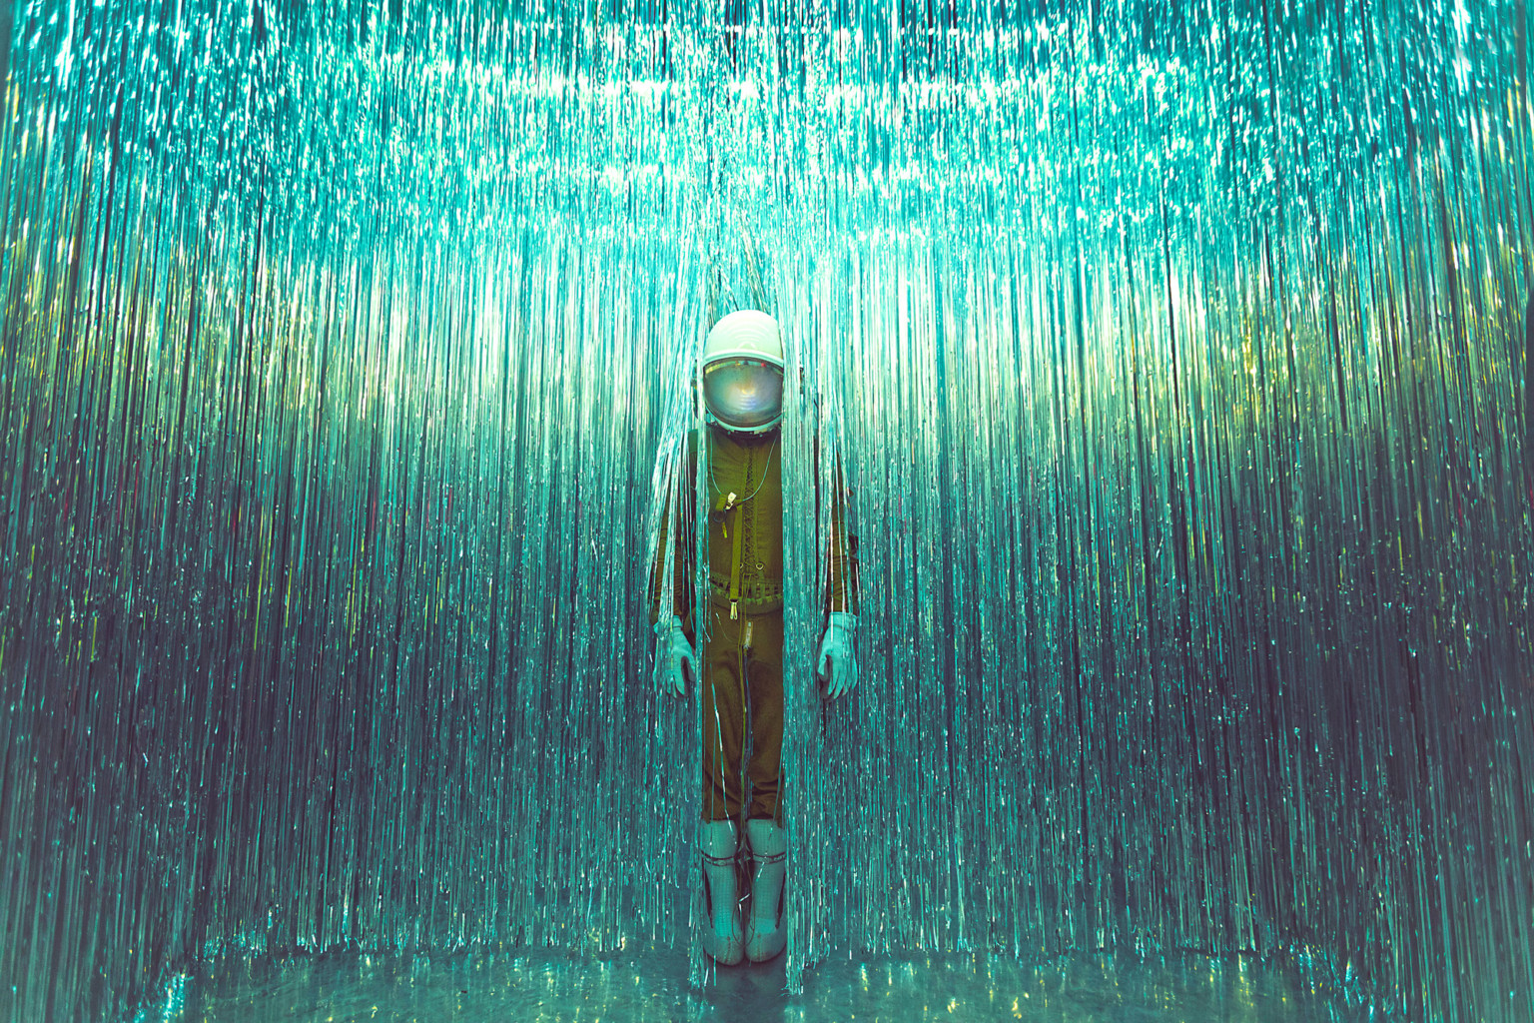
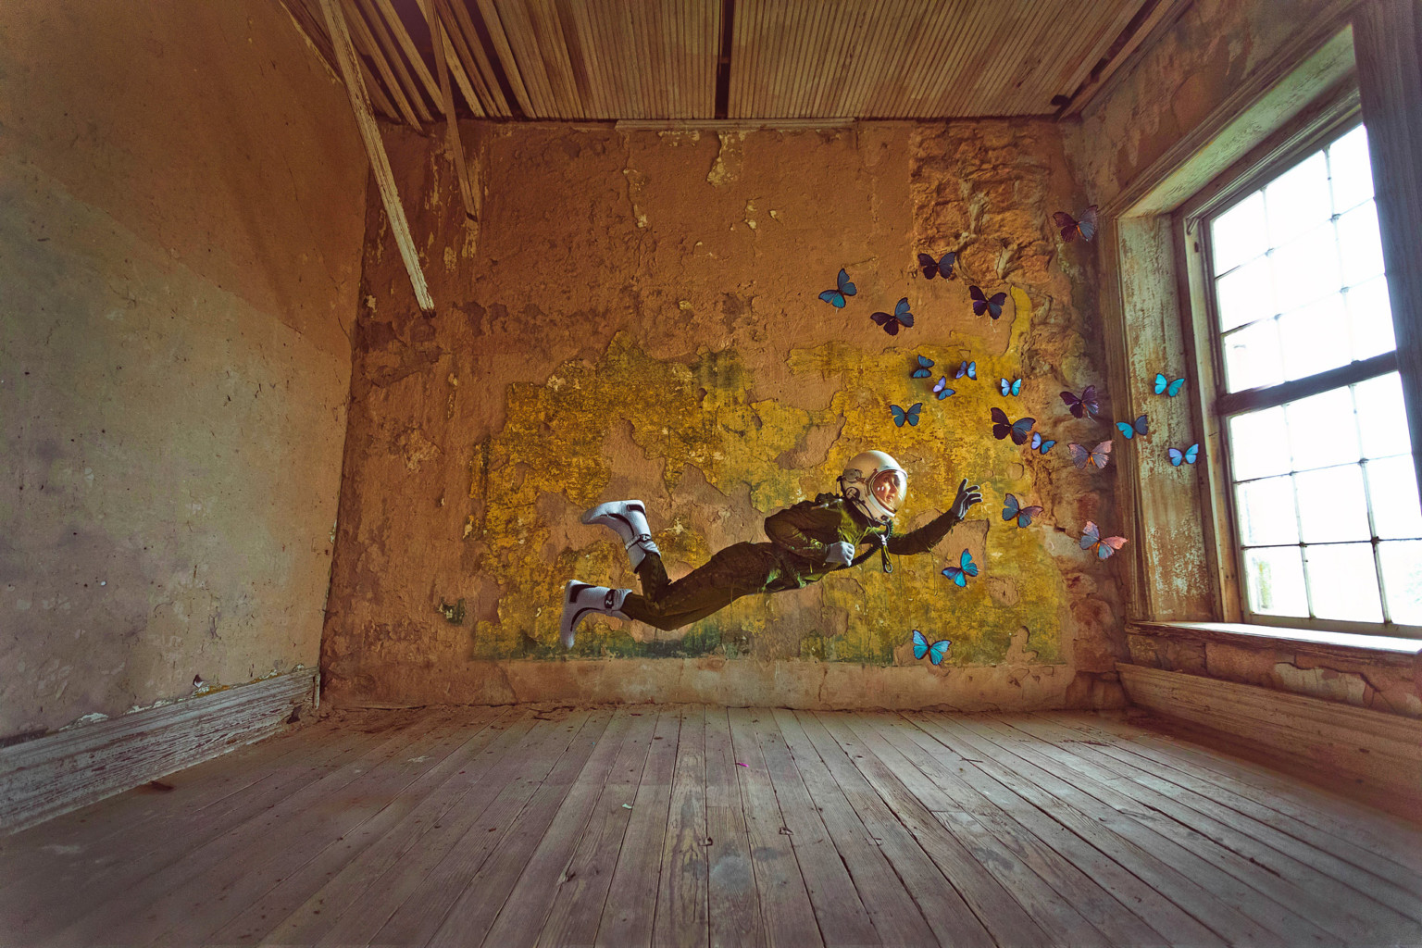
Photographer Karen Jerzyk explores themes of loneliness and isolation through her ongoing series, The Lonely Astronaut. Sparked by her purchase of an authentic vintage high-altitude space suit in 2017, Jerzyk has been traveling the world taking photos of women in the suit. Each subject is alone, placed in a deserted yet evocative environment, from an abandoned theater to an old-fashioned bedroom. In some scenes, the astronaut engages with their surroundings—reading a book or talking on the phone—where in others, the character stands apart from the world they inhabit.
https://www.thisiscolossal.com/2019/04/lonely-astronaut-series/

Slide 15
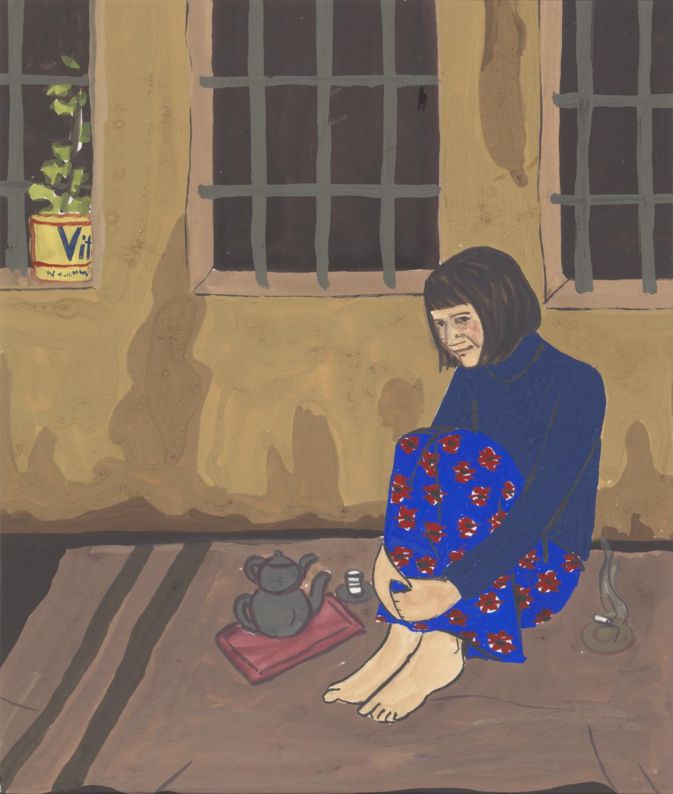
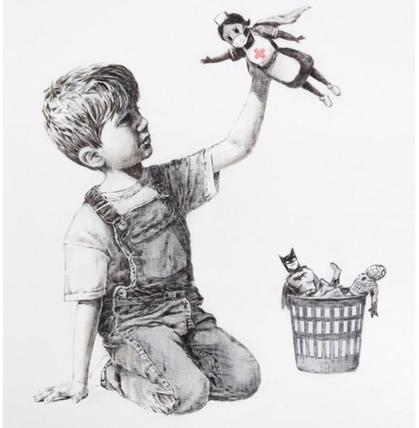
A new Banksy artwork has appeared at Southampton General Hospital.
Gulsun Karamustafa Prison Paintings 9 1972 Tate
https://www.bbc.com/news/amp/entertainment-arts-52556544
https://www.tate.org.uk/art/talking-point/making-art-isolation

Slide 16
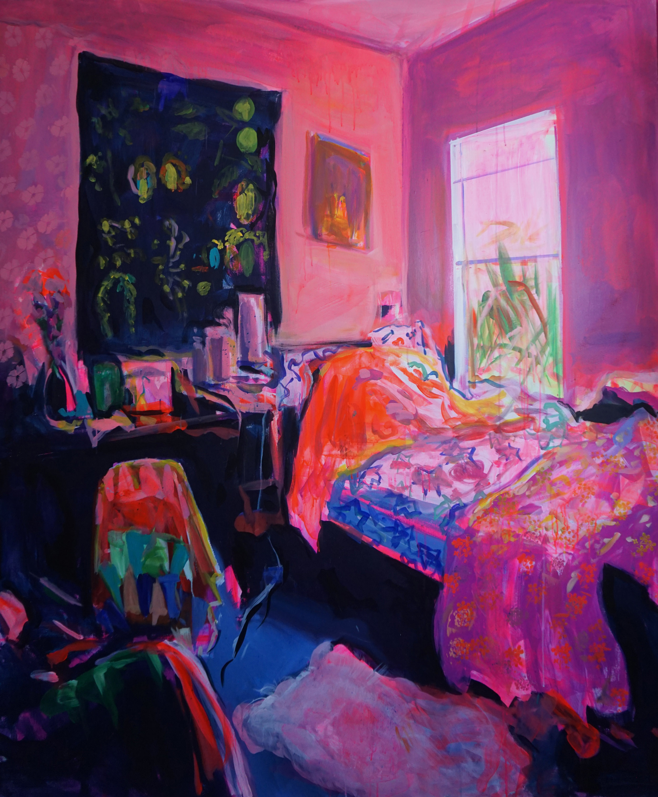
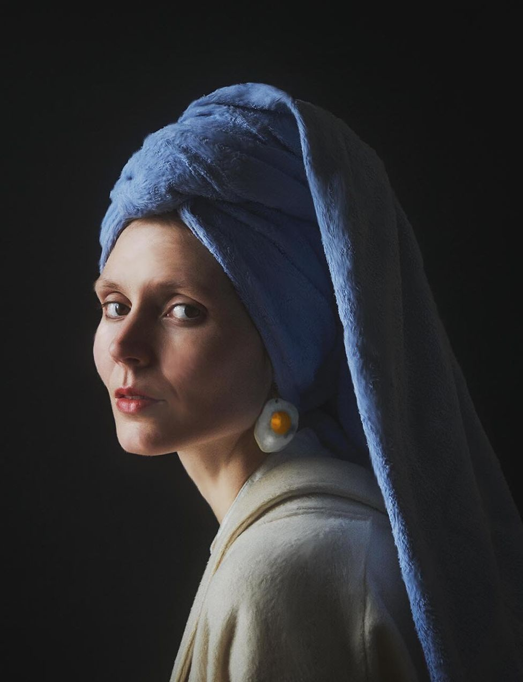
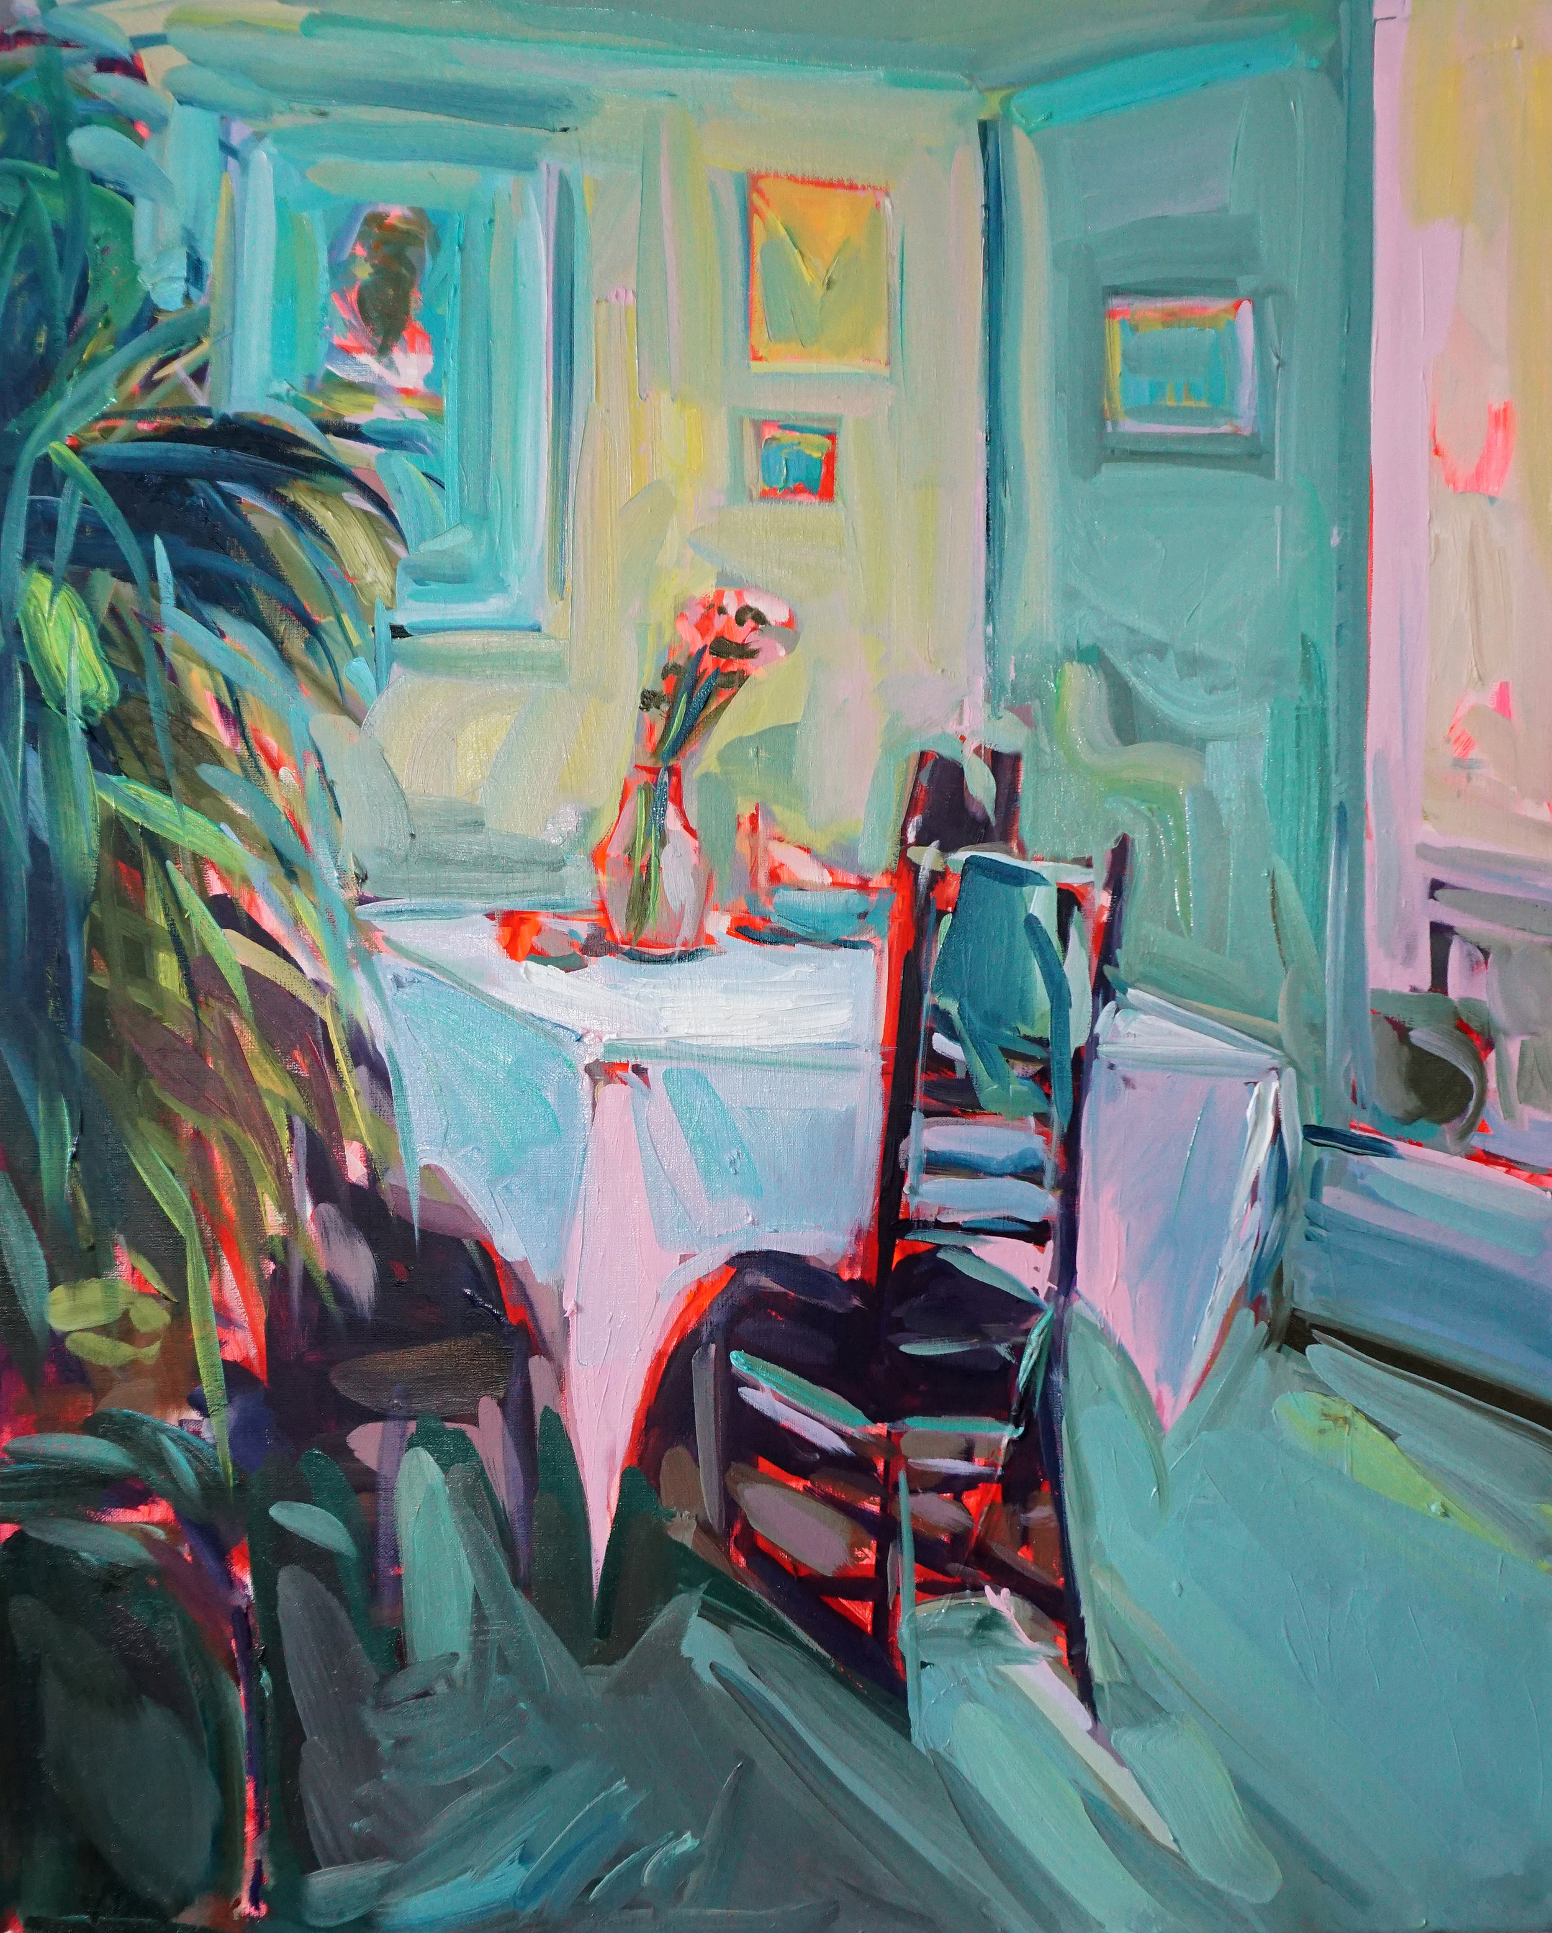
Ekaterina Popova
https://www.katerinapopova.com/
Photographer Julia Keil decided to turn the camera on herself, making a series of self-portraits inspired by paintings, the cinema or other photographs.

Slide 17
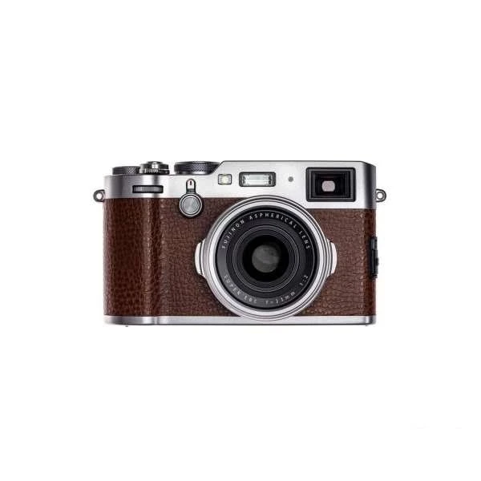
Task 2
Photography Response
Take a selection of photographs in the style of your artist. You will use this set of photographs to create your final piece next week.
Remember, everything you know about photography from week 1.

Slide 18
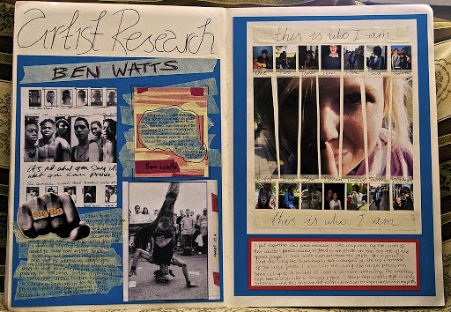
Task 3
TOP TIP
The studies could be sketches/paintings/drawings. If possible use similar materials to your chosen artists.
You should use your photographs from Task 2 to carry out this task.
Visual Response
It is important to push your own ideas further, rather than making copies of an artwork. Create 1 -2 studies responding to the artist’s work as well as your own.
e.g. I’ve chosen Andrew Wyeth’s windows, but instead of using paint I will take photos of windows curtains up at a window and possibly include a silhouette of a lonely figure. I will use pencil and charcoal instead of paint. I like the composition of the curtains blowing in the breeze.

Slide 19
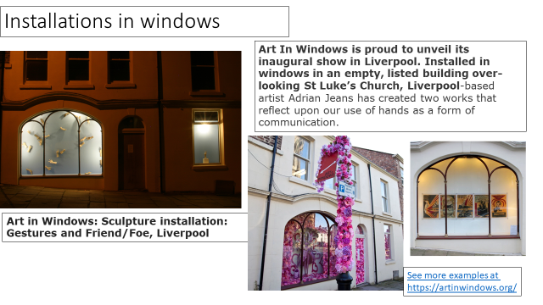
Task 4
1/https://hattongallery.org.uk/ The Hatton Gallery are sharing virtual tours of their artworks. Watch some of the exhibitions which interest you most. Artists need to communicate with gallery curators how their artwork needs to be displayed and the audience to move around the artwork.
2/ Create quick sketches/plans to help you work out what your final composition will look like? You could also consider work how and where you would ideally display your work? (e.g. is it a piece that would be best viewed from a billboard? Or in a book?)
Think about how you might want to display your final piece next week. Could you use a window to display it or show It outside. It could raise a smile! ☺
https://www.youtube.com/watch?v=jI5LnvjBPjI#action=share

