Slide 1
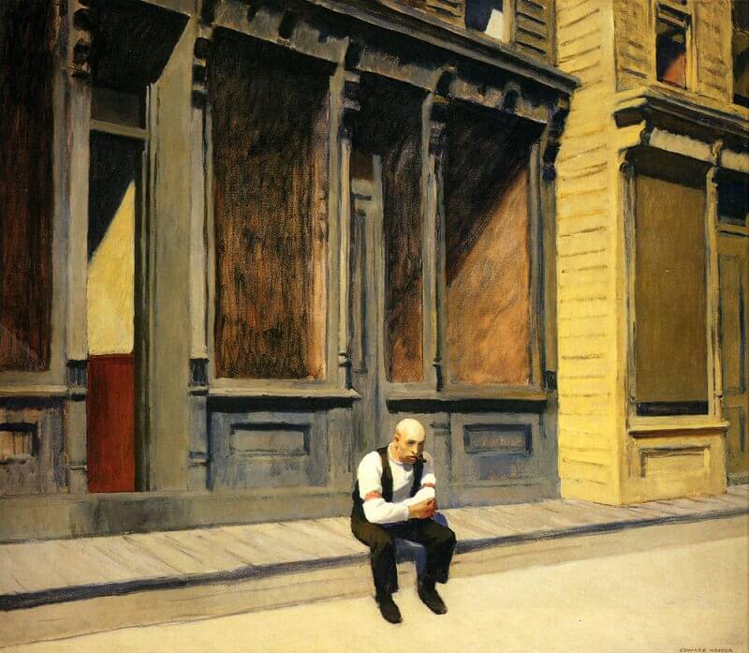
Recap
https://youtu.be/vxQN_GgJFRY Watch more of Edward Hopper’s paintings
How does Hopper create mood and feeling in his work?
Does his painting raise any questions?
List your ideas.
Great art is the outward expression of an inner life of the artist, and this innerlife will result in his personal vision of the world.” - Edward Hopper
Sunday, 1926

Slide 2
‘They appear to accept their fate passively. The world they live in is strangely static, the streets largely empty of passersby, hardly a car or truck on the road. No tourist, no stranger has strayed into this silent world. All the windows are closed, and no movement is detectable behind them. It seems to be perpetually Sunday, the city abandoned (or asleep), and for the old man sitting in his shirtsleeves on the sidewalk in Sunday, 1926, this Sunday emptiness is apparently even harder to bear than the weekday vacuum, even more meaningless, more of a dead end. This is a world without a future. And perhaps the oddest thing of all - it includes no children. Hopper never portrayed a child. His is a world of adults condemned to extinction, and conscious of the fact.’
Courtesy of www.EdwardHopper.net
Sunday, 1926
You will notice in a number of Hoppers paintings the subject is sat waiting. There is empty space around his subject, creating solitude. Apparently, Hopper suffered from Chronic boredom which often stifled his urge to paint. Does this all sound familiar to some of you at the moment?

Slide 3
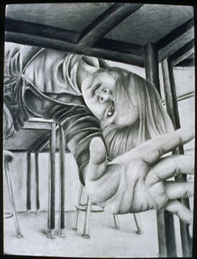
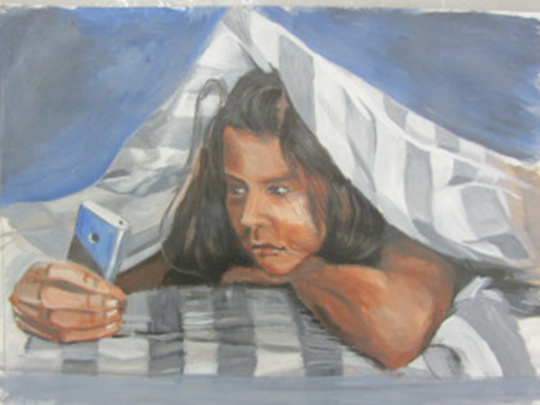
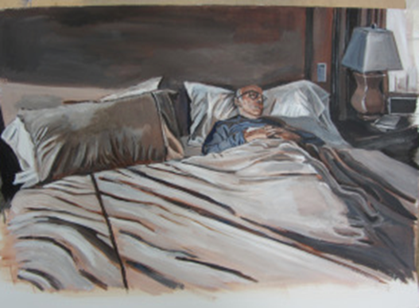
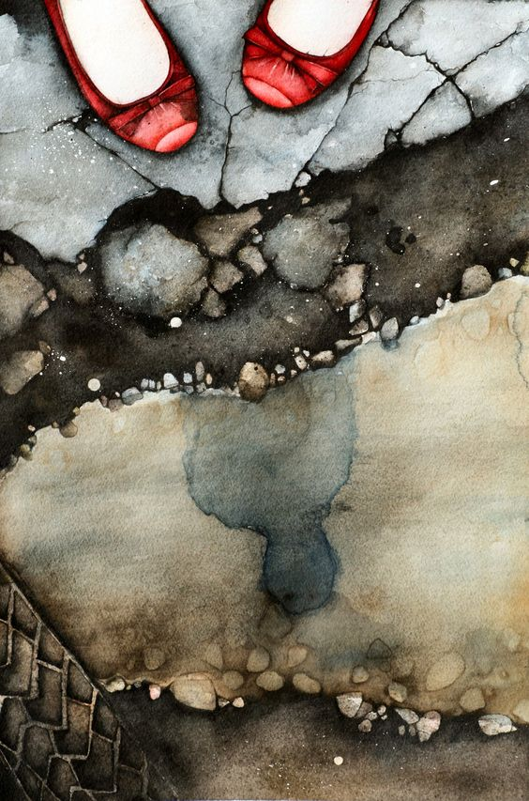
Week 4 FINE ART Outline
This week you will create your final piece to go with the theme ISOLATION. You will drawn upon your earlier work to help you create a refine piece of work. You should use artist research to inform your final piece. You will be ambitious with your final piece and consider how you would like to display it. Keep in mind the mood you want to portray in your work? What feelings do you want the viewer to feel?

Slide 4
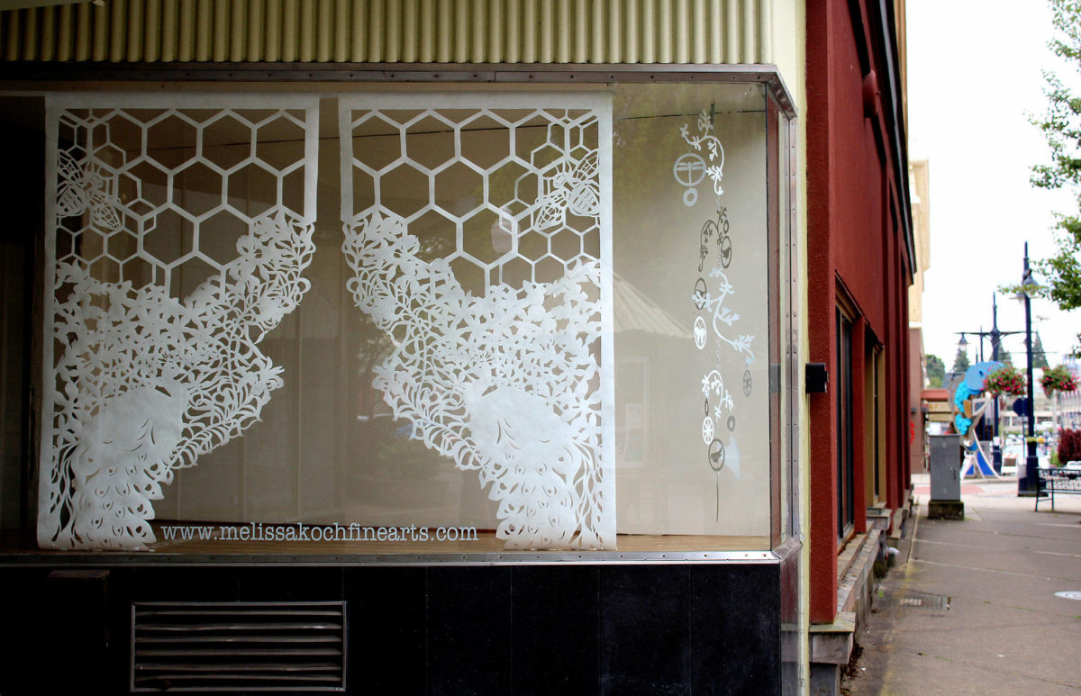
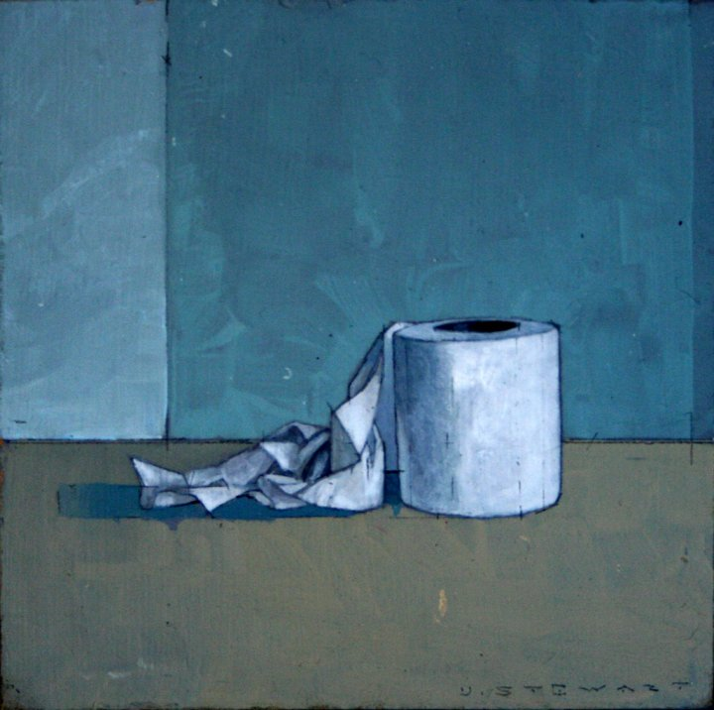
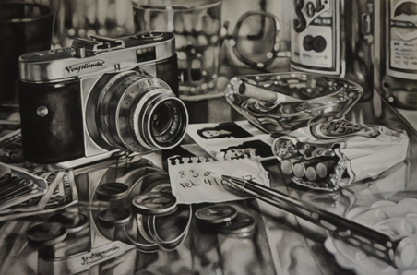
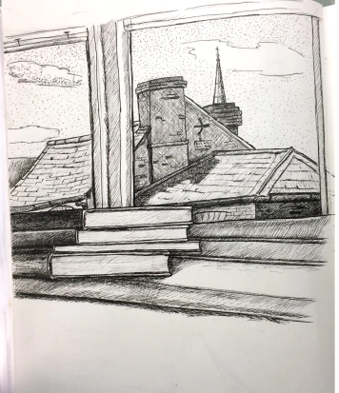
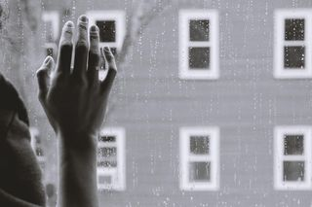
Look back to your mind map to make sure you are following your best idea.
ISOLATION

Slide 5
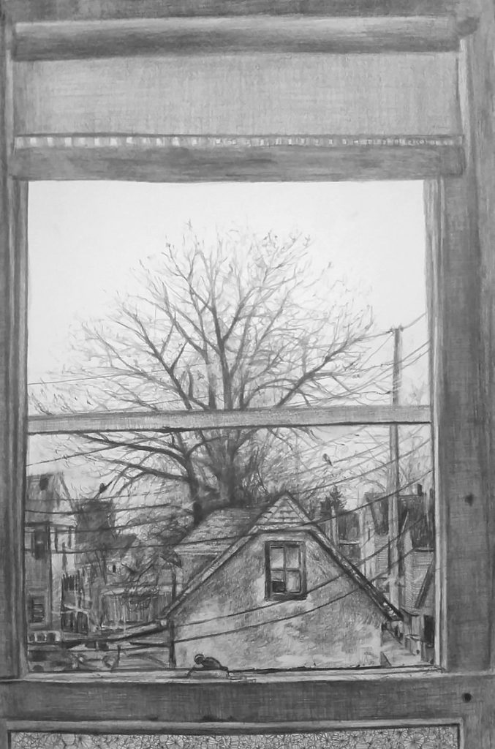
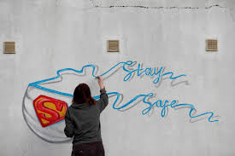
FINAL DECISIONS
What surface do you have available?
What materials will you work with?
Do you have the images/objects you’d like to use to hand?
Refer back to earlier research before you make final decision about your final piece.
Look at your set of photographs from Week 1 & 3.
Use your sketches and artist research to work out how you will start your final piece.

Slide 6
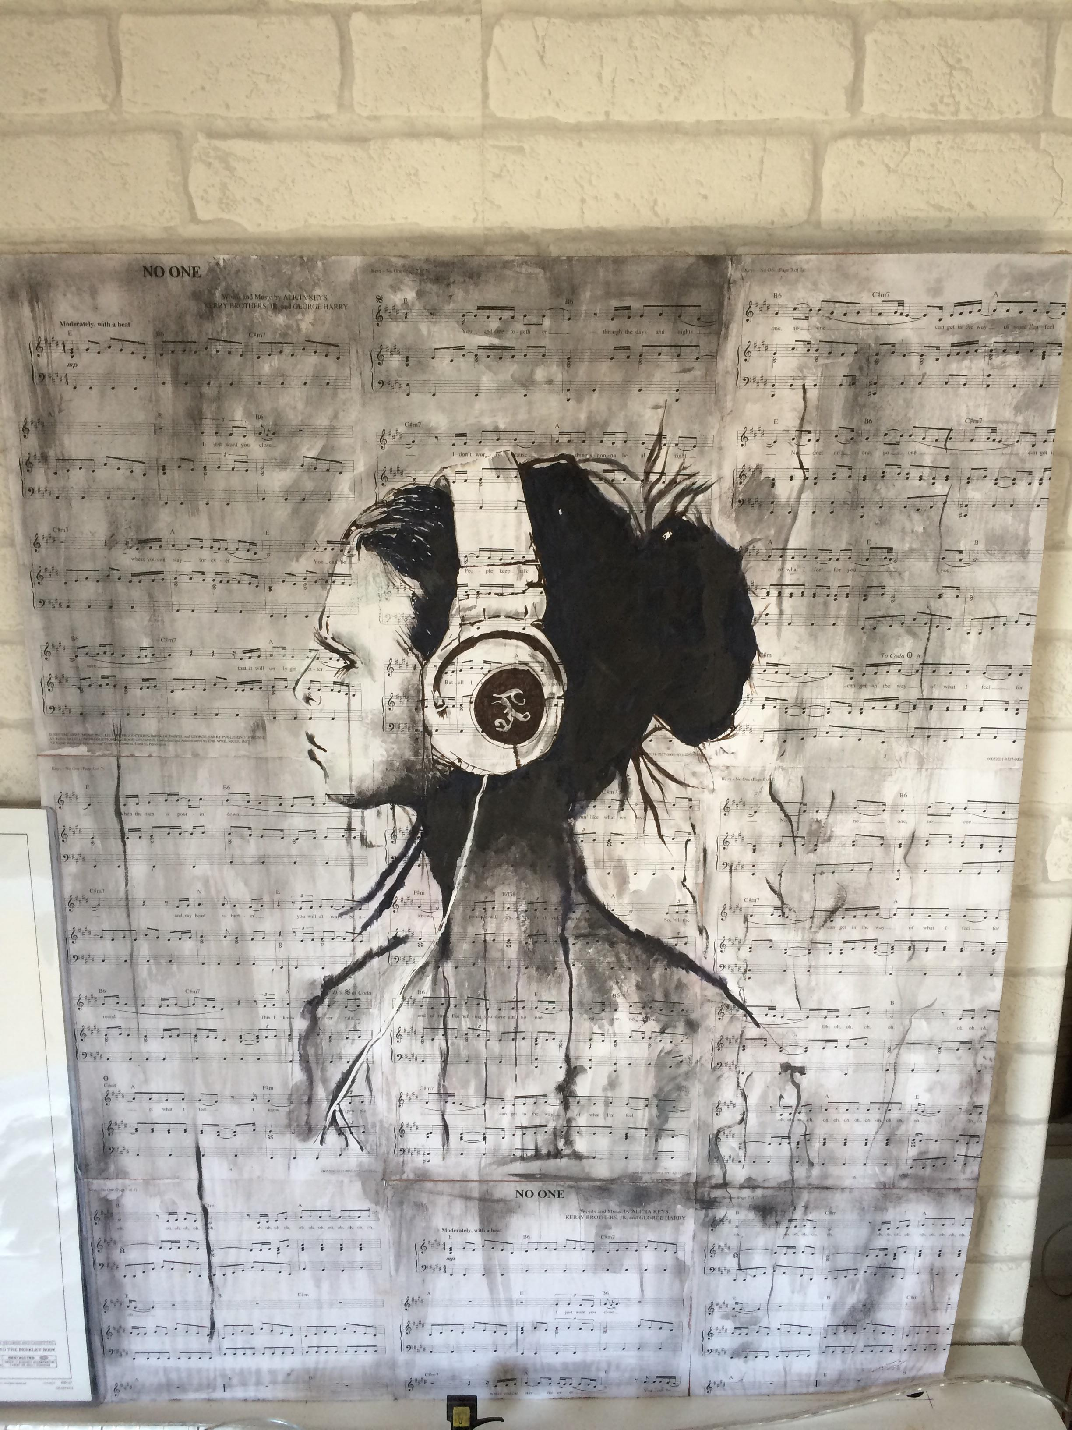
Creating
SURFACE TIP:
Acrylic Paint could work well on cardboard, an old sheet (painted with white emulsion paint) or any type of paper.
This week your time should be spent making your final piece to conclude your ISOLATION project. (Approx. 5 hours)
We understand you might not have access to your preferred materials to create your final piece, but try your best to create something you are proud of.
This is the time to experiment, so you should take a risk and work differently to your normal style.

Slide 7
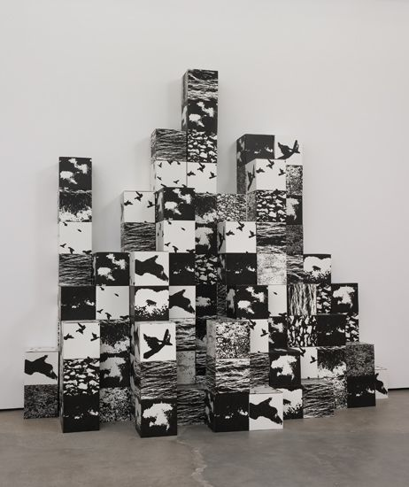
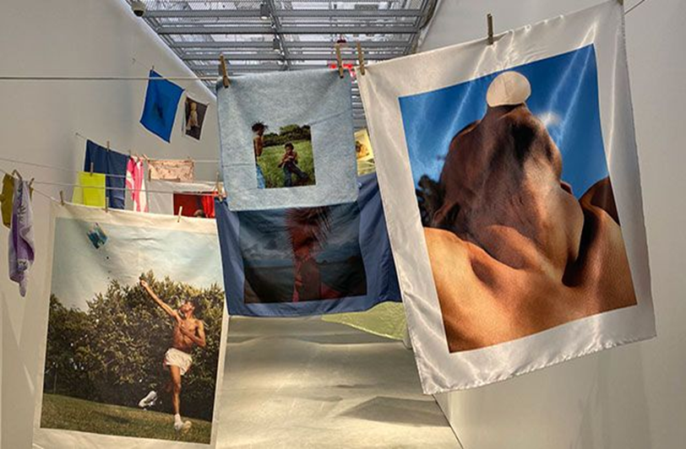
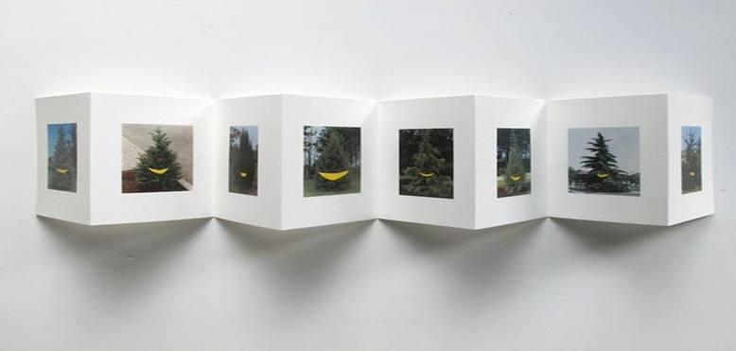
TASK DISPLAY
The following slides will give you some examples of how artists display their final work.
Consider how you would like the audience to view your final piece. Would you like it to reach the wider public outside or to be housed in a gallery?

Slide 8
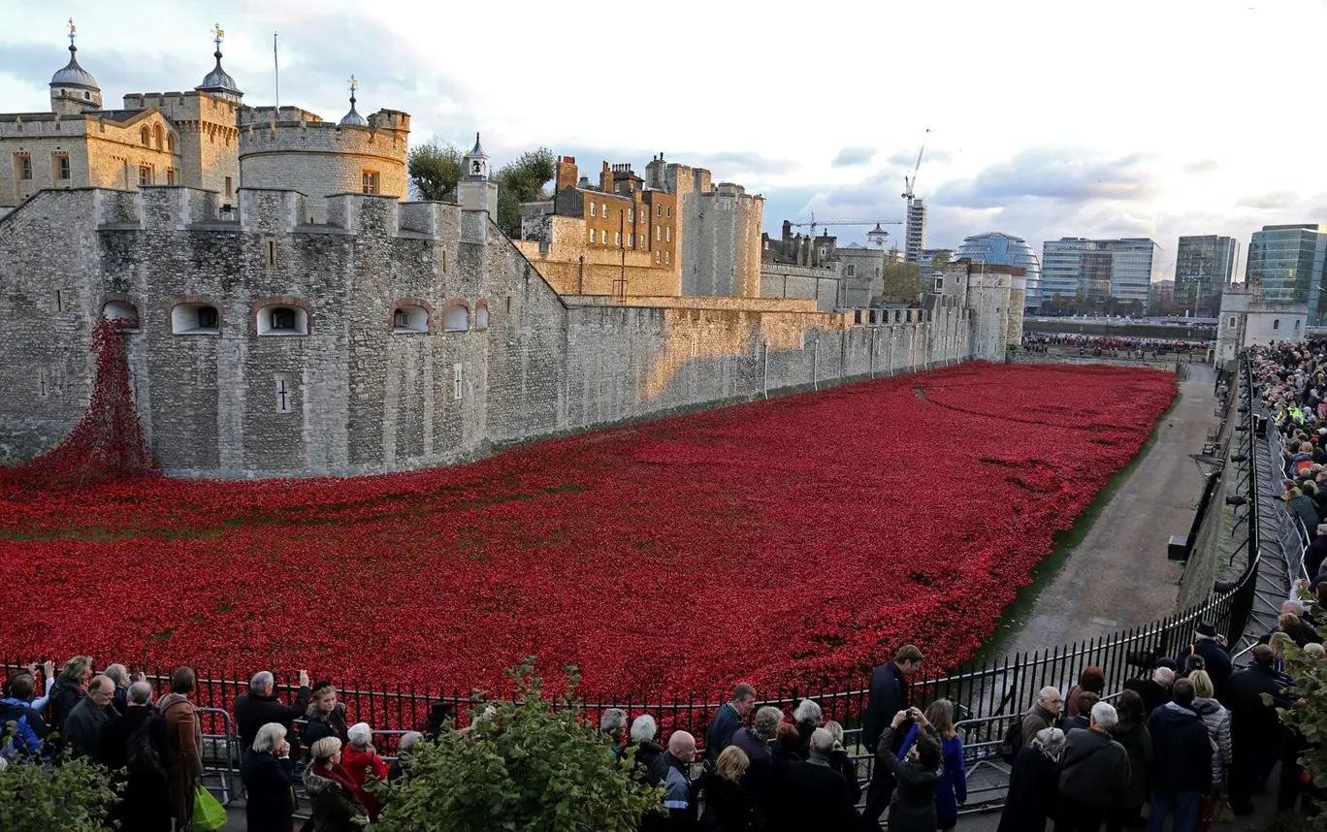
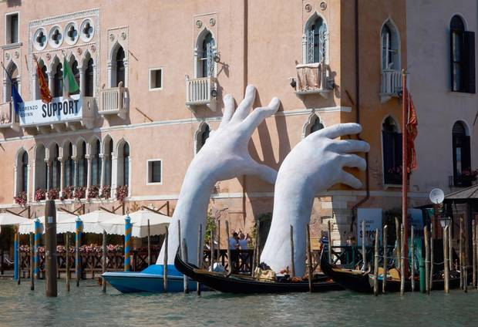
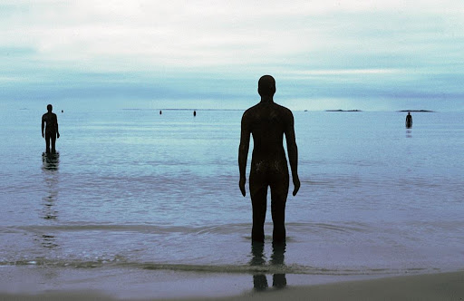
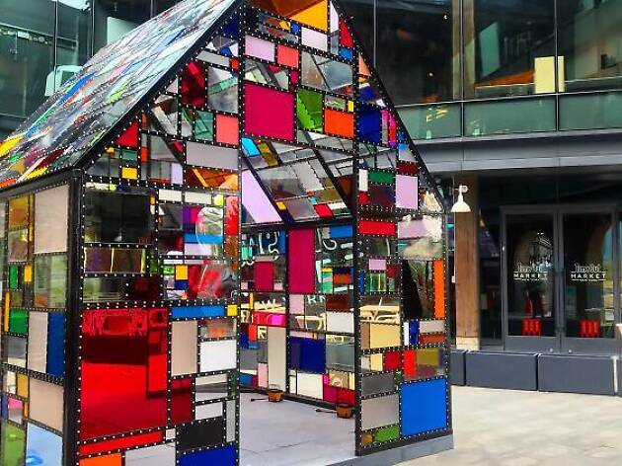
Public Installations

Slide 9
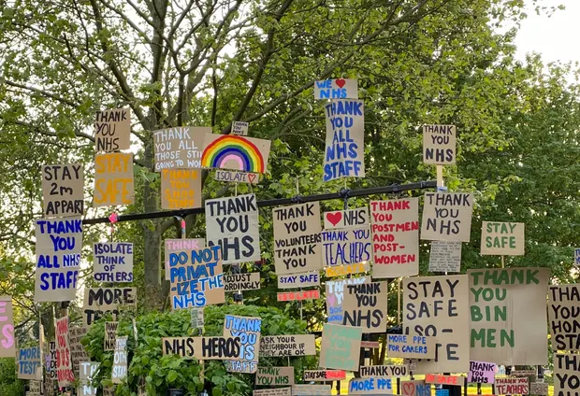
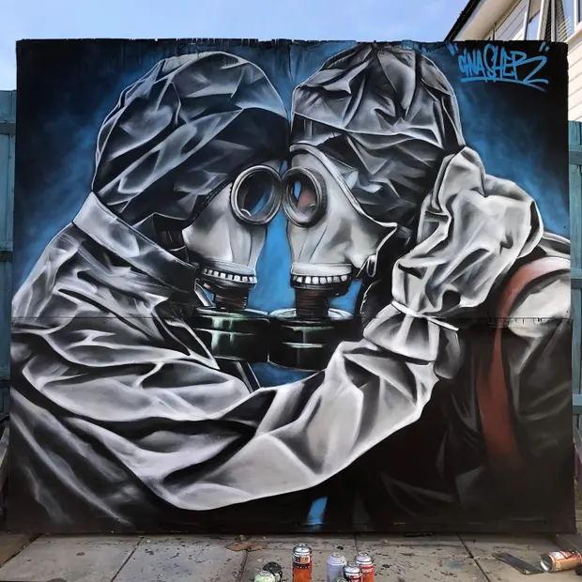
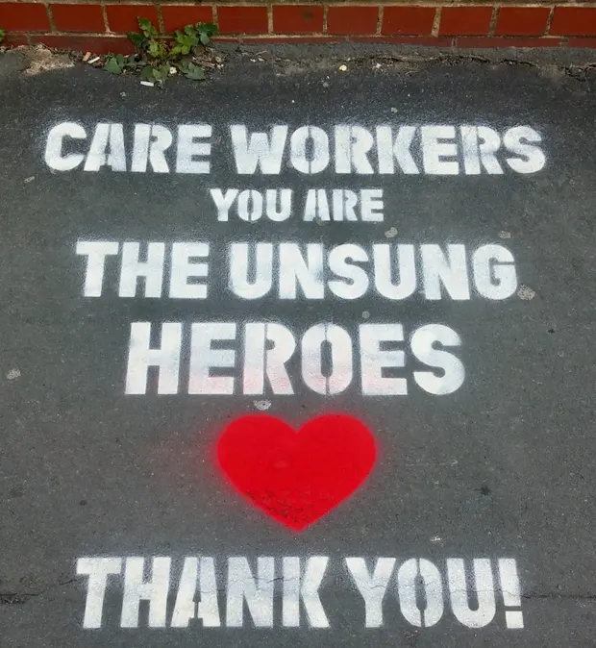
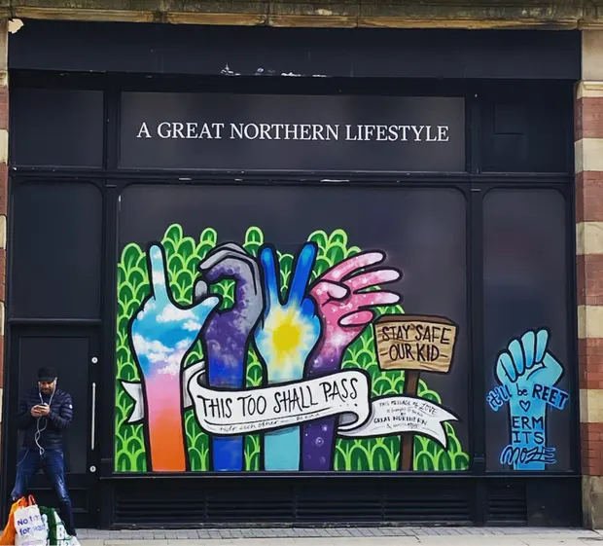
Street Art
https://www.theguardian.com/artanddesign/2020/may/12/readers-favourite-coronavirus-street-art-laugh-uk-lockdown-houses-roads-shops?CMP=Share_AndroidApp_Copy_to_clipboard&fbclid=IwAR1aOjTyZ3s4fTnkLAcRdMR7Wc6dgPK0Oo-7RfNsRzSwmOtJJCeIgaK0sM8
Vic Brown, Tamworth

Slide 10
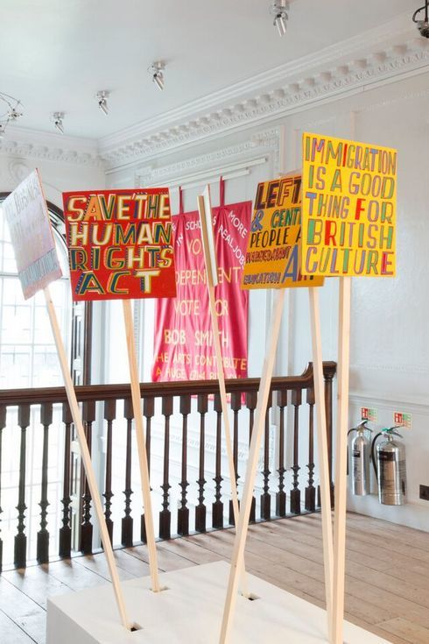
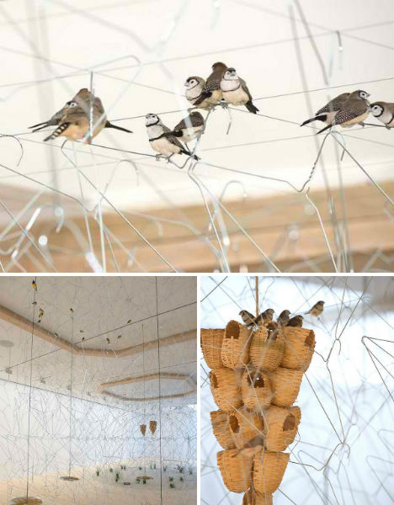
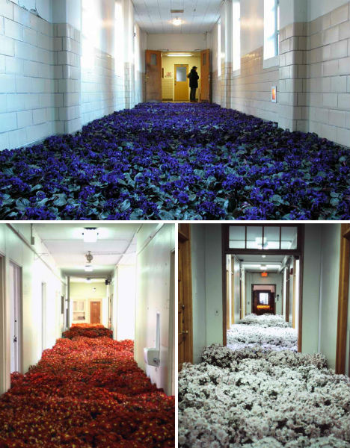
Gallery Installations
https://weburbanist.com/2012/04/02/surreal-art-spaces-15-stunning-gallery-transformations/

Slide 11
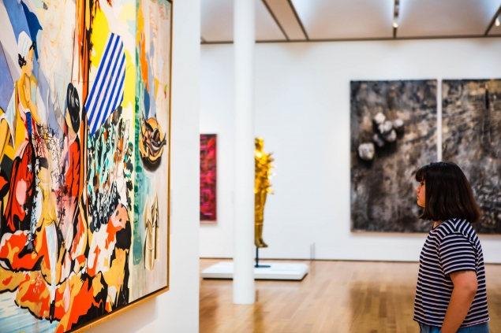
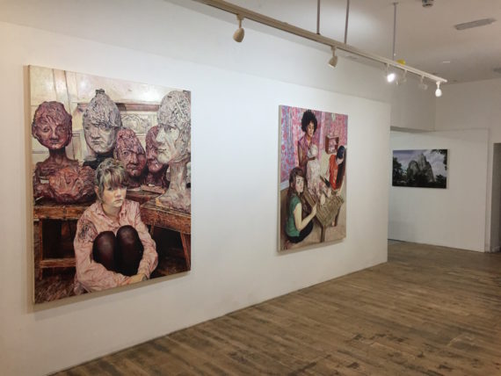
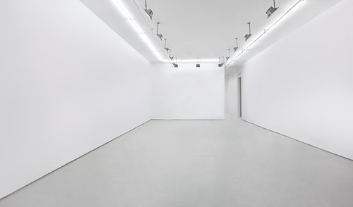
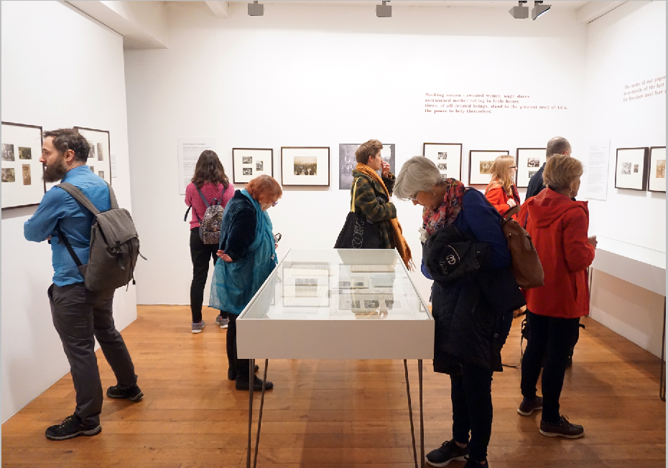
The white box gallery

Slide 12
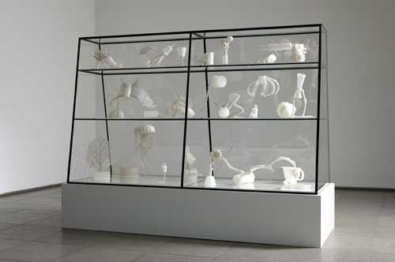
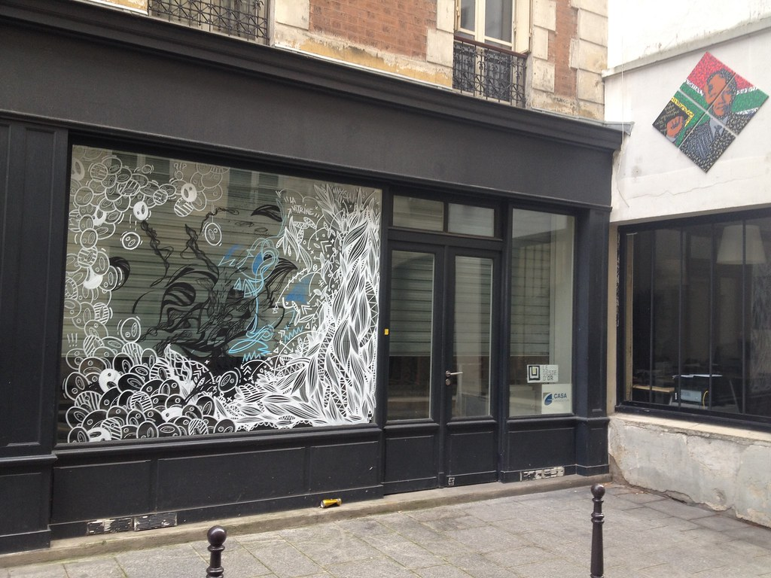
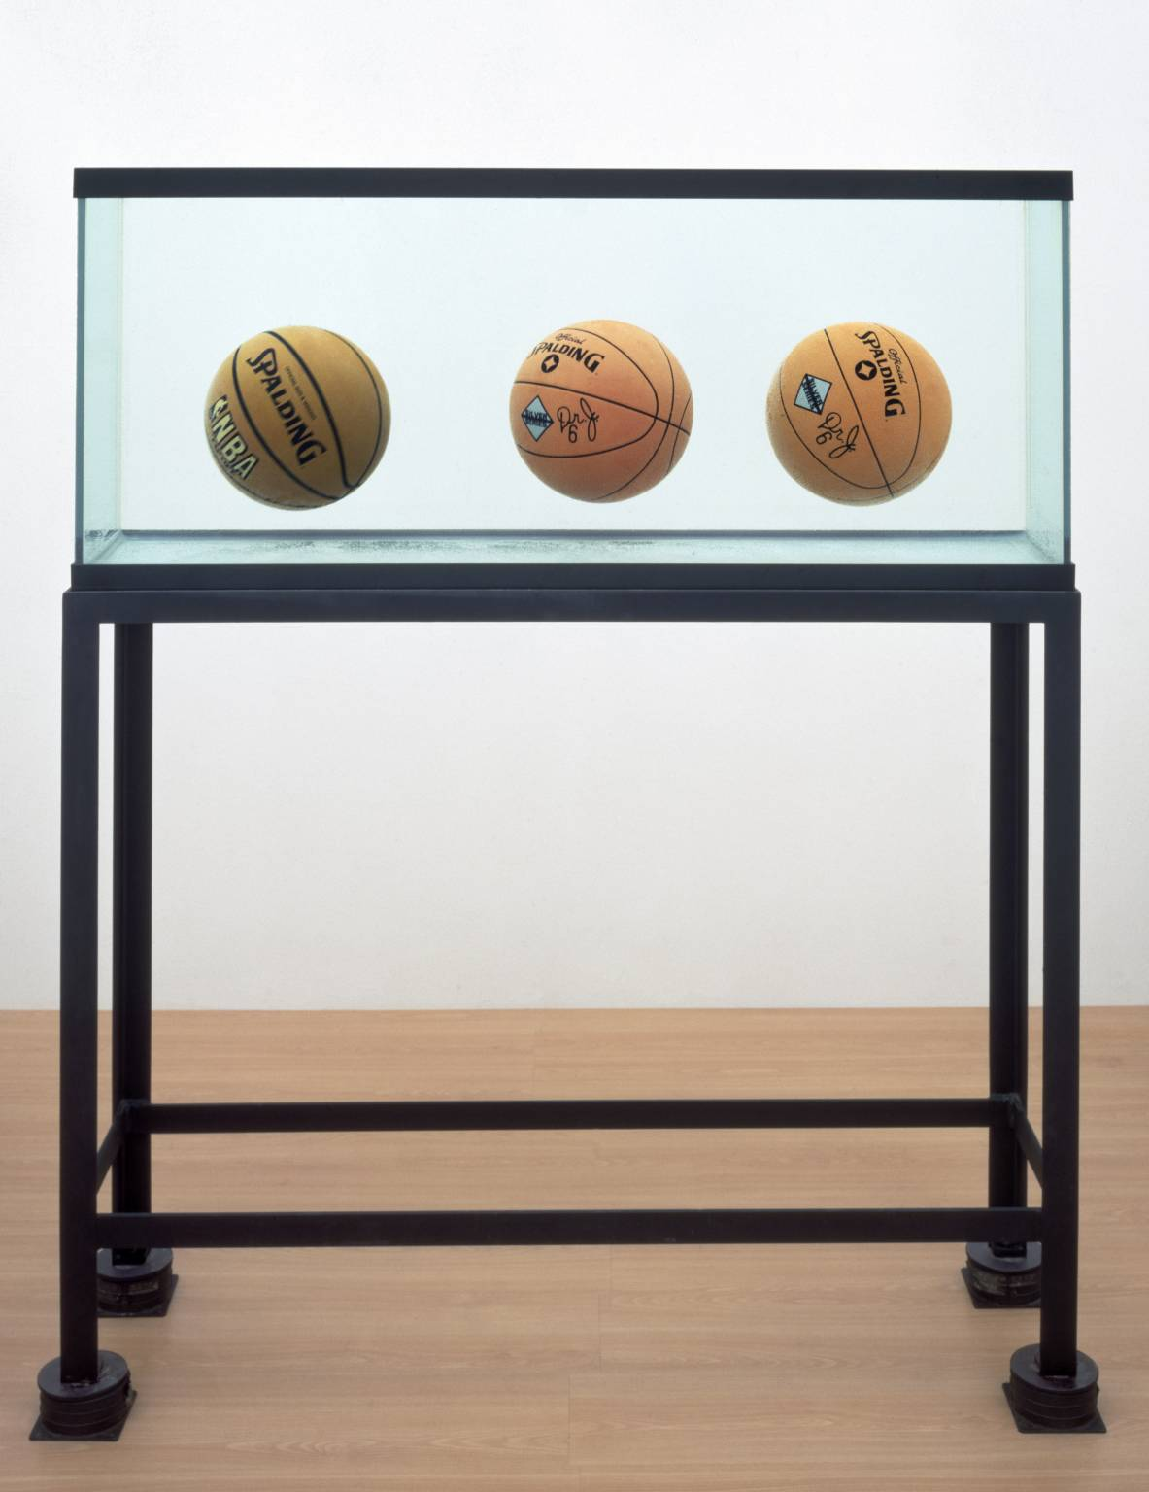
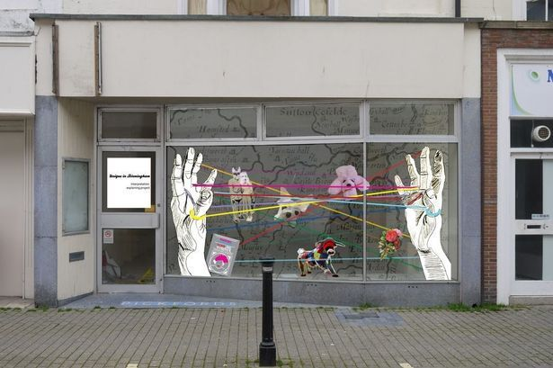
Windows/Vitrines
Vitrine A large, glass cabinet used for displaying art objects.

Slide 13
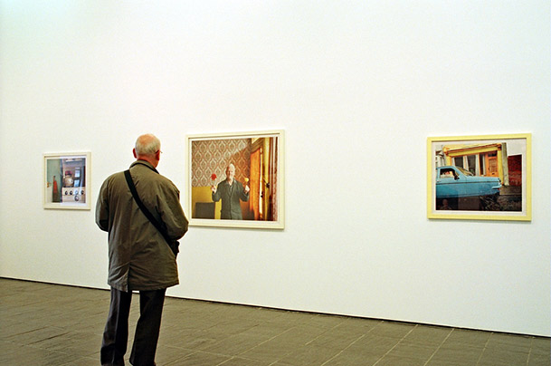
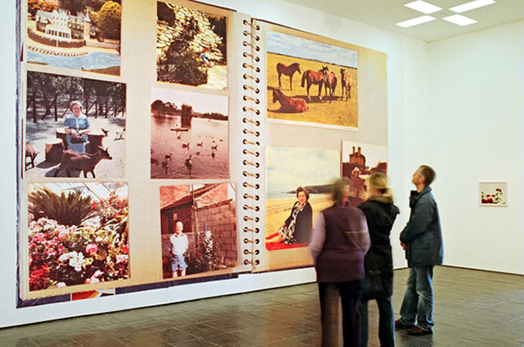
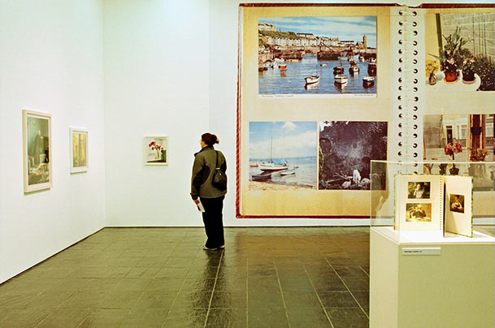
TASK
Write a short proposal to a gallery curator about how your work should be displayed in a gallery space. Alternatively, you could opt to display your work outside as a public installation. Use sketches if it helps.
This is a proposal, so can be ambitious with your display ideas. Think about how you would like the audience to see your work.

Slide 14
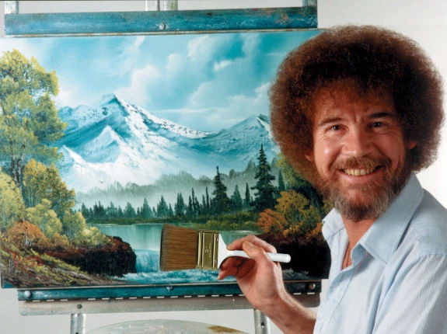
Well Done, Year 11.
You have completed the Fine Art Bridging Course. Keep your work safe and bring it back to us when you return to school. We look forward to seeing what you have created.
Take Care ☺
Just for fun, you can watch Bob Ross at work.
https://www.youtube.com/watch?v=mT0RNrTDHkI

Slide 15
Virtual Gallery Tours
mustseemuseums.org.uk
Hatton Gallery
https://laingartgallery.org.uk/whats-on/explore-the-laing-art-gallery-from-home
Laing Gallery
https://baltic.art/
Baltic Contemporary Art Virtual Tours
https://www.nationalgallery.org.uk/visiting/virtual-tours
National Gallery
https://www.theguardian.com/travel/2020/mar/23/10-of-the-worlds-best-virtual-museum-and-art-gallery-tours

