Slide 1
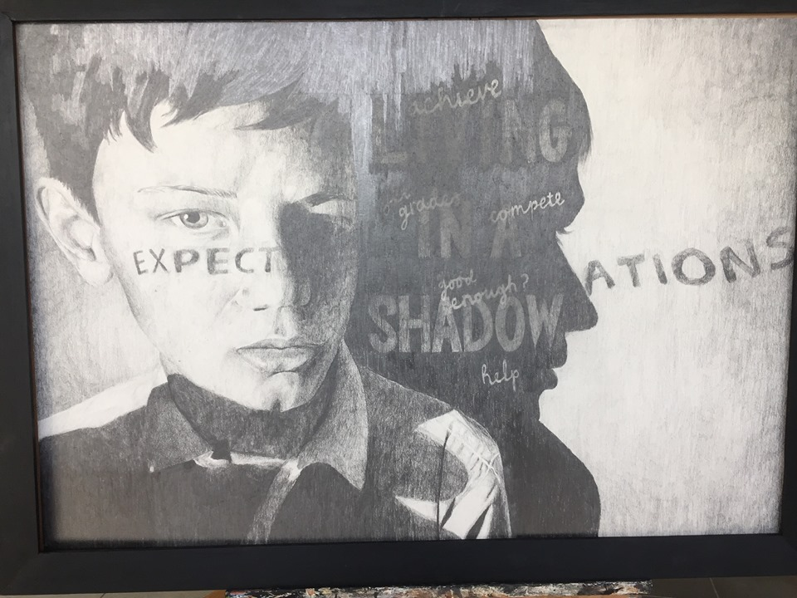
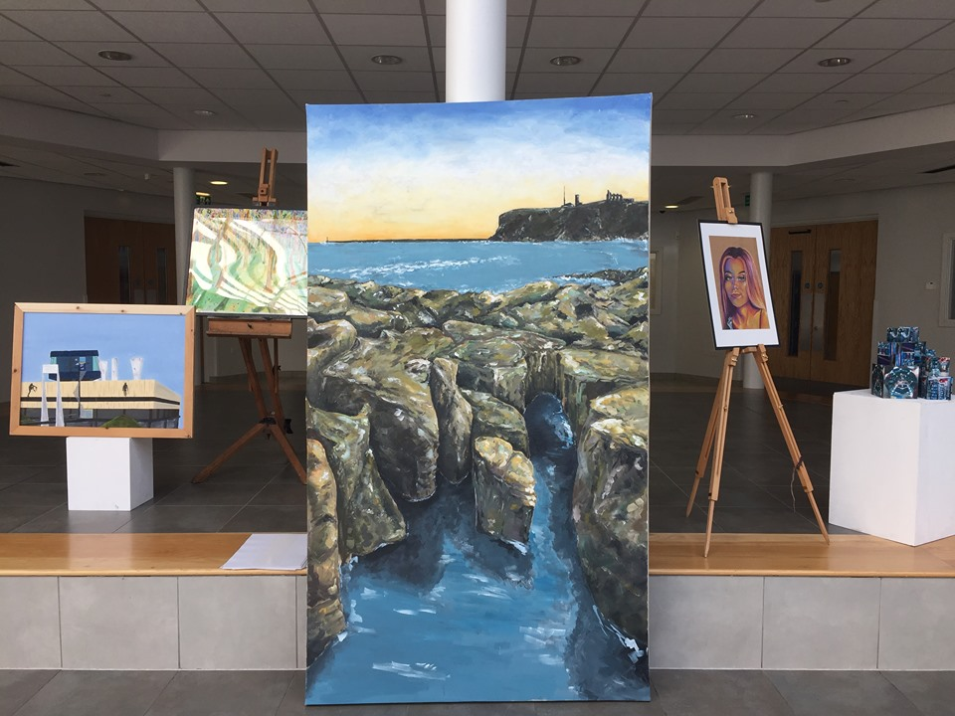
A Level Fine Art Bridging Project Week 1
Art enables us to find ourselves and lose ourselves at the same time.
Thomas Merton

Slide 2
Entry Requirements for Studying A-level Fine Art
Students who are expected to achieve at least a grade 5 in GCSE Art and a grade 5 in one of their GCSE English courses.
Students who have enjoyed their GCSE Art course, and who enjoy going to galleries and learning about artworks.
Students who enjoy working with new materials and developing different techniques.
Students who relish the opportunity to work in new ways and take risks within their art work.
Students who enjoy working to a broad theme and gathering research through visual and written form.
What to expect from A-level Fine Art.
The A-level Fine Art course allows students to develop their own chosen themes, encouraging them to really stamp their personality on their projects from day one. You will be asked to research your theme and chosen artists in greater depth and push your ideas to more ambitious scales than you have been used to. We begin Year 12 with a short introductory project to challenge you with materials and scales, while giving you the chance to brush up on your recording skills after a long break. You will regularly share your artwork with your peers and teachers in group critiques, which allow you to organise your ideas and gather ideas from others. We also offer visits from artists and opportunities to work with local universities through skills workshops led by university lecturers. The broadness of the course and themes allow you to use your artwork as a powerful tool to communicate messages to an audience, as escapism, documentation or immersing yourself in the pure aesthetics. Our sixth form students benefit and value the extra space we offer them to work on weekly tasks outside of lesson time. If you are thinking about studying A-level Art, then attempt some of this work to give you a flavour of the demand of the subject. If you decide that Art is the A-level you want to study, remember this bridging course should be completed in full.
Component 1 Coursework Portfolio worth 60% | Component 2 Externally Set Exam – worth 40%
This is a personal investigation chosen by you. It will comprise of sketchbooks, boards and final pieces. This portfolio of art work should be an exciting and in depth investigation. A written essay between 1,000-3,000 words is required to support your personal investigation artwork. Lessons will be dedicated to coursework until the exam papers are given out. | The theme for exam project is set by the AQA exam board around 1st Feb. There are 8 starting points to choose from. You have approx. 10 weeks to produce a sketchbook/boards to respond to your chosen theme. During the exam lasting 15 hours, across 3 days in the art room you will create your final pieces. Sketchbooks/boards/research for the exam MUST be present in the exam room and should be referred to during the exam.

Slide 3
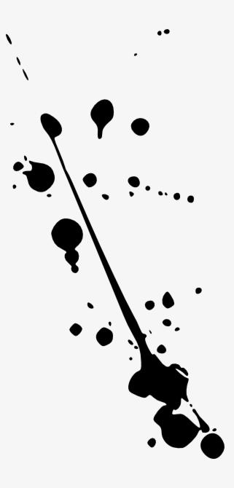
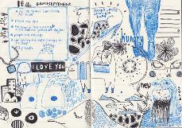
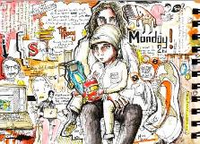
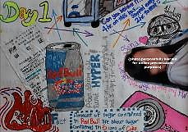
Theme: Isolation 2020
This thing – Coronavirus (COVID-19) – it’s living history. Which means YOU are part of living history. We are ALL part of living history, and this time will be talked about for generations to come. Schools are closed; sports events, concerts and gatherings are cancelled; people are quarantined…on a GLOBAL level. We haven’t seen this in our lifetime before, and hopefully, we never will again. That’s why it’s important to record these moments, so you can make sense of things, remember, and share with others in the future.
Recording events, activities, fears and feelings, perhaps taking news clippings, collecting objects or even interviewing relatives and friends for differing experiences to document how we spent our time in isolation.
This will become something personal, unique to you and unique to a period in our history. Once your project is marked you will be given it to keep to share with family members in the future. It will become YOUR own primary source of YOUR moment in history and how YOU lived it.
We’ll have an exhibition on our return to school - a time to share your new work alongside your older work.

Slide 4
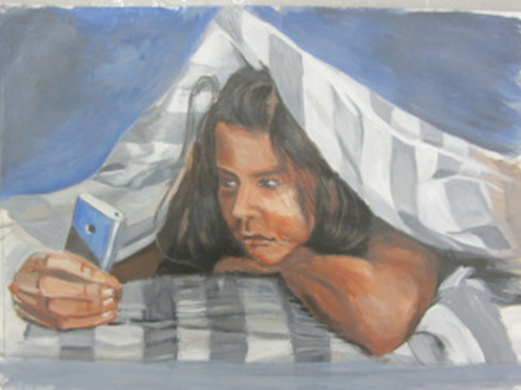
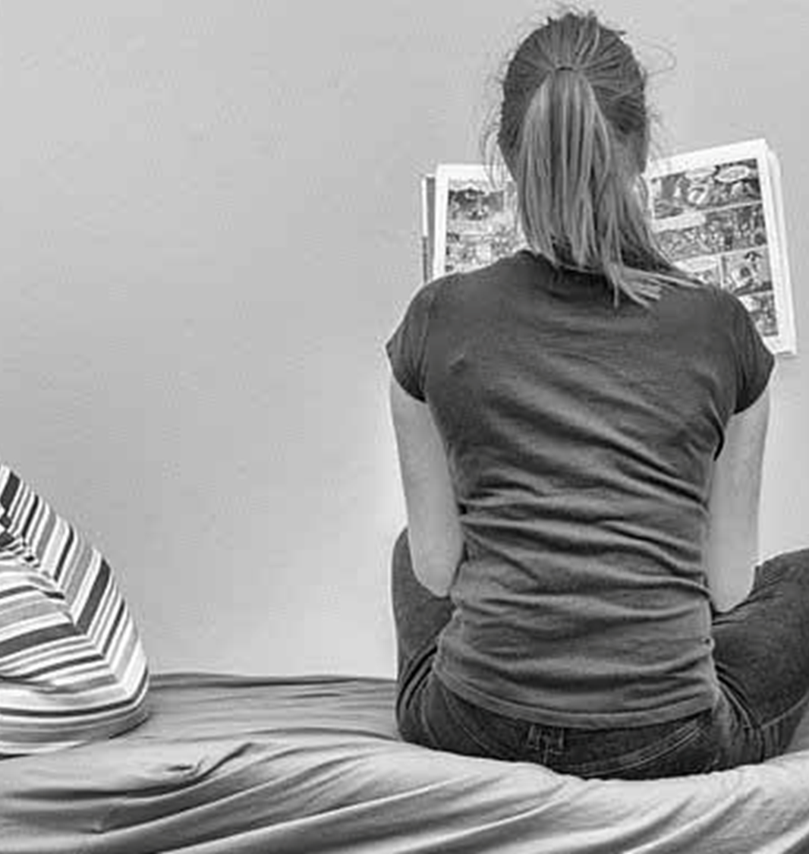
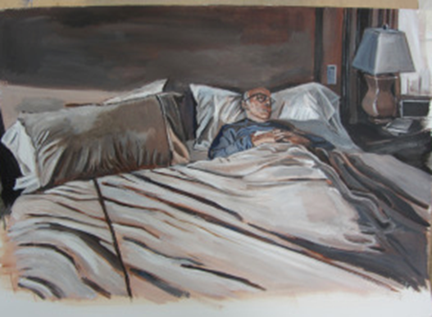
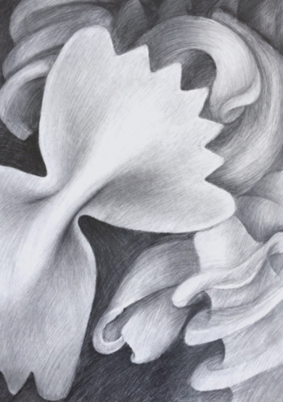
Week 1 Outline
This week you will gather research to create a visual diary/mindmap of isolation, drawing upon outside sources as well as personal accounts of the current climate. (e.g. newspapers, bulletins, stories, scientific research, everyday tasks and routines etc)
You will practise recording your ideas creatively with a camera. This is an important skills to develop for your future A Level projects.
You will begin collecting ideas through drawing in a range of materials. Considering space in and around the subject and a range of mark making techniques.
Please don’t worry if you have to swap materials around depending on what you have available at home. The most important thing is to keep up your drawing skills by practising. ☺
I will also share some other art resources to look out for. (See Last Slide)

Slide 5
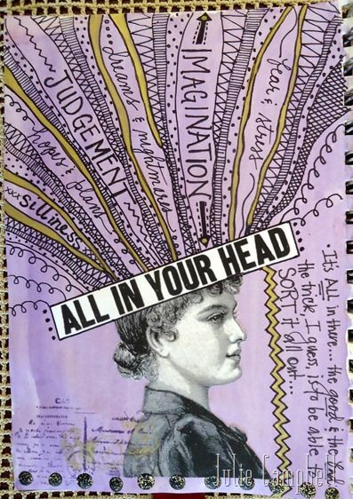
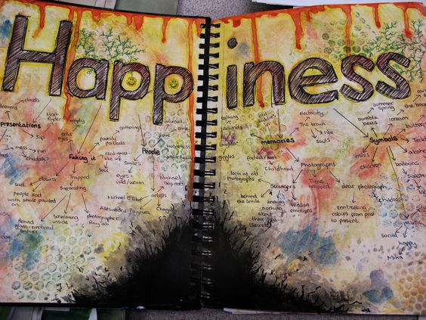
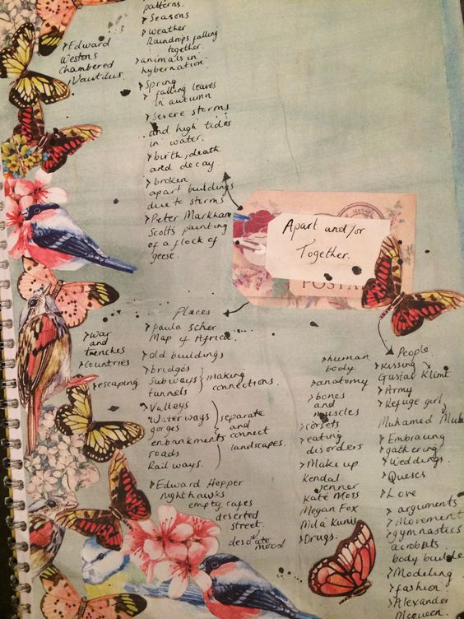
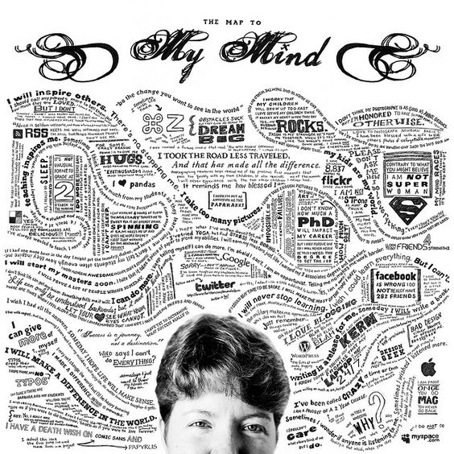
Task 1 Creative Mind Mapping (approx. 2 hours)
Collect and presenting initial ideas for the theme, Isolation 2020.
Talk to people at home to generate ideas about time in isolation.
Read articles/news reports/quotes around your theme and what is going on in the world. Consider watching the news to see how others around the country are dealing with the lockdown.
Think carefully about how you present your collection of research.
Concentrate on visual images with a few notes document the current situation.
There are examples of creative mind maps on the next slides.

Slide 6
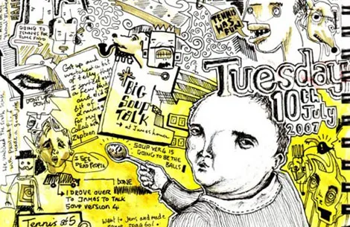
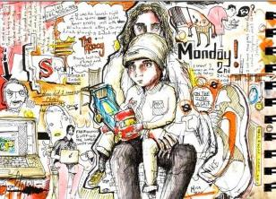
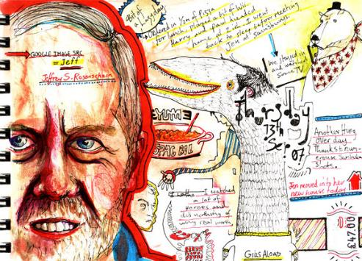
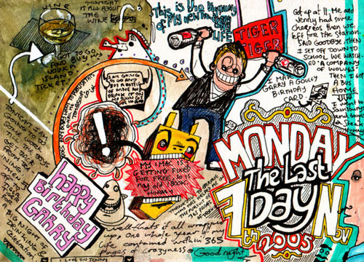
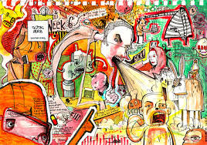
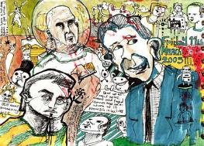
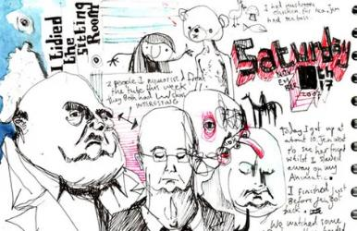
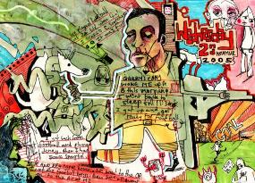
Royal College of Art student Tom Judd has finished the mammoth challenge of drawing everyday for a year in what looks like the same sketchbook. Even more remarkably this isn’t the first time Tom has completed the task having decided to maintain this year-on year-off schedule throughout his entire life.
TOM
JUDD

Slide 7
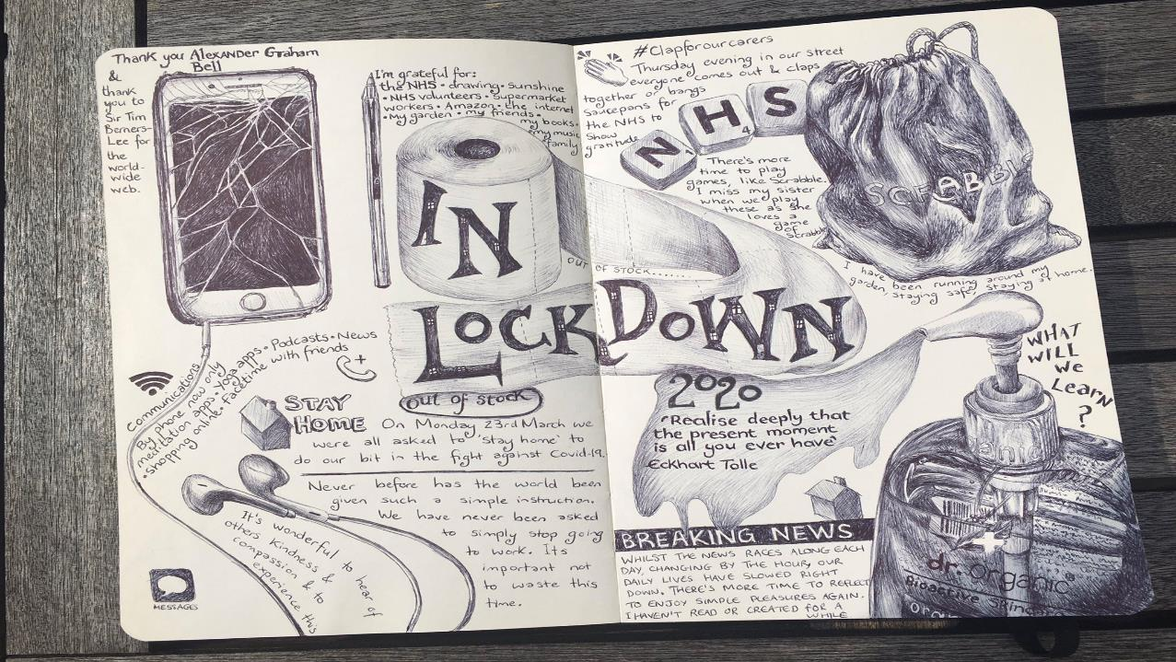
How cool is this example?!
And it’s all done using ONLY a Biro pen…

Slide 8
Don’t worry if you have not completed your creative mind map, you can continue to add ideas and images as your project moves on and things change in the world.

Slide 9
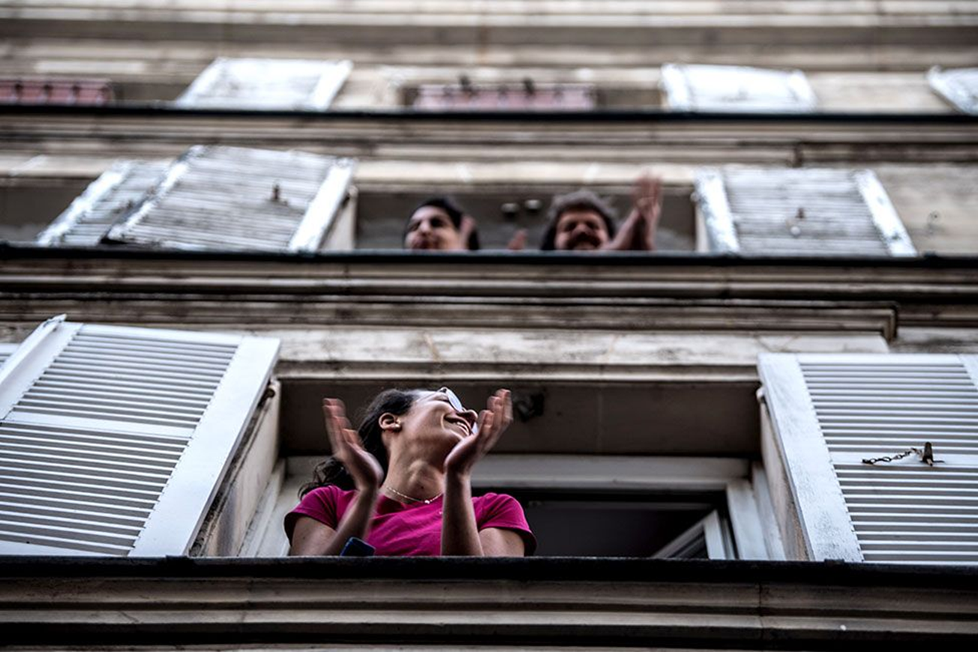
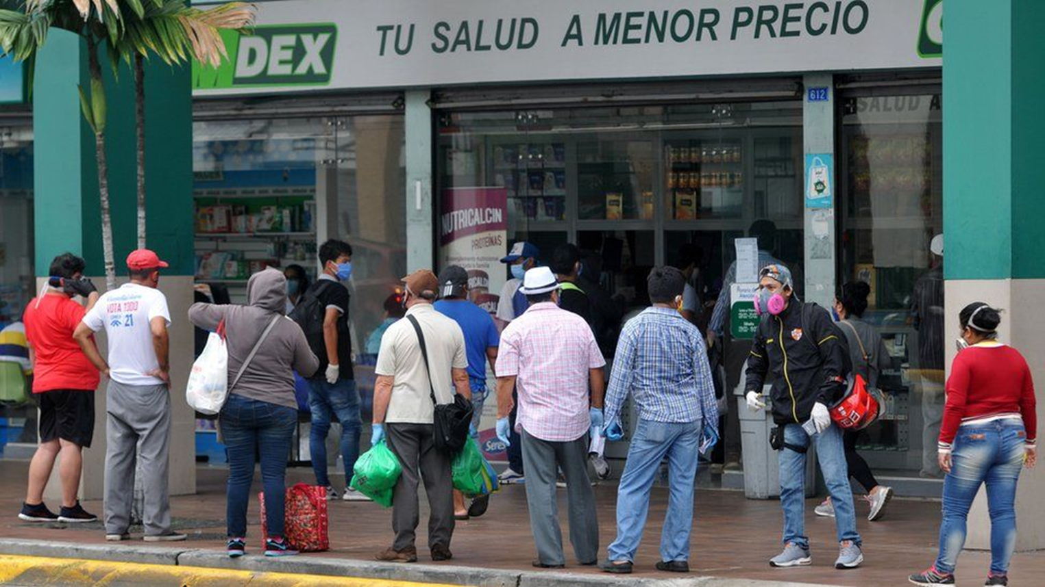
Task 2 Photoshoot (Approx 1 hour) (You might want to split this task up across your week to document different events of your week e.g. clapping on a Thursday night for the NHS)
Task: Once you have collected your research, you will now start to create your own images through photography.
Use your photo/tablet/camera to take a series of 15 photographs to go with the theme ISOLATION. You could consider your own experience of the lockdown.
The most successful A Level projects start with a strong set of photographs to illustrate your initial ideas. At A Level it is more important to personalise your work early on, rather than relying on found images for too long.
Aim to be imaginative with the way you set up your photographs. The sample images and suggestions on the next slides should help you.
Parisian residents applaud to show their appreciation of healthcare workers.
As in many other countries now, long queues form outside Guayaquil's pharmacies.

Slide 10
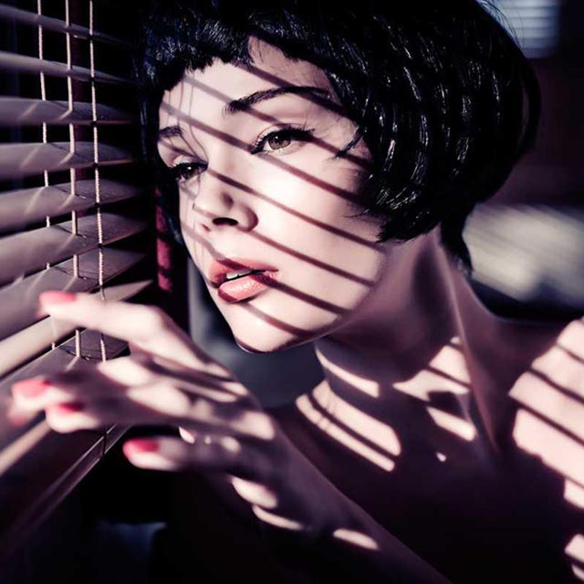
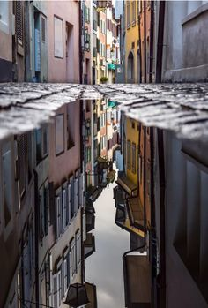
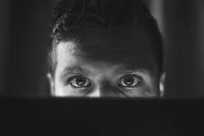
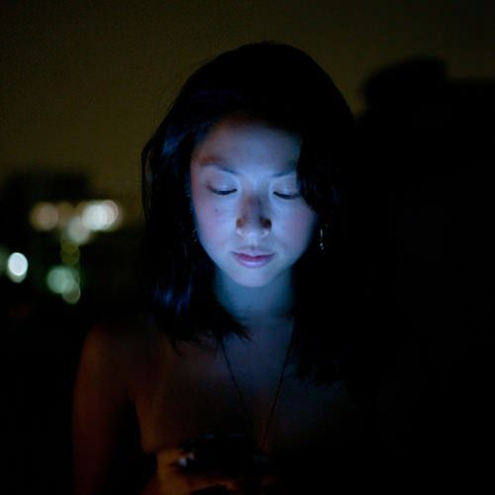
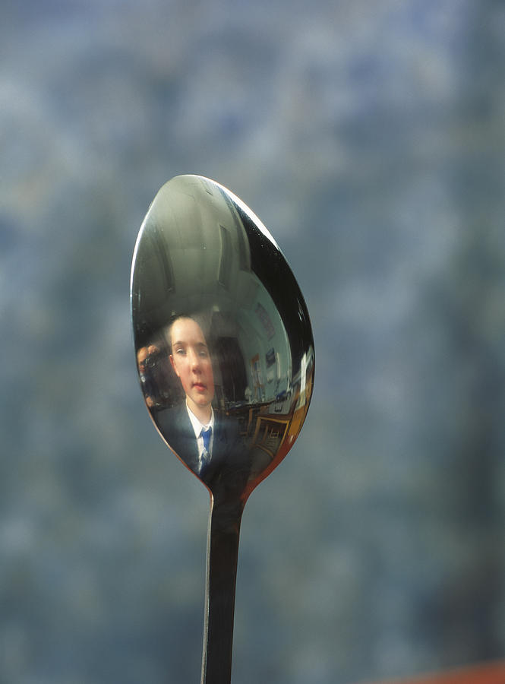
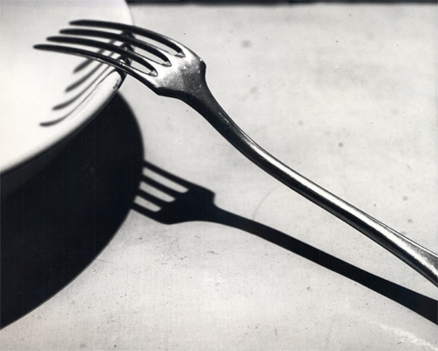
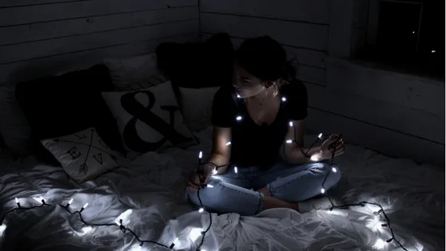
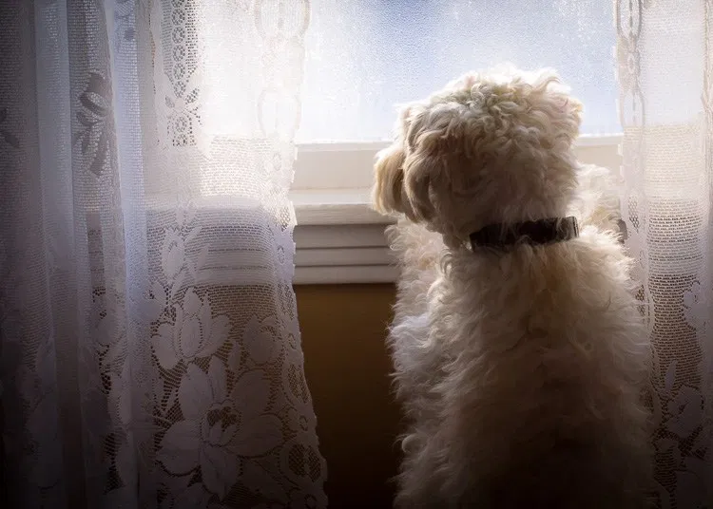
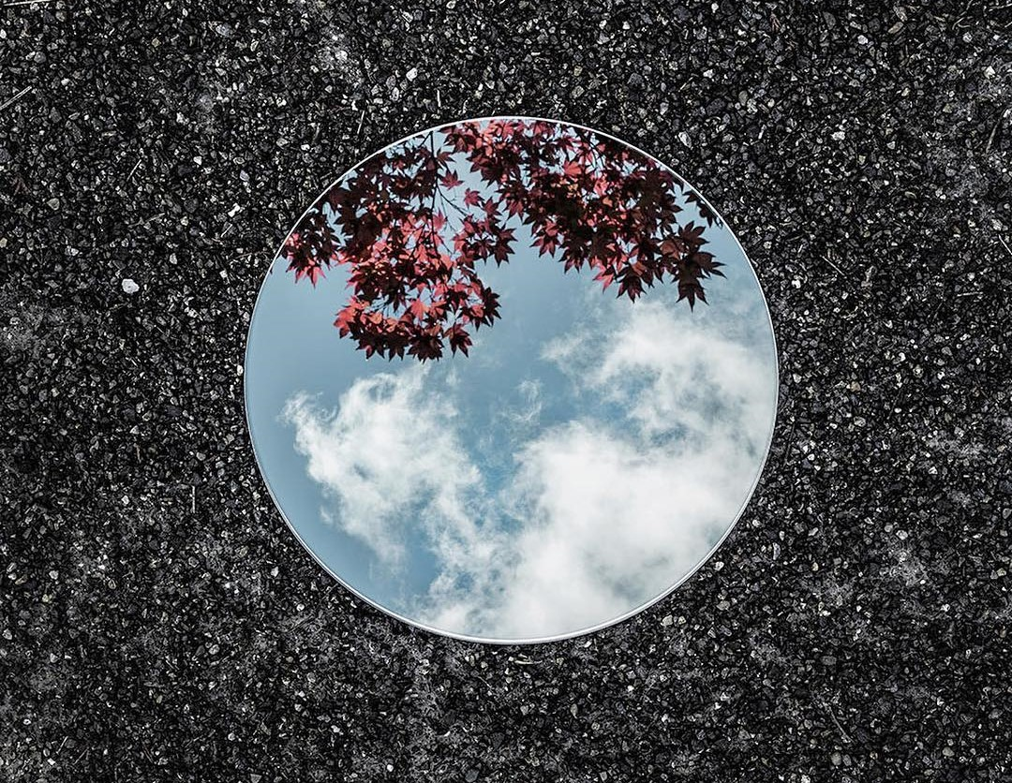
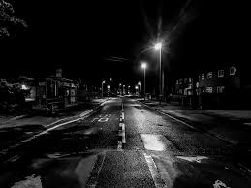
Experiment with lighting.
Could you use natural light, torches, candles, fairy lights, lamps, street light, light from a phone or laptop screen, window light? What time of day will you take your photographs?
Dramatic Shadows & Reflective objects can add depth to your photographs and change the mood of your work.

Slide 11
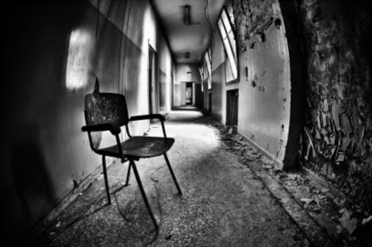
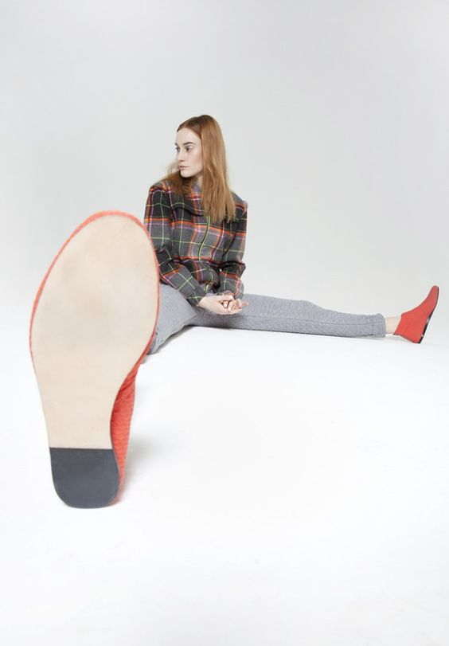
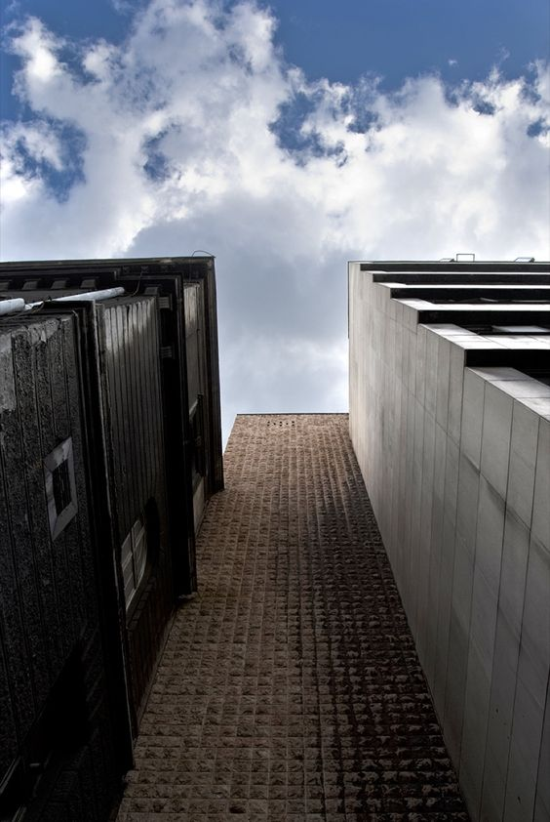
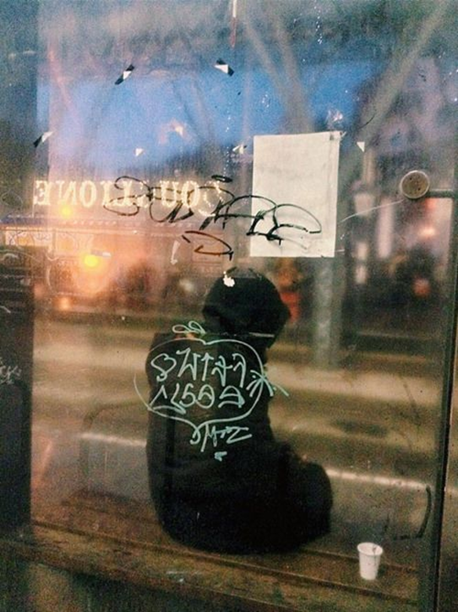
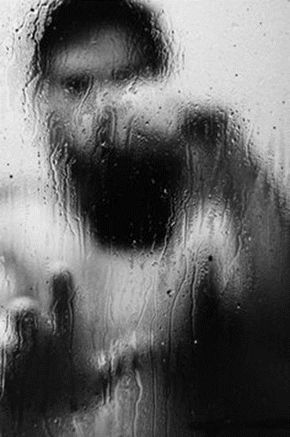
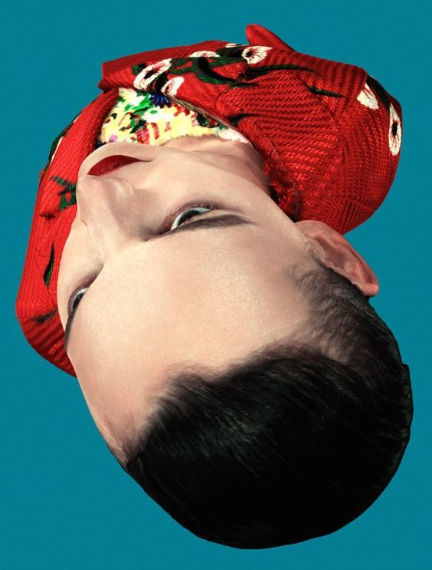
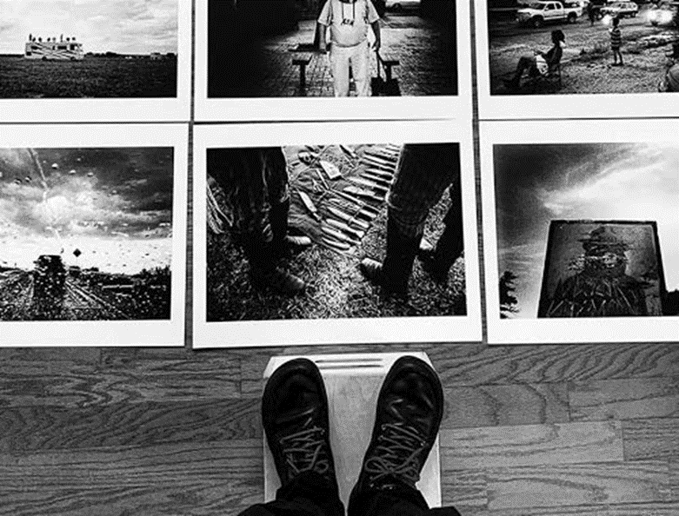
Changing the viewpoint from where you take your image. Get down on the floor or higher than your subject. This will help you capture exciting unusual angles in your work.
Change the angle that you shoot from
Lie down on the floor
Shoot under or below things
Birds eye view
Zoom right in on something
Take a photograph from a reflection

Slide 12
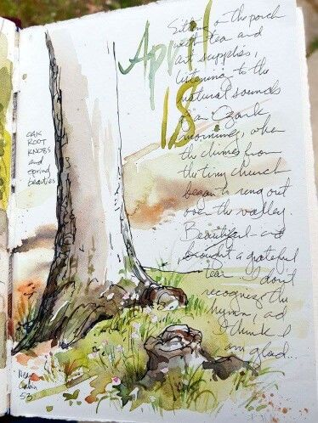
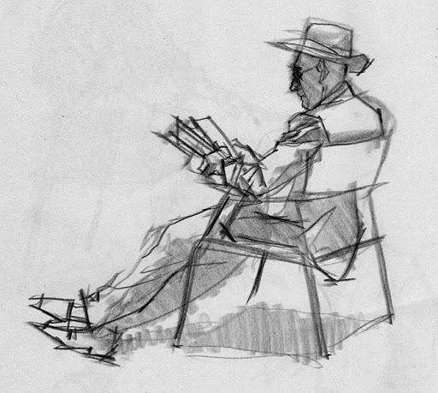
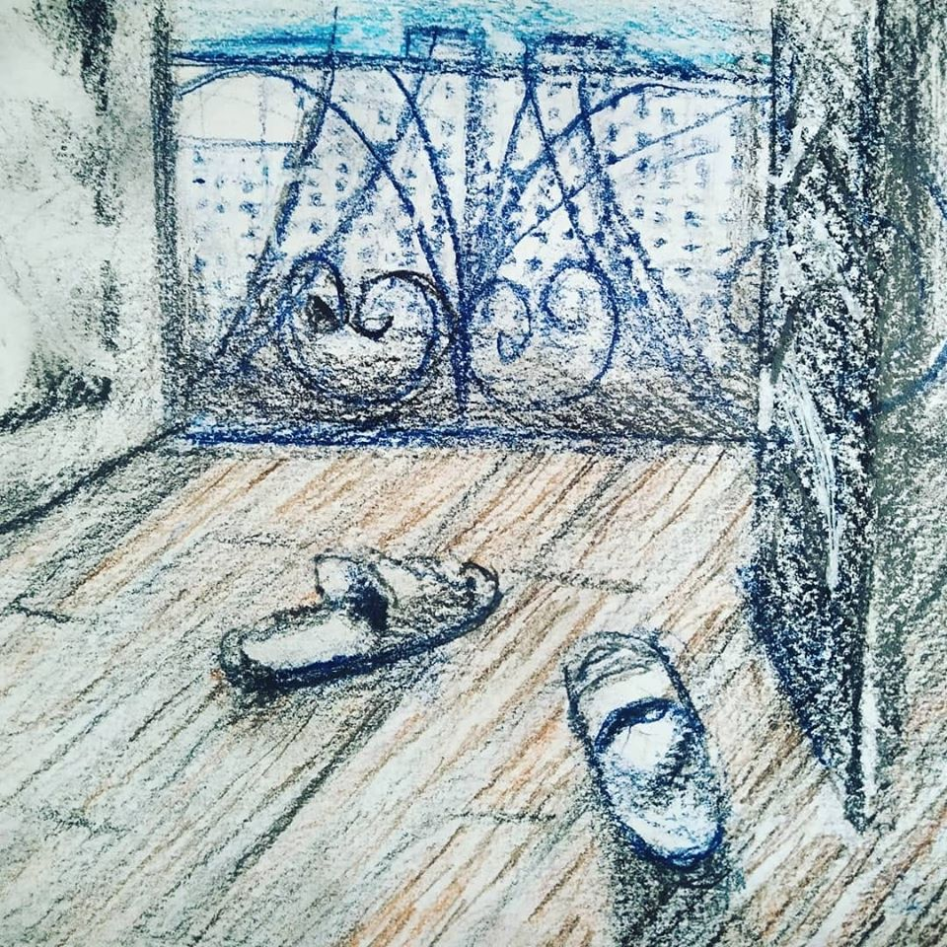
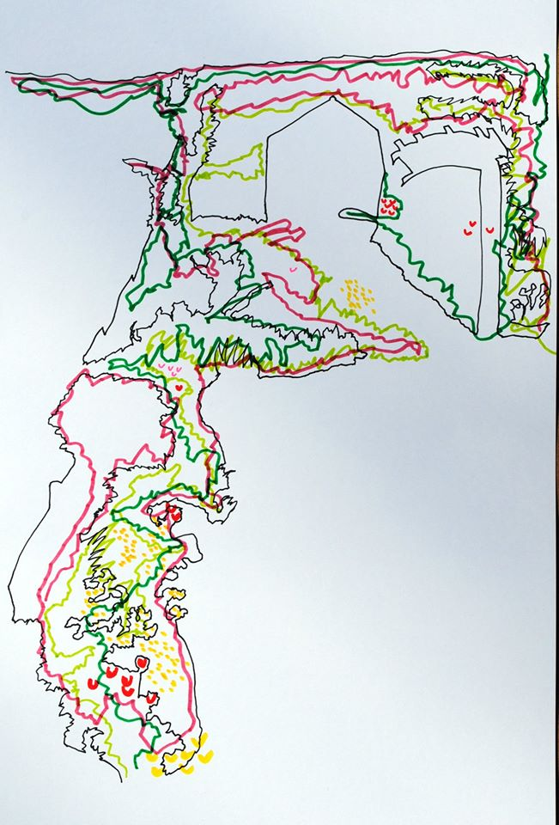
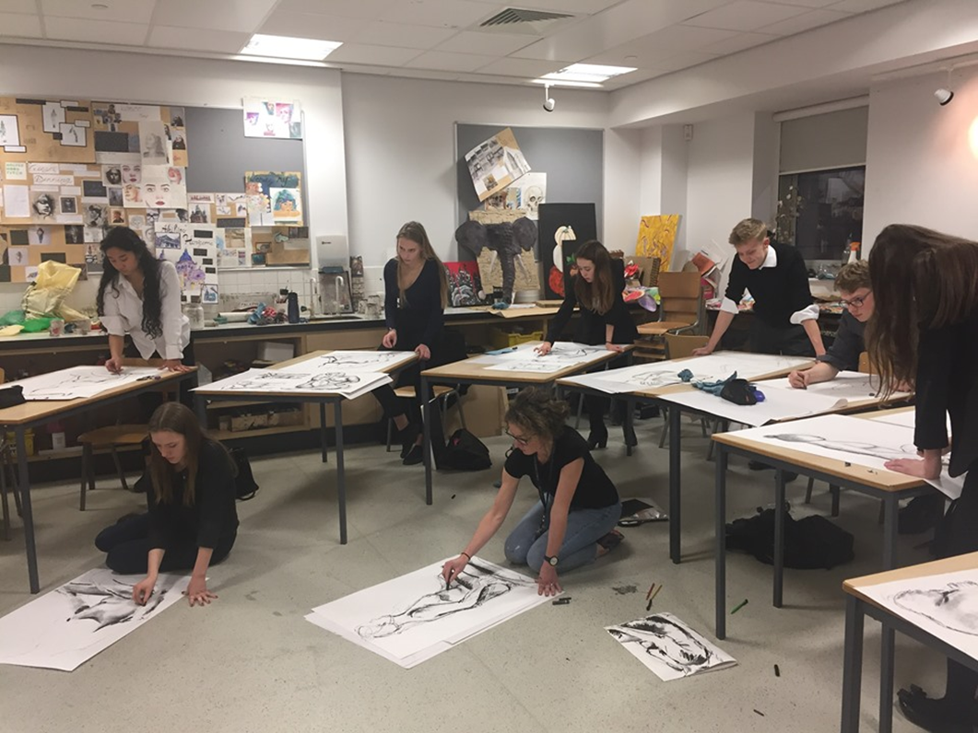
TASK 3: Create lively Sketches and drawings across your double page/board, but instead of working from images work from things that are in front you, draw from life. E.g. A drawing in your garden; drawing someone absorbed in a task or an object. (approx. 2 hours)
Consider the following:
Experimenting with the way you use LINE in your drawings (looser lines/tight lines/heavy/light)
Building up layers of pencil and pen.
You can add washes of watercolour/coffee/watered down acrylic to add a suitable background to your drawings if you have them available.
Don’t be too precious about your drawings. Drawing from life has to be quicker to capture what’s in front of you. It’s a tricky skill to practise, but does make you more confident and observant in the long run!

Slide 13
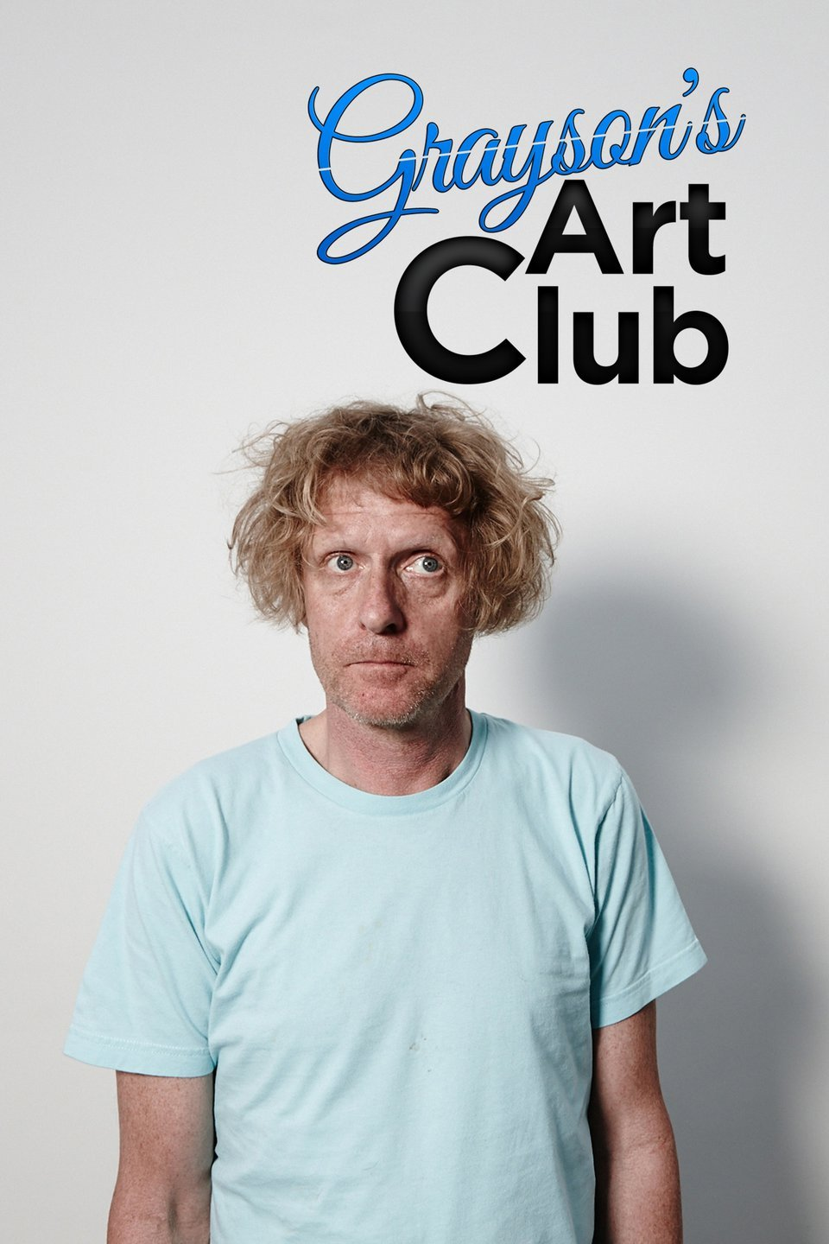
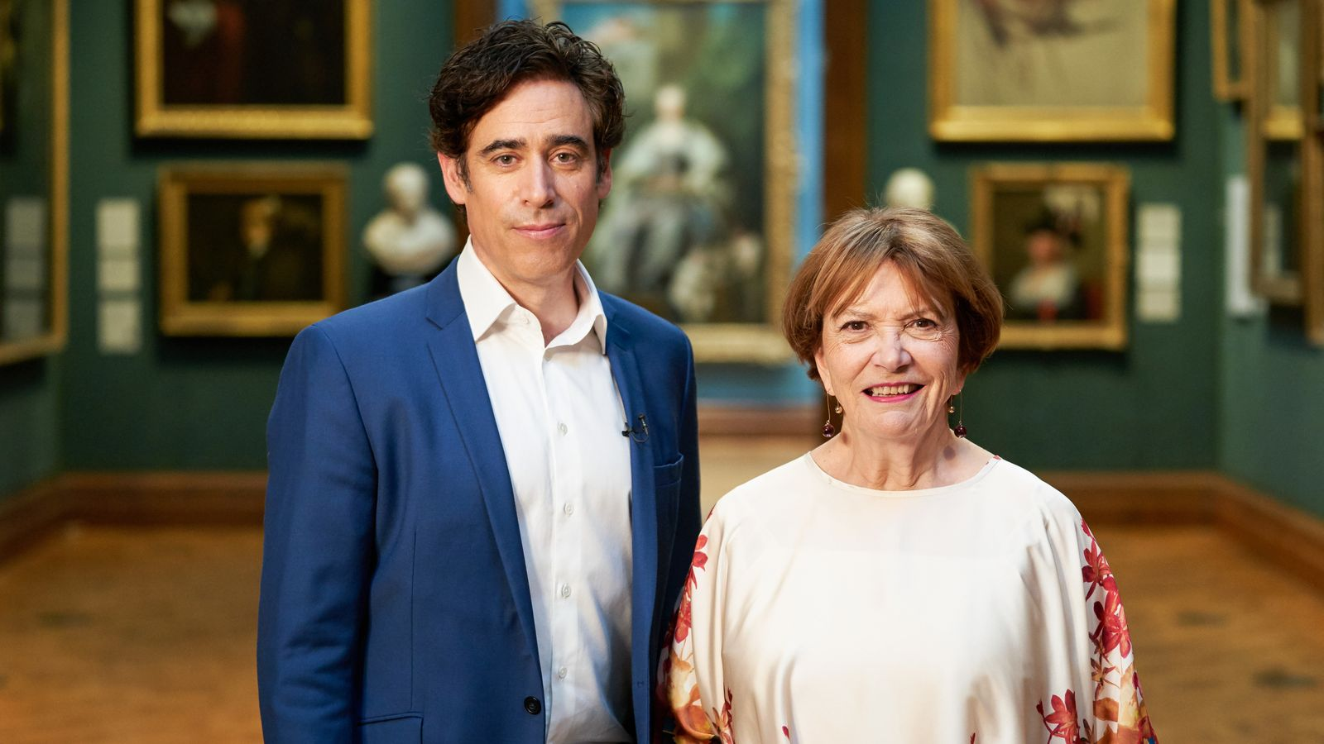
Things to Watch Airing Monday 27th April
There’s also lots of Art clubs during lock down appearing on Instagram.
Antony Gormley, Tacita Dean and Vic Reeves are among the guests that Grayson Perry is inviting, via video call, into his workshop as he encourages the UK to think creatively while in isolation on a new Channel 4 show.
Grayson’s Art Club launches on Monday with Perry promising to help “battle the boredom” and take viewers “on a journey of art discovery” with a six-part series of themed shows where the British public is encouraged to create their own work.
The first episode’s theme is “portrait” and will feature the American-born English artist Chantal Joffe who is known for her large-scale figurative paintings and the comedian Joe Lycett, who recently changed his name to Hugo Boss, and has taken up portraiture during the lockdown.
The Portrait Artist of the Year competition on Sky Arts will now become a free, weekly paint-along programme to entertain viewers during lockdown.
Viewers at home will be invited to paint the “celebrity sitters” who appear on the Sky TV Facebook page, posing live from their own houses.
Those painting at home will then be able to submit their final portraits via Instagram (@artistoftheyear) so that judges Tai Shan Schierenberg, Kathleen Soriano and Kate Bryan can pick out their favourites.
Dancer and choreographer Akram Khan will be the first subject for amateur artists to paint, sitting still for four hours from 10am on Sunday 26th April.

