Slide 1
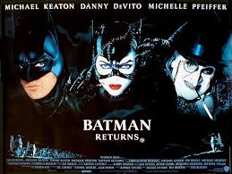
Batman Returns (1992)
Music by Danny Elfman

Slide 2
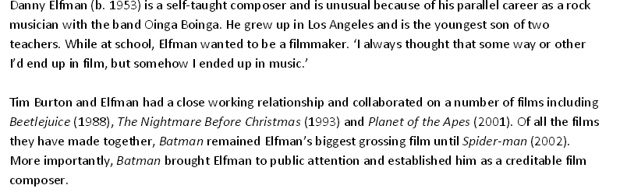
Composer – Danny Elfman

Slide 3
What is a leitmotif?

Slide 4
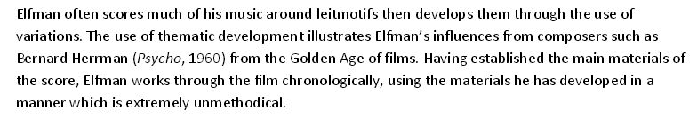
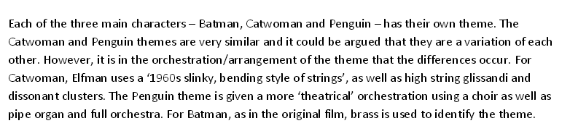
Leitmotif
How might a leitmotif change throughout the film and why?

Slide 5
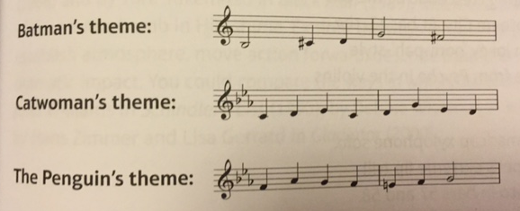
Copy out and label the notes
Play them through – can you make alternative versions of the same leitmotif to change the mood?

Slide 6
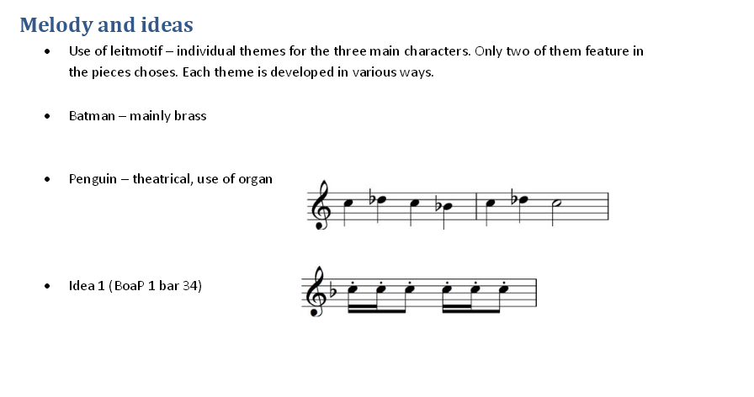

Slide 7
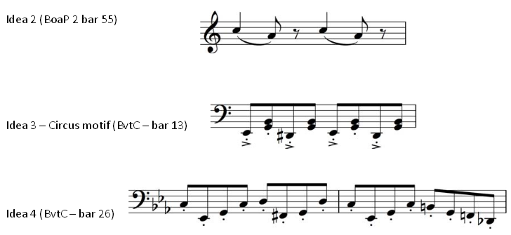

Slide 8
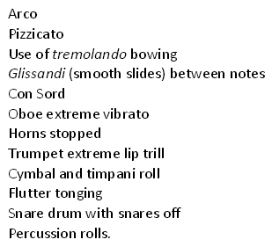
Performance techniques
Pick one of the 4 extracts
Find out which of the list happens in your piece, find out what it means, explain what it sounds like and identify a bar number in which it happens

