Slide 1
The UK Revision
TOPICS
Location
Geography of the UK
Atlas work
Climate
Migration
Population change
Waste
Employment structure
Economic distribution
UK in the world

Slide 2
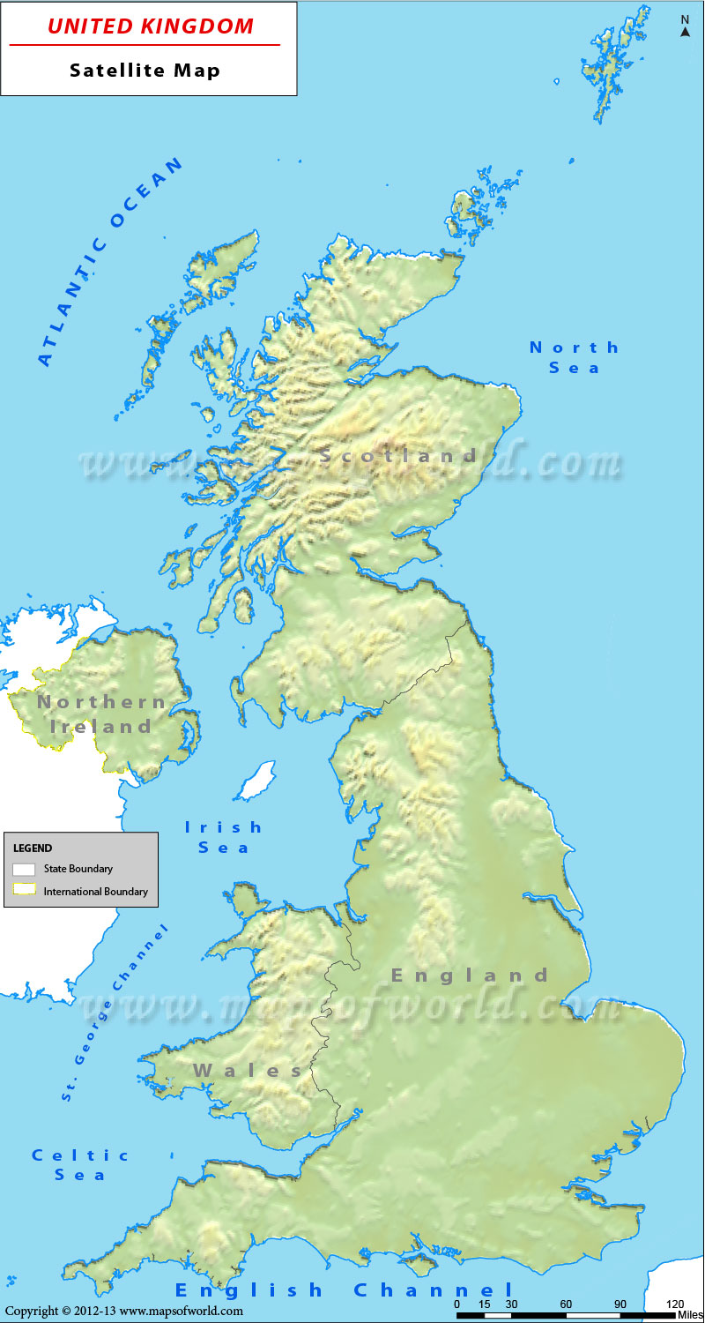
Climate – match the statement with the area on the map
Warm summers, cold winters, dry
Mild summers, mild winters, wet
Warm summers, mild winters, not so wet
Mild summers, cold winters, not so wet
What causes these differences??
A
B
D
C

Slide 3
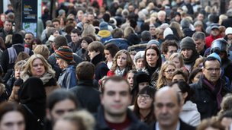
Migration
What do the terms migration, immigration and emigration mean?
What reasons are there for migration? (push and pull?)
What groups of migrants have come to the UK over time?
Who were the first migrants:
Celts
Romans
Angles
Saxons
Vikings
Normans

Slide 4
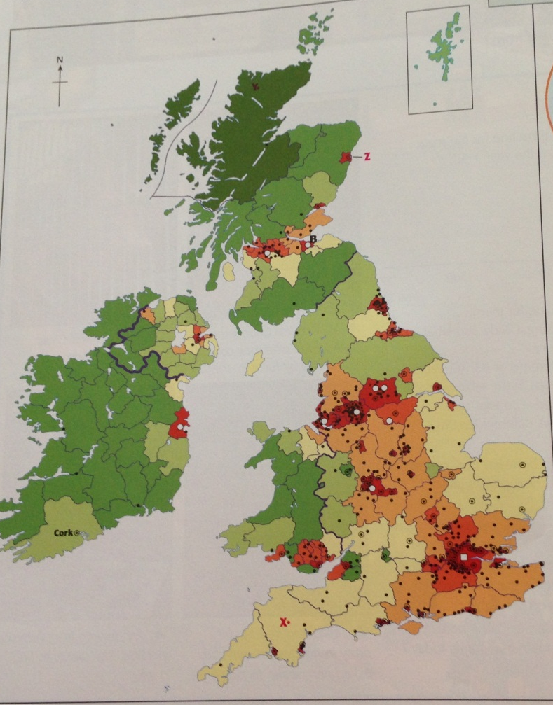
Population change
What has happened to population over time?
Where is the population spread? (population density)?
Why is England so densely populated?
Why are cities more populated?

Slide 5
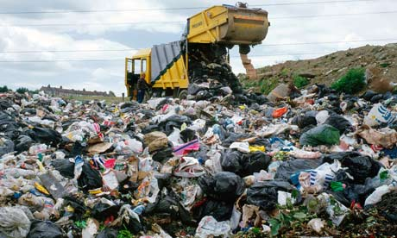
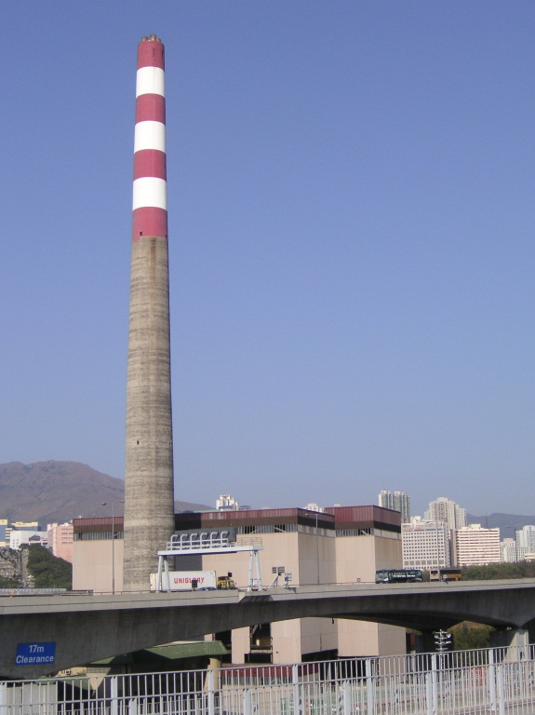
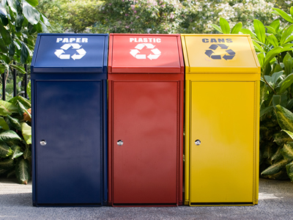
Waste
Why is there a problem with our waste?
How do we deal with our waste?
What are the positives and negatives of these?

Slide 6
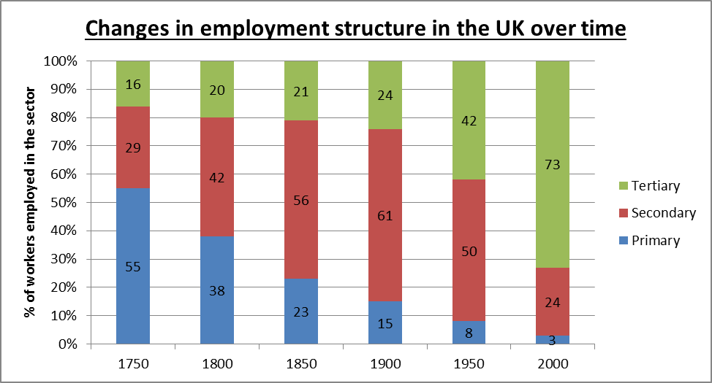
Employment structure
Primary | Secondary | Tertiary | Quaternary
Categorise these into table above: Nurse, Postman, factory worker, oil rigger, actor, gene researcher, footballer, fireman, farmer, miner, policeman, bank manager, builder, inventor
What has happened to employment structure over time?
How do you plot a divided bar graph?

Slide 7
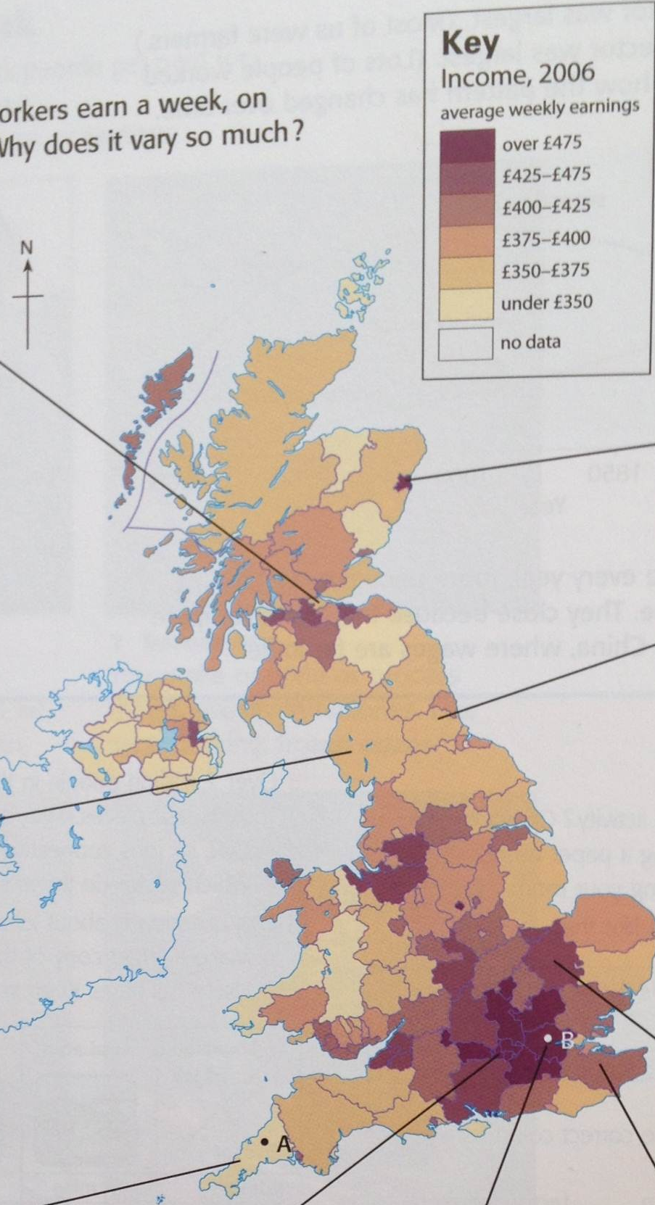
Economic distribution
What is the pattern of economic distribution?
What helps an area become wealthy?
How can governments help poorer areas?

Slide 8
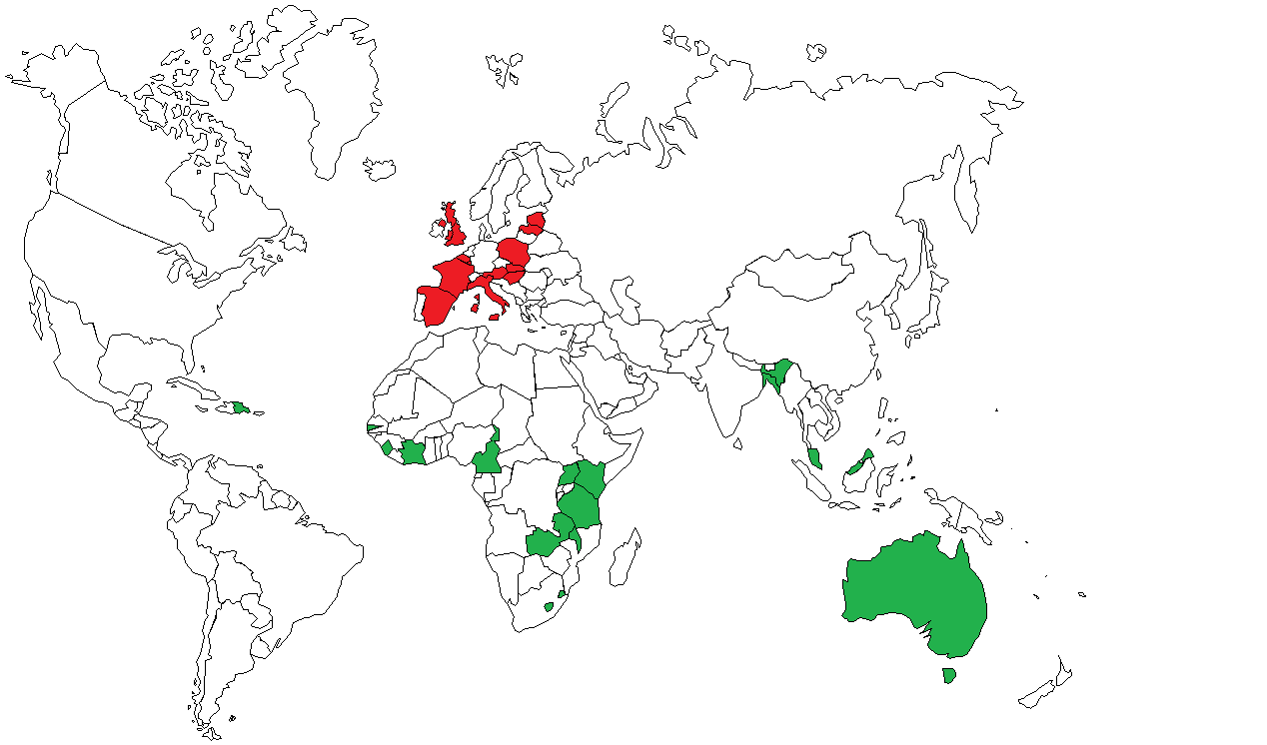
UK in the world
What links the UK to the countries highlighted on the map?
How is the UK linked to the world by:
  Language and culture
  Tourism
  Trade
  Aid
  TNCs
  Treaties

