Slide 1
AQA
    GCSE
      Design and Technology 8552
Working with textile based materials
Unit 5E
  Textiles
2

Slide 2
Objectives
Understand how textiles and components are available in standard forms and sizes
Be aware of school and commercial based cutting, forming and processing techniques

Slide 3
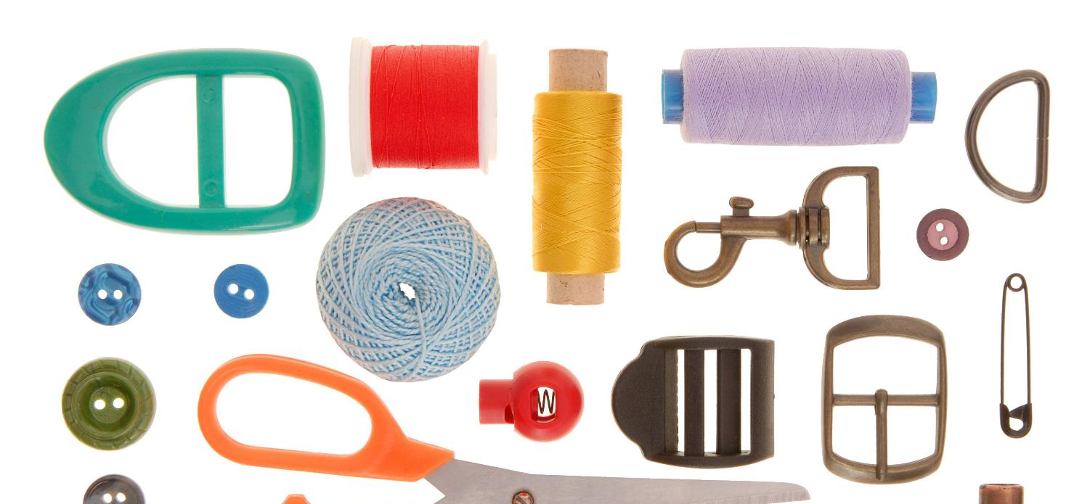
Starter
Think of a product you want to design and make
  What factors would affect your choice of material
  and components?

Slide 4
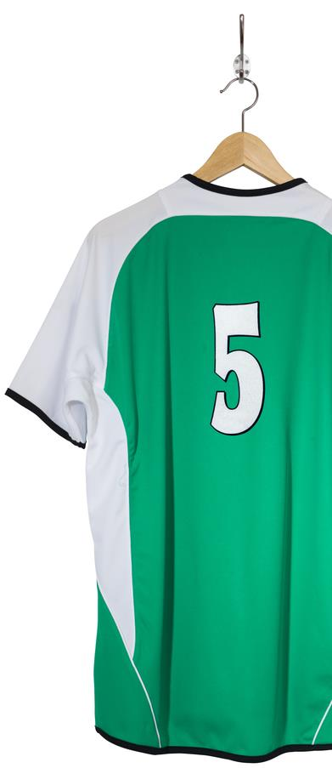
Textile properties
How are the physical and working properties of polyester suitable for sport shirts?
  Use the headings below to help you
Aesthetics | Drape
Intended lifespan | Cost
Where it will be used | Size of material available
Stability | Suitable finish
Availability | Desired properties
Weight | Workability

Slide 5
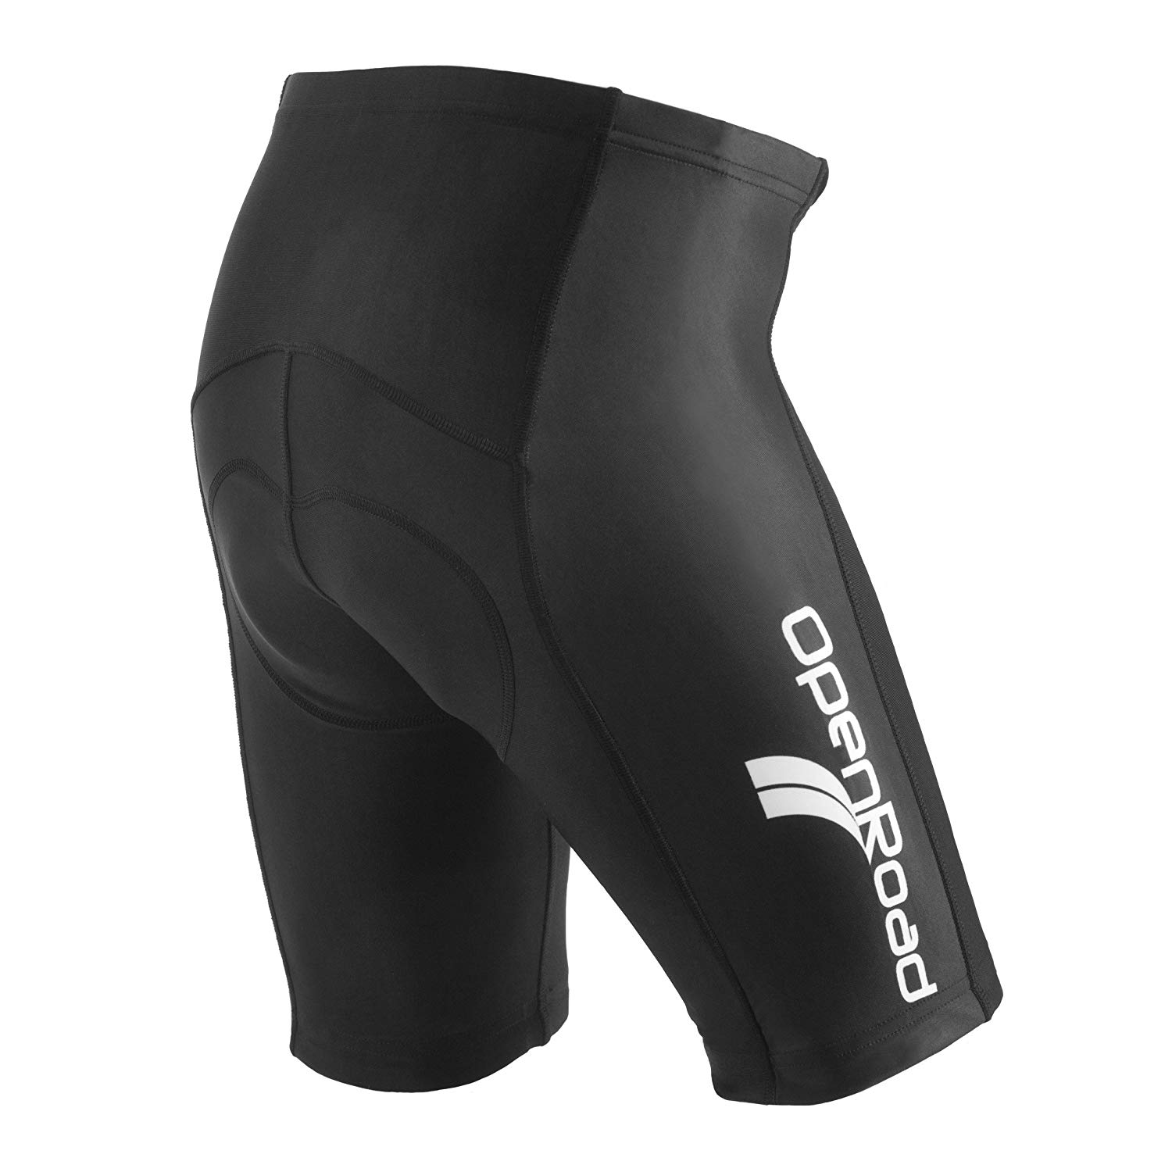
Textile properties
How are the physical and working properties of elastane for cycling shorts: Use the headings below to help you
Aesthetics | Drape
Intended lifespan | Cost
Where it will be used | Size of material available
Stability | Suitable finish
Availability | Desired properties
Weight | Workability

Slide 6
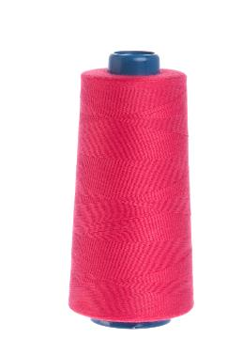
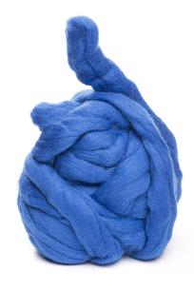
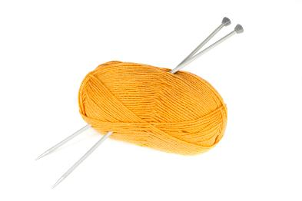
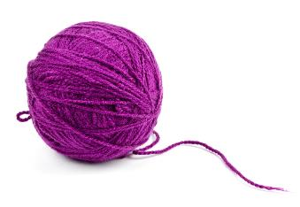
Stock forms
Yarns are sold in various different forms and are usually sold by weight or per unit
  High-street stores often sell these stock items per unit
  Industrial manufacturers buy yarns according to weight
Hanks
Skeins
Balls
Reels or Spools

Slide 7
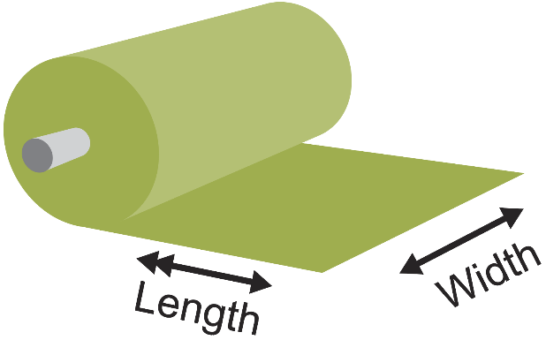
Standard roll form
Fabric is sold on a roll or ‘bolt’ with standard widths
  Standard widths vary from one roll to another
  As a buyer, you will need to specify the length you need
  Why might some projects require a specific roll width?

Slide 8
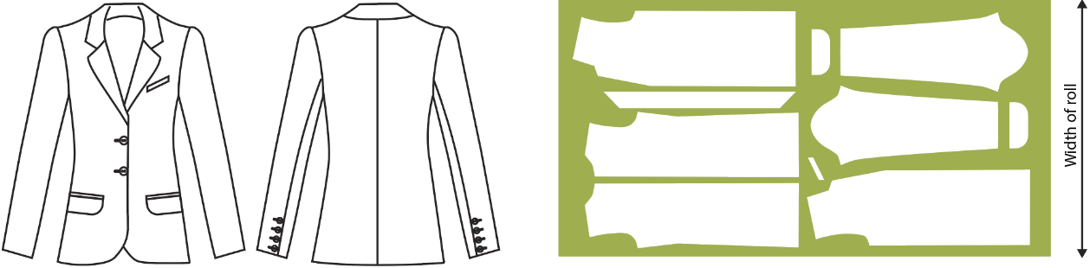
Roll widths
Different products will have different lay plans so one specific roll width will make more efficient use of the fabric area
  Similarly some larger parts may only fit on a wider roll of fabric
Jacket lay plan

Slide 9
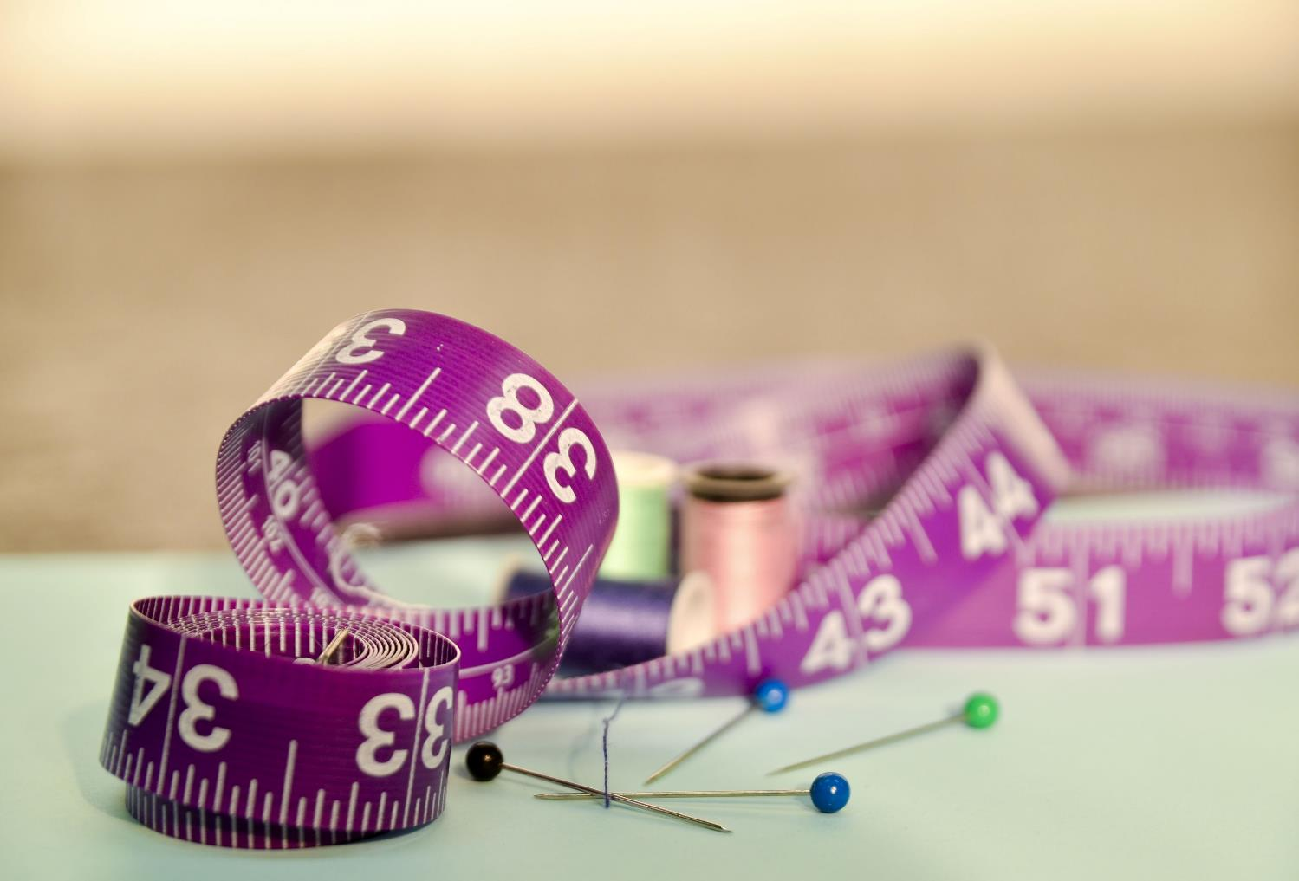

Standardisation
What advantages are there to having standard types and sizes of yarn, fabrics and fasteners?

Slide 10
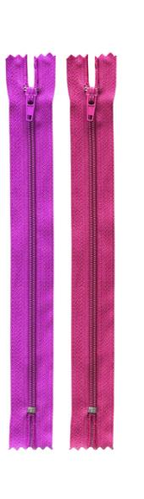
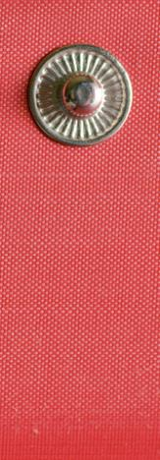
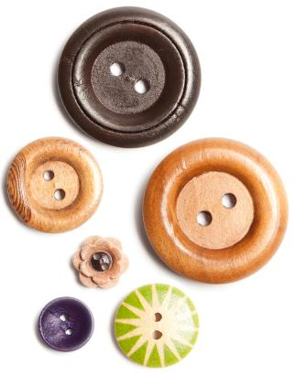
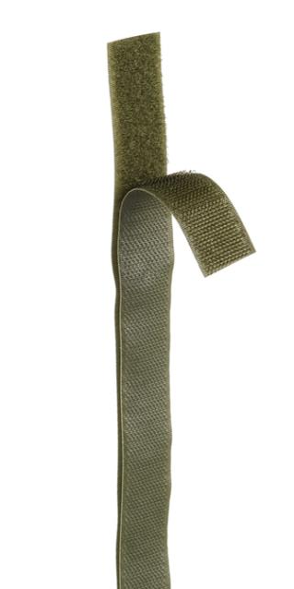
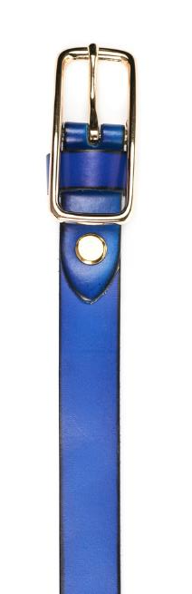
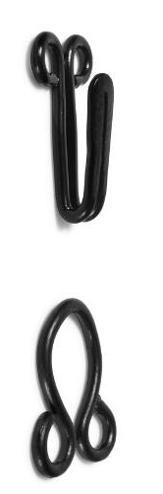
Components
Many common types of fastener are available to work with a range of common types of fabric
  What fasteners are you wearing today?

Slide 11
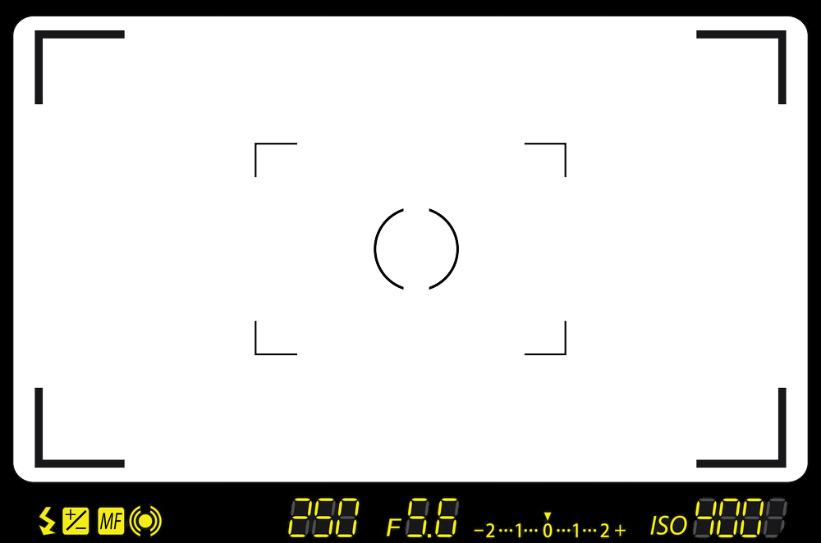
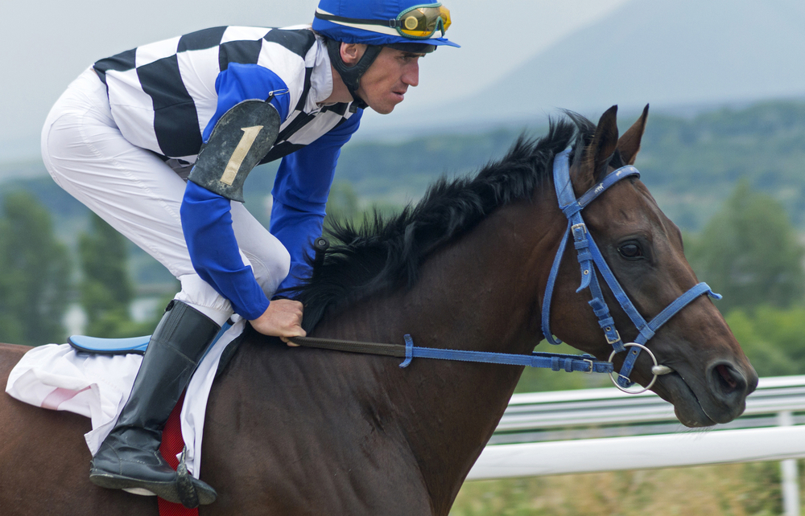
Worksheet 2 Task 1

Slide 12
Components
Headgear:
Ladder lock buckle, clip, elastic
Top:
Safety pin, button
Trousers:
Zip,
button/ popper/ pop stud/ hook and bar, elastic
Bridle:
Buckle, eyelet, ring

Slide 13
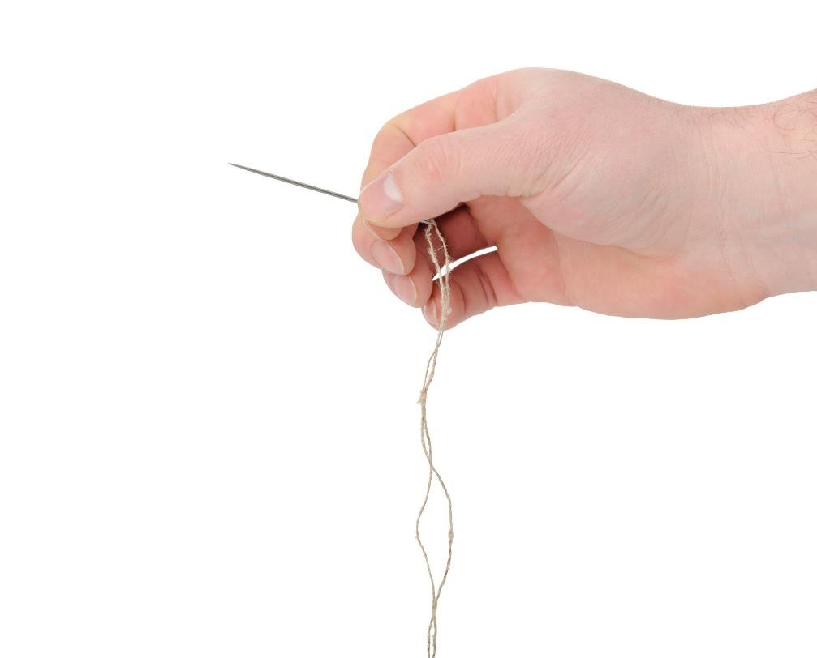
Shaping, processing
and machining
How can you change the shape, colour, texture, pattern or structure of a fabric or product?
  Suggest ways in which fabric may be processed within school

Slide 14
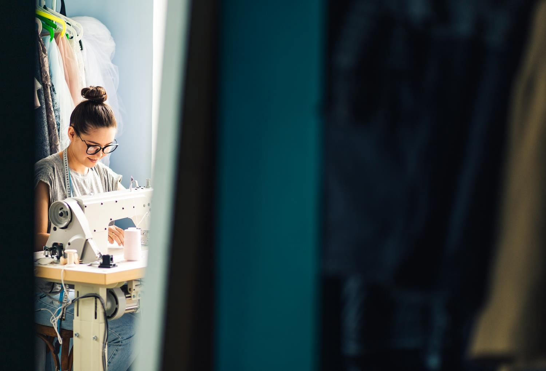
Sewing
Whether sewing by hand or machine there are a myriad of different styles to choose from
  Modern sewing machines have many different settings and the length and width of these stitches can be changed for further variety

Slide 15
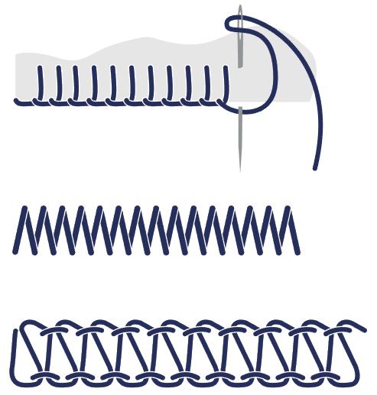
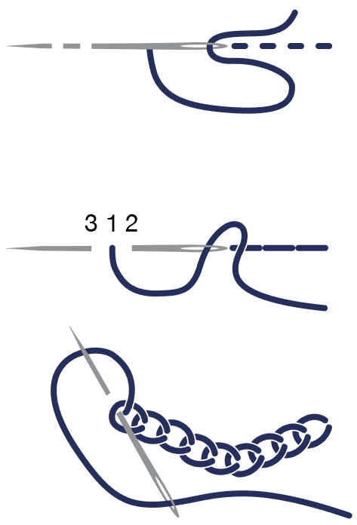
Types of stiches
Identify the following six types of stitch:
  What factors might you consider when choosing a
  stitch style?

Slide 16
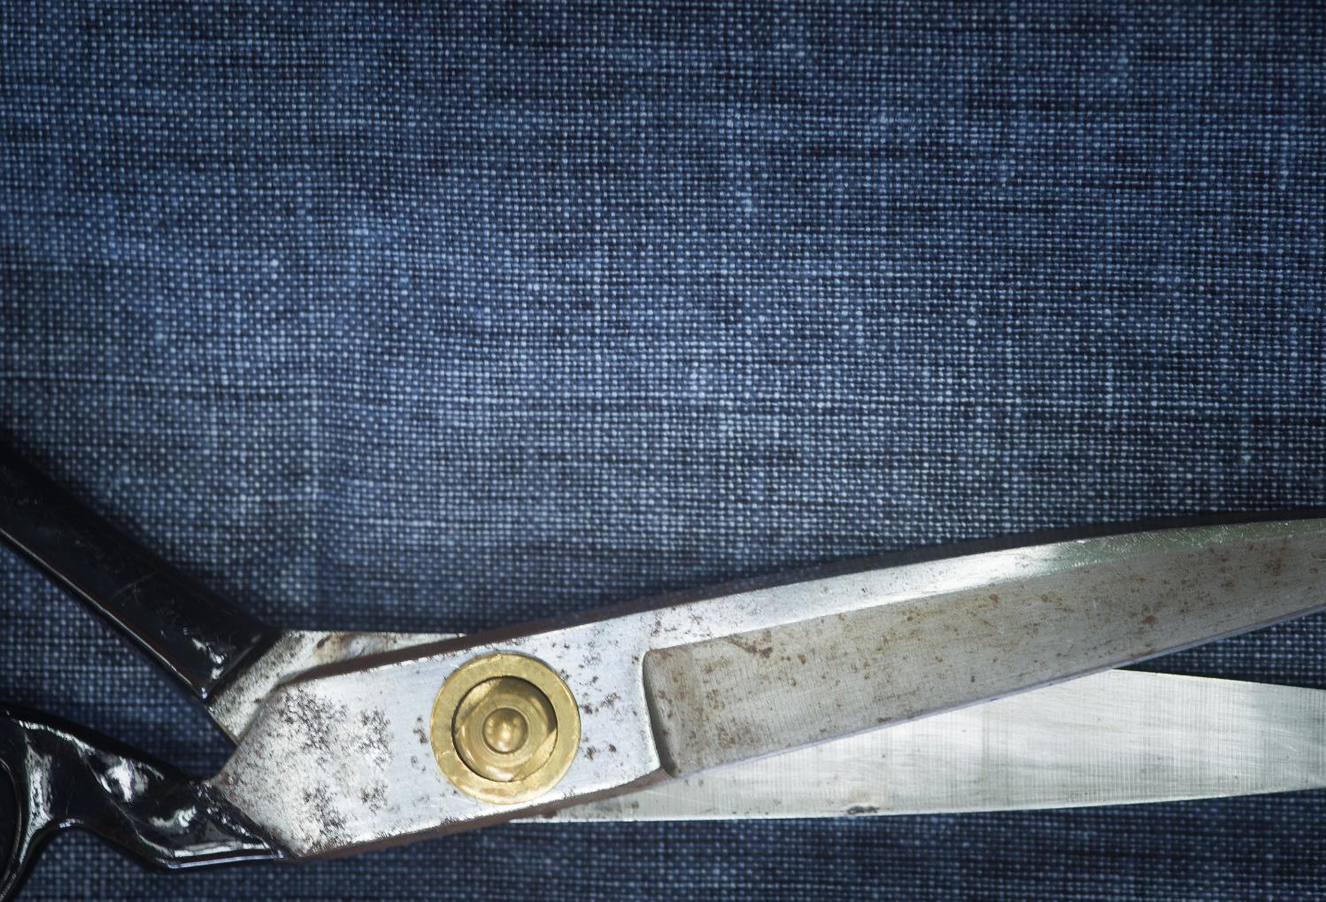
Cutting
Bespoke tailoring requires a range of common tools
Mass and batch production of garments requires efficient and accurate commercial cutting tools
These include:
  Textile band saws
  Electric rotary cutters

Slide 17
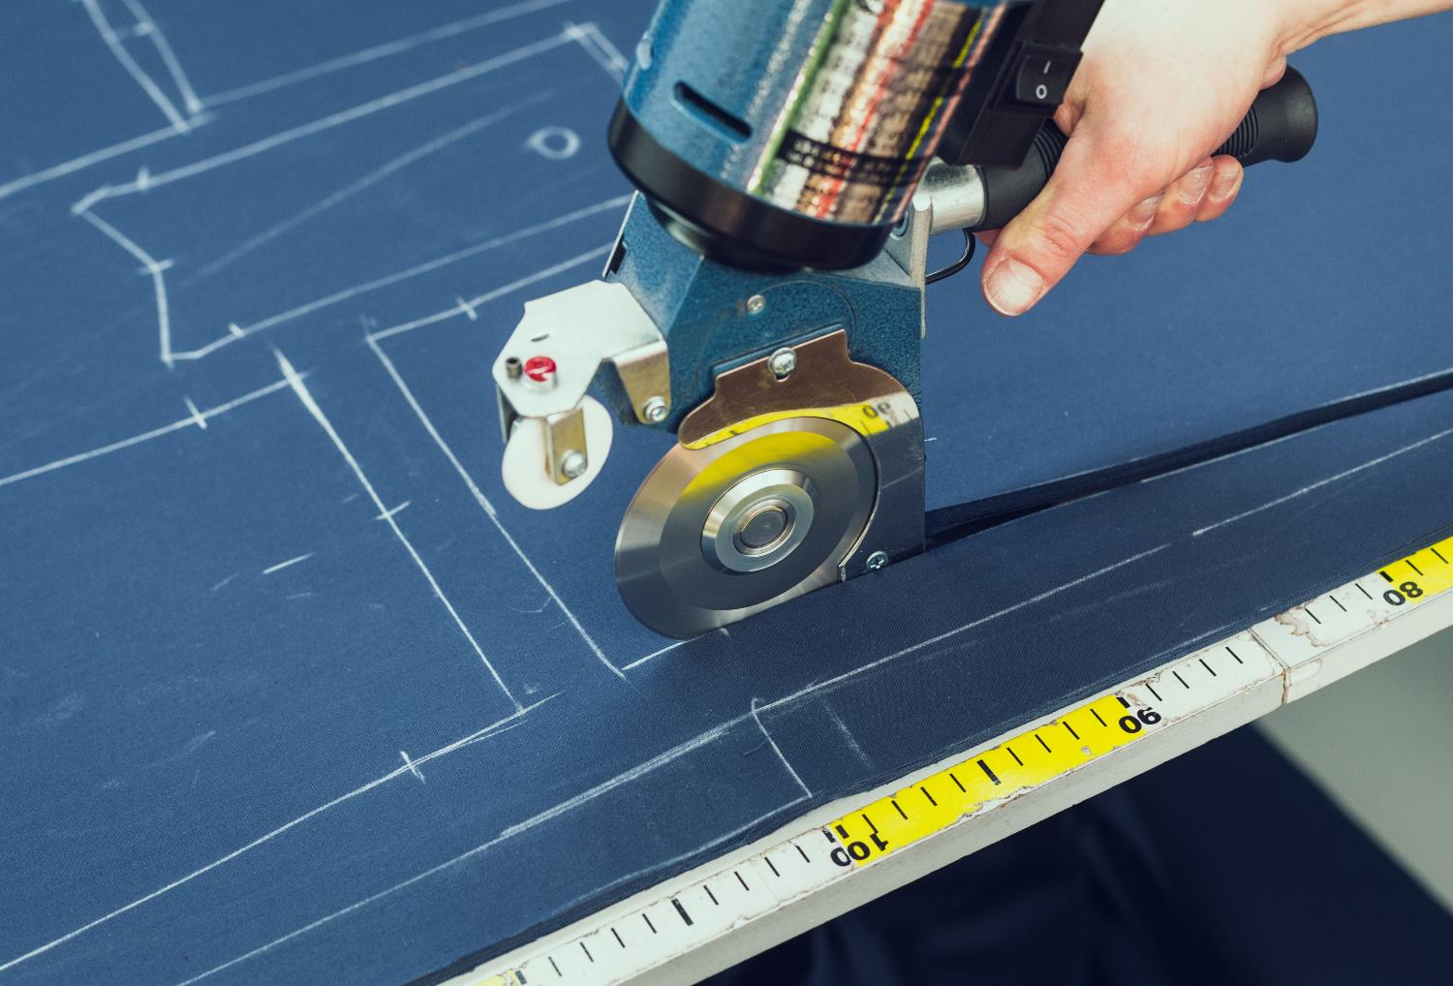
Worksheet 2 Task 2
Correctly match the tools to their descriptions

Slide 18
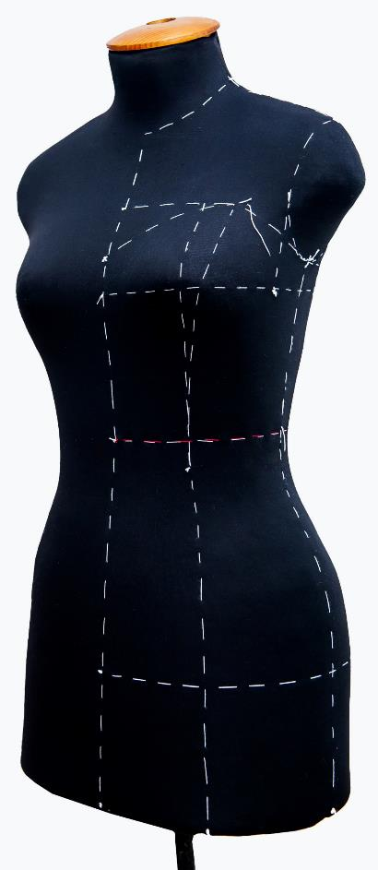
Draping fabric
For this method of fabric manipulation a draper will use the natural drape and weight of the fabric to form a toile (prototype)
  The toile will later be used to make the final garment

Slide 19
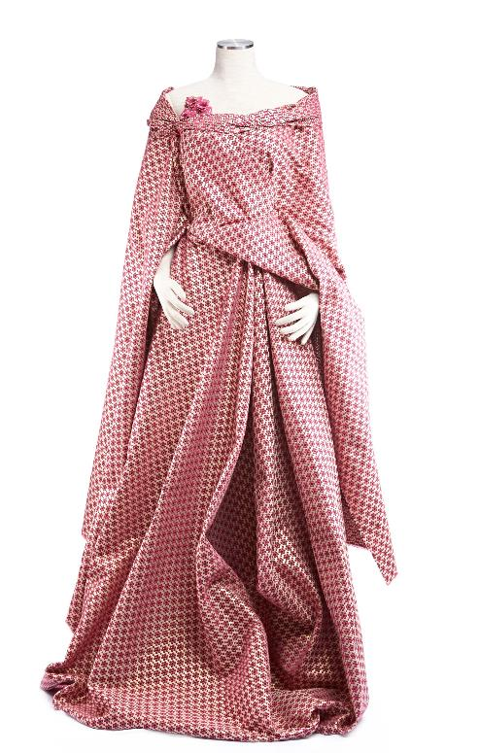
Forming a toile (prototype)
Skilled drapers pin lengths of cloth to a dummy or stand, usually at the shoulder or waist line
They then pin, fold, pleat, gather and tuck the fabric into the correct shape for any given garment
Fabric is often pinned to the stand on the bias
  What does bias mean?
  What are the benefits of draping?

Slide 20
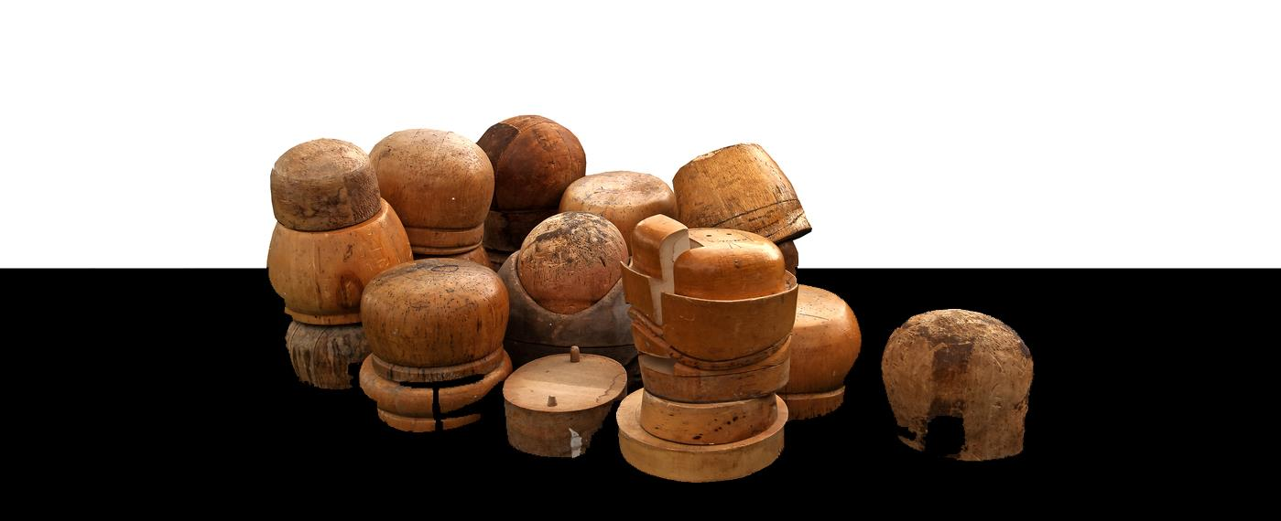
Draping felt
Millinery is the art of hat making. A common technique used in hat making is called draping
  Felt fibres are repeatedly soaked in hot water then stretched and formed over a hat block and left to dry
  Pins and ties are used to hold the felt in place as it dries

Slide 21
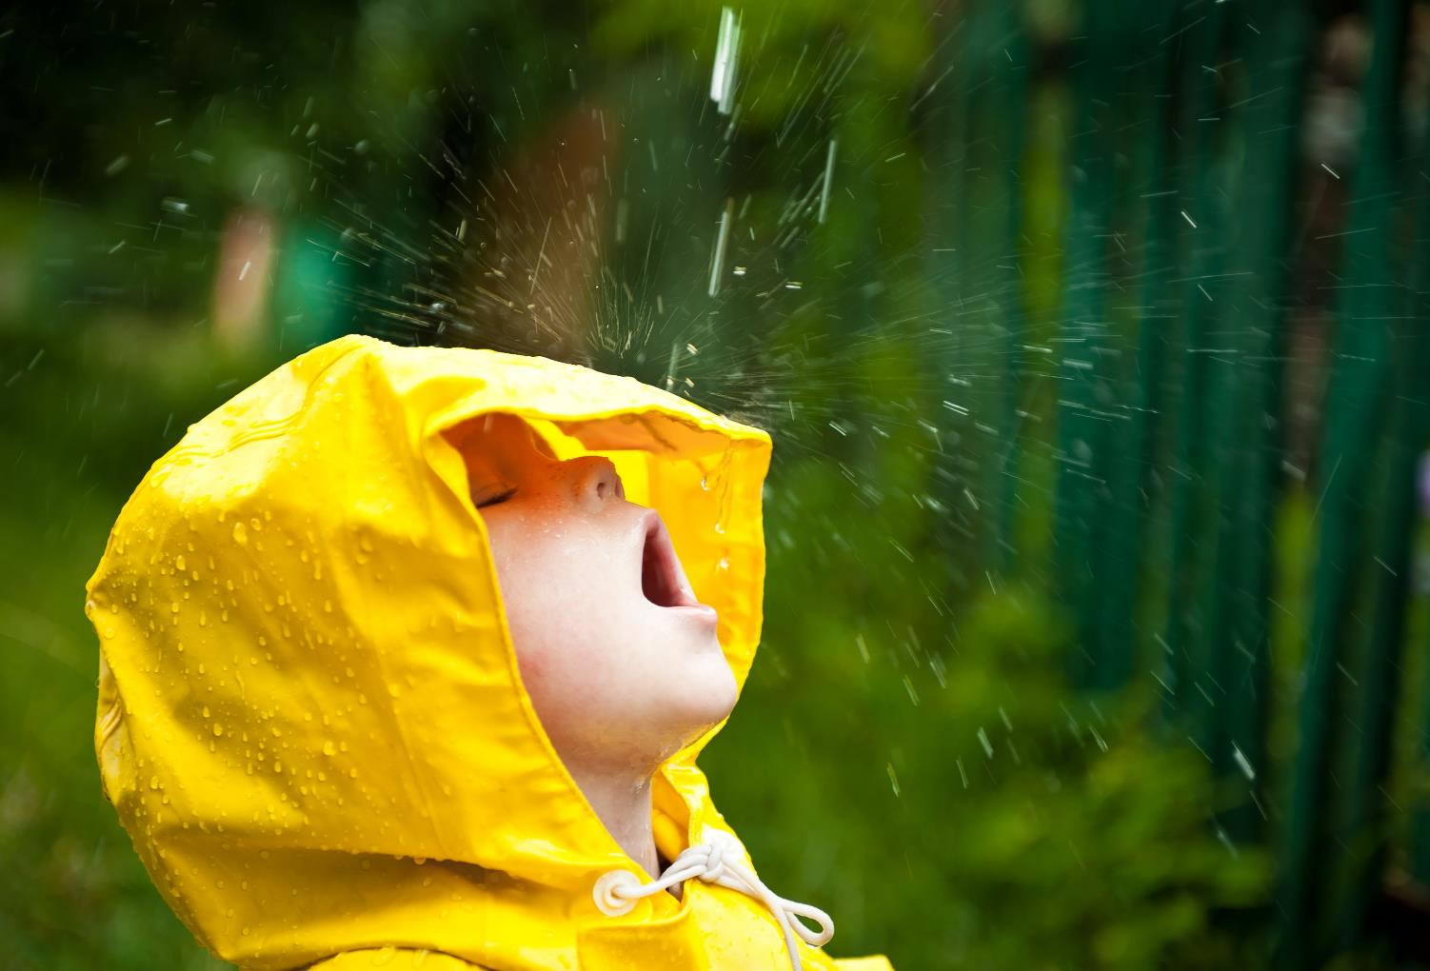
Layered and laminated fabrics
Fabrics can be layered together in multiple ply form to enhance their properties
  Suggest two examples
  of laminated fabrics
  used in sportswear
  How could the ply
  layers be bonded
  or held together?
  What advantages are
  there of laminating
  different fabrics?
. In the case of a laminated fabric, a film, foam, or another fabric, as a preformed material, is bonded to the first fabric by an adhesive. Coated fabrics generally cost less than laminated ones because coating combines film formation and bonding into one process.

Slide 22
Coated fabrics are engineered flexible composite materials consisting of a textile and a polymer coating attached to the fabric surface. Polymer is coated on as a thickened liquid solution or dispersion and under the action of heat, a continuous layer is formed as the liquid matrix is removed. Most coated fabrics have only one side coated but there is no reason why both sides cannot be coated. In the case of a laminated fabric, a film, foam, or another fabric, as a preformed material, is bonded to the first fabric by an adhesive. Coated fabrics generally cost less than laminated ones because coating combines film formation and bonding into one process.

Slide 23
In sports, previously a traditional apparel textile was used. For that the player has to face so many problems [1] such as: i. Sweating – which stick the fabric with body ii. Feeling hot during run iii. Improper stretch ability iv. Extra weight of the fabric v. Give protection to body skin during fall on the ground vi. Inadequate fabric for fluid resistance for swimmer vii. Windproof, waterproof fabric for sailor viii. Light weight shoe with proper strength & air circulation ix. High tenacity & resistance to abrasion for the skiwear uniform x. Improper gripping of the shoes during run etc.

Slide 24
3.2 Textile fibrous material Synthetic fibres can have either hydrophilic (wetting) surfaces or hydrophobic (non wetting) surfaces. Synthetic fabrics are generally considered to be the best choice for sportswear as they are able to provide a good combination of moisture management, softness, lightweight, insulation and quick drying. It is generally agreed that fabrics with moisture wicking properties can regulate body temperature, improve muscle performance and delay exhaustion [11]. Polyester has outstanding dimensional stability and offer excellent resistance to dirt, alkalis, decay, mold and most common organic solvents. Being durable, yet lightweight, elasticity and a comfortable smooth feel, these are all important qualities to consumers for wide variety sportswear applications. Excellent heat resistance, good moisture transport properties, low moisture absorption, easy care properties and low cost make it very useful for sportswear [12]. Otherwise, cotton provides a good combination of softness and comfort. However, cotton is not recommended for use in active sportswear because of its tendency to absorb and retain moisture [13]
].The use of carbon fibre as the main structural material in the sport such as various varieties of motor sport, in the construction of road cars, high performance sports equipment, thermal comfort of garments, diving suits, ski wear and active sportswear.

Slide 25

School-based dyeing
Dyeing fabric will permanently change its colour
Various techniques
are used, either by
hand or by machine
These include:
  Dip dyeing
  Tie dyeing
  Machine dyeing

Slide 26
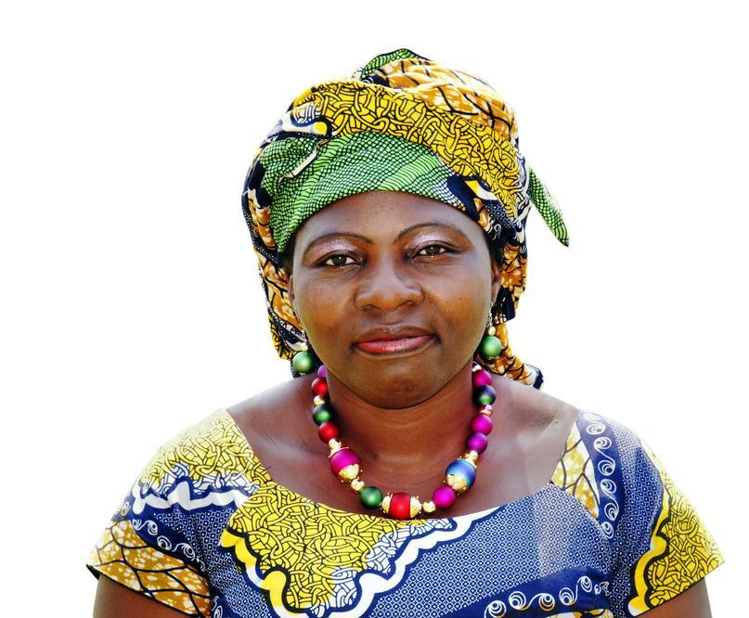
Batik
Melted wax is applied by hand with a tjanting tool or printing blocks
  Dye is added by hand to individual
  sections or to the whole fabric
  (commonly silk) in a vat
  The wax forms an impermeable
  barrier to resist the dye and is
  later removed with heat
  The process is then repeated
  to add additional colour

Slide 27
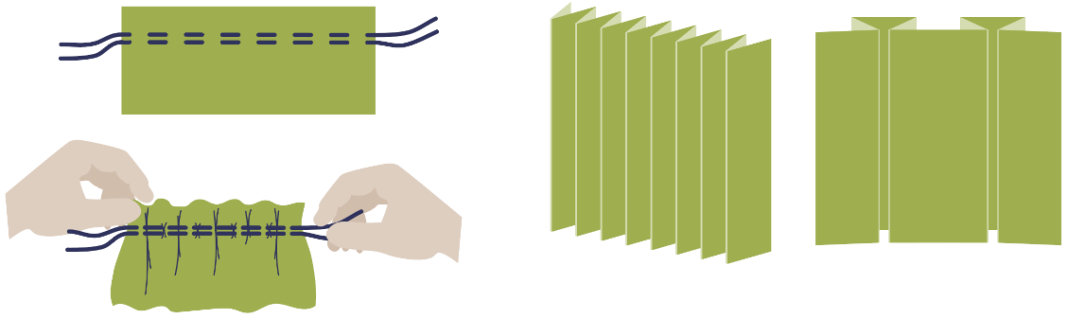
Pleating and gathering
Pleating and gathering are similar techniques which are used to add volume, elasticity, weight and/or freedom of movement to the user
Gathers can be elasticated to introduce stretch into a garment
Pleats come in many different folded forms and are usually ironed and stitched in place

Slide 28
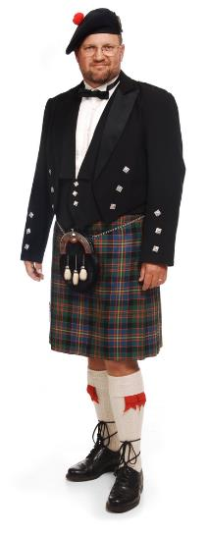
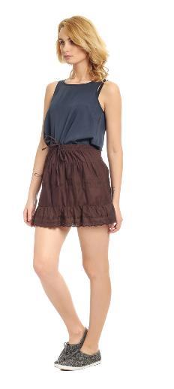
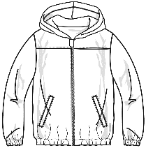
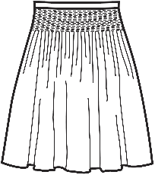
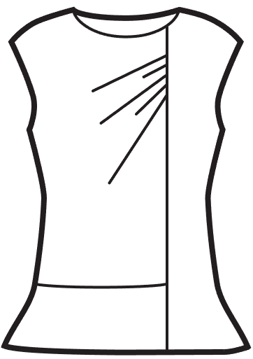
Pleats or gathers?
Identify where pleats or gathers have been used
  What are the advantages of each?

Slide 29
Pleats or gathers?
Use some scraps of fabric, pins, a needle, thread and elastic to make models of gathers and pleats
Pleats
Gathers
Gathers
Gathers
Pleats
Pleats

Slide 30
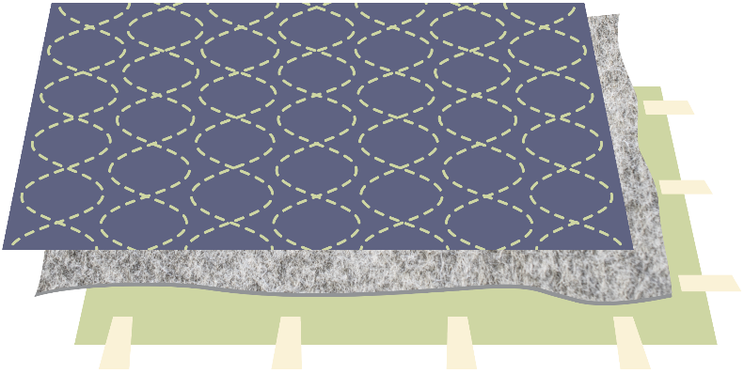
Quilting
Quilting is a traditional decorative technique used in many different cultures
  Layers are sewn together; the stitching often forms part of the decorative pattern on the top layer

Slide 31
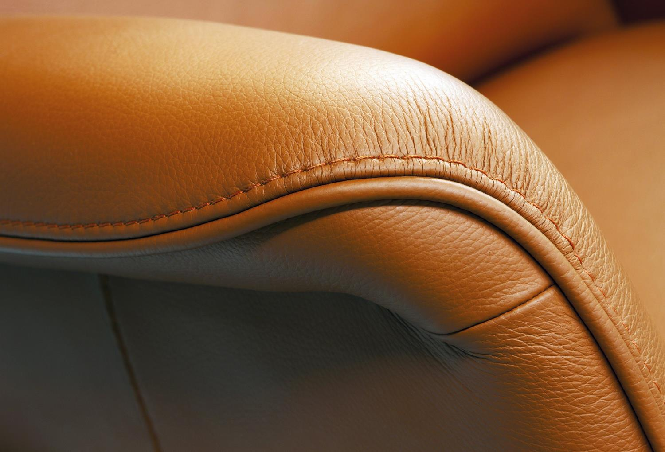
Piping
Piping is a decorative trim applied to textile products
  Suggest two functional and aesthetic reasons for adding piping to a sports holdall
  How might a piping cord or plastic strip be sewn into a fabric?

Slide 32
Worksheet 2 Task 3
Design a hiking jacket which incorporates a number of different processes and components as well as machining and shaping techniques

Slide 33
Plenary
Pitch your design proposals to the rest of the class, explaining all the processes and techniques you have used

