Slide 1
Key Tectonic Words and Diagrams
Add the correct words and notes to the diagrams on the next slide

Slide 2
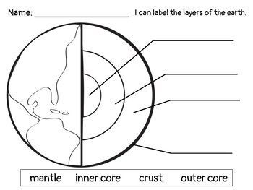
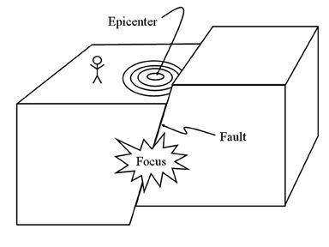
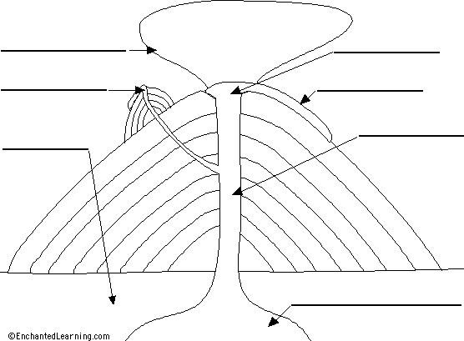
The Focus is ______________________
________________________________
________________________________
The Epicenter is ___________________
_________________________________
_________________________________
A Fault is _________________________
_________________________________
_________________________________

