Slide 1
Climate Data for Aberdeen
 | Jan | Feb | Mar | Apr | May | Jun | Jul | Aug | Sep | Oct | Nov | Dec
Rainfall mm | 59 | 65 | 65 | 68 | 64 | 70 | 64 | 68 | 54 | 57 | 64 | 67
Temperature °C | 2 | 3 | 4 | 7 | 8 | 10 | 12 | 14 | 13 | 9 | 5 | 3
Drawing Climate Graphs
These have 2 graphs on one sheet.
Rainfall (or precipitation) is ALWAYS a BAR Graph.
Temperature is ALWAYS a LINE Graph.
Remember to use the correct scale to draw them

Slide 2
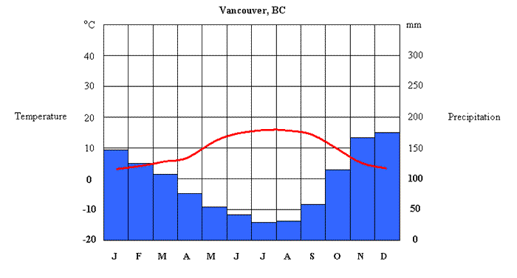
An Example of a Climate Graph for Vancouver in Canada
Temperature
Is a LINE graph
Rainfall (or
Precipitation)
Is a BAR graph

Slide 3
16
14
12
10
8
6
4
2
0
80
70
60
50
40
30
20
10
0

Slide 4
Describe the graphs
Copy out and complete the passage below. Use the
Words/numbers in the box at the bottom
Aberdeen has a highest temperature of ____ degrees C in the month of ________. The coldest temperature is ___ C in the month of ______.
In Aberdeen the rainfall is very _______ for each month.
It ranges between 54mm and ___ mm. A difference of 16mm.
The wettest month is _____ with 70mm of rain.
The driest month is ________ with ____ mm of rain
August 14 70 June
September 2 54 similar January

