Slide 1
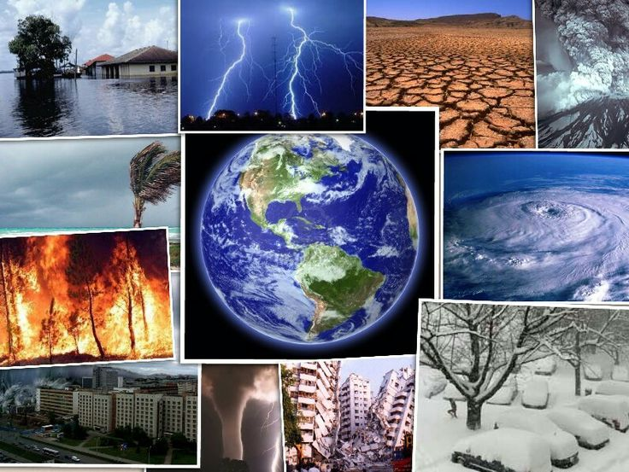
Challenge of Natural Hazards revision
Notes:
COPYRIGHT NOTICE
This Document is the copyrighted property of Robert Gamesby and http://www.coolgeography.co.uk
This document can be copied, revised, customised and used for the use of a PAID SUBSCRIBING SCHOOL ONLY under the conditions of the School Subscribers Agreement found at http://www.coolgeography.co.uk
PROHIBITED USES
The School shall not and shall procure that each and every Authorised User within their school does not:
Copy, print out or otherwise reproduce any Resources (in whole or part) for any commercial use or any of purpose except as permitted under the School Subscribers Agreement or authorised in advance by Http://www.coolgeography.co.uk in writing;
Mount or distribute any part of the Resources on any electronic network, including TES resources, Nings, file sharing sites etc.
Remove or alter any copyright notices or means of identification or disclaimers as they appear in the Resources. This includes the BACKGROUNDS of PowerPoints which have a copyright notice on them.
NOTE
I have spent hundreds of hours putting the resources together, please respect my work!

Slide 2
Revision Questions
Define A Natural Hazard.
Name 4 Natural Hazards.
What are the names of the 4 layers of the earth?
Describe how continental crust is different to oceanic crust.
Describe and explain the location of earthquakes.
Name 4 features you find at a Destructive plate margin
Explain how one of these features is made
Explain what happens at a constructive plate boundary
Name 3 effects of the Kobe earthquake
Name 3 responses to the Haiti earthquake

Slide 3
Revision Questions continued
Give 3 of the names used for Tropical storms
Describe the location of tropical storms
Explain how tropical storms are formed
Give a SEE effect for Typhoon Haiyan
Where in the UK did storm St. Jude hit and How much damage did it do?
Name 3 ways the UK responded to the 2003 Heatwave
Explain what the “Enhanced Greenhouse Effect”, is
Describe 3 ways people are contributing to Global Warming
Explain 3 effects of global warming
What can we do to mitigate the effects of global warming?

