Slide 1


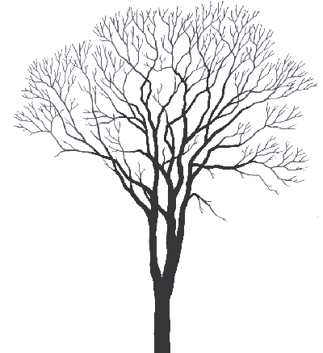







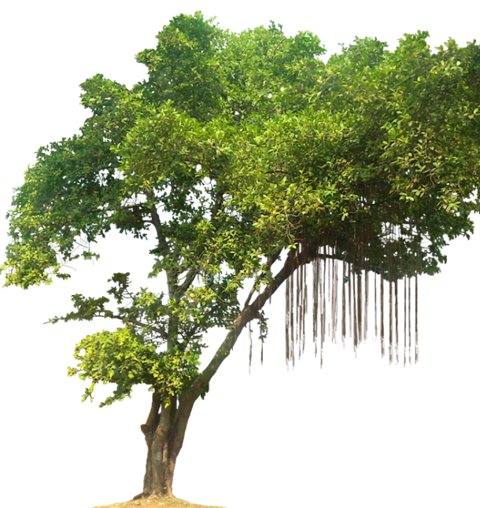



















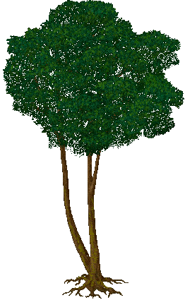














The Structure of a Rainforest
45
40
35
30
25
20
15
10
5
0
TASK – using the next slide, add the names and information of the layers of the forest to your diagram.

Slide 2
Read and then add these labels to the Rainforest Diagram
Canopy
The main layer of the rainforest where most of the plants and animals live.
Emergents
Very tall trees with buttress roots to hold them up.
Shrub layer
The very dark layer next to the ground where very few plants grows as only a small amount of sunlight reaches it.
Under Canopy
The layer where trees wait to join the canopy once one of the trees dies.

