Slide 1

Why do we carry out research?
What is primary data? What is secondary data?
Where should research feature in the design and production of a product?
Investigation Techniques
Primary Research Secondary Research
Internet
Books
Observations of users
Interviews
Magazines
Articles
Case studies
Product analysis
Observations of materials
Company information
Taking measurements
Official data
Government statistics
Focus groups
Physical material testing
Questionnaires
Newspapers
Radio
The work of others
TV

Slide 2
Why do we carry out research?
What is primary data? What is secondary data?
Where should research feature in the design and production of a product?
Investigation Techniques
Primary Research Secondary Research
Observations of users
Internet
Interviews
Official data
Case studies
Magazines
Observations of materials
Articles
Product analysis
Books
Company information
Taking measurements
Government statistics
Focus groups
Newspapers
Physical material testing
The work of others
Questionnaires
TV
Radio

Slide 3
Investigation Techniques
Market research
Interviews, questionnaires and focus groups – Open and closed questioning dependant of size of group and type of information required. Audio and recordings of these can help for later reference and checking. There can be interaction with products, components and prototypes to carry out observations as well as questioning. In a focus group conversations and comments can be collected too.
Product Analysis – product interaction and well as product disassembly can highlight strengths and weaknesses of existing products or competitors products. Can help us understand how a product is made, material qualities, uses, aesthetics etc.
Ergonomics and anthropometrics – The collection of specific measurements of the population,
averages are taken and these guide the dimensions needed for a product. Ergonomics is a
use of this data to create products which are comfortable to use. Testing with clients and focus
groups will allow the usability to be tested.

Slide 4
Market research - Task
Context
You are designing a product to improve the physical or mental health of a 14/15 year old school student. You are to conduct a client interview and have 10 questions to ask. You are going to design these questions individually and then conduct a client interview with a peer.
These questions must:
Give you information about the clients needs
Explain what their preferences are
Examine any issues they have
Begin to give you inspiration for what type of product is required and how to make it successful
Evaluate:
Which questions gave you the most useful information?
Were there any questions which didn’t give you useful feedback?
Were there any questions which would have been improved by simple adding the question why to the end? e.g. How much would you be willing to spend on a fitness gadget and why might your spend more?
Why is it important to have questions which are open yet directed? e.g. can you identify any aspects of your health which you would like to improve and you need the support of a product to do this?

Slide 5
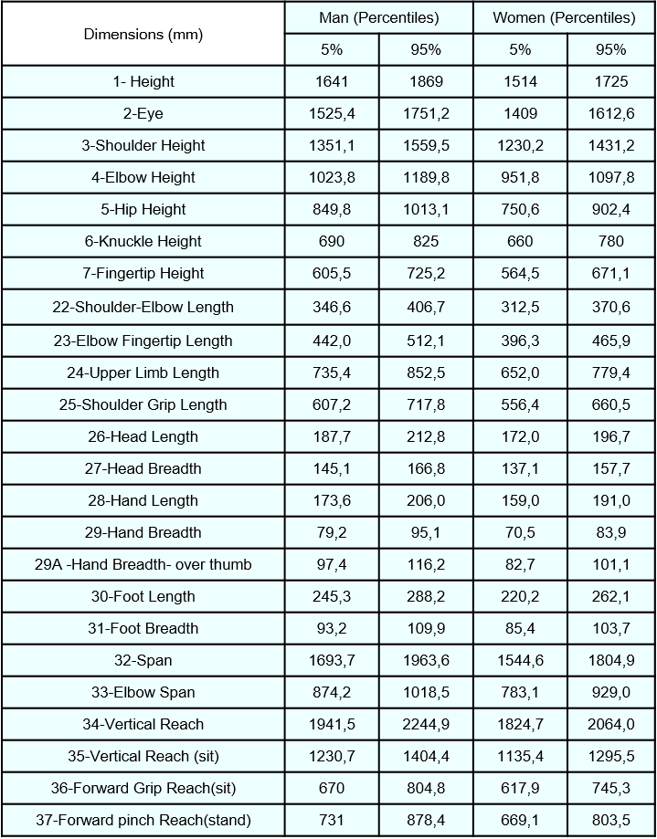
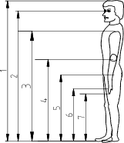
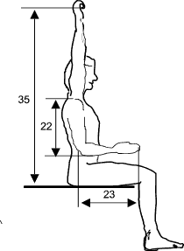
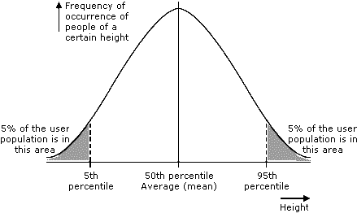
Anthropometric data
Measurements are taken of specific lengths, distances, heights, weights, angles and reaches within a human body. This survey will be carried out with thousands of people. Only the middle 90% of the data is included in an average for each measurement, this to exclude anomalies.
What issues could this create?
Where is the gap in the market?

Slide 6
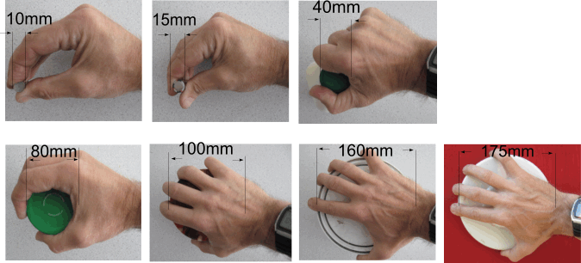
Anthropometric data

Slide 7
Ergonomics
The consideration about how a user interacts with a product. These take into account:
Dimensions for comfort and ease of use
Materiality for comfort and ease of use
Texture
Form
Functionality
Colour
Weight
Ease of understanding (how do you know how the product works?)
Short, medium and long term use and its affects
Ergonomic design is user centred and mostly thinks about function over form.

Slide 8
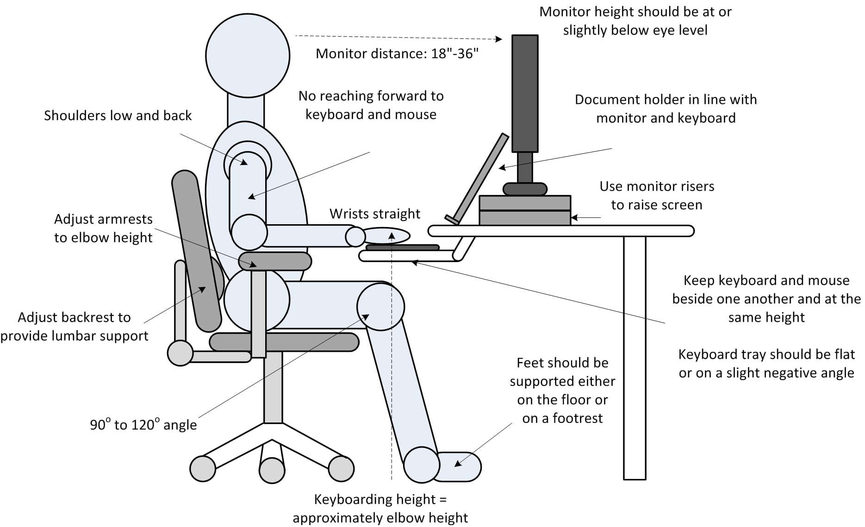
Ergonomics
Choose 3 of the ergonomic rules or features which have been identified in the diagram to the left, for each of these you need to explain how this feature or consideration will impact the user…

Slide 9
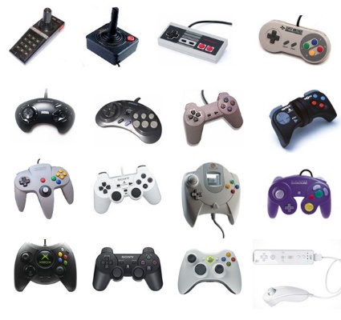
Ergonomics
Discuss:
How have these products evolved with ergonomic considerations?
Which will be the most comfortable to use? Why?
How has the shape, layout, texture and colour changed?
What do new controllers aim to do?

Slide 10
Ergonomics
Task:
1. You will be given a real product on your table. Collect the correct product image and stick it onto your worksheet in the image box.
2. Spend some time with your group assessing the product. Look at and make notes on:
Textures
Material choices
Form
Colour
Dimensions
Weight
Ease of understanding
Functionality
Short, medium and long term effects of use
3. Identify where you think anthropometric data has been used to design the product
4. Use notes and sketches to make improvements to the products ergonomics

Slide 11
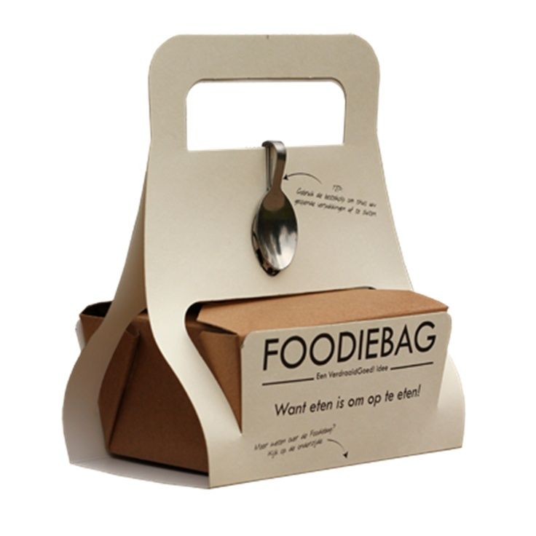
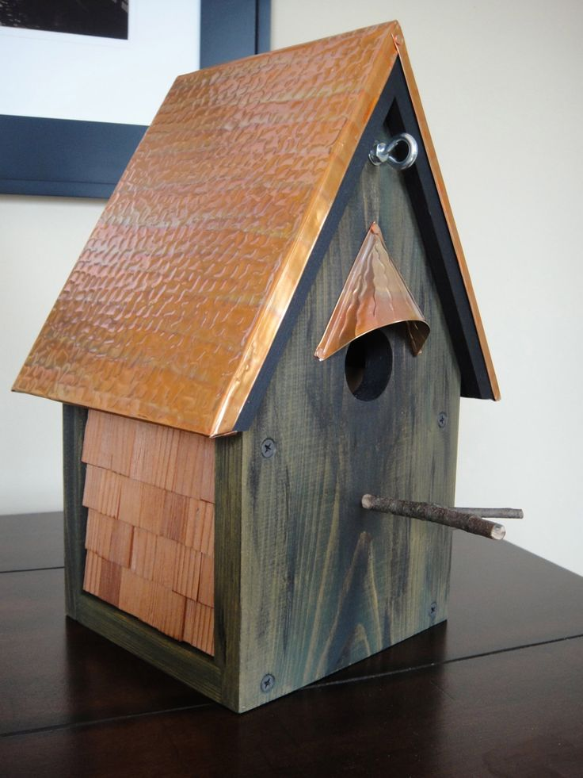
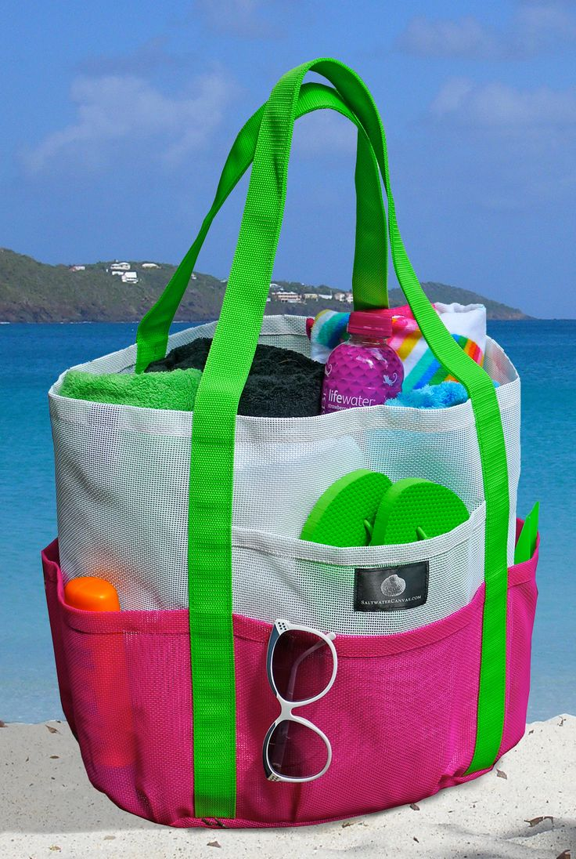
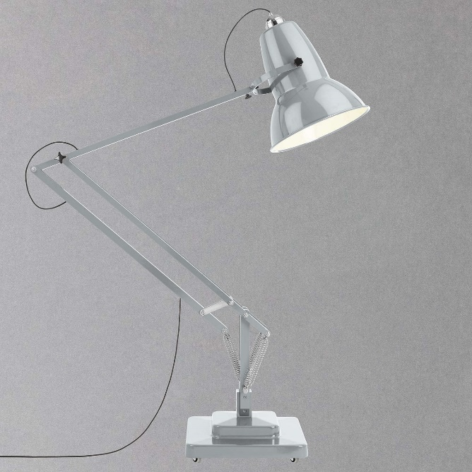
What would the design brief be for these products?
Design Brief
What should a design brief include / do?
Set out the context for why the product is needed
Relevant to previous research
Needs / wants of the user for the product
Realistic constraints for time scale, budget and dimensions
Identify a target group or client and their needs
ACCESSFMM can be covered
WWWWH can help to guide it

Slide 12

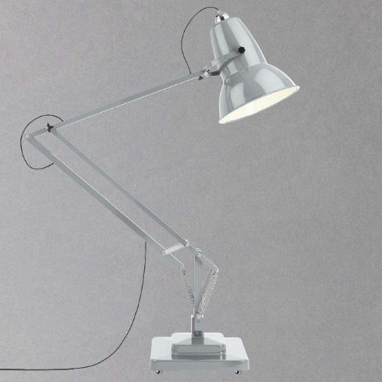
Design Brief
Who: who is going to buy the product? Who is the products intended user?
What: What is the products function? Is one function more important than another? What is the life span of the product?
What is the context for the products need?
When: When will the product be purchases? When will the product be used?
Where: Where will the product be used? Where will it be stored?
Why: Why will the customer buy this product? Why do they need it? Why will they choose this product over its competitors?
How: How often will the product be used? How much would it cost? How long will the product take to manufacture? How big is it?
Remember:
Explain the context
Link to research (in this case make it up..)
Use ACCESSFMM to help cover all areas
Always link each constraint back to the client and their needs!
What would the design brief be for these products?

Slide 13
Design Brief
Has your peer…
Explained the context for why the product is needed?
Used WWWWWH and ACCESSFMM to write a thorough brief?
Made strong links back to the clients needs or aspirations for each constraint?
Is the brief justified?
Give detailed feedback using WWW and EBI, you must have at least 2 good point and one very specific way to improve.
Peer Assessment:

Slide 14
Manufacturing Specification
A clear set of rules and constraints which have been devised from research and testing. They should be well justified and measureable.
e.g. The nursey chair needs to be able to hold the weight of a 4-5 year old child. A minimum set of dimensions are … and a maximum set are … The weight must take into account seating position and additional forces from a child's movement as seen in the focus group testing. The texture must provide grip to the human body and flooring. The shape of the chair must provided stability and the materials used should be light weight so a child of age 5 can lift it with ease. In testing plastics such as ABS and HDPE were most appropriate.
Modifications:
These can be made during manufacture and changes from the clients needs can be made, but they must be fully justified e.g. change in material availability, components which are below specification, changes in dimensions to improve functionality, change in budget.
A manufacture specification is different from an initial specification. It needs to include technical information such as dimensions, specific material and component choses and qualities, costings, plan for manufacture and constructions details. These can be shown in a number of ways:
CAD / hand drawing with scales and dimensions
Annotated designs which show non visible details
Exploded drawings
Description of materials, components, finishes to be used
Construction diagrams to show how assembly takes place
Information about acceptable tolerances.

Slide 15
Manufacturing Specification
A clear set of rules and constraints which have been devised from research and testing. They should be well justified and measureable.
e.g. The nursey chair needs to be able to hold the weight of a 4-5 year old child. A minimum set of dimensions are … and a maximum set are … The weight must take into account seating position and additional forces from a child's movement as seen in the focus group testing. The texture must provide grip to the human body and flooring. The shape of the chair must provided stability and the materials used should be light weight so a child of age 5 can lift it with ease. In testing plastics such as ABS and HDPE were most appropriate.
Presentation:
Category | Specification Point | Justification | Link to research
Size | The chair must be no bigger than … and no smaller than … | These dimensions will allow a child from the age of 3-7 sit comfortably on the chair without risk of falling. I have widened the age sizing to 3-7 to allow for smaller and taller children in the population | When researching anthropometric data for children aged between 3-7 the average measurements were within these dimensions.
Safety | The chair must be able to hold a childs | The chair needs to safety support the weight of a child | When completing my research I looked at the avergage

Slide 16
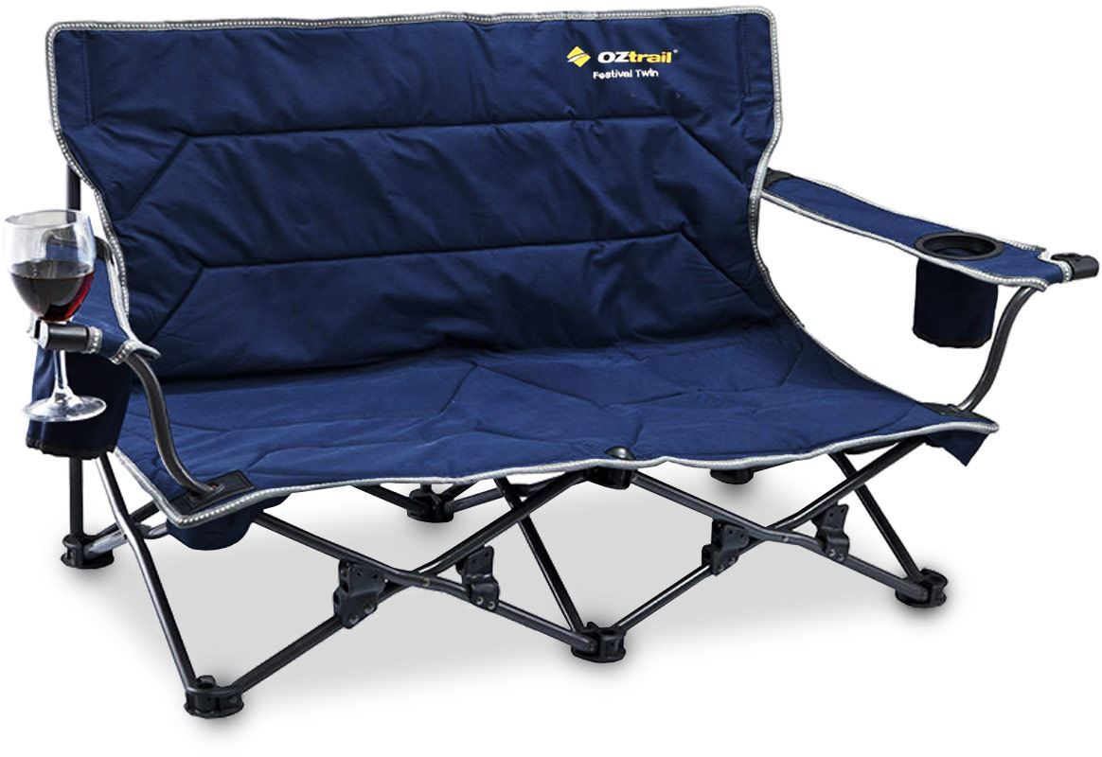
Manufacturing Specification
Category | Specification Point | Justification | Link to research
A
C
C
E
S
S
F
M
M
Write a specification for this fold up chair. You will need to use your own knowledge to judge size, materials etc, use your own understanding the justify the choices made and consider what research would have taken place before the product would have been made…

Slide 17
Environmental, social and economic challenges
Designers responsibilities:
Impact of their product on society e.g. does it promote communication and interaction, is the production ethical and does it have a positive impact (think fair trade)?
Impact on global warming e.g. can this product actually reduce the pollution or waste in the world? Can it be carbon neutral?
Impact on the economy e.g. does it provide jobs, does the product promote economic growth, is the product fair trade, is the product a luxury or an affordable product for all?
+

Slide 18
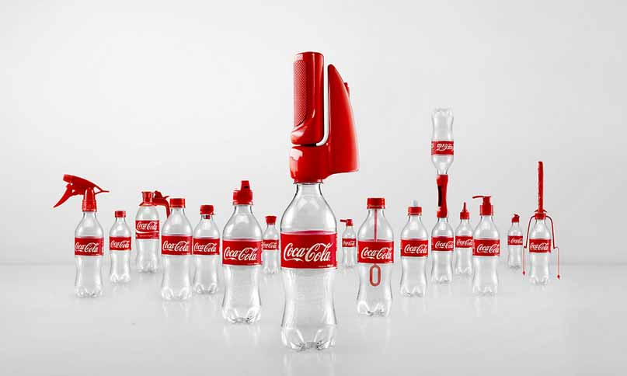
Environmental, social and economic challenges
Designers and manufacturers are now presented with the need to address ESE challenges. Some companies are using these challenges as a way to engineer new and improved products.
https://www.youtube.com/watch?v=46WX59wDB4E

Slide 19
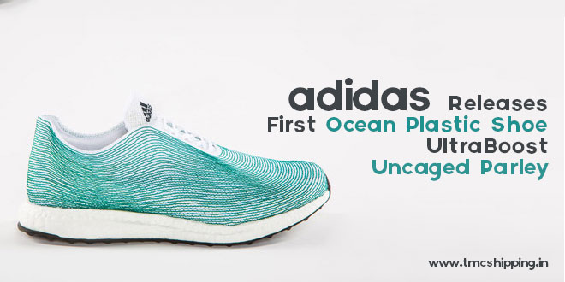
Environmental, social and economic challenges
Designers and manufacturers are now presented with the need to address ESC challenges. Some companies are using these challenges as a way to engineer new and improved products.

Slide 20
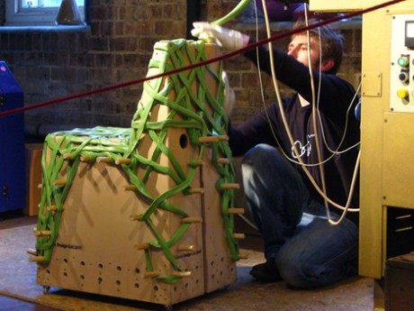
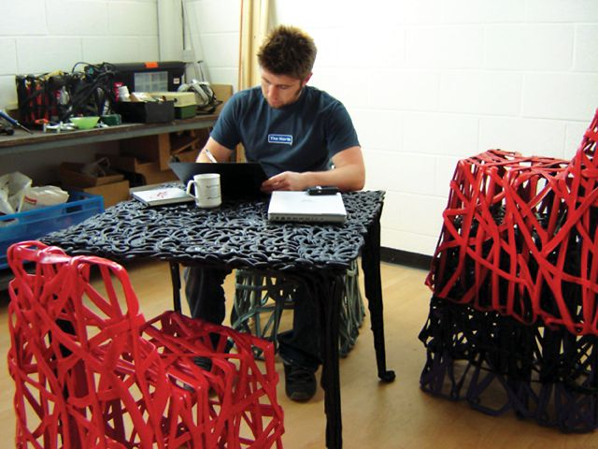
Environmental, social and economic challenges
Designers and manufacturers are now presented with the need to address ESC challenges. Some companies are using these challenges as a way to engineer new and improved products.
COHDA chair – 100% recycled extruded HDPE

Slide 21


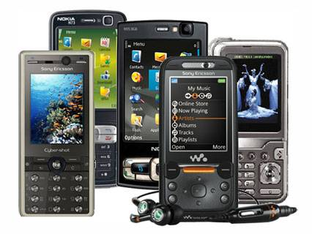
Environmental, social and economic challenges
What does your mobile phone have to do with the lives of people and animals in Africa?

Slide 22
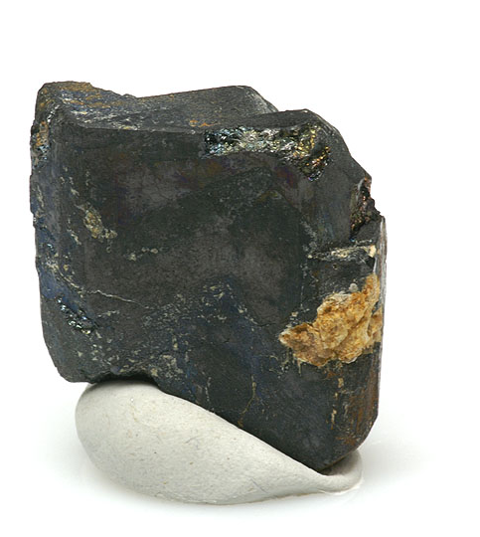

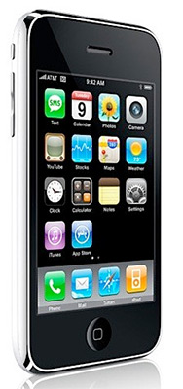
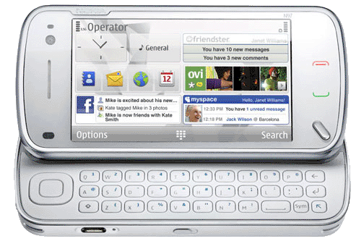
Columbite-Tantalite (CT)
Columbite-Tantalite (CT), is an important ore that contains the elements niobium and tantalum.
CT a vital element in creating components that store energy and are used in almost all of our small electronic devices, especially our mobile phones.

Slide 23
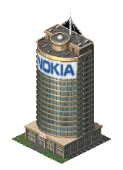
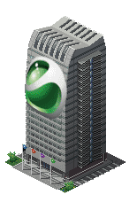

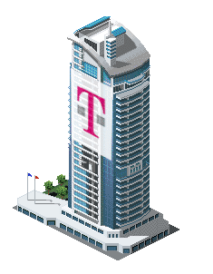
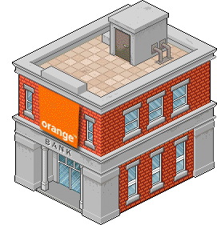

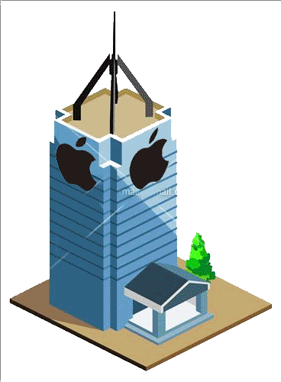
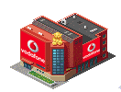
In Europe almost 200 million mobile phones are sold each year.
Worldwide, there are over 2 billion mobile phones connected.
England
Europe

Slide 24

The CT needed to make our phones is found in large quantities in the African country of
Democratic Republic of Congo.
(DOC is about 3400 miles across the planet from London, England).
DRC

Slide 25


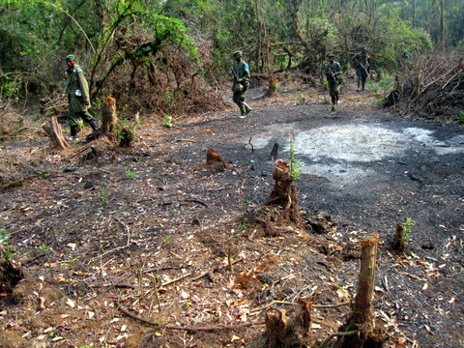
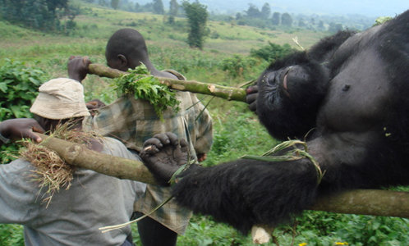
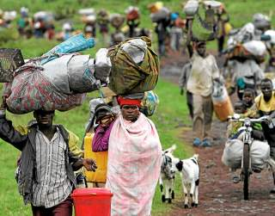

England
DRC is striving to recover from civil war; millions have died, mostly through starvation and disease.
Fighting is fuelled by the country's vast CT wealth, and groups fight to control the CT supplies.
Land is cleared to make the mining of CT easier and DRC’s natural habitat is destroyed.
Because of the mining farmers can no longer grow food and are forced to look for other food supplies and jobs.
Gorillas are either killed for meat or leave because their habitat has disappeared.
DRC
Money made from CT is used to finance Militia.
Opportunities to make money decreases any chance of peace and increases conflict.

Slide 26
England
DRC is striving to recover from civil war; millions have died, mostly through starvation and disease.
Discuss...
Fighting is fuelled by the country's vast CT wealth, and groups fight to control the CT supplies.
Does CT Have a negative or positive impact on the lives of people.
Land is cleared to make the mining of CT easier and DRC’s natural habitat is destroyed.
Because of the mining farmers can no longer grow food and are forced to look for other food supplies and jobs.
How big an impact do each of these areas have on people..
Completely Negative
Mostly Negative
Neutral
Mostly Positive
Completely Positive
Gorillas are either killed for meat or leave because their habitat has disappeared.
DRC
Money made from CT is used to finance Militia.
Opportunities to make money decreases any chance of peace and increases conflict.

Slide 27
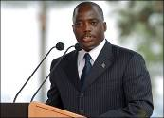

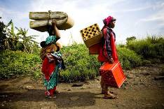
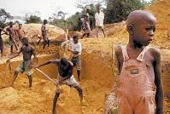
DRC Government
Joseph Kabila is the president. He didn’t want the job, took the job because his father was killed. The Government is weak and Joseph has had to ask warlords to help him. The Government is isolated and has little power.
Militia
Groups of Militia from neighbouring countries control mining areas in DRC. They are well paid and can control the government.
DOC Facts
Women
Woman in the north-east can find work in mines, some carrying heavy loads, others as prostitutes. They are forced to leave their families and during the civil war many have been raped.
Miners
CT is dug by hand, this is a dirty and hard job. Some miners earn a good wage, but often have their money stolen by militia. Some miners are children. Miners do what they need to survive.
DRC

Slide 28

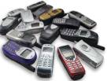
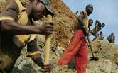
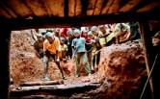
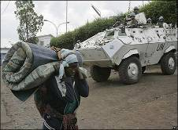
Discuss...
Has your views on mobile phones changed?
What can we all do to address these issues? Think recycling, reusing, reducing and refusing...
Access to CT is causing conflict in DRC!
What are the social, economic and environmental impacts?
Should this influence the phone manufacture’s choice of material?

Slide 29
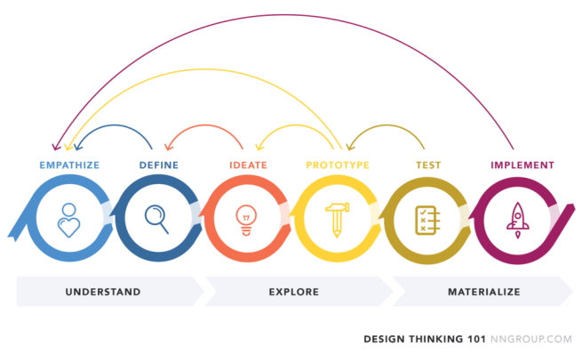
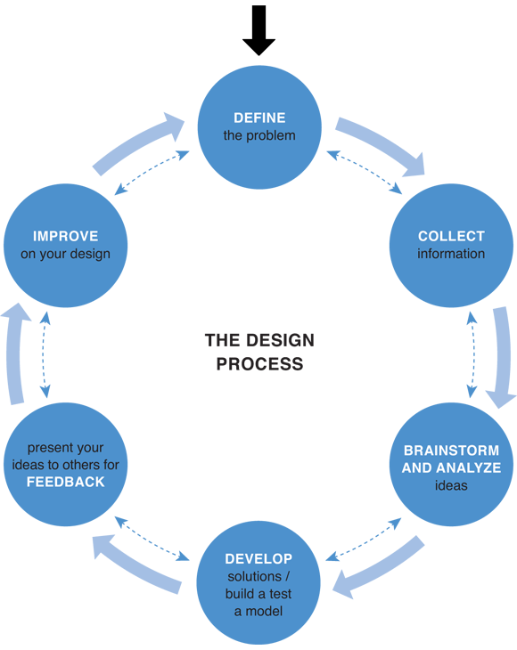
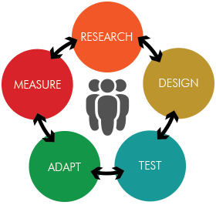
Iterative Design

Slide 30
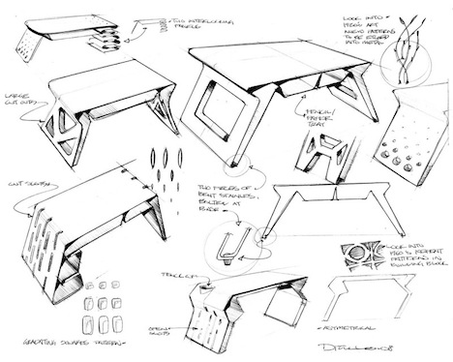
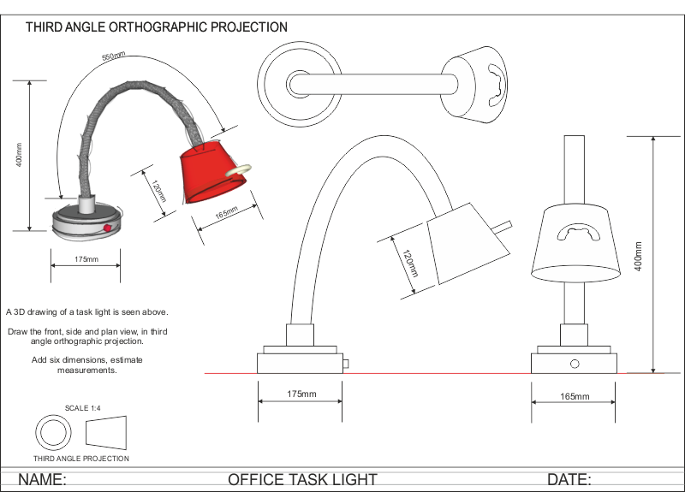
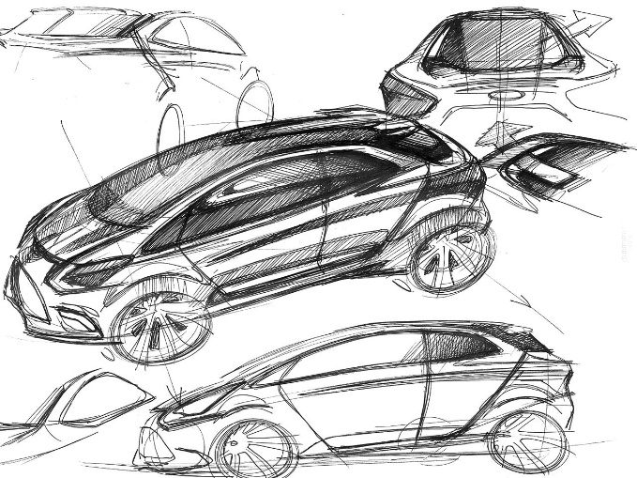
Iterative Design – methods of design
Sketching / drawing – informal, isometric, axonometric, oblique, 3rd angle orthographic, exploded, plans, sections, elevations

Slide 31
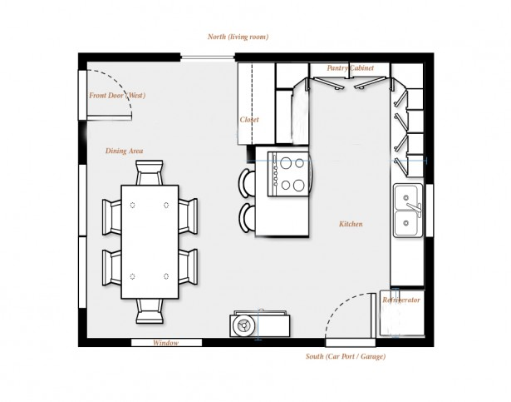
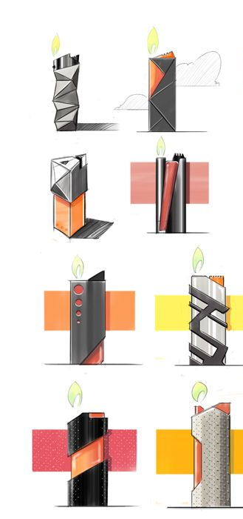
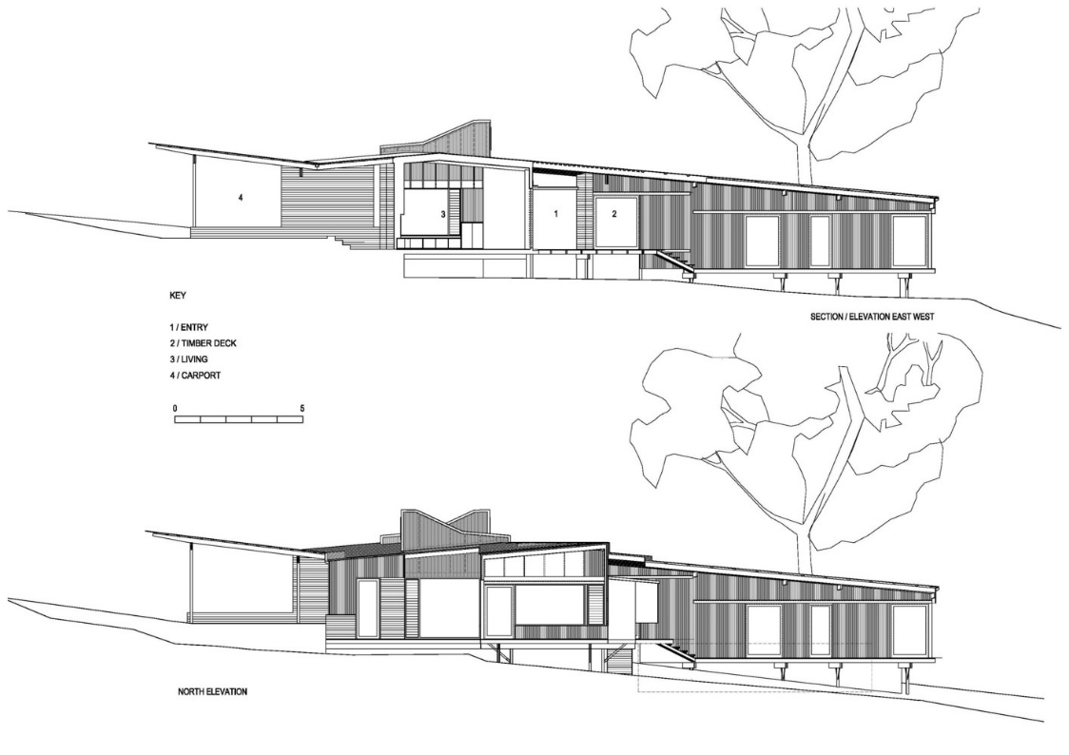
Methods of Communication
2D drawings –
These can help to show scale, dimensions and smaller details of a product. Plans, sections and elevations are all forms of 2D drawings.

Slide 32
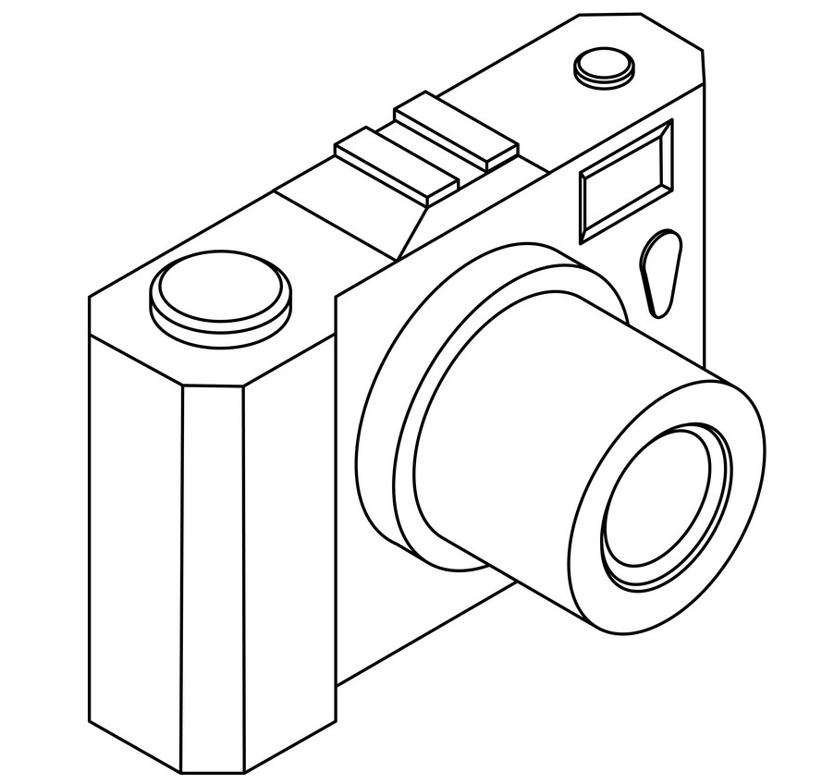
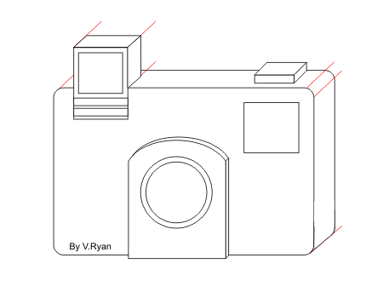
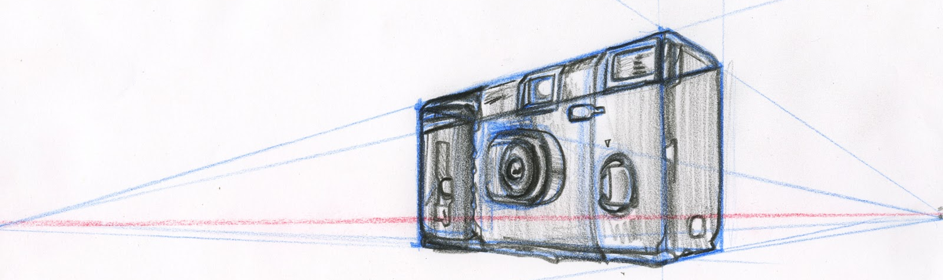
Methods of Communication
Isometric
Oblique
2 Point Perspective

Slide 33
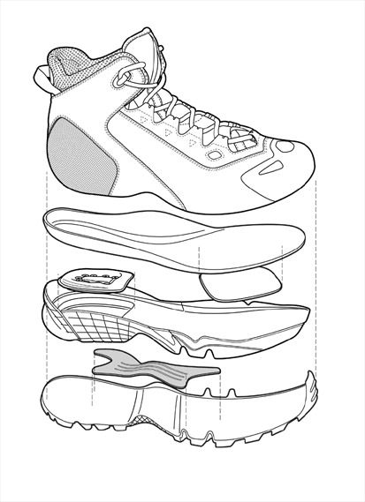

Methods of Communication
Exploded drawings –
Useful to see how component parts fit together, can show the detail which is hidden below layers and is useful to manufacturers.

Slide 34

Methods of Communication
Working drawings –
These show technical detail which will be useful to a manufacturer. These often include, plans, sections and elevations

Slide 35



Iterative Design – methods of design
Modelling – Rough, scaled, sectional, partial, functional, CAD solid, CAD wire model, virtual reality

Slide 36



Iterative Design – methods of testing
Non destructive testing – testing a product to its limits without breaking or damage to see what a product can cope with in use.
Destructive testing – testing a product to until it breaks. These show how a product performs under extreme conditions and gives data about how safe a product is in use.

Slide 37



Iterative Design – methods of testing
Market testing – Inspection of parts and components for size, quality, construction and finish.
Functional and aesthetics testing of prototype in use, this will take place with client and user group.

Slide 38

Design influences
Designers are involved in almost everything in our modern world and crossovers occur between many areas of design
  Can you identify areas of design that are related?
  For example, does
  graphic design influence smartphone design?
  How has smartphone design influenced other areas of design?
  Possible areas: transport design, architecture, structural engineer, trend analytics, product design, landscape design, textiles design

Slide 39



Influence on modern society
Starter:
Why do we look at other designers and their products before we design?
Consider how did the first chair influence the second…

Slide 40
Influence on modern society
Designs, fashions and trends symbolise the spirit of the times
  Designers and design companies will be influenced by those who have gone before
  Companies aim to build upon and improve design, to create a product that’s more effective and also more desirable
  Material development and technological innovations will continue to aid in the advancement of design
  Culture and society also influence product design.

Slide 41
Work of others…
• Alexander McQueen
• Aldo Rossi
• Charles Rennie Macintosh
• Coco Chanel
• Ettore Sottsass
• Gerrit Reitveld
• Harry Beck
• Louis Comfort Tiffany
• Marcel Breuer
• Mary Quant
• Norman Foster
• Philippe Starck
• Raymond Templier
• Sir Alec Issigonis
• Vivienne Westwood
• William Morris.

Slide 42
The Work of Others
Phillippe Stark

Slide 43


Task :
Whilst learning about Phillipe, create a mind map about the designer and his work. This must include:
His design philosophy
This background
Materials and technologies used
His influences and inspiration
Key product names
Product information and explanation
How has his work changed the world?
You will be using all this information and some images to create your own A3 revision page about Philippe Starck at the end of the lesson.

Slide 44

Bell Task: What is it???

Slide 45

Walter Wayle ll
Wall Clock

Slide 46
WHO IS HE?
He is probably the best-known product designer of our time, and is relentlessly creative in a wide range of different fields. The Frenchman has designed everything from café chairs to toothbrushes, from stools to hotels, even motorbikes and yachts. Philippe Starck designs practically everything, ranging from everyday products through to sophisticated products, for a wide variety of international brands.

Slide 47
PHILOSOPHY
It is his belief that the purpose of design is to enhance life for the greatest possible number of people, with the external design being just one element of it. His unconventional ideas take us by surprise time and again, and he believes that responsibility for the environment is also a vital part of the creative process.
His concept of ‘democratic design’ led him to focus on mass-produced consumer goods rather than one-off pieces, seeking ways to reduce cost and improve quality in mass-market goods. Through his democratic design concept, Starck has campaigned for well-designed objects that are not just aimed for upper-tiered incomes.
He believes in honesty and integrity in design and aims to make products which are both useful and durable. Although his designs look whimsical and amusing, they are not created as throwaway artefacts and are made to last. His approach is always interesting and playful.

Slide 48

MATERIALS / TECHNOLOGY.
Starck likes to use interesting or unusual combinations of materials such as glass with stone, plastic with aluminium, velvet fabric with chrome. He sometimes designs items which have a traditional shape but are
made of modern materials. For example his first business venture was creating inflatable objects, he also has designed very traditionally shaped chairs using modern, injection-moulded plastic or his iconic Ghost Chair. These contradictions are part of the reason his work is so interesting. His designs are often of curved, rounded, ‘feminine’ shapes so he uses materials such as polyamide, resins, soft plastics, and modern technological processes, which allow him the flexibility to create unusual shapes and forms.

Slide 49
INFLUENCES / INSPIRATION.
He is influenced by many things, including the latest fashions and novelty items / toys. You could argue that many of his designs are inspired by natural, forms as he commonly uses organic or anthropomorphic shapes as the basis for his designs. He travels widely and is also influenced by other cultures, in particular Japanese simplicity, American streamlining and Italian Futurism. He is also interested in science fiction, Walt Disney characters and cartoons.

Slide 50



Juicy Salif
A truly iconic object and symbol not only of Philippe Starck but of Alessi itself, this citrus squeezer - as revolutionary as it is surprisingly functional - was sketched in its essentials by Starck during a holiday by the sea in Italy, on a pizzeria napkin.

Slide 51




Mister Meumeu
A Parmesan cheese grater with integrated spoons and storage box with lid.

Slide 52


Bertta Hob Top Kettle
The working elements of the kettle (the handle, spout and body) were completely rethought and reengineered into sculptural forms that bore no resemblance to their predecessors. The result was a shape that wowed then and continues to amaze today.

Slide 53

Kartell Louis Ghost Chair
The Baroque style, with its flamboyant flourishes, is boiled down into one single mould of polycarbonate. Polycarbonate is highly durable, wipe-clean and practical. Up to 7 of these chairs can be stacked.

Slide 54


Yacht
Designed for and commissioned by Steve Jobs.

Slide 55


Axor Faucet
The control at the end of the spout is what turns the faucet on and off, meaning your hands reach the water a lot quicker than they would with regular top-mounted knobs, thus saving water.

Slide 56

Masters Chair
Masters is roomy and comfortable. Supported on slender legs, the back shapes of the 3 original designs are create by solid lines and voids which flow down and join together along the perimeter.

Slide 57


Zik Headphones

Slide 58



Zik Headphones
Take/End/Refuse a Call Tap on the right headphone to take or end a call, touch the panel for two seconds to reject it.
Switch Dual Call Sliding your finger horizontally on the control panel to switch between calls.

Slide 59
What effect has Starck’s work had on the design world?
Philippe’s idea of democratic design has permeated down to other designers and created many new affordable luxury product design and furniture brands, some might even say that the quality of our high street products is a result of his philosophy.
Starck’s use of modern materials with traditional forms and influences can be see in modern interior design.
Starck also focuses on design which improves and alters a users life, where function is just as important as form. We can see this even in products like those from Apple, where the function is extremely important but the form is also thoroughly considered.
For us as the general public, it has allowed us to more easily access fashionable, well made, iconic products which should have longevity.

Slide 60
Task :
Use the information / mind map you have made to create an A3 revision page about Philippe Starck. This must include detailed responses about:
His design philosophy
This background
Materials and technologies used
His influences and inspiration
Key product names
Product information and explanation
How has his work changed the world?
You should use the images provided to help showcase his work and explain all the above point.

Slide 61

Ensure your core theory booklet is out on your desk, ready for checking. Those who did not have their A3 worksheets last lesson will need these out today also.
Starter:
On your post it note, write down 10 things you remember about Philippe Starck. They could cover:
His design philosophy
This background
Materials and technologies used
His influences and inspiration
Key product names
Product information and explanation
How has his work changed the world?

Slide 62
You have 20 minutes to complete your A3 revision sheet. Anything which is incomplete must be completed for homework.
Task :
Use the information / mind map you have made to create an A3 revision page about Philippe Starck. This must include detailed responses about:
His design philosophy
This background
Materials and technologies used
His influences and inspiration
Key product names
Product information and explanation
How has his work changed the world?
You should use the images provided to help showcase his work and explain all the above point.

Slide 63
Research another designer and one brand of your choosing and create an A3 information sheet about them, just like the one completed in lesson. Ensure it has images to visually support your knowledge.
Homework – Due Tue 13th Feb
• Alexander McQueen
• Aldo Rossi
• Charles Rennie Macintosh
• Coco Chanel
• Ettore Sottsass
• Gerrit Reitveld
• Harry Beck
• Louis Comfort Tiffany
• Marcel Breuer
• Mary Quant
• Norman Foster
• Raymond Templier
• Sir Alec Issigonis
• Vivienne Westwood
• William Morris.
Apple
Braun
Alessi
Gap
Under Armour
Zara
Primark
Designers
Brands

Slide 64

The Work of Others
Dyson

Slide 65

STARTER: Which of these statements was coined by James Dyson? Why does it make sense to have this as a design philosophy? Discuss…
Good Design has to be saleable…
Good Design has to solve a problem…
Good Design has to have longevity…
Good Design has to be innovative…

Slide 66
Task :
Use the information / mind map you have made to create an A3 revision page about Dyson. This must include detailed responses about:
Their design philosophy
Their background
Materials and technologies used
Their influences and inspiration
Key product names
Product information and explanation
How has his work changed the world?
You should use the images provided to help showcase his work and explain all the above point.

Slide 67








‘Good Design has to solve a problem’
What was the problem? How did Dyson Solve it?

Slide 68
Ensure your homework is out ready to be checked later in the lesson. Completed Philippe Starck A3,
Core theory book 2 (chapter 5)
Task 1:
Collect a green folder
Collect a label from the middle of your desk
On your label write: Your name, GCSE Design & Technology, Core Theory, Mrs McVay
Read your feedback from your core theory book 1 on your desk (those of you without this booklet have it in your possession and I will discuss this with you today)
Add your completed and mark core theory book 1 to your green folder.
Pace your core folder in the allocated class box at the back of the room.
Task 2:
Have your core book 2 out to show your completed chapter 5.
Write in your homework: mark chapter 4 and 5 in core booklet, due 3rd March
Collect your purple design & making principles folder and a set of file dividers
Await next instruction

Slide 69
Ensure your homework is out ready to be checked. Completed Philippe Starck A3,
a chosen brand page and
a chosen design page.
I will also be collecting in any core theory books, have them ready with chapter 1 and 3 completed
Starter:
On your post it note, write down 5 things you know about the Dyson brand e.g. products, design philosophy, technology…

Slide 70
Task :
Whilst learning about Dyson, create a mind map about the company and James Dyson’s work. This must include:
Their design philosophy
Their background
Materials and technologies used
Their influences and inspiration
Key product names
Product information and explanation
How has their work changed the world?
You will be using all this information and some images to create your own A3 revision page about Dyson at the end of the lesson.

Slide 71
Design Philosophy…
https://www.youtube.com/watch?v=p9hn6IqVTMw
Dyson is an engineer at heart
Find a problem and fix it with good design (does not invent problems)
User and technology centred
Products can cost a little more than competitors but they should last longer.
Products should be easy to disassemble and reuse / recycle
Products should be able to be cleaned and maintained by the customer without need for an engineer. Use of colour educates and indicated to customer.
Products should be able to be fixed in small sections to increase longevity
Aesthetics are important but not at the cost of function.

Slide 72

Design and Product Evolution…
Born in 1947, James Dyson studied furniture and interior design at the Royal College of Art in London from 1966-1970 before moving into engineering.
1947

Slide 73

Design and Product Evolution…
The Sea Truck, Dyson's first product, was launched in 1970 while he was at the Royal College of Art. A flat-hulled, high-speed watercraft made from fibreglass, used to land vehicles without jetties or harbour facilities.
1970

Slide 74

Design and Product Evolution…
Dyson designed a smooth-edged plastic bin. He replaced the wheel with a load-spreading red ball. Its large ball gave it stability and stopped it sinking into soft ground.
1974

Slide 75
Design and Product Evolution…
Dyson had the idea of using cyclonic separation to create a vacuum cleaner that wouldn’t lose suction. He became frustrated with his Hoover Junior’s diminishing performance: dust kept clogging the bag and so it lost suction.
1980

Slide 76

Design and Product Evolution…
It had taken James five years and 5,127 prototypes to perfect his bagless vacuum cleaner technology. The market ignored the invention as the Vacuum bag market was worth £250 million. He eventually sold his first vacuum cleaner called the ‘G-Force’ to the Japanese market.
1983

Slide 77

Design and Product Evolution…
The royalties from G-Force allowed James to manufacture a machine under his own name, DC01. The first bagless vacuum cleaner with cyclonic separation. The Dyson was born!
1993

Slide 78

Design and Product Evolution…
Following his success the other major manufacturers began to market their own bagless vacuum cleaners. Dyson sued Hoover UK for patent infringement and won around £3m in damages.
2000

Slide 79
Design and Product Evolution…
The idea for Ball technology came from an engineer studying new ways to steer. It started crudely - an old wand handle attached to a wheel. Eventually the wheel became a ball - an ideal home for the motor.
2005

Slide 80

Design and Product Evolution…
"Dyson engineers figured out that hand washing clothes for 15 minutes removed more dirt than two hours in a conventional washing machine," It has two drums rotating in opposite directions to simulate the manipulation and flexing of hand washing." The washing machine was also more energy-efficient than other ones out there and could handle larger loads. Unfortunately, the machine was so expensive to make that Dyson stopped production.
2005

Slide 81


Design and Product Evolution…
Digital motor - no brushes, 98,000 rpm (5x formula 1 car engine spins), half the size and weight or previous motors, this will help to revolutionise a range of new products.
https://www.youtube.com/watch?v=yajwmhe96pg

Slide 82
Design and Product Evolution…
Dyson Airblade is a fast hand dryer. It produces an air stream flowing at 400 mph. A sheet of air acts like an invisible windscreen wiper to wipe moisture from hands.
2006

Slide 83


Design and Product Evolution…
The Dyson Bladeless Fan was created to minimise noise (75% reduction), create a smoother airflow than a bladed fan, reduce energy consumption and to increase the safety of fans.
2009
https://www.youtube.com/watch?v=8he8afjQyd8
https://www.youtube.com/watch?v=gChp0Cy33eY

Slide 84
Design and Product Evolution…
Developed from the bladeless system using the digital motor Dyson has been able to develop a quiet and efficient hair dryer.
2016

Slide 85


What makes Dyson stand out???

Slide 86
Collect your purple folder
Take out notes and images about Dyson
You have until 1.30pm to complete your Dyson Brand page to include all topics listed:
Their design philosophy
Their background
Materials and technologies used
Their influences and inspiration
Key product names
Product information and explanation
How has their work changed the world?
As you work I will come around to check your core theory homework has been completed and collect your marks for sections 4 & 5

Slide 87
Homework – Due 17th March
Complete Dyson A3 sheet
Complete chapter 6 of core theory book 2

Slide 88
Task: Research one more designer and one more brand of your choosing from the list below. Create at least 2 A4 information pages for each of them.
• Alexander McQueen
• Aldo Rossi
• Charles Rennie Macintosh
• Coco Chanel
• Ettore Sottsass
• Gerrit Reitveld
• Harry Beck
• Louis Comfort Tiffany
• Marcel Breuer
• Mary Quant
• Norman Foster
• Raymond Templier
• Sir Alec Issigonis
• Vivienne Westwood
• William Morris.
What to include:
Range of 6-10 key product images
Key product names
Product information and explanation
Their design philosophy
Their background
Materials and technologies used
Their influences and inspiration
How has their work changed the world?
Apple
Braun
Alessi
Gap
Under Armour
Zara
Primark
Designers
Brands

Slide 89
Task: Research one more designer and one more brand of your choosing from the list below. Create at least 2 A4 information pages for each of them.
• Alexander McQueen
• Aldo Rossi
• Charles Rennie Macintosh
• Coco Chanel
• Ettore Sottsass
• Gerrit Reitveld
• Harry Beck
• Louis Comfort Tiffany
• Marcel Breuer
• Mary Quant
• Norman Foster
• Raymond Templier
• Sir Alec Issigonis
• Vivienne Westwood
• William Morris.
What to include:
Range of 6-10 key product images
Key product names
Product information and explanation
Their design philosophy
Their background
Materials and technologies used
Their influences and inspiration
How has their work changed the world?
Apple
Braun
Alessi
Gap
Under Armour
Zara
Primark
Designers
Brands

