Slide 1
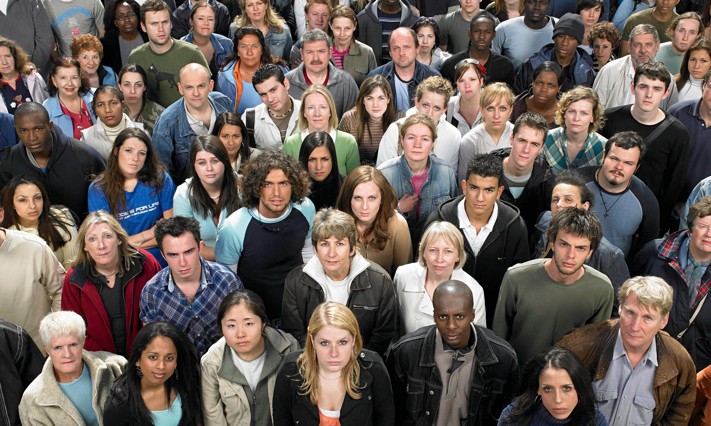
Y8 Population Review

Slide 2
Revision Topics
Population Change
a) Natural Change (BR & DR)
b) Migration
2) The Demographic Transition Model (DTM)
3) Population Pyramids
a) Different shapes
b) Different stages of the DTM
c) What do they show
i) Birth Rate
ii) Death Rate
iii) Life Expectancy
4) Key terms (see above)
5) Benefits and problems of population change/growth
6) Graph drawing and interpreting

Slide 3
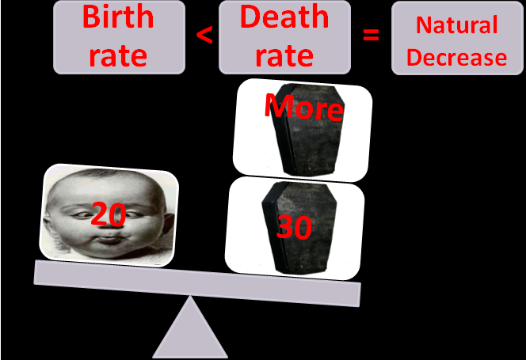
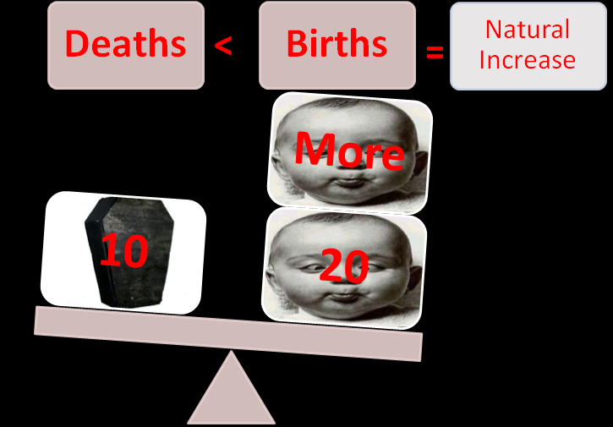
Population Change
Natural Change (Birth Rates and Death Rates)
Definitions
Life Expectancy Definition
And why they are different between Rich (MEDC)
And Poor (LEDC) countries

Slide 4
Definitions
Birth Rate:
Number of live babies born per 1000 people per year. E.G.: 10 births per 1000 people per year.
Death Rate:
Number of people who die per 1000 people per year. E.G.: 17 deaths per 1000 people per year.
Natural Increase:
The difference between the birth rate and the death rate. It is expressed as per 1000 per year. Birth rate>Death rate.
Natural Decrease:
When the death rate is greater than the birth rate. More people die per 1000 than babies born.
Life expectancy:
The average age that someone is expected to live to.
Migration:
The movement of people from one place to another to live &/or work

Slide 5
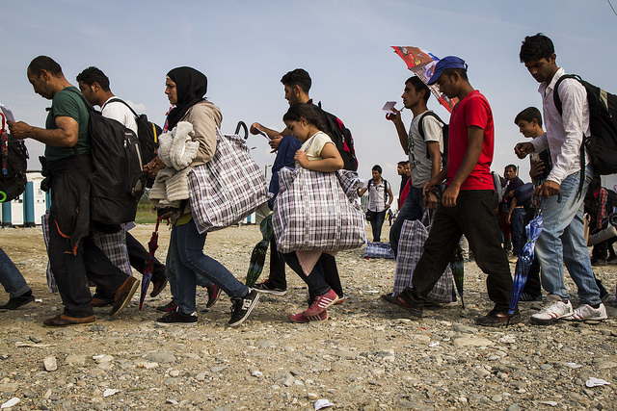
Migration
Push and Pull Factors
Impacts/Effects of Migration (good and bad)

Slide 6
Demographic Transition Model
Birth Rates and Death Rates
How to tell the 5 Different stages
Population Change
Resultant population totals
Death rate
Birth rate
Dashed line indicates predictions

Slide 7
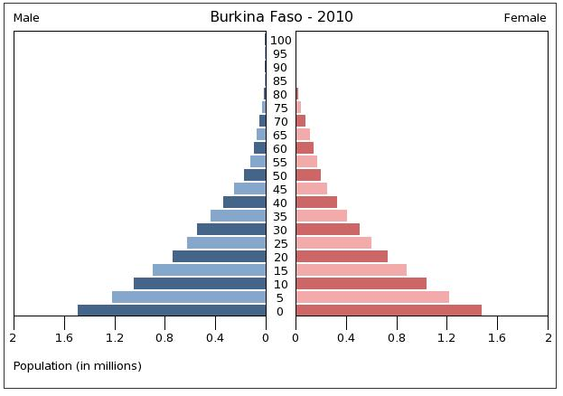
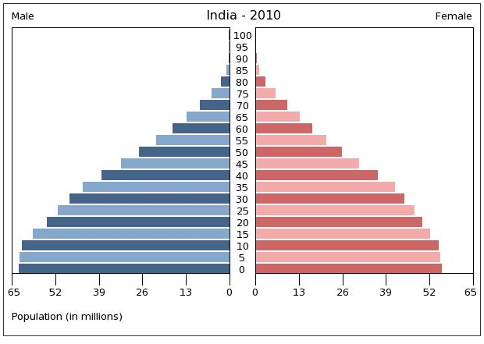
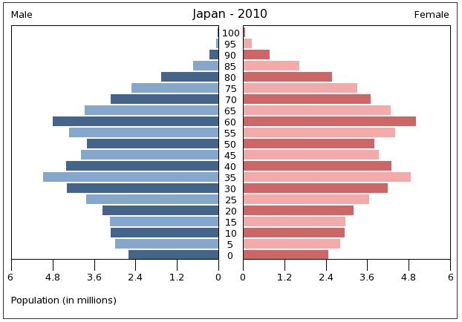
Population Pyramids
Birth Rates, Death Rates and Life Expectancy
How to tell the 5 Different types

Slide 8
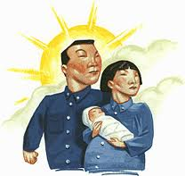
The ‘one child’ policy
Introduced on 1st January 1979
Couples were only allowed one child and were given a ‘one-child certificate’ entitling them to a package of benefits.
The government used incentives and disincentives to enforce this policy.

Slide 9


Incentives:
5-10% rise in pay;
Priority Housing;
Pension Benefits;
Free health care;
Free education for the single child.
Disincentives:
If a couple had a second child
10% salary cut
Huge fines imposed
Have to pay for health and education
Housing benefits removed
Pay cuts for fellow workers

