Slide 1
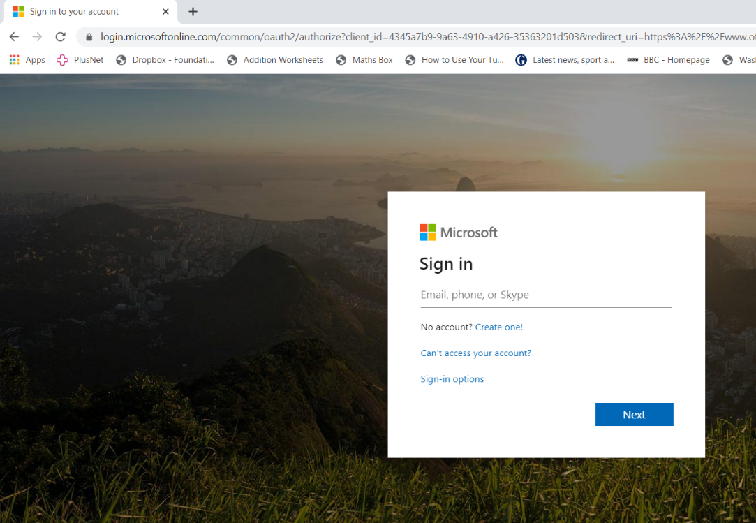
To access lessons that have been shared with you, you need to type the following web address into your web browser (e.g. Safari, Internet Explorer, Chrome etc.)
https://login.microsoftonline.com/
This will take you to a screen which looks like this:
You then need to type in your school email address: forename.surname@st-marys.newcastle.sch.uk (for example: john.brown@st-marys.newcastle.sch.uk)

Slide 2
Your password is the usual password that you use to login into the school network at St Mary’s

Slide 3
When you login your screen will look like this:
You now need to click on Outlook
You will have received an email about accessing any shared folders
Click on this to access the resources for the first time

Slide 4
Next time you access your work, click on “OneDrive” which contains all of your documents and those that are shared with you
On the left hand side, you should see an option for “Shared”, click on this and you will now be able to access any folders and work shared with you

