Slide 1
OAA
Task list:
Describe how you have used each key skill in your lessons and why they are important to be able to complete a task successfully.
Create your own problem solving challenges (3) that could be done within a PE setting. Think about the equipment you would need, how many people could carry it out and what space you would need.
Create your own ‘map challenge’ of your local area. Use google maps to take a ‘street view’ screen shot and plot out your map challenge.

Slide 2
OAA/Problem solving
Team work
Communication (verbal and non-verbal)
Listening
Problem solving
Resilience
Map reading

Slide 3
TASK 1
Describe how you have used each key skill in your lessons and why they are important to be able to complete a task successfully.
CHALLENGE: Rank order the key skills within OAA. Which is most important to be able to be successful in completing a task. Justify your response.
https://www.indeed.com/career-advice/resumes-cover-letters/problem-solving-skills

Slide 4
Team work

Slide 5
Communication (verbal and non-verbal)

Slide 6
Listening

Slide 7
Problem solving

Slide 8
Resilience

Slide 9
Map reading

Slide 10
Task 2
Task 2: Create your own problem solving challenges (3) that could be done within a PE setting. Think about the equipment you would need, how many people could carry it out and what space you would need.
CHALLENGE: How could you make your challenge harder?
SUPPORT: https://thephysicaleducator.com/game_category/cooperation/

Slide 11
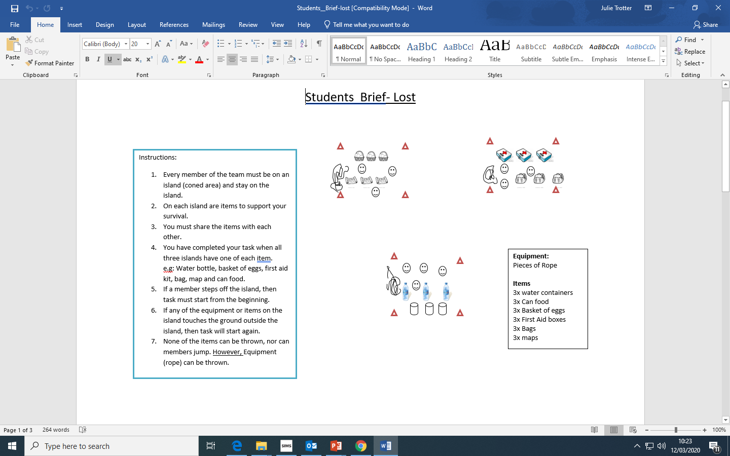
Example problem solving task

Slide 12
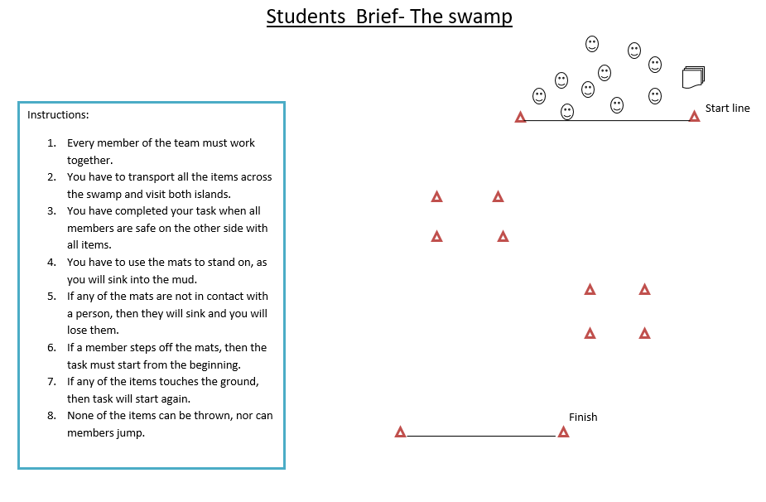
Example problem solving task

Slide 13
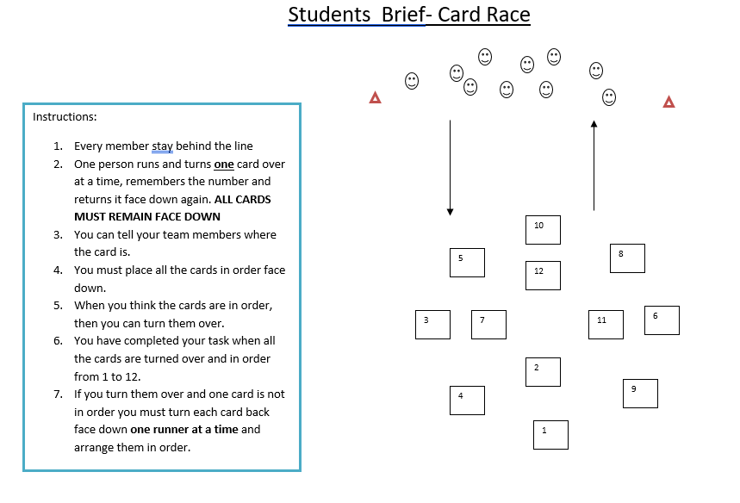
Example problem solving task

Slide 14
Problem solving task 1:

Slide 15
Problem solving task 2:

Slide 16
Problem solving task 3:

Slide 17
Task 3
Task 3: Create your own ‘map challenge’ of your local area. Use google maps to take a ‘street view’ screen shot and plot out your map challenge.
Consider what resources you would give to the person completing your map challenge. What are they going to ‘collect’ at each point of your map challenge.
CHALLENGE: Could you use clues that would direct them to the next clue?! Be creative!

Slide 18
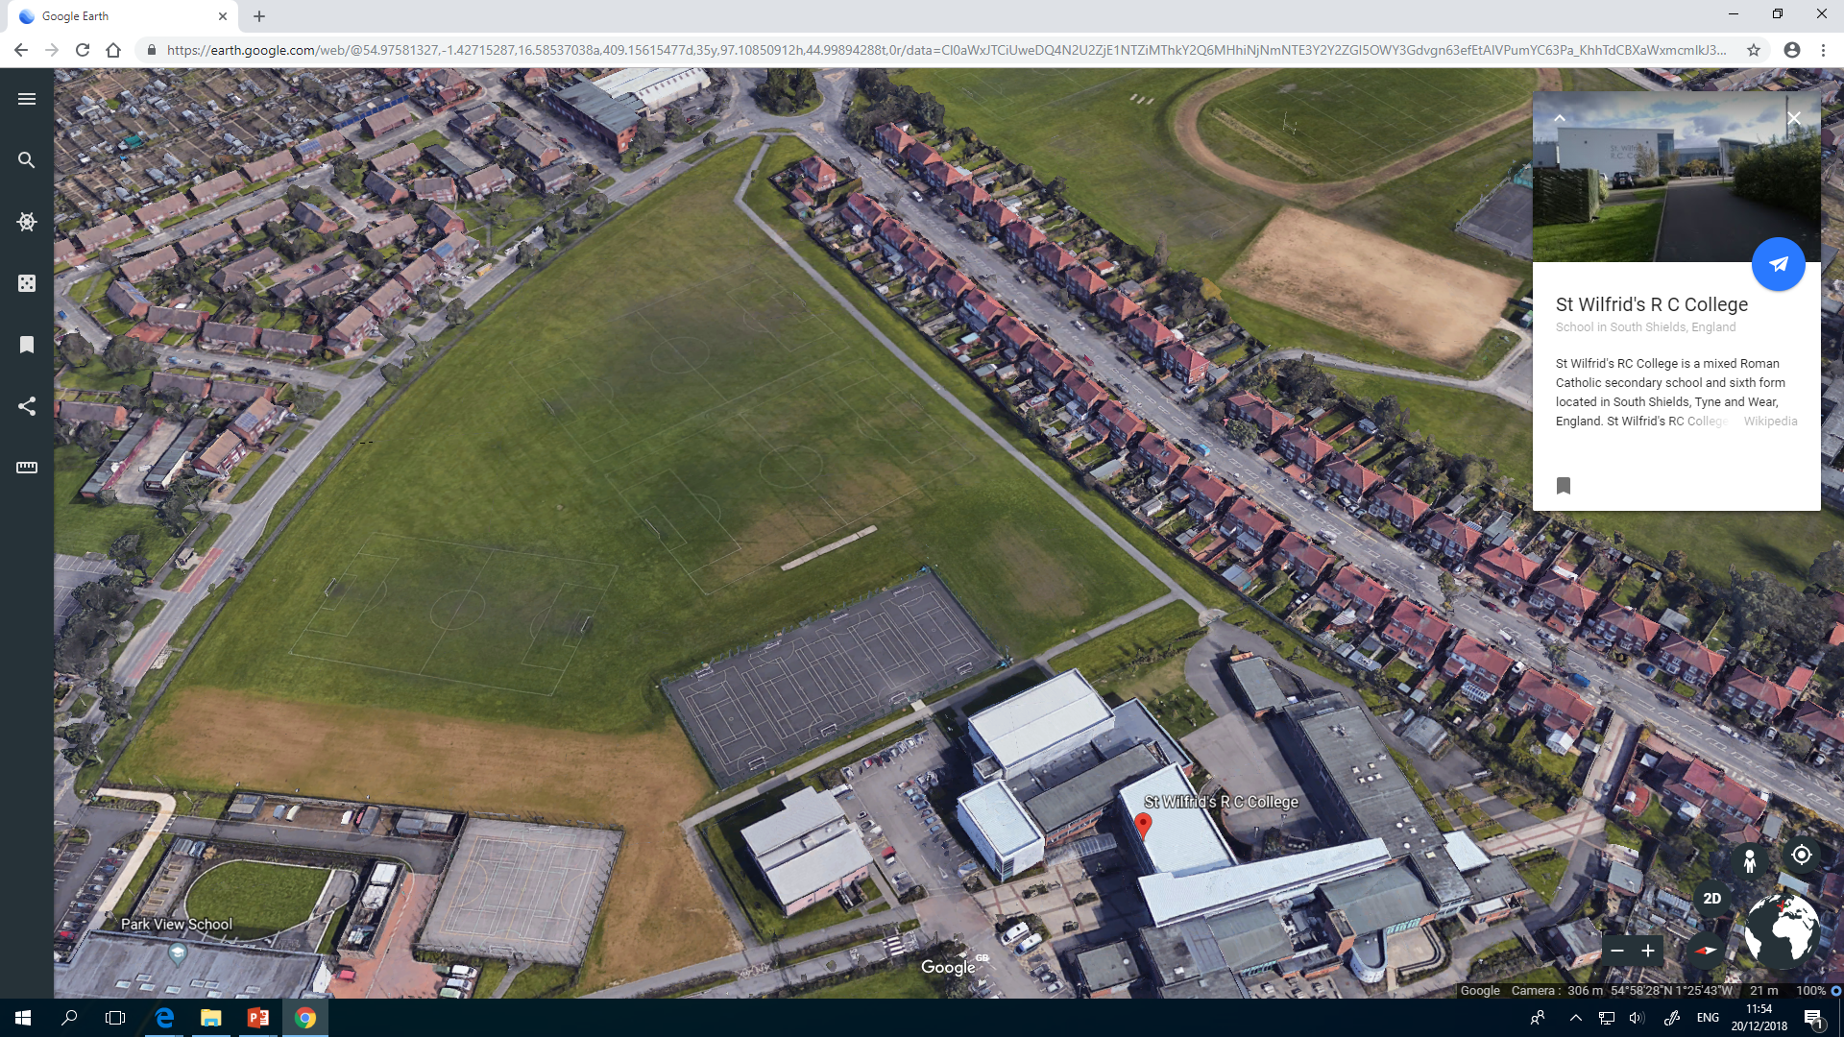
OAA map challenge
6
28
11
26
20
23
PITCH 2
13
8
1
PITCH 1
16
15
4
21
9
PITCH 3
5
MUGA
2
27
OUT OF BOUNDS – NEW BUILD
14
19
Sports Hall
22
10
25
24
17
7
3
Sixth form
18
12

Slide 19
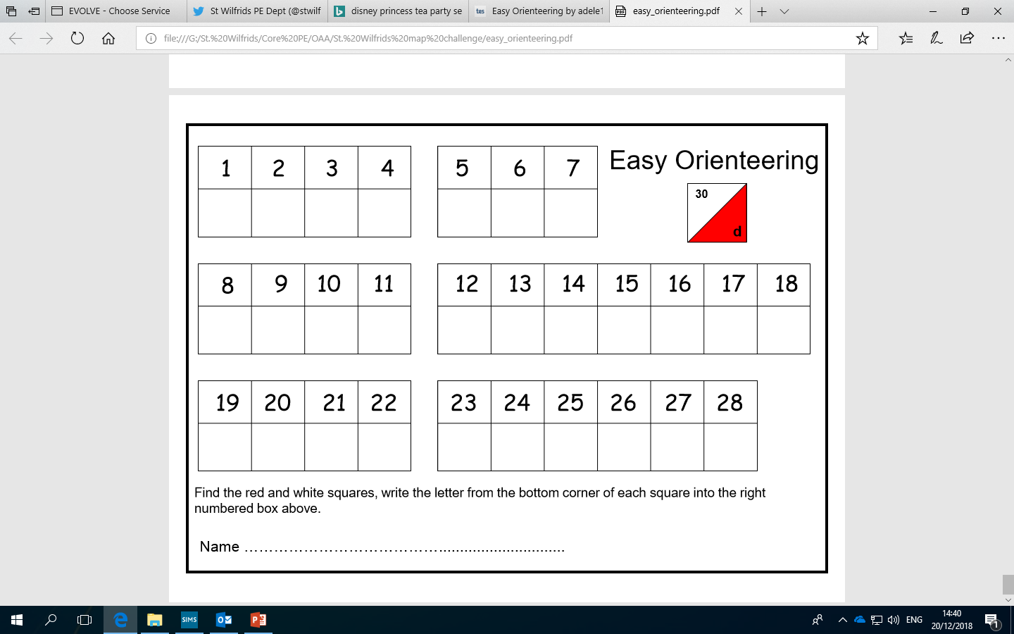
OAA map challenge – student answer sheet

Slide 20
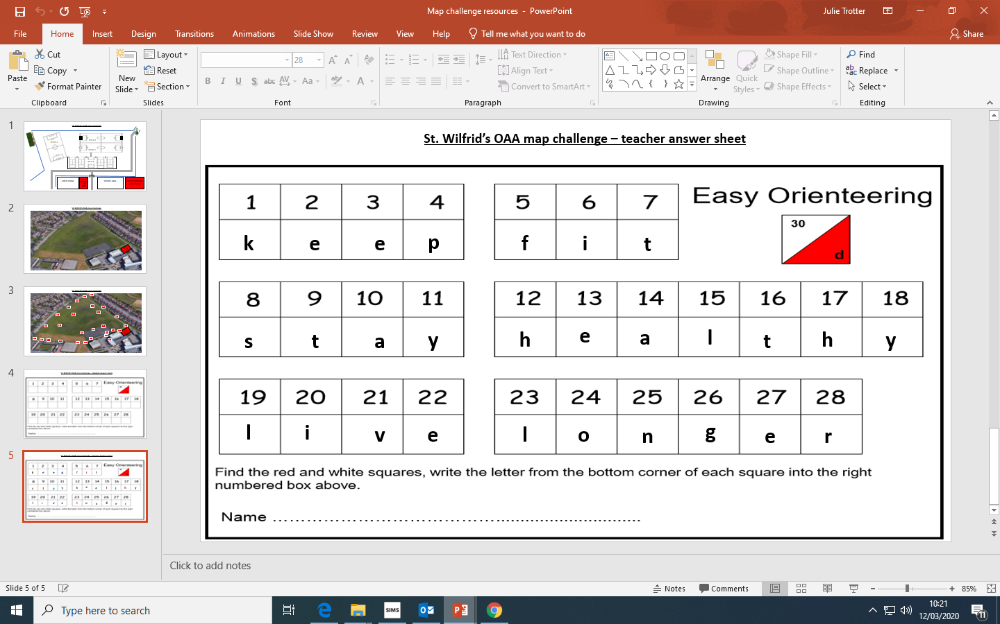

Slide 21
Task 3: My map challenge

