Slide 1
AOS1: Instrumental Music 1700-1820
JS Bach: Brandenburg Concerto No.5 in D major, 3rd movement

Slide 2
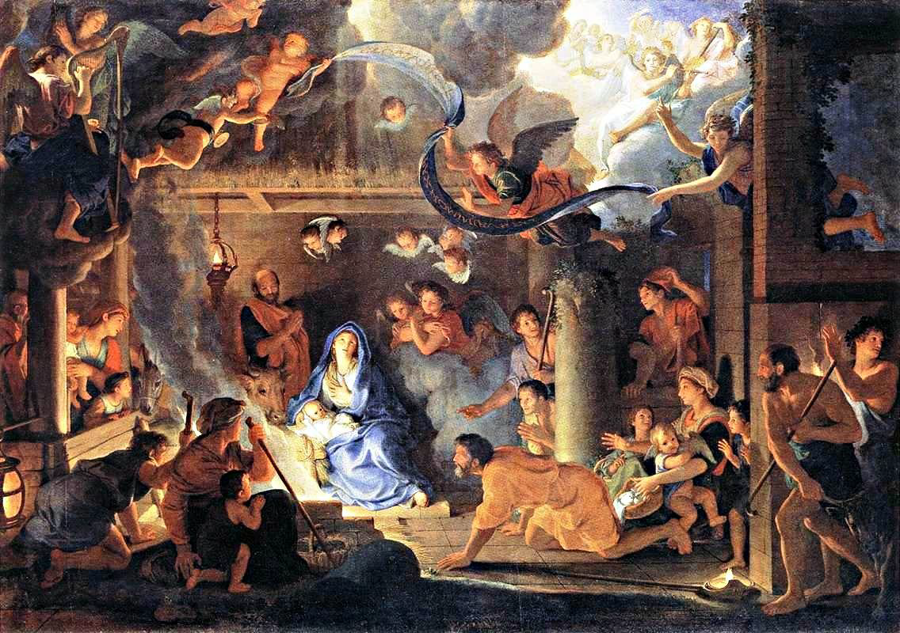
The Baroque era
What are the dates of the Baroque era?
  1600-1750
Where does the word ‘baroque’ come from?
  Portuguese word for ‘pearl’. Ornate and highly decorative architecture, paintings and frescos that cover German and Italian churches of the period. This decorative element translates into the use of ornamentation in melodic lines.
List some musical features of the baroque style.
  Ornamented melodies
  Major/minor tonal system
  Diatonic chords
  Basso continuo
  Mono, homo and polyphonic textures
  Musical devices such as sequence, pedals, and suspensions
  Affection
  Terraced dynamics
What did a baroque orchestra look like?

Slide 3
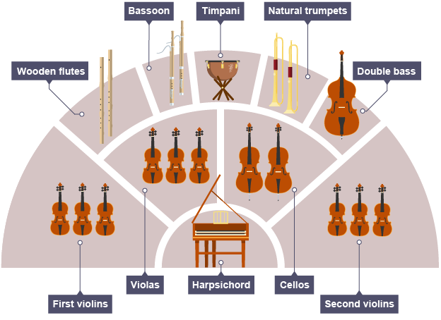

Slide 4
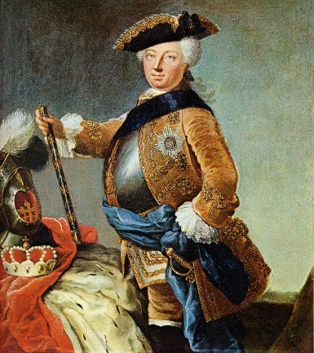
The Brandenburg Concertos
How many Brandenburg Concertos did Bach compose?
  6
Who were they dedicated to?
  The Margrave of Brandenburg (a nobleman)
What was patronage and how does it relate to the Brandenburg Concertos?
  The wealthy/aristocratic classes would commission (employ) a composer to write a piece of music for them. The Margrave was impressed with Bach’s music so commanded him to submit some pieces.
Why was Bach not paid for writing the concertos?
  Probably because they were delivered two years after the commission. Also they were revised versions of existing works!

Slide 5
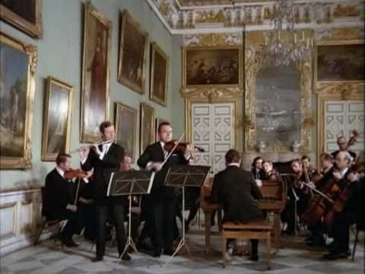
The Concerto Grosso
How many groups of instruments does a concerto grosso feature?
  2
What is the smaller group known as?
  The concertino
What is the larger group known as?
  The ripieno
What sort of textural effects can be created?
    - Dialoguing and antiphonal effects
How is a concerto grosso different to a solo concerto?
  A solo concerto is for one soloist and orchestra. A concerto grosso is for a group of soloists and orchestra.

Slide 6
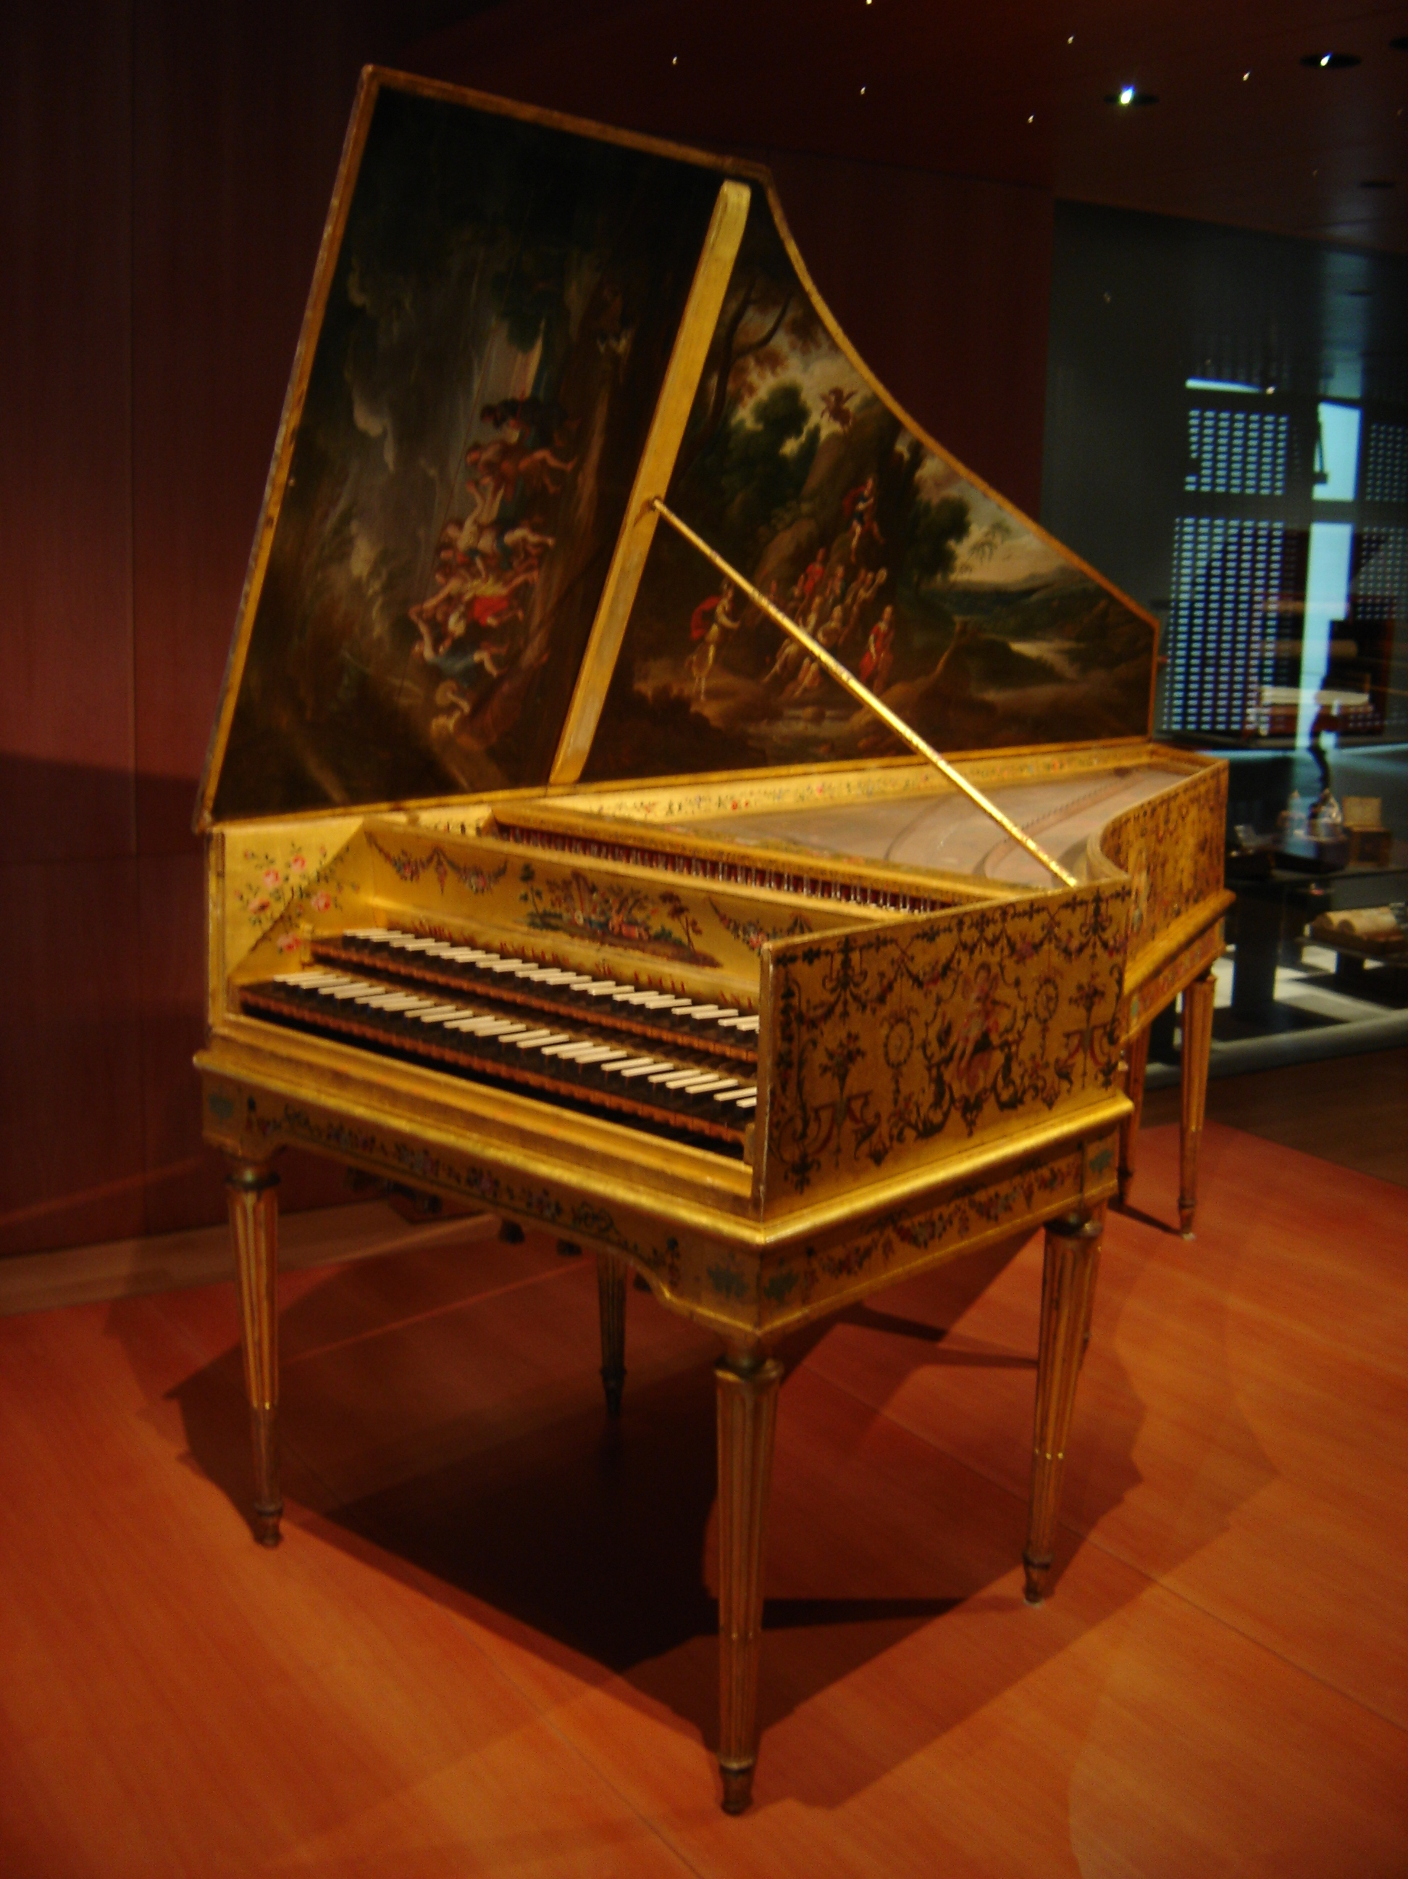

The Basso Continuo
What is the literal translation of basso continuo?
  Continuous bass
Which instruments normally play this part?
  A keyboard instrument (harpsichord or organ) and a bass instrument (cello or bassoon)
How is the music realised?
  A bass line is given and the keyboard player would add chords to fill in the harmonies.
What is figured bass?
  The numbers underneath the bass line which the keyboard player uses to identify which chord to play.
Why was it no longer needed in the classical era?
  The classical orchestra grew in size so the support of a keyboard instrument was no longer required.
What are the main roles of the harpsichord in Brandenburg Concerto No. 5, 3rd movement?
  Soloist
  Accompanist
  Realisation of figured bass
  Direct the ensemble

Slide 7
Structure
A
1-78
B
79-232
A
233-310
Ternary
Form
Fugue
Fugal exposition Middle section Final section
(exact repetition of Fugal exposition)

Slide 8
Score-reading
Look at the list of instruments on the right hand side of your score. Can you see any that you are unsure of?
What does Allegro mean?
How many different clefs are used? Can you name them?
What is the time signature?
What is the key signature?
Draw a bracket around the ‘concertino’ instruments and label ‘concertino’. Likewise for the ‘ripieno‘ instruments.
Mark on ‘A: 1-78’ on your score next to the word Allegro at bar 1.
Mark on ‘B: 79-232’ on your score at bar 79.
Mark on ‘A: 233-310’ on your score at bar 233.

Slide 9
Section A
Mark the answers on your scores
Which instrument plays the ‘subject’ at bars 1-2? (Highlight this and mark as ‘subject’)
Which instrument plays the ‘answer’ at bars 3-4?
Describe the texture between these two instruments.
What does the solo violin play whilst the flute is playing the answer?
What do the small numbers underneath the harpsichord part mean? Label them.
What key has been reach at bar 19? How do you know? (look at the accidentals in bars 14-18 for a clue)
Why are trills used on the sustained notes in the harpsichord part at bar 52 and bar 54?
What key does the A section end in? (see bar 78)
What type of cadence occurs at bars 77-78?

Slide 10
TEMPO: FAST
G# = MODULATING
ANSWER
CONCERTINO
SUBJECT
COUNTER-SUBJECT
TREBLE
ALTO
BASS
KEY-SIGNATURE: D-MAJOR
SUBJECT
TIME-SIGNATURE: SIMPLE DUPLE
RIPIENO
FIGURED BASS

Slide 11
Activity
There are two types of answer in a fugue: real and tonal. In a real answer, the interval between one note and the next is exactly the same as in the subject. Otherwise it is a tonal answer.
Look at the answer in bars 3-4. In the preceding subject, the interval between the first two notes (D to A) is a perfect 5th, but in the answer (A-D) it is a perfect 4th, so this is a tonal answer.
Can you find other examples of tonal answers in the music?
2. Try to compose a two-bar subject that will work with a real answer. Write in C major so that the subject begins on the note C and the answer will begin on G. Make sure that every interval is the same in the subject and the answer. This is tricky!

Slide 12
Why might the harpsichord use trills here?
Why does a similar melody played by the solo flute and solo violin not use trills?

Slide 13
Section B (tonality/harmony)
Mark the answers on your scores
What is the key at the start of this section? (look out for extra accidentals [#])
Name the musical device in the LH part of the harpsichord at bars 90-95.
What key has been reached by bar 98?
Name the musical device in the LH part of the harpsichord at bars 100-106.
Name the musical device at bars 114-118.
What sort of cadence occurs at bars 147-148? What is the key here?
Name the musical device in the LH part of the harpsichord at bars 148-154.
Name the key at bars 157-159.
Name the key at bars 161-163.
The subject occurs at bar 181 in what key?
Name the musical device in the bass instruments at bars 217-221.
What type of cadence occurs at bars 231-232? What is the key here?

Slide 14
SECTION B (79-232)
Use of raised 7th (A#) and B (tonic) pedal signify B-minor
Melody starts similarly to subject.
Use of triplet quavers from subject as accompaniment.

Slide 15
Section B (melody and texture)
Mark the answers on your scores
Which instrument plays the subject at bar 79?
Describe the texture between the concertino instruments and the harpsichord at bars 107-110.
Describe the texture between the flute and solo violin at bars 118-123.
The flute and violin have the subject at bar 130. Describe the texture between the two instruments.
At bars 129-134 describe the melodic movement of the bass parts.
Describe the texture between the RH and LH parts of the harpsichord at bars 163-176.
Describe the texture between the flute and solo violin at bars 193-202.
Describe the texture between the flute, solo violin and RH harpsichord at bars 203-214.
The subject is heard many times at bars 220-224 overlapping with each other in different instrumental parts. What is this device called?
Name the musical device at bars 225-229.

Slide 16
Imitative texture
Ascending sequence

Slide 17
An example of 2-part counterpoint between flute and violin
Subject and answer in F# minor

Slide 18
Flute and violin in unison
Sequential patterns in flute and violin
More chordal accompaniment in harpsichord

Slide 19
Tonic pedal A (key=A-major)
Subject in E-minor
Subject in B-minor

Slide 20
Canon between RH and LH at the octave

Slide 21
Interjections of subject from concertino.
Descending sequence.
D-major.

Slide 22
2-part counterpoint
Variant of subject
Triplet quaver passagework

Slide 23
Dominant pedal C# (key=F#-minor)
3-part counterpoint between solo flute, violin and RH of harpsichord

Slide 24
Stretto
Ascending sequences build tension

Slide 25
Pause
Cadential 6/4
Ic-V7-I
Perfect cadence

Slide 26
Context | Instrumentation | Melody | Rhythm Metre Tempo | Harmony Tonality | Texture | Structure | Dynamics
Concerto Grosso Affection | Concertino Ripieno Flute Harpsichord Figured bass | Sequences Suspensions Violin Subject Answer Countersubject Passagework Chromatic Scalic | Fast Gigue | D-major Pedals B-minor (relative minor) Secondary dominant Cadential 6/4 (ic-V7-i) Passing modulations | Homophonic Dialoguing Counterpoint Contrapuntal Tutti Monophonic Stretto Canon Fugal Unison | Fugue Ternary (ABA) Fugal exposition Middle section Final entries | Terraced dynamics

Slide 27
Exam style questions
1. The middle section starts at bar 79.
What is the key here? (1 mark)
How does this key relate to the opening key of the movement? (1 mark)
2. Starting at bar 189, the flute and solo violin play together (in thirds), A bar later the harpsichord plays a similar phrase, imitating them. All three instruments have a minim in the second bar of their phrase, but only the harpsichord has a trill over the minim. Why?
(1 mark)

Slide 28
Revision questions
Find two examples of different musical textures in the movement. Write a bar number followed by the single word describing the texture: monophonic, homophonic or polyphonic.
In what way is the flute phrase at bar 79 a variant of the opening theme? Name both a similarity of rhythm and a similarity of interval.
Apart from playing the written notes, the harpsichordist was important in other ways. Briefly describe one other role of this instrument.
Explain how this piece demonstrates some of the key features of the Baroque style.
Extension task:
In the 20th century Sir Michael Tippett wrote a Concerto for Double String Orchestra. Listen to the opening movement and compare it to this Bach Baroque movement. Can you identify some similarities and differences?

Slide 29
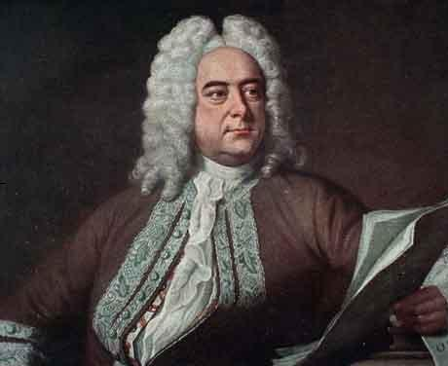
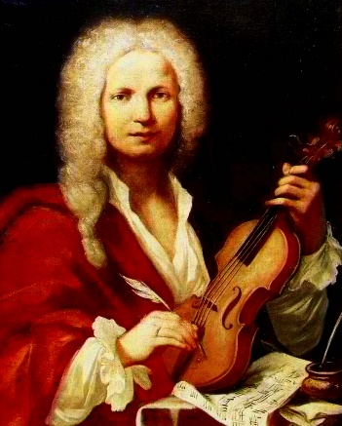
Wider listening
Handel
Vivaldi
Concerto Grosso Op.6 No.5, 2nd movement
‘Winter’ from the Four Seasons Concertos

Slide 30
Wider listening
Handel
Vivaldi
Similarities | Differences
Similarities | Differences

Slide 31
Examination structure
Section A: Listening
Set works (54 marks)
Melodic dictation (6 marks)
Unfamiliar listening analysis (8 marks)
Section B: Extended writing
Comparison question (set work and unfamiliar work) (12 marks)
80 marks in total

