Slide 1
Please use your exercise book to complete the following tasks.

Slide 2
Component 1:
Human Lifespan Development
Lesson 2
Physical Development - Childhood

Slide 3
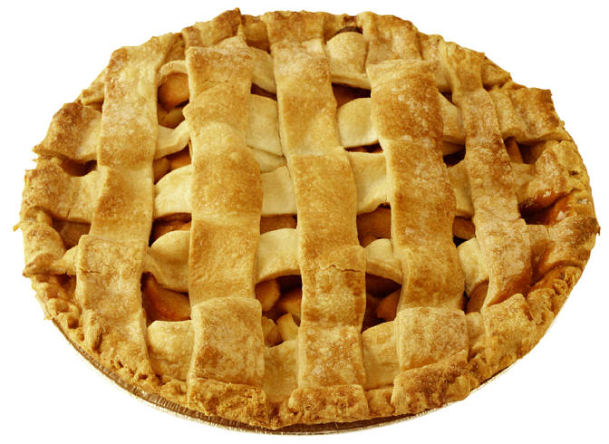
Last lesson we considered the acronym…PIES!
INTELLECTUAL
PHYSICAL
EMOTIONAL
SOCIAL

Slide 4
Recap Activity: PIES
Create a key to show which part of is relevant to each area of PIES
P
I
E
S
Describes how people develop their identity and cope with their feelings
Describes growth patterns and changes in mobility of the large and small muscles.
Describes how people develop friendships and relationships
Describes how people develop their thinking skills, memory and language
Copy this into your book and using work from last lesson identify the PIES

Slide 5
Physical Development through the Life stages
Today we are going to focus on one of the physical aspect of development.

Slide 6
Gross and Fine Motor Skills
Write down these definitions in your book
Gross Motor Skills:
These are using, controlling and co-ordinating the larger muscles in the body. EG: Walking, crawling
Fine Motor Skills:
These are using, controlling and co-ordinating the smaller muscles in the body for more precise movements. EG: Pointing, holding a spoon.

Slide 7
Gross or Fine?
In your book identify if the following skills are due to gross or fine motor skills.
Running
Holding a crayon or pencil
Pointing
Crawling
Jumping
Fastening a button

Slide 8
Answers
Running - gross
Holding a crayon or pencil - fine
Pointing- fine
Crawling - gross
Jumping - gross
Fastening a button - fine

Slide 9
Physical Development in the Early Stages
Copy this table into your book.
Top to Toe
Development starts from the head down. Infants gain control of their heads, before their back, muscles and head
Inner to Outer
Control starts form the body and moves out to the limbs, toes and fingers.
Same Patterns at Different Rates
Infants pass through the same stages but may do so at different ages.

Slide 10

Age | Gross Motor Skills | Fine Motor Skills
BIRTH UP TO 6 MONTHS | Lifts up head when lying on front Can roll over from back onto stomach | Can hold a rattle for a few seconds Will reach out and hold a toy
6 MONTHS TO 12 MONTHS | Sits without help Can walk holding on to furniture | Can grasp and pass an object from one hand to another. Can grasp things between finger and thumb.
12 MONTHS TO 18 MONTHS | Walks Climbs stairs | Can pick up small objects in finger and thumb and hold a crayon to scribble with.
18 MONTHS TO 2 YEARS | Can kick and throw a large ball Can propel a wheeled toy | Builds a tower with blocks. Can feed self with a spoon.
2 YEARS TO 3 YEARS | Can walk upstairs Can jump off a low step | Draw lines and circles with a crayon. Can turn pages of a book.

Slide 11

Watch the motor skills in action on this short video clip

Slide 12
*Please copy into your books and fill in the blanks!
Children 3-8 Years
By the age of five children will have developed the ___________skills for everyday_________. Examples include dressing, ___________ and using a knife and fork. This helps them to become _______________
By the age of ______ children will have good _________, co-ordination and __________which helps them to take part in physical games and _________.
ACTIVITIES SPORTS PHYSICAL WASHING CONTROL EIGHT INDEPENDENT BALANCE

Slide 13
Plenary
Using the table provided choose two colours and shade in each box to represent either fine motor skill or gross motor skill.

