Slide 1
Lesson 1 – Human Lifespan Development
Y10, you are now going to start a new topic that considers how we develop and the factors that influence our development.
There will be two assignments to this unit that you will need to complete before the end of Y10.
This is the first lesson to introduce you to the six stages of human development.

Slide 2
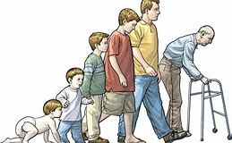
Component One:
Human Lifespan Development
Lesson 1.

Slide 3
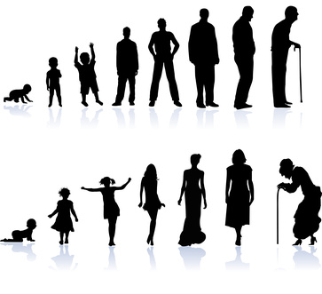
In todays lesson we will…
All will be able to Identify the 6 life stages.
Most will be able to recall the 6 life stages.
Some will be able to identify the key features of physical development during each life stage.

Slide 4
Learning Aims of this component:
You will produce a report for this coursework component.
A | Understand human growth and development across the life stages and the factors that affect it
B | Investigate how individuals deal with life events

Slide 5
What is a Life Stage?
Write this out in your book
A life stage is a distinct phase in which people pass through in their lives based on their age. Each life stage has distinct characteristics.

Slide 6

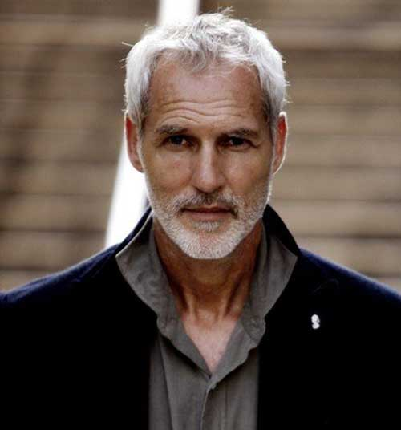
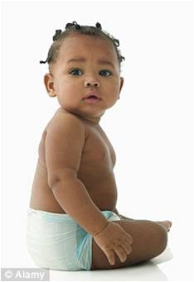
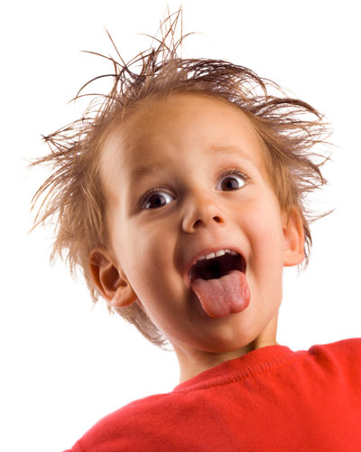
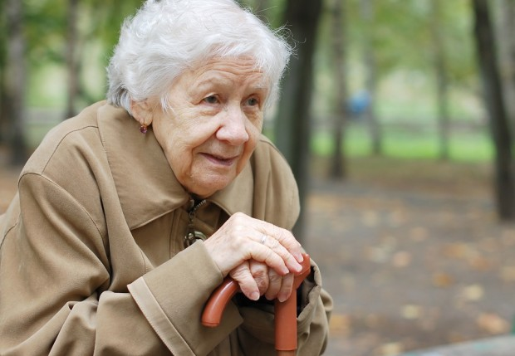

Put the pictures in order of age
A
B
C
D
E
F

Slide 7
The Six Life Stages
Draw this timeline in your books
0-2yrs
46-65yrs
3-8yrs
9-18yrs
19-45yrs
65+yrs
INFANCY
ADOLESCENCE
MIDDLE ADULTHOOD
EARLY CHILDHOOD
EARLY ADULTHOOD
LATER ADULTHOOD

Slide 8
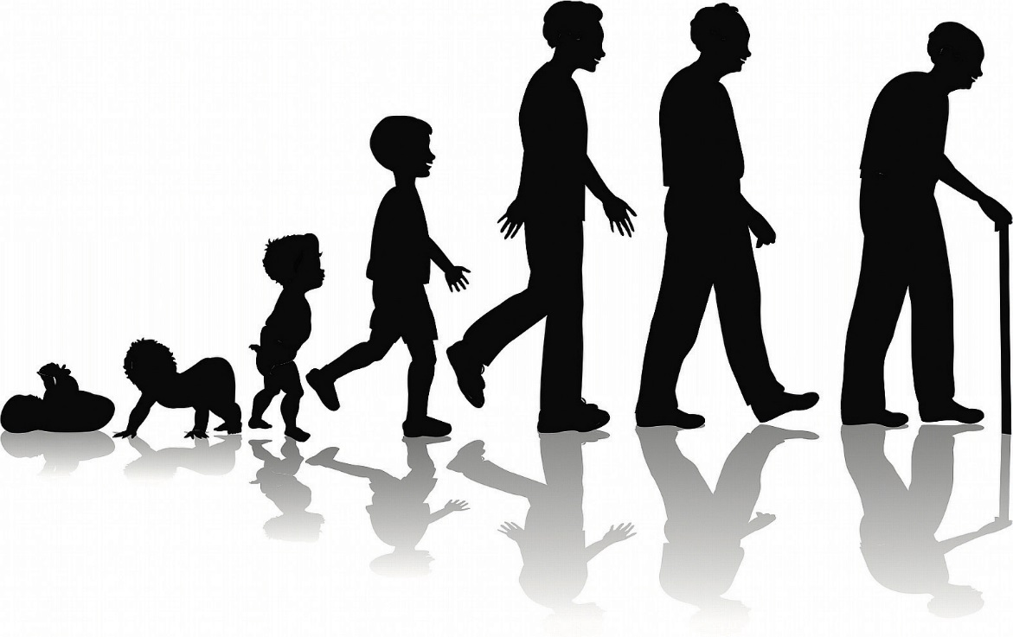
Life stages
Infancy (0-2yrs)
Early Childhood (3-8 yrs)
Adolescence (9-18yrs)
Early Adulthood (19-45yrs)
Middle Adulthood (46-65 yrs)
Late Adulthood (65+ yrs)

Slide 9
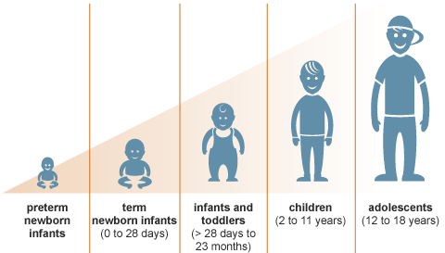
Growth and Development
As we pass through the different life stages, we all grow and develop in different ways.
Growth is a change in size or weight and is easy to measure.
Development is different and involves acquiring new skills and capabilities.
Being able to count, write and handle our own feelings and emotions are all important aspects of development.

Slide 10
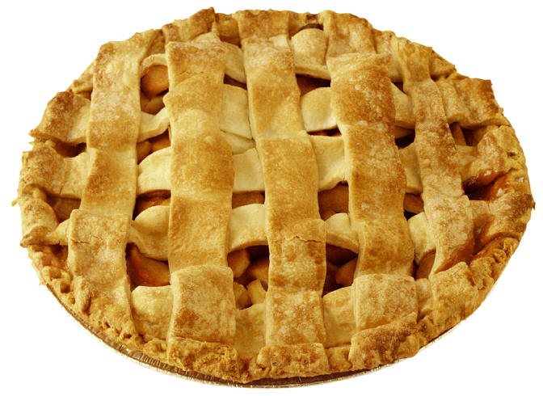
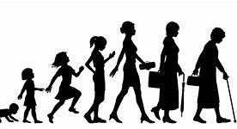
Development is often referred as …PIES!
PHYSICAL
INTELLECTUAL
SOCIAL
EMOTIONAL

Slide 11
PIES
Draw a picture of a pie and put each of the headings into it!
PHYSICAL = Body and how it develops
INTELLECTUAL = How are brain develops, how we learn and communicate with others.
EMOTIONAL =Feelings and how you view yourself.
SOCIAL = The relationship we have with others and the world around us.

Slide 12
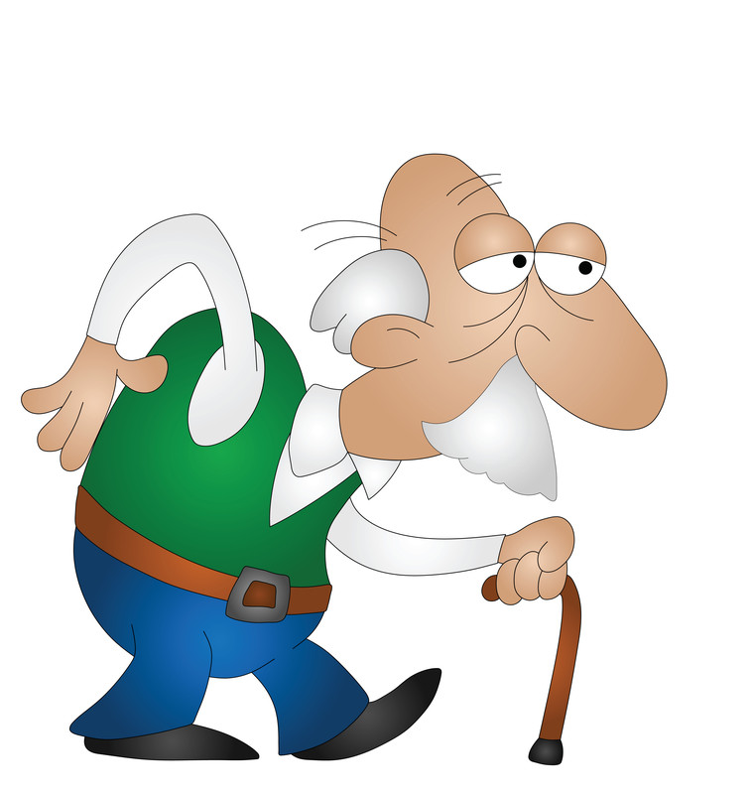
Timeline
Task:
Consider all of the changes that 83 year old Bill has been through in his life. Draw and annotate a timeline to show the distinct changes or characteristics he may have seen during this time. (examples include getting married, learning to walk and skills he may have developed etc)
0-2yrs
3-8yrs
9-18yrs
19-45yrs
46-65yrs
65+yrs
Using colours or letters, create a key and identify whether you feel these characteristics or changes where physical, intellectual, emotional or social.

