Slide 1

Language Paper 1: Question 5
Descriptive Writing Practice Homework

Slide 2
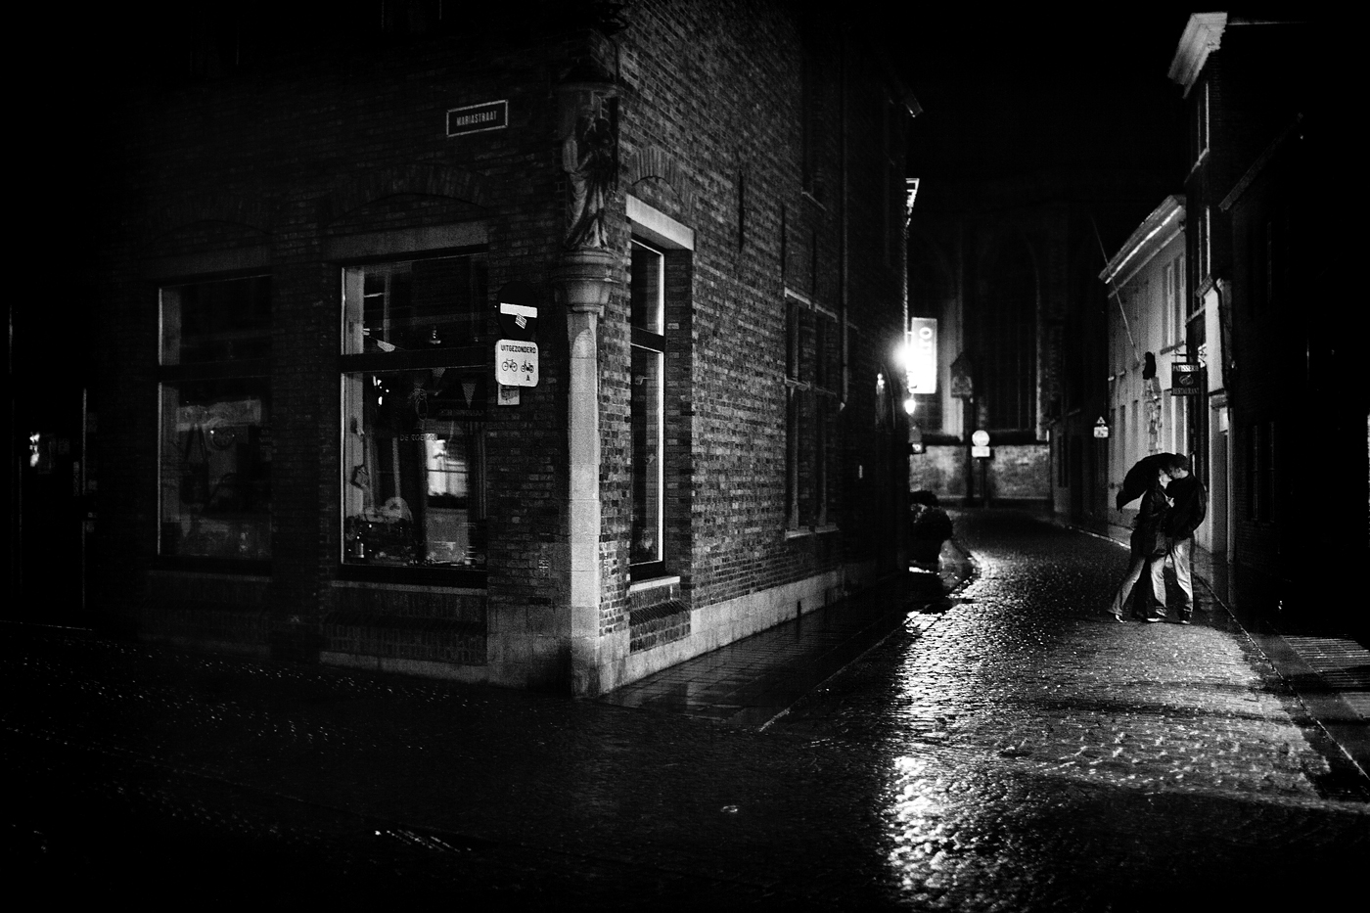
Language Paper 1: Question 5
Descriptive Writing
Write a description of a dark street as suggested by this picture:
LAYOUT
Panoramic – describe the scene, broadly. Introduce the time and atmosphere.
Zoom – focus your lens in on one segment of the image (draw a box)
Single line – emphasise the key feeling of your description in one line, apart from the text. BE DRAMATIC!
Shift – focus your lens on another segment of the image (draw a box)
Shift – focus your lens on another segment of the image (draw a box)
Panoramic – zoom out to look at the scene as a whole, how has it changed given the new perspective?
REMINDER
You must include:
a range of linguistic devices
a range of punctuation
ambitious vocabulary
varied structural features.
Plan before you write. Consider what you need to include (specifically) and where you will include it; create a tick list.

Slide 3
Plan
__________________________________________________________________________________________________________________________________________________________________________________________________________________________________________________________________________________________________________________________________________________________________________________________________________________________________________________________________________________________________________________________________________________________________________________________________________________________________________________________________________________________________________________________________________________________________________________________________________________________________________________________________________________________________________________

Slide 4
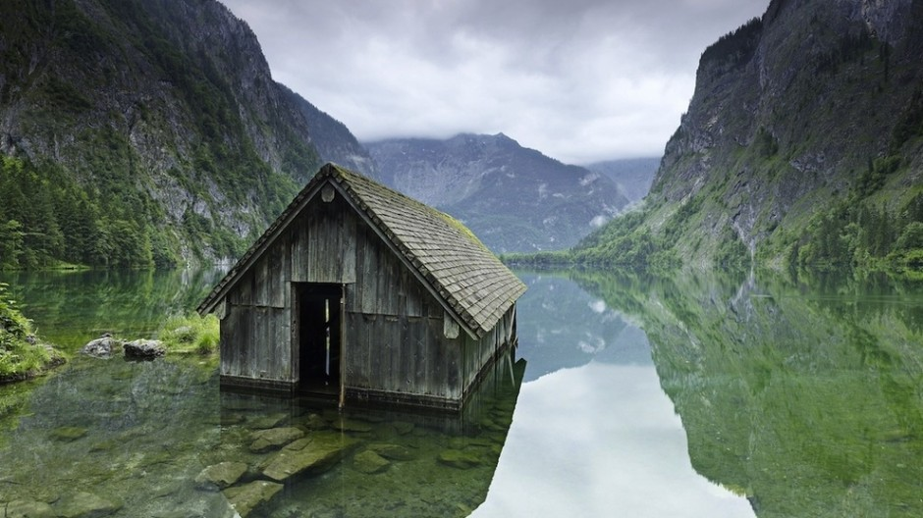
Language Paper 1: Question 5
Descriptive Writing
Write a description as suggested by this picture:
LAYOUT
Panoramic – describe the scene, broadly. Introduce the time and atmosphere.
Zoom – focus your lens in on one segment of the image (draw a box)
Single line – emphasise the key feeling of your description in one line, apart from the text. BE DRAMATIC!
Shift – focus your lens on another segment of the image (draw a box)
Shift – focus your lens on another segment of the image (draw a box)
Panoramic – zoom out to look at the scene as a whole, how has it changed given the new perspective?
REMINDER
You must include:
a range of linguistic devices
a range of punctuation
ambitious vocabulary
varied structural features.
Plan before you write. Consider what you need to include (specifically) and where you will include it; create a tick list.

Slide 5
Plan
__________________________________________________________________________________________________________________________________________________________________________________________________________________________________________________________________________________________________________________________________________________________________________________________________________________________________________________________________________________________________________________________________________________________________________________________________________________________________________________________________________________________________________________________________________________________________________________________________________________________________________________________________________________________________________________

Slide 6

Language Paper 1: Question 5
Descriptive Writing
Write a description of a wood as suggested by this picture:
LAYOUT
Panoramic – describe the scene, broadly. Introduce the time and atmosphere.
Zoom – focus your lens in on one segment of the image (draw a box)
Single line – emphasise the key feeling of your description in one line, apart from the text. BE DRAMATIC!
Shift – focus your lens on another segment of the image (draw a box)
Shift – focus your lens on another segment of the image (draw a box)
Panoramic – zoom out to look at the scene as a whole, how has it changed given the new perspective?
REMINDER
You must include:
a range of linguistic devices
a range of punctuation
ambitious vocabulary
varied structural features.
Plan before you write. Consider what you need to include (specifically) and where you will include it; create a tick list.

Slide 7
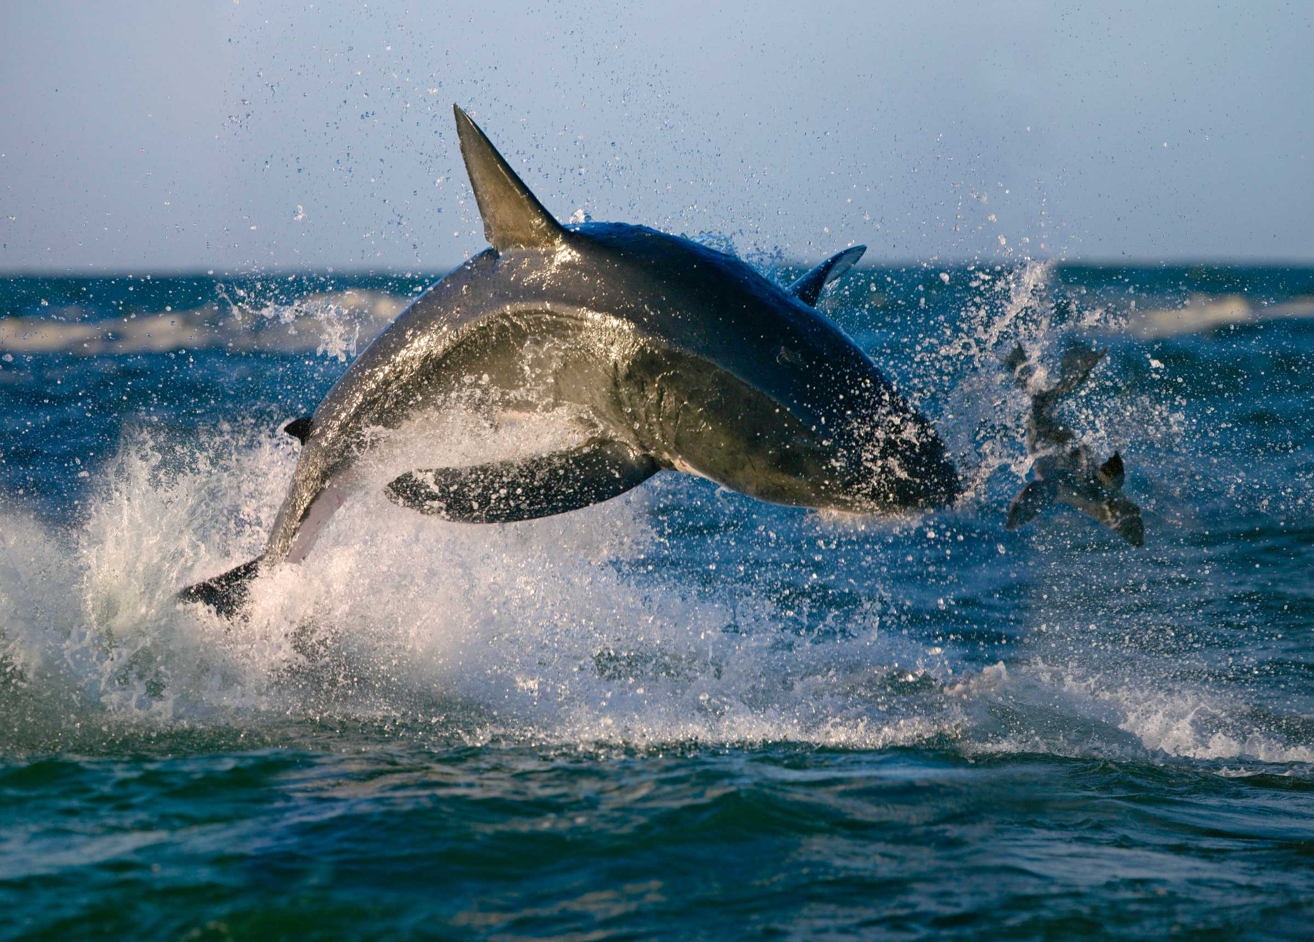
Language Paper 1: Question 5
Descriptive Writing
Write a description as suggested by this picture:
LAYOUT
Panoramic – describe the scene, broadly. Introduce the time and atmosphere.
Zoom – focus your lens in on one segment of the image (draw a box)
Single line – emphasise the key feeling of your description in one line, apart from the text. BE DRAMATIC!
Shift – focus your lens on another segment of the image (draw a box)
Shift – focus your lens on another segment of the image (draw a box)
Panoramic – zoom out to look at the scene as a whole, how has it changed given the new perspective?
REMINDER
You must include:
a range of linguistic devices
a range of punctuation
ambitious vocabulary
varied structural features.
Plan before you write. Consider what you need to include (specifically) and where you will include it; create a tick list.

Slide 8
Plan
__________________________________________________________________________________________________________________________________________________________________________________________________________________________________________________________________________________________________________________________________________________________________________________________________________________________________________________________________________________________________________________________________________________________________________________________________________________________________________________________________________________________________________________________________________________________________________________________________________________________________________________________________________________________________________________

Slide 9
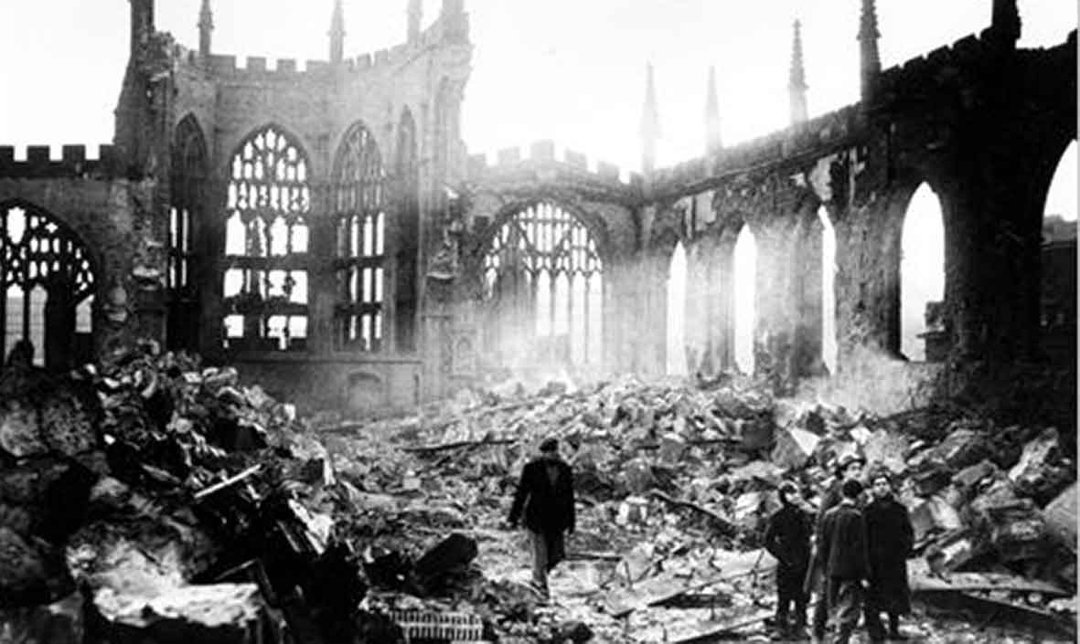
Language Paper 1: Question 5
Descriptive Writing
Write a description about destruction, as suggested by this picture:
LAYOUT
Panoramic – describe the scene, broadly. Introduce the time and atmosphere.
Zoom – focus your lens in on one segment of the image (draw a box)
Single line – emphasise the key feeling of your description in one line, apart from the text. BE DRAMATIC!
Shift – focus your lens on another segment of the image (draw a box)
Shift – focus your lens on another segment of the image (draw a box)
Panoramic – zoom out to look at the scene as a whole, how has it changed given the new perspective?
REMINDER
You must include:
a range of linguistic devices
a range of punctuation
ambitious vocabulary
varied structural features.
Plan before you write. Consider what you need to include (specifically) and where you will include it; create a tick list.

Slide 10
Plan
__________________________________________________________________________________________________________________________________________________________________________________________________________________________________________________________________________________________________________________________________________________________________________________________________________________________________________________________________________________________________________________________________________________________________________________________________________________________________________________________________________________________________________________________________________________________________________________________________________________________________________________________________________________________________________________

Slide 11
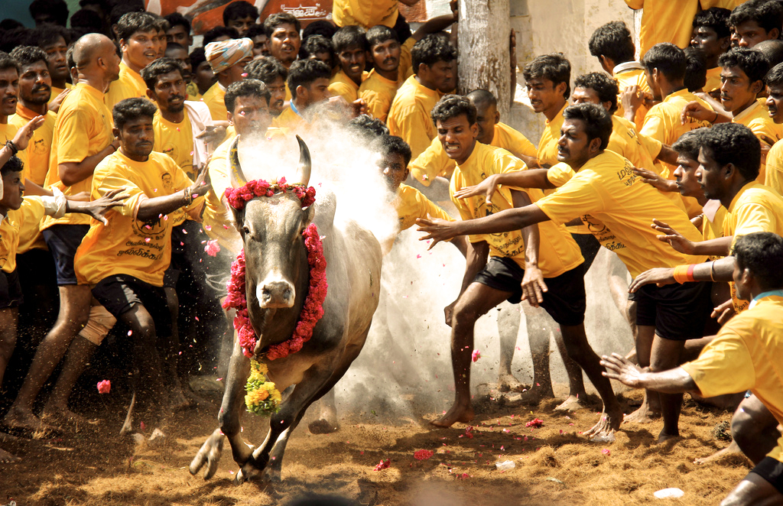
Language Paper 1: Question 5
Descriptive Writing
Write a description as suggested by this picture:
LAYOUT
Panoramic – describe the scene, broadly. Introduce the time and atmosphere.
Zoom – focus your lens in on one segment of the image (draw a box)
Single line – emphasise the key feeling of your description in one line, apart from the text. BE DRAMATIC!
Shift – focus your lens on another segment of the image (draw a box)
Shift – focus your lens on another segment of the image (draw a box)
Panoramic – zoom out to look at the scene as a whole, how has it changed given the new perspective?
REMINDER
You must include:
a range of linguistic devices
a range of punctuation
ambitious vocabulary
varied structural features.
Plan before you write. Consider what you need to include (specifically) and where you will include it; create a tick list.

Slide 12
Plan
__________________________________________________________________________________________________________________________________________________________________________________________________________________________________________________________________________________________________________________________________________________________________________________________________________________________________________________________________________________________________________________________________________________________________________________________________________________________________________________________________________________________________________________________________________________________________________________________________________________________________________________________________________________________________________________

Slide 13
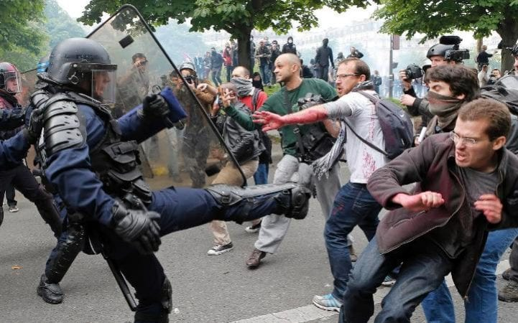
Language Paper 1: Question 5
Descriptive Writing
Write a description as suggested by this picture:
LAYOUT
Panoramic – describe the scene, broadly. Introduce the time and atmosphere.
Zoom – focus your lens in on one segment of the image (draw a box)
Single line – emphasise the key feeling of your description in one line, apart from the text. BE DRAMATIC!
Shift – focus your lens on another segment of the image (draw a box)
Shift – focus your lens on another segment of the image (draw a box)
Panoramic – zoom out to look at the scene as a whole, how has it changed given the new perspective?
REMINDER
You must include:
a range of linguistic devices
a range of punctuation
ambitious vocabulary
varied structural features.
Plan before you write. Consider what you need to include (specifically) and where you will include it; create a tick list.

Slide 14
Plan
__________________________________________________________________________________________________________________________________________________________________________________________________________________________________________________________________________________________________________________________________________________________________________________________________________________________________________________________________________________________________________________________________________________________________________________________________________________________________________________________________________________________________________________________________________________________________________________________________________________________________________________________________________________________________________________

Slide 15
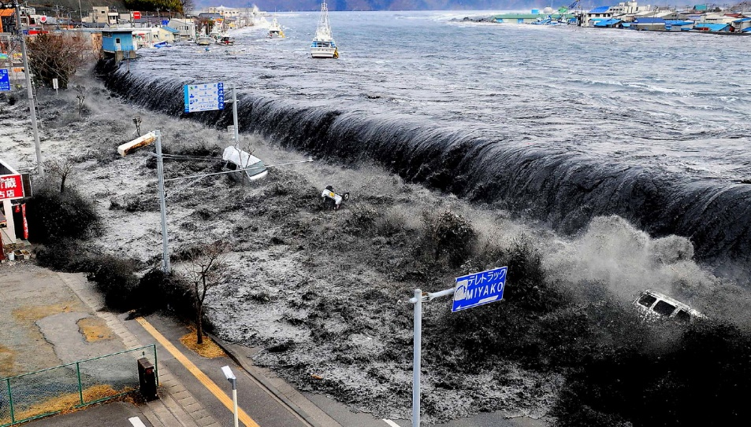
Language Paper 1: Question 5
Descriptive Writing
Write a description as suggested by this picture:
LAYOUT
Panoramic – describe the scene, broadly. Introduce the time and atmosphere.
Zoom – focus your lens in on one segment of the image (draw a box)
Single line – emphasise the key feeling of your description in one line, apart from the text. BE DRAMATIC!
Shift – focus your lens on another segment of the image (draw a box)
Shift – focus your lens on another segment of the image (draw a box)
Panoramic – zoom out to look at the scene as a whole, how has it changed given the new perspective?
REMINDER
You must include:
a range of linguistic devices
a range of punctuation
ambitious vocabulary
varied structural features.
Plan before you write. Consider what you need to include (specifically) and where you will include it; create a tick list.

Slide 16
Plan
__________________________________________________________________________________________________________________________________________________________________________________________________________________________________________________________________________________________________________________________________________________________________________________________________________________________________________________________________________________________________________________________________________________________________________________________________________________________________________________________________________________________________________________________________________________________________________________________________________________________________________________________________________________________________________________

Slide 17
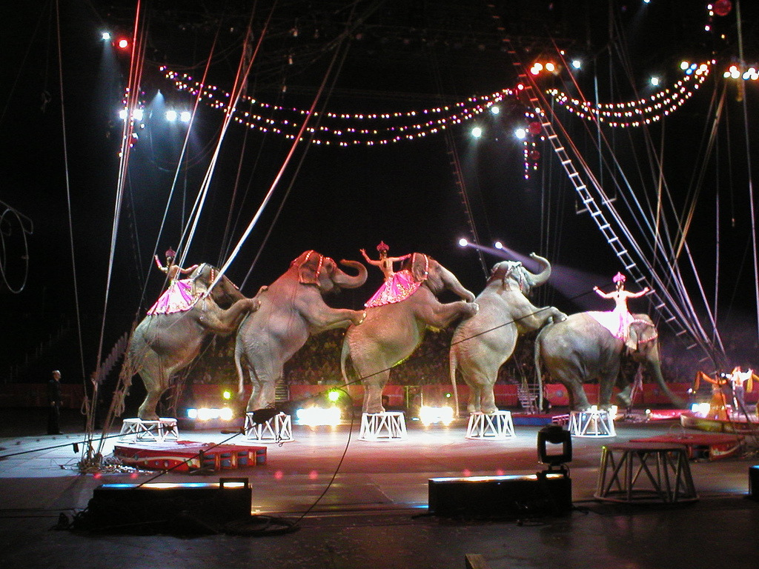
Language Paper 1: Question 5
Descriptive Writing
Write a description of a circus as suggested by this picture:
LAYOUT
Panoramic – describe the scene, broadly. Introduce the time and atmosphere.
Zoom – focus your lens in on one segment of the image (draw a box)
Single line – emphasise the key feeling of your description in one line, apart from the text. BE DRAMATIC!
Shift – focus your lens on another segment of the image (draw a box)
Shift – focus your lens on another segment of the image (draw a box)
Panoramic – zoom out to look at the scene as a whole, how has it changed given the new perspective?
REMINDER
You must include:
a range of linguistic devices
a range of punctuation
ambitious vocabulary
varied structural features.
Plan before you write. Consider what you need to include (specifically) and where you will include it; create a tick list.

Slide 18
Plan
__________________________________________________________________________________________________________________________________________________________________________________________________________________________________________________________________________________________________________________________________________________________________________________________________________________________________________________________________________________________________________________________________________________________________________________________________________________________________________________________________________________________________________________________________________________________________________________________________________________________________________________________________________________________________________________

Slide 19

Language Paper 1: Question 5
Descriptive Writing
Write a description as suggested by this picture:
LAYOUT
Panoramic – describe the scene, broadly. Introduce the time and atmosphere.
Zoom – focus your lens in on one segment of the image (draw a box)
Single line – emphasise the key feeling of your description in one line, apart from the text. BE DRAMATIC!
Shift – focus your lens on another segment of the image (draw a box)
Shift – focus your lens on another segment of the image (draw a box)
Panoramic – zoom out to look at the scene as a whole, how has it changed given the new perspective?
REMINDER
You must include:
a range of linguistic devices
a range of punctuation
ambitious vocabulary
varied structural features.
Plan before you write. Consider what you need to include (specifically) and where you will include it; create a tick list.

Slide 20
Plan
__________________________________________________________________________________________________________________________________________________________________________________________________________________________________________________________________________________________________________________________________________________________________________________________________________________________________________________________________________________________________________________________________________________________________________________________________________________________________________________________________________________________________________________________________________________________________________________________________________________________________________________________________________________________________________________

Slide 21
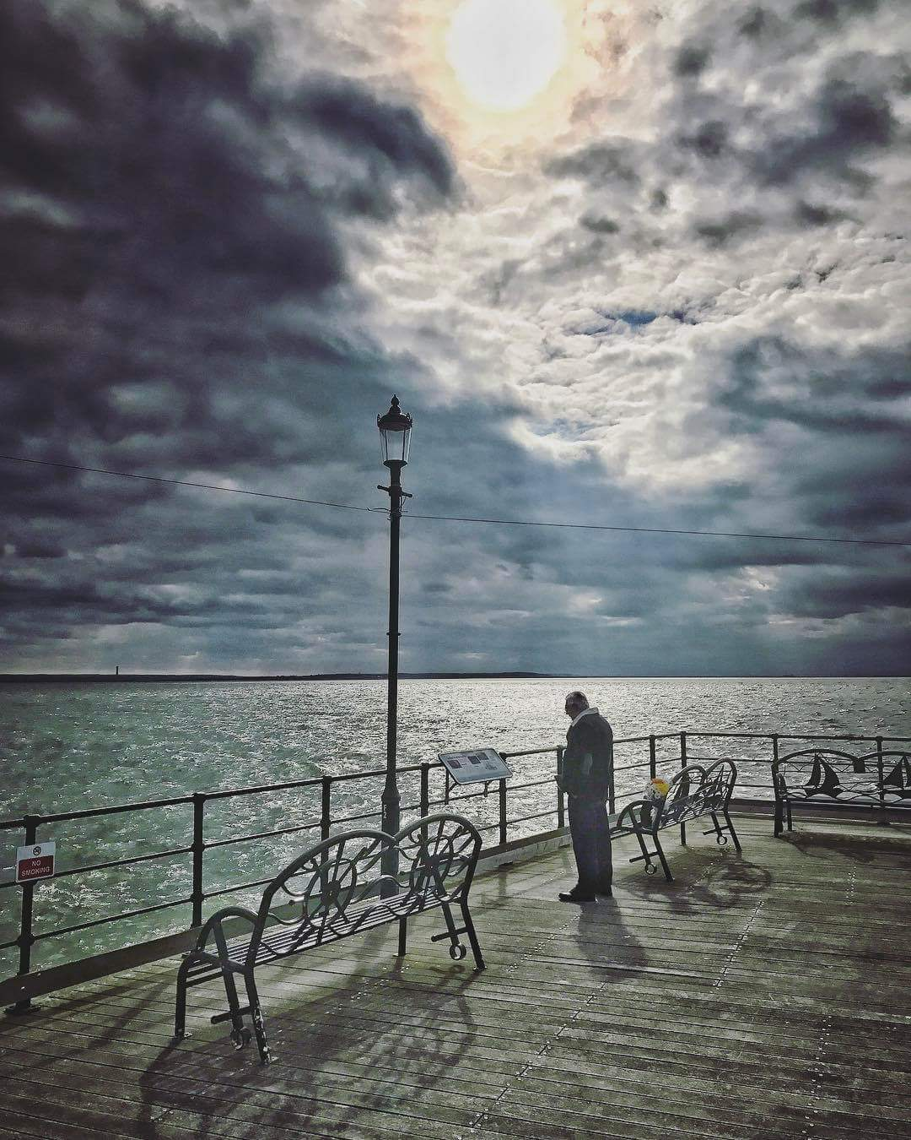
Language Paper 1: Question 5
Descriptive Writing
Write a description as suggested by this picture:
LAYOUT
Panoramic – describe the scene, broadly. Introduce the time and atmosphere.
Zoom – focus your lens in on one segment of the image (draw a box)
Single line – emphasise the key feeling of your description in one line, apart from the text. BE DRAMATIC!
Shift – focus your lens on another segment of the image (draw a box)
Shift – focus your lens on another segment of the image (draw a box)
Panoramic – zoom out to look at the scene as a whole, how has it changed given the new perspective?
REMINDER
You must include:
a range of linguistic devices
a range of punctuation
ambitious vocabulary
varied structural features.
Plan before you write. Consider what you need to include (specifically) and where you will include it; create a tick list.

Slide 22
Plan
__________________________________________________________________________________________________________________________________________________________________________________________________________________________________________________________________________________________________________________________________________________________________________________________________________________________________________________________________________________________________________________________________________________________________________________________________________________________________________________________________________________________________________________________________________________________________________________________________________________________________________________________________________________________________________________

Slide 23
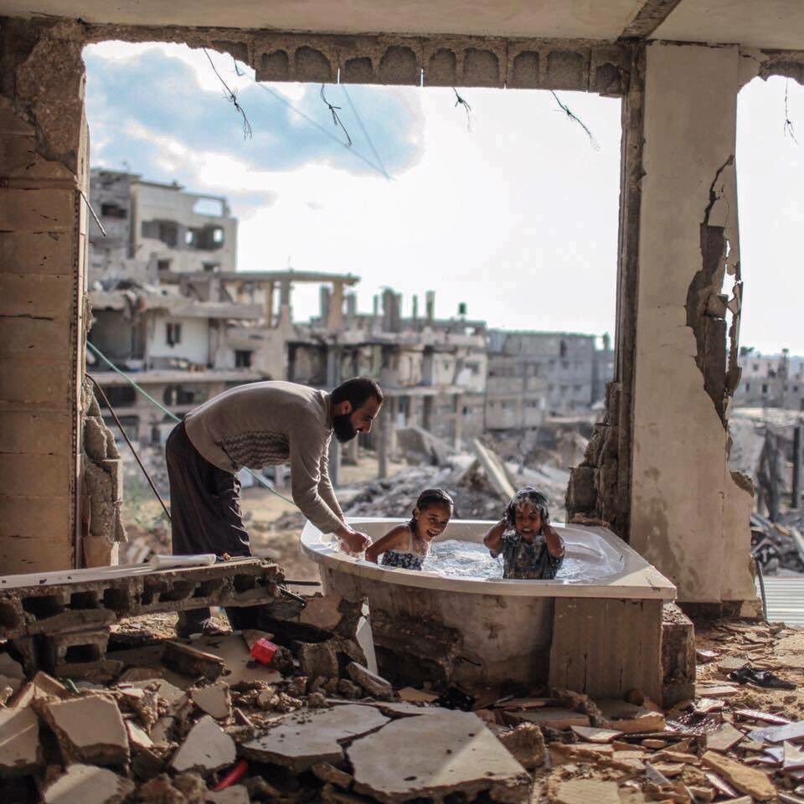
Language Paper 1: Question 5
Descriptive Writing
Write a description as suggested by this picture:
LAYOUT
Panoramic – describe the scene, broadly. Introduce the time and atmosphere.
Zoom – focus your lens in on one segment of the image (draw a box)
Single line – emphasise the key feeling of your description in one line, apart from the text. BE DRAMATIC!
Shift – focus your lens on another segment of the image (draw a box)
Shift – focus your lens on another segment of the image (draw a box)
Panoramic – zoom out to look at the scene as a whole, how has it changed given the new perspective?
REMINDER
You must include:
a range of linguistic devices
a range of punctuation
ambitious vocabulary
varied structural features.
Plan before you write. Consider what you need to include (specifically) and where you will include it; create a tick list.

Slide 24
Plan
__________________________________________________________________________________________________________________________________________________________________________________________________________________________________________________________________________________________________________________________________________________________________________________________________________________________________________________________________________________________________________________________________________________________________________________________________________________________________________________________________________________________________________________________________________________________________________________________________________________________________________________________________________________________________________________

Slide 25
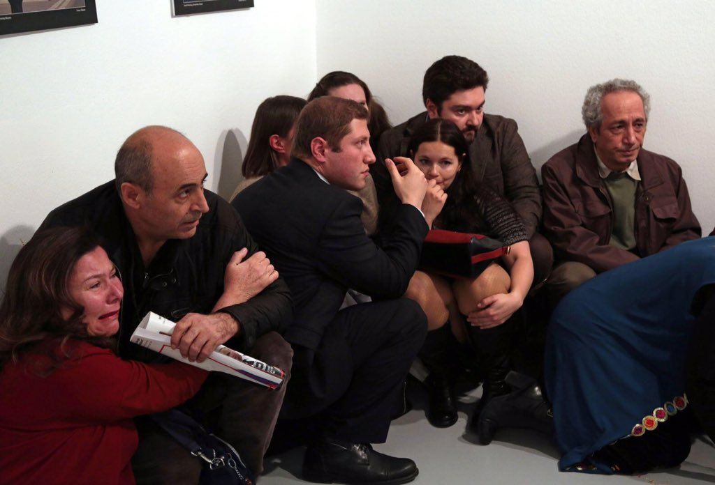
Language Paper 1: Question 5
Descriptive Writing
Write a description as suggested by this picture:
LAYOUT
Panoramic – describe the scene, broadly. Introduce the time and atmosphere.
Zoom – focus your lens in on one segment of the image (draw a box)
Single line – emphasise the key feeling of your description in one line, apart from the text. BE DRAMATIC!
Shift – focus your lens on another segment of the image (draw a box)
Shift – focus your lens on another segment of the image (draw a box)
Panoramic – zoom out to look at the scene as a whole, how has it changed given the new perspective?
REMINDER
You must include:
a range of linguistic devices
a range of punctuation
ambitious vocabulary
varied structural features.
Plan before you write. Consider what you need to include (specifically) and where you will include it; create a tick list.

Slide 26
Plan
__________________________________________________________________________________________________________________________________________________________________________________________________________________________________________________________________________________________________________________________________________________________________________________________________________________________________________________________________________________________________________________________________________________________________________________________________________________________________________________________________________________________________________________________________________________________________________________________________________________________________________________________________________________________________________________

