Slide 1
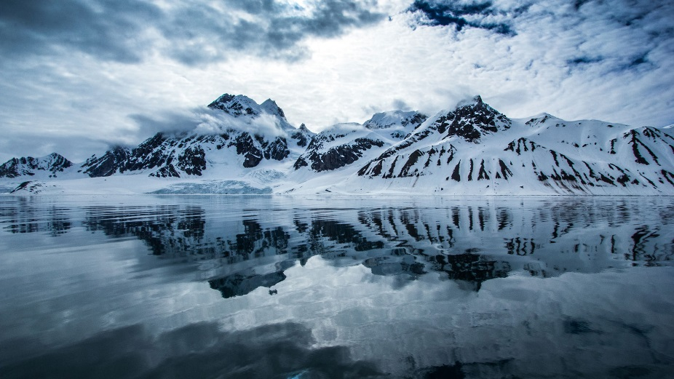
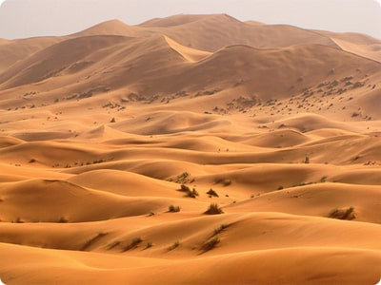
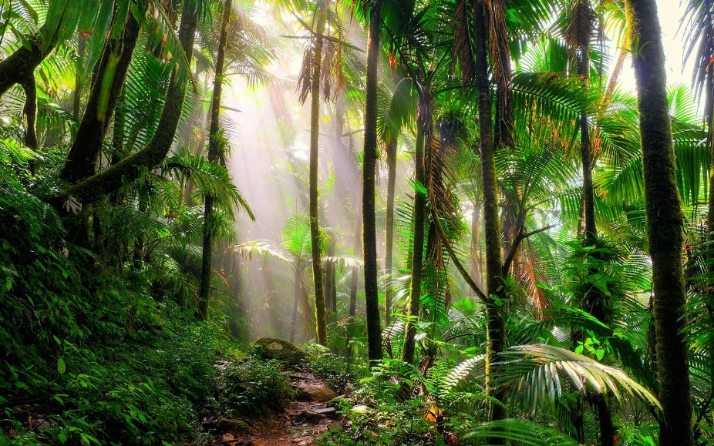
Impossible places revision

Slide 2
Impossible places revision
What is an impossible place?
What is the distribution of world population like and why?
Why is the Arctic an impossible place?
What is xeriscaping?
How can we xeriscape gardens?
How do we plot climate graphs and what do they show?
Why does Las Vegas need xeriscaping?

Slide 3
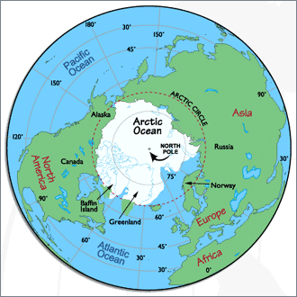
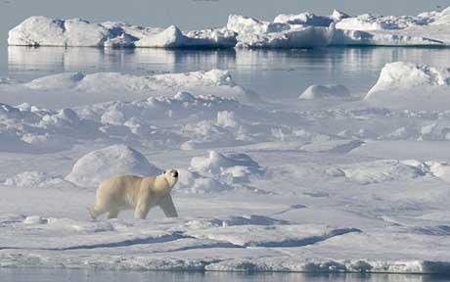
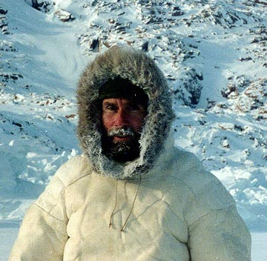
The Arctic
Why is the Arctic an impossible place?

Slide 4
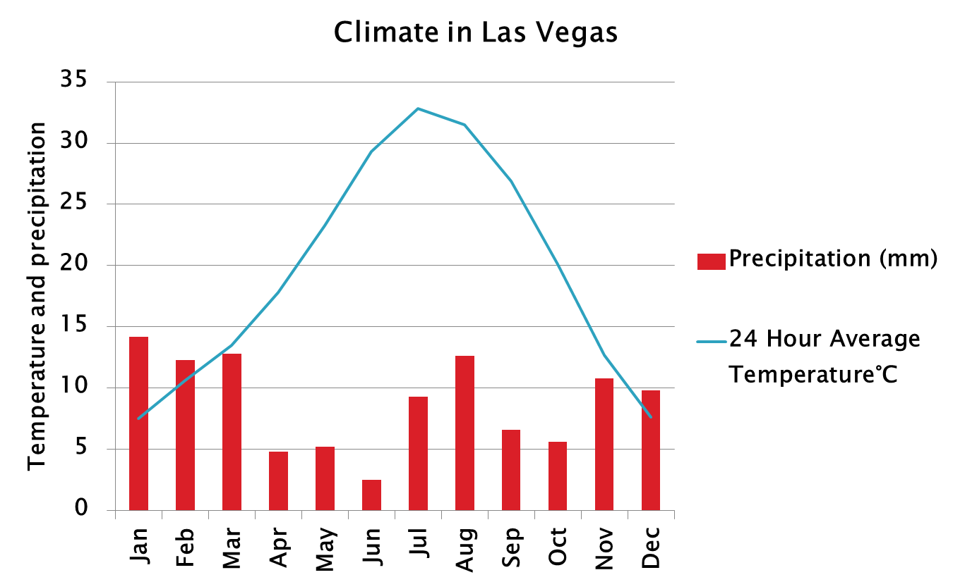
Las Vegas and climate graphs
How do you plot a climate graph? Come up with instructions you could give a year 7
Why does Las Vegas’ climate mean it needs xeriscaping?

Slide 5
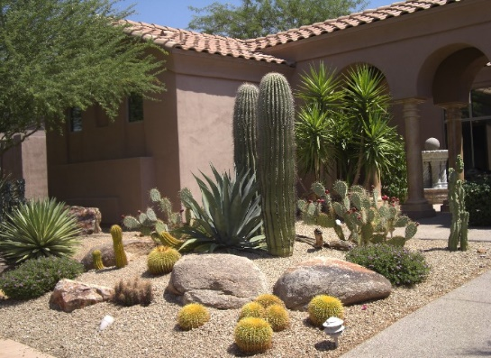
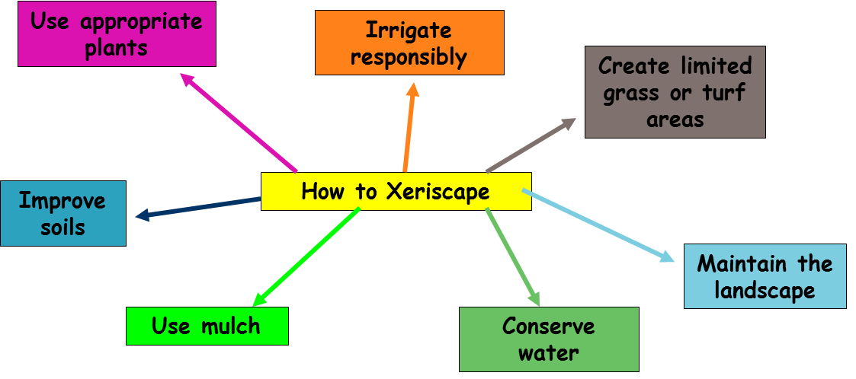
How do we xeriscape?
Discuss how each of these concepts helps create a xeriscaped garden

