Slide 1
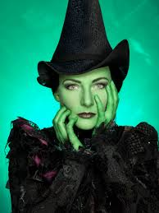
Wicked
Defying Gravity

Slide 2
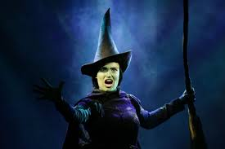
How can you tell that this piece is a Musical?

Slide 3
Background
Forms the finale to Act One, sort of cliff hanger.
Orchestrated by specialist (Bill Brohn) rather than original composer (Stephen Schwartz)
We have short score, in original there are:
4 strings
Double bass
4 woodwind
6 brass (trumpets, trombones, horns)
2 guitars and harp
Drums
Percussion
3 keyboards

Slide 4
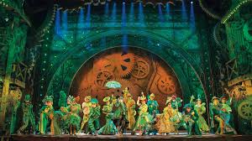
Look through score and pick out examples of idiomatic writing

Slide 5
Look through score and pick out examples of idiomatic writing
Bars 11, 40, 45: Electric guitar with overdrive (distortion)
Bars 20-23: Chordal writing for low brass contrasting with melody on solo synth
Bars 34-36: Tremolo- creates excitement
Bar 54: Drum fill- brief drum improvisation filling gaps between vocal phrases
Bars 89-91: Descending scales for bass clarinet
Bar 122: cymbal roll announcing change of key
Bar 135: Tutti for climax
Bars 152-160: Synth and glockenspiel play a high pitched ostinato as Elphaba sings of flying high
Elphaba: Mezzo sop Glinda: soprano

Slide 6
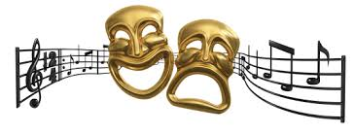
How is the structure idiosyncratic of Music theatre?

Slide 7
Structure
Verse and chorus form
A scena with duet sections (Continuous piece of vocal music comprising several distinct sections)
Passages of underscore (music played under dialogue)
Recitative (vocal music that follows the rhythms of speech)
At the very end the entry of the chorus and stage effects just before the curtain falls.

Slide 8
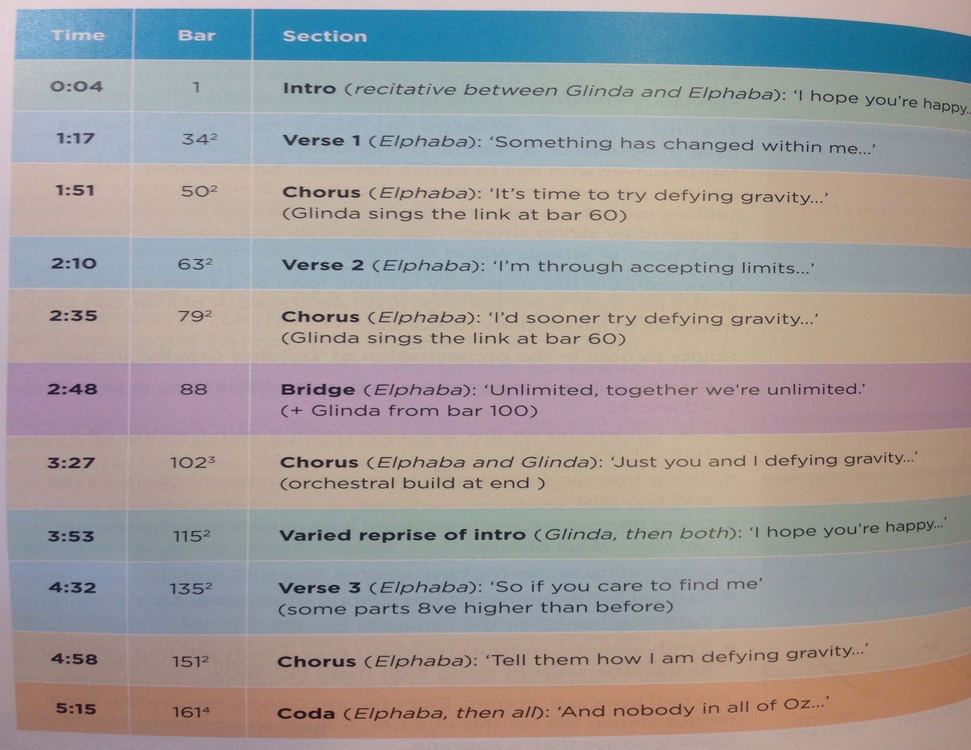

Slide 9
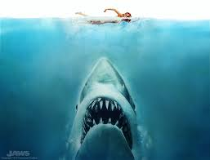
What is a leitmotif?

Slide 10
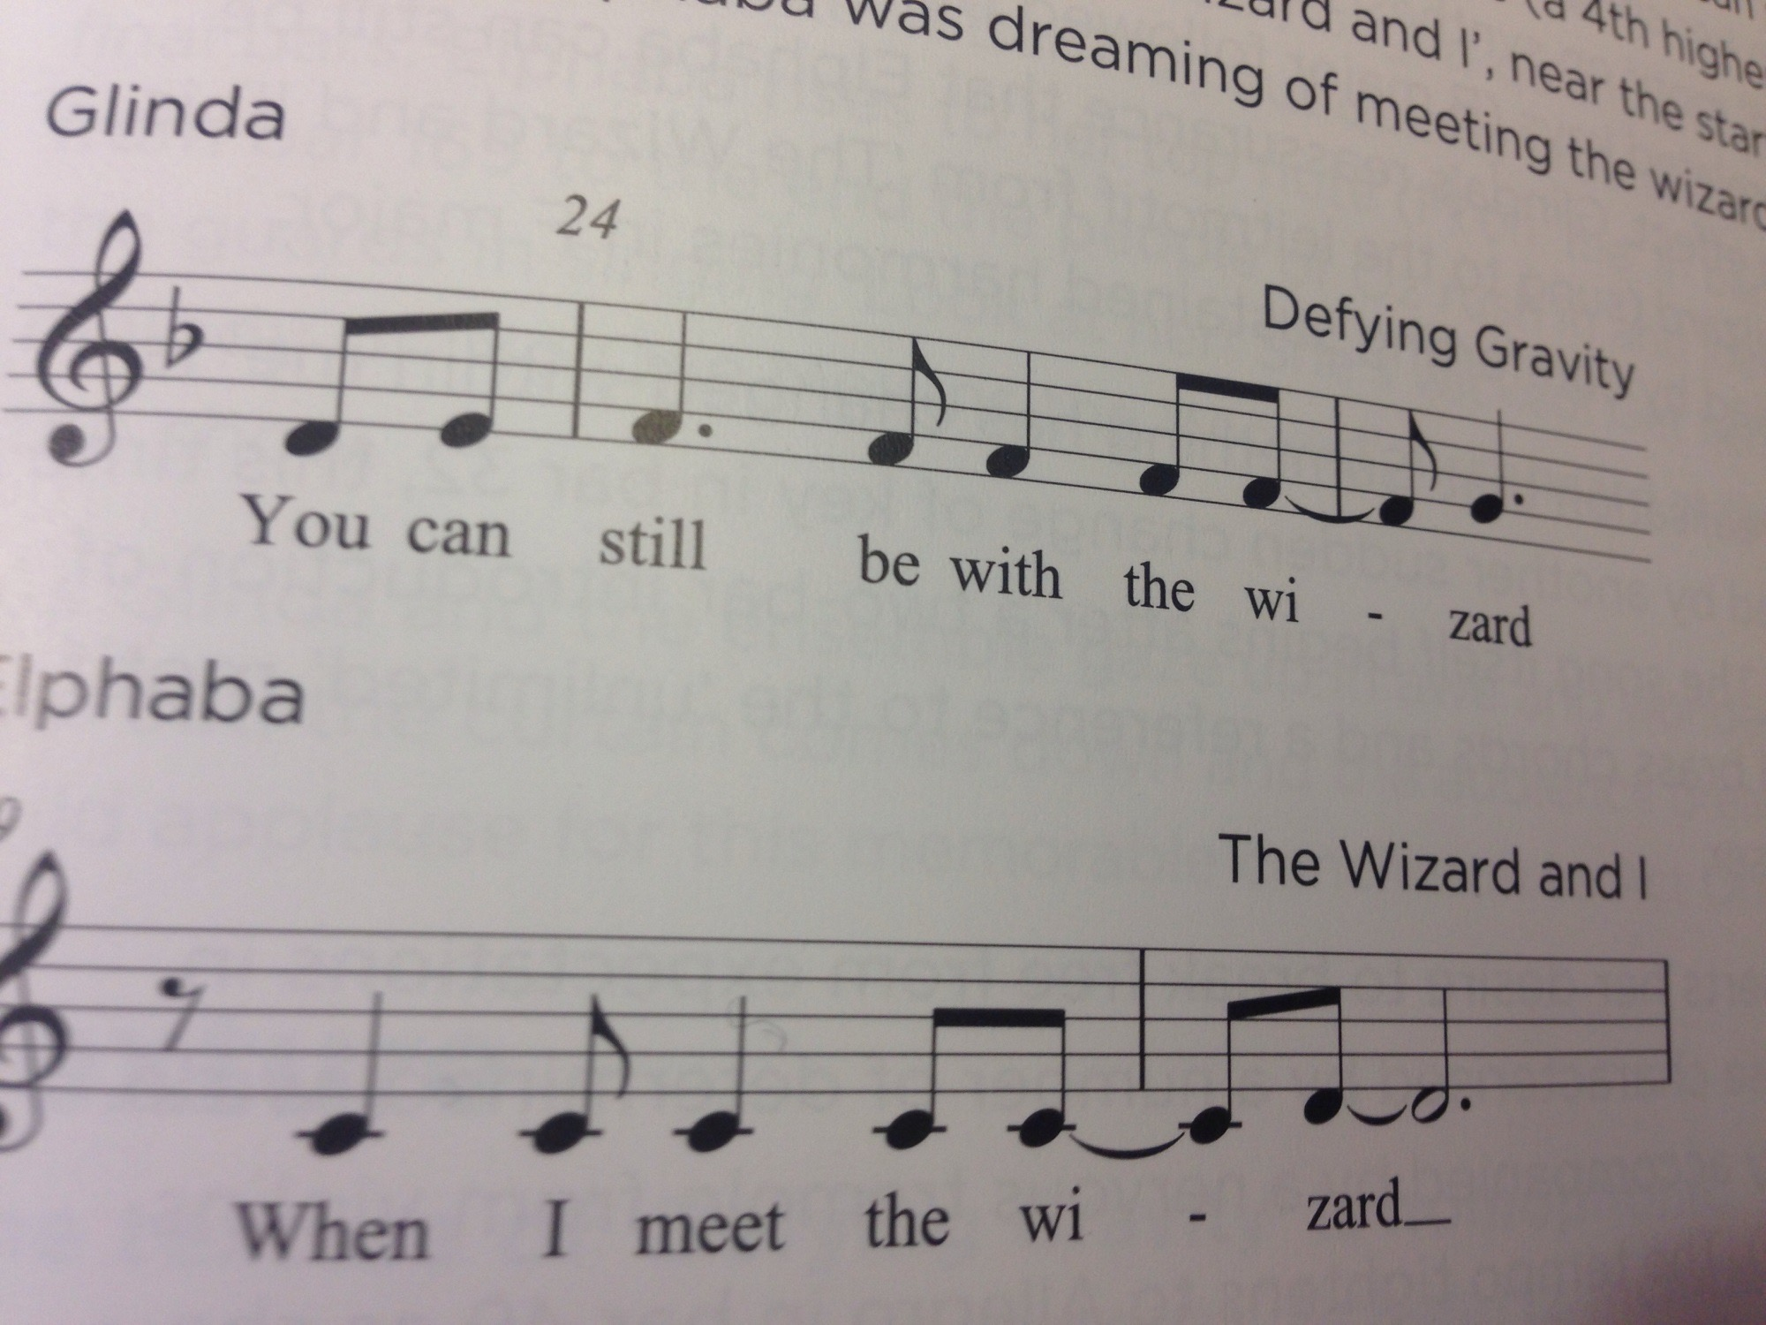

Slide 11
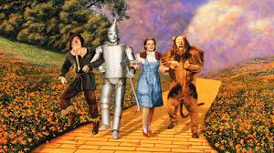
Leitmotif
Musical label for character/theme/idea
IE, ‘wizard idea’, same melodic idea.

Slide 12
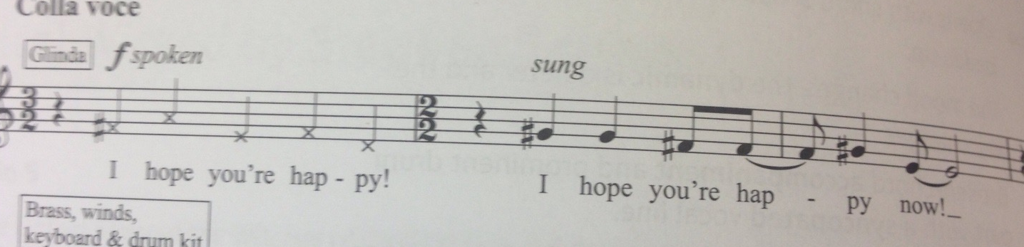
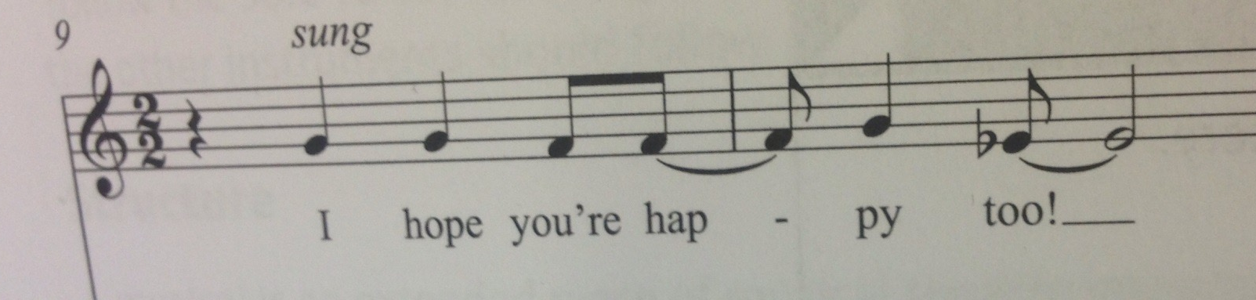
Commentary
Glinda:
Elphaba:
Describe the interval.
What is the effect of this?

Slide 13
Describe what musical features in Defying Gravity show this is a piece of Musical theatre?
Use bullet point notes to plan this essay
This will be a 15 mark question
You can use MRS HIT formula, or go through the pieces chronologically
Due Thursday 05/10/17

Slide 14
Using MRS HIT formulae to describe Defying Gravity
Melody
Rhythm
Structure
Harmony
Instrumentation
Tonality/harmony
Relate each point to context (Musical theatre)

Slide 15
What musical devices are used to express ‘Something has Changed within me’ idea

Slide 16
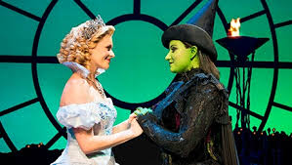
What musical devices are used to express ‘Something has Changed within me’ idea
Key change to D major
Syncopated idea expressed strongly
Dramatic rall
Unlimited idea expressed in same key
Exciting tremelos in strings
Colla voce emphasising lyrics
(halfway down page 144)

Slide 17
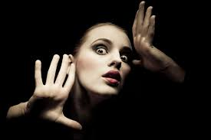
Examine Dramatic devices used in chorus!

Slide 18

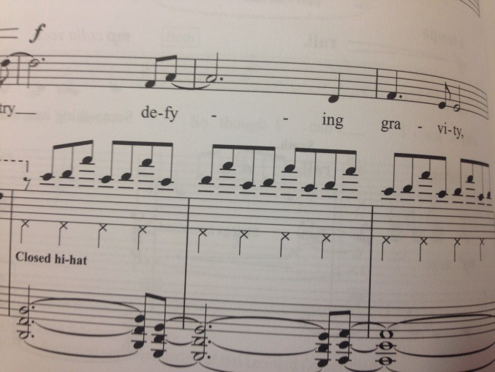
Elphaba wants to break free!
Determined wide leaps!
Tempo switches to Allgegro for chorus (bar 49)
Nervous tremolos from violins (bars 34-39)
Angular leaps in chorus line (triadic)
Repeated accompaniment of 3 ascending quavers flying high, defying gravity!

Slide 19
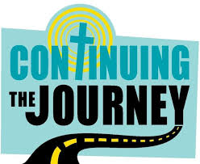
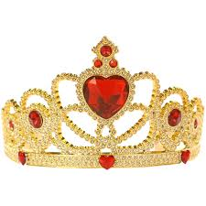
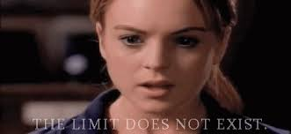
Bar 59: Introductory chords from
bars 32-3 return repeated as
accompaniment to Glinda’s
accusation in triplets that
Elphaba is having
‘delusions of grandeur’
Elphaba cares not and defiantly continues
into verse 2 with faster tempo and firmly
syncopated accompaniment
for ‘I’m through accepting limits’

Slide 20
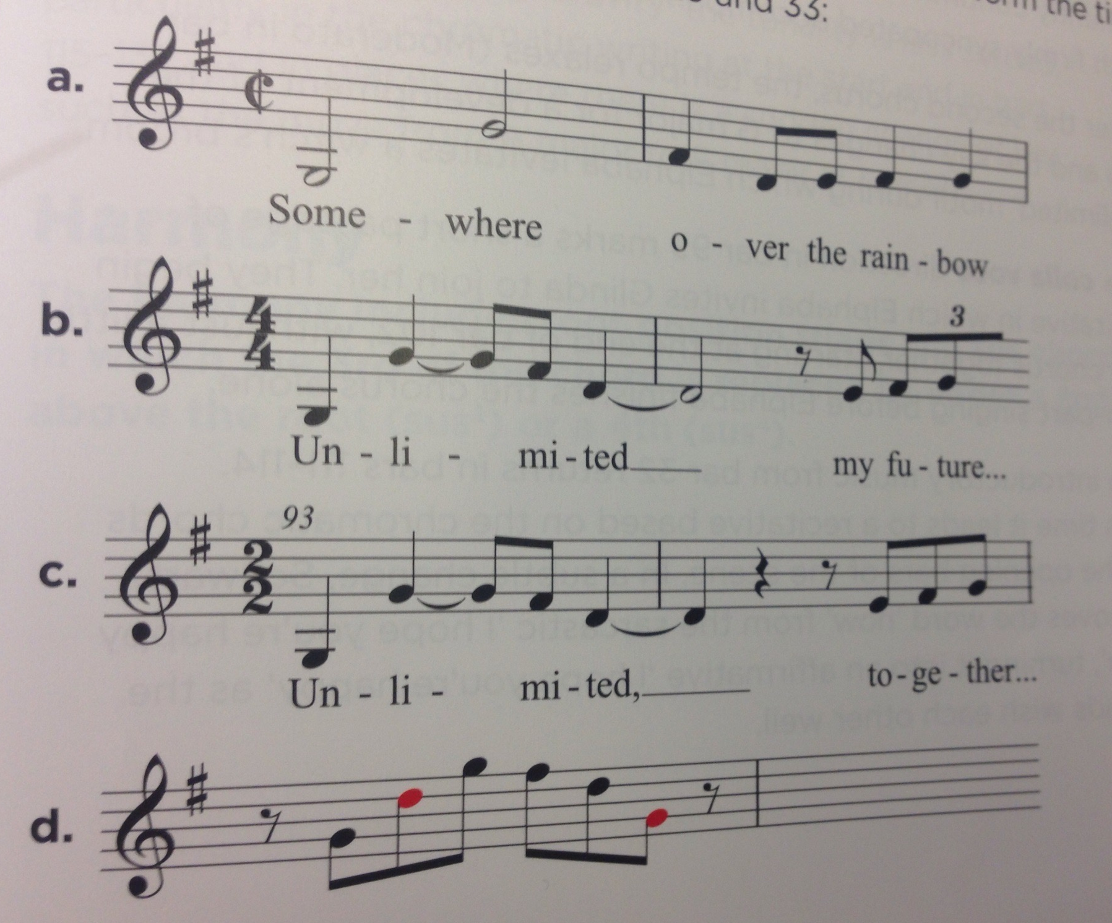

Slide 21
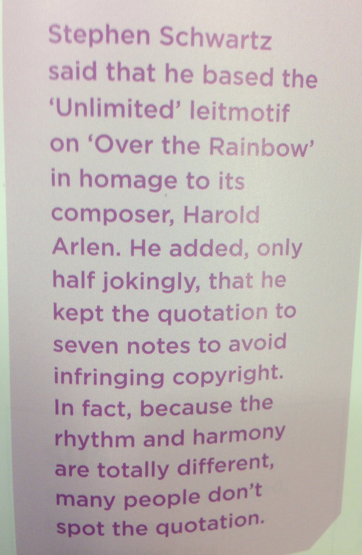

Synthesiser flourishes (bars 21, 23, 33), same melodic shape

Slide 22
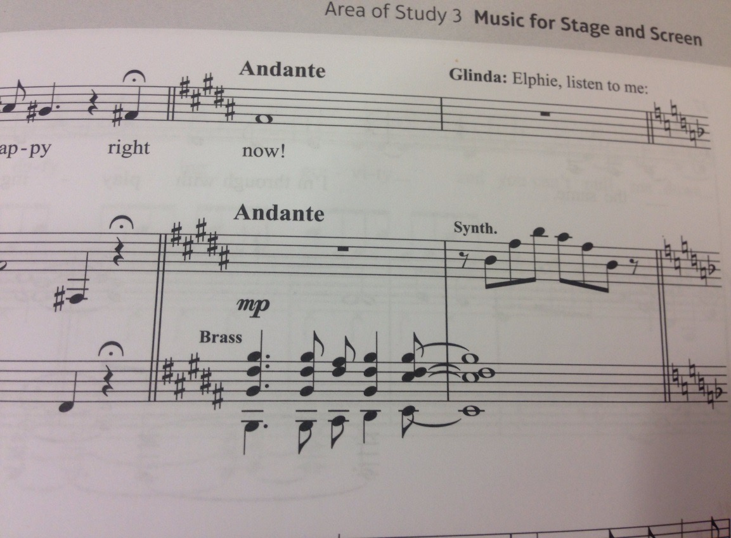
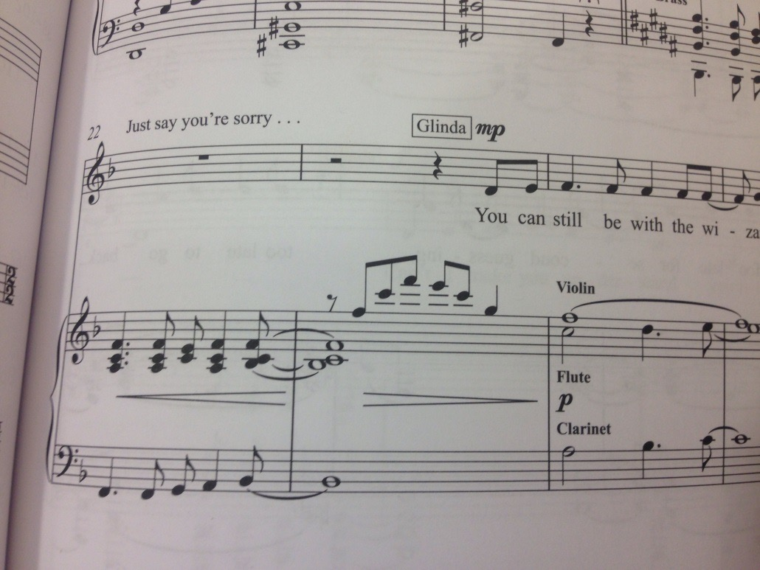
What ideas/leitmotifs are being explored?
How are they being treated?

Slide 23
What ideas/leitmotifs are being explored?
How are they being treated?
Key signature: Switches to totally unrelated keys
Syncopated idea: Introduce chorus, main idea hinted at but unrelated keys has unsettling effect
Somewhere over rainbow motif hinted at in synth
Alternative ending, wizard motif stated, battle between 2 outcomes. Secure sustained harmonies in F major

Slide 24
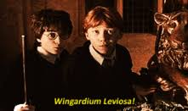
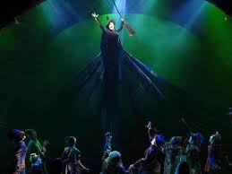
After second chorus!
Tempo relaxes (Moderato in bar 88)
Key changes to G major
Development of ‘Unlimited’ motif (Elphaba levitates broom)

Slide 25
Describe what musical features take place in the recitative?
musical narrative and dialogue parts of opera and musical theatre
sung in the rhythm of ordinary speech with many words on the same note.
"singing in recitative"

Slide 26
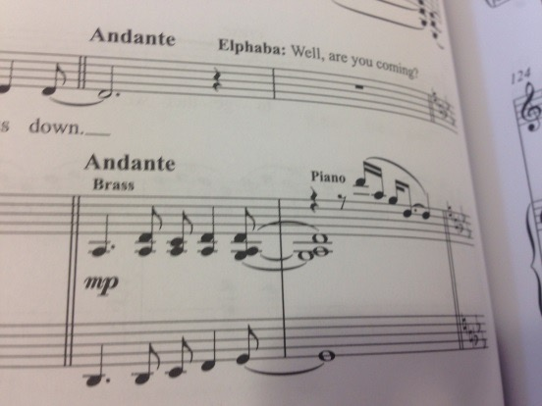
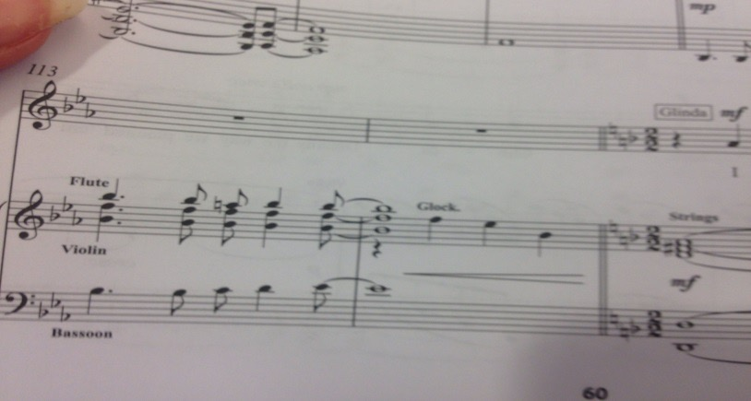
RECITATIVE
Introductory music from bar 32 returns in bars 111-114: Leads to recitative based on the chromatic chords of the opening bars of the scene. ‘Now is removed from originally sarcastic ‘I hope you’re happy now’
Bar 99 (colla voce)
Passage of recitative while Elphaba invites Glinda to join her
Bar 102:Begin chorus togerher with a little 2 part singing while Elphaba finishes chorus alone

Slide 27
Describe what musical features in Defying Gravity show this is a piece of Musical theatre?
Use bullet point notes to plan this essay
This will be a 15 mark question
You can use MRS HIT formula, or go through the pieces chronologically
Due Thursday 05/10/17

Slide 28
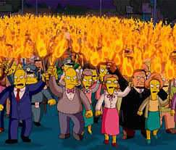
Bars 129-132: Introductory snchopated motif to the verses is heard again
Bar 132: Return to D major for an exciting orchestral build up (Crescendo on repeated quavers)
This is the bit where the castle guards break in!

Slide 29
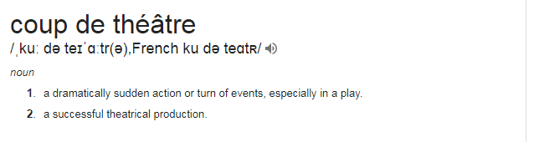
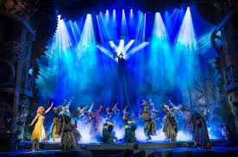
Parts of this verse are sung an octave higher, a decision made by Idina Menzel herself!

Slide 30
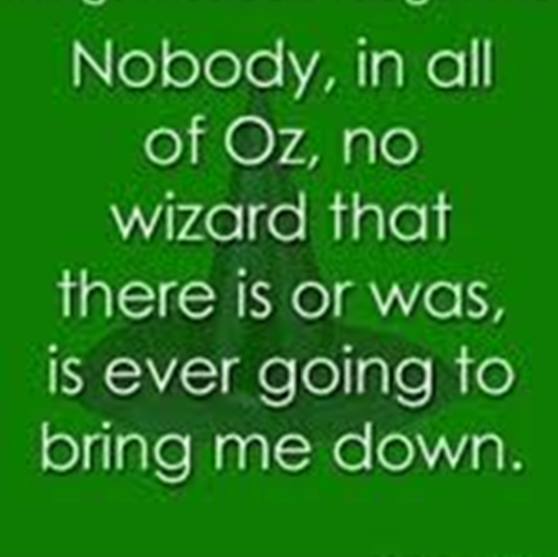

Slide 31
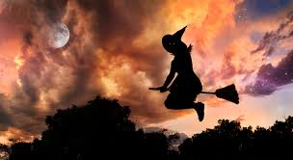
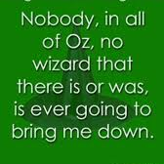
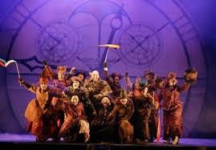
Coda
Begins quietly at slower pace
Crescendos
‘Me’- Elphaba sings top F#
Look at her she’s wicked!

