Slide 1
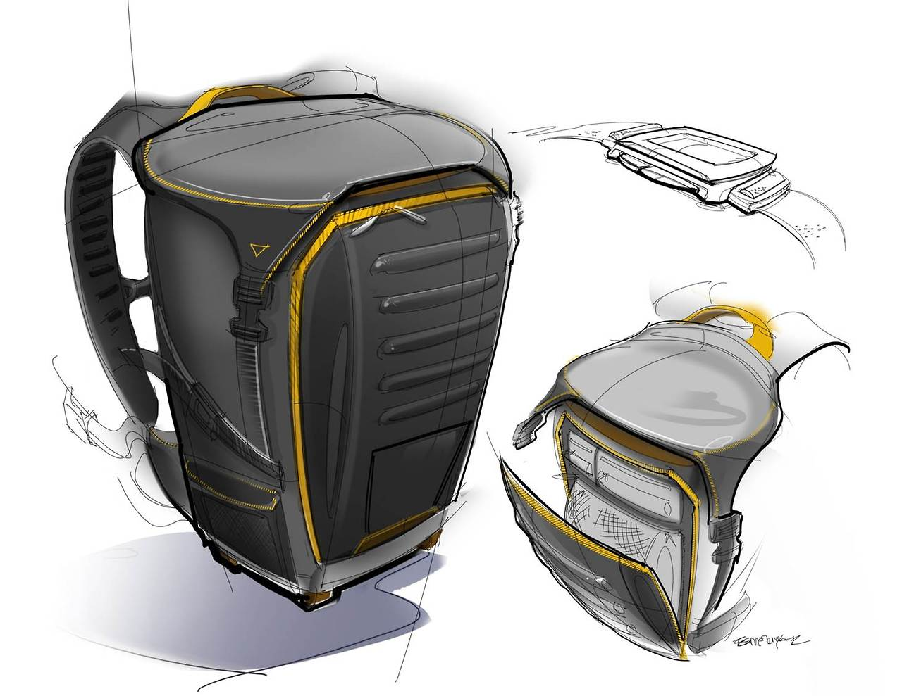
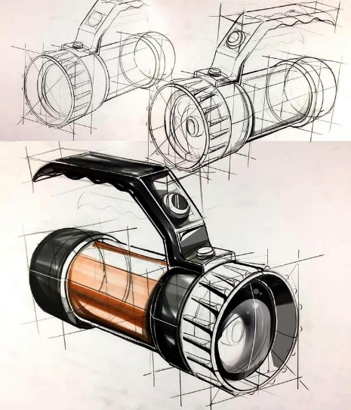
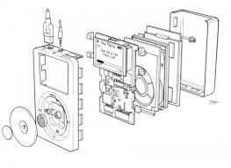
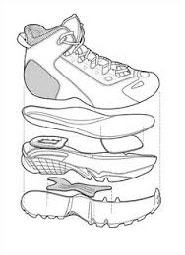
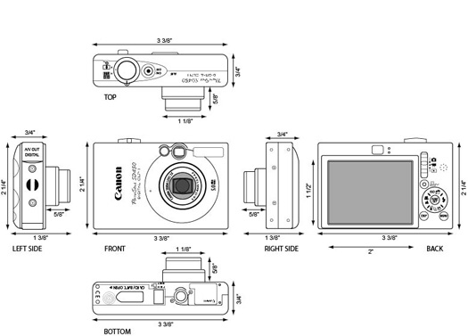
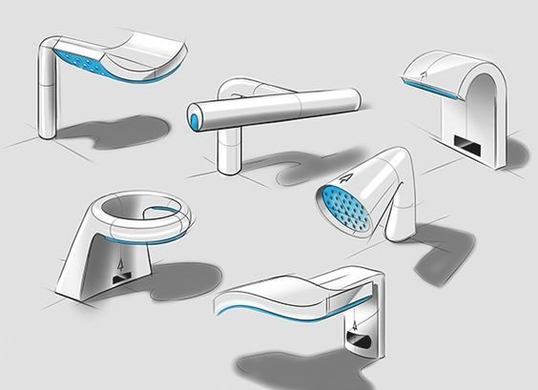
Discuss different types of drawing styles used in product design. You should be able to identify the styles and explain how and when they are useful.
STARTER
C
A
B
1. Which of these drawings would be the most useful to a designer? Why?
2. Which of these drawings would be most useful to a customer? Why?
3. Which of these drawings would be most useful to a manufacturer? Why?
D
E
F

Slide 2
By the end of this series of lessons…
Objectives:
Discuss different types of drawing styles used in product design. You should be able to identify the styles and explain how and when they are useful.
Demonstrate an understanding of drawing techniques to interpret an isometric drawings and convert it into a 3rd angle orthographic using set by set instructions or independently.
Evaluate your own drawing skills and confidence against success criteria.

Slide 3
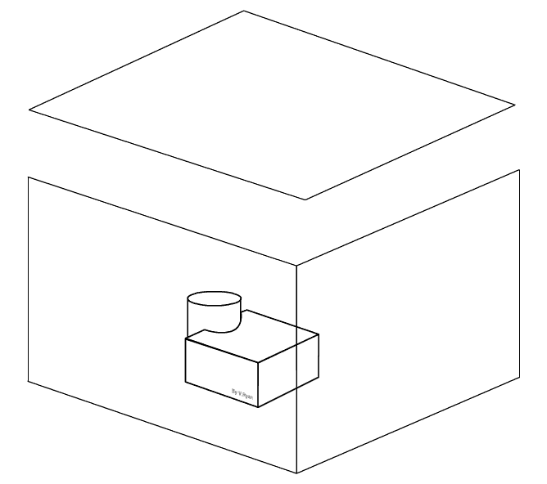
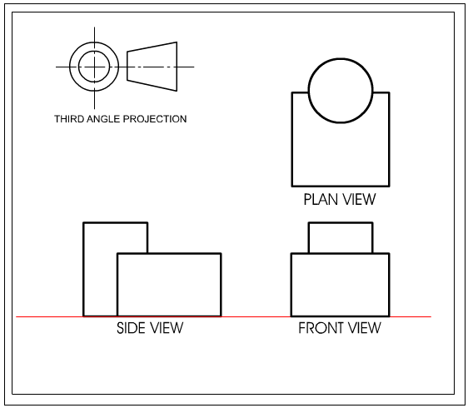
Discuss different types of drawing styles used in product design. You should be able to identify the styles and explain how and when they are useful.
What is a 3rd Angle Orthographic?

Slide 4
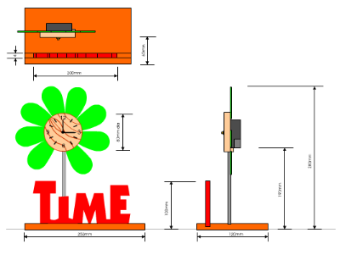
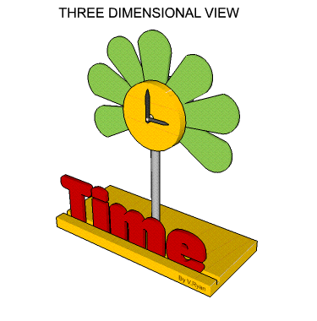
Discuss different types of drawing styles used in product design. You should be able to identify the styles and explain how and when they are useful.

Slide 5
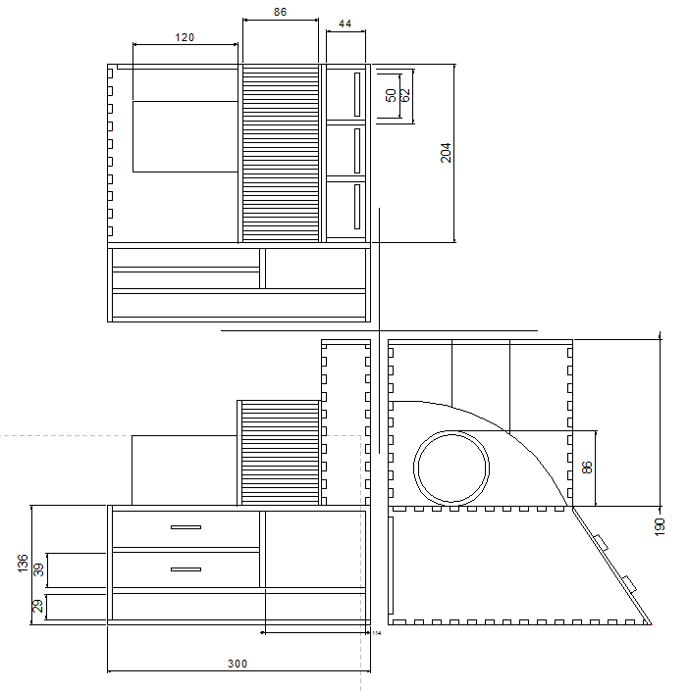
STARTER
Explain at least 3 reasons why a 3rd Angle Orthographic Projection is more useful to a manufacturer than a rendered image of a product…

Slide 6
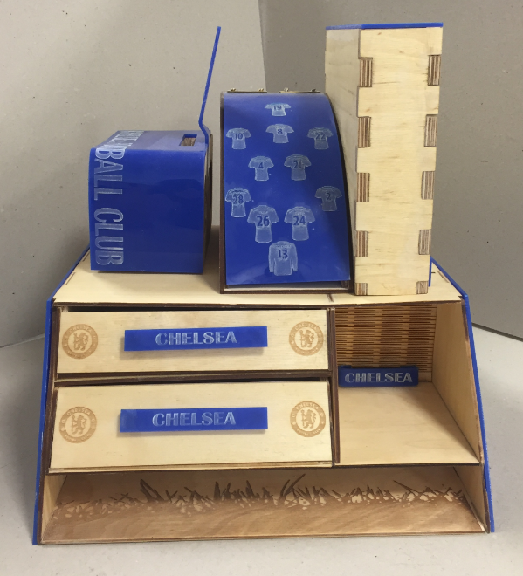
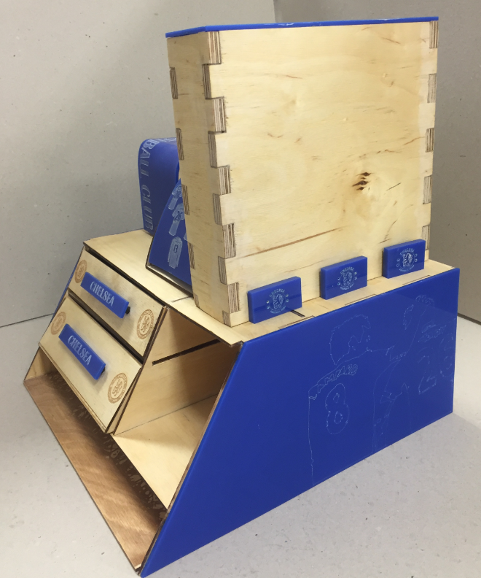
Discuss different types of drawing styles used in product design. You should be able to identify the styles and explain how and when they are useful.
Provides a scaled drawing of a product
Dimensions can be given or can be measured from is technical drawing
Multiple flat elevations showcase the design from a variety of angles, helping the manufacturer understand the product.
Allows a manufacturer to construct or make the product without the designers presence.

Slide 7
Demonstrate an understanding of drawing techniques to interpret an isometric drawings and convert it into a 3rd angle orthographic using set by set instructions or independently.
Challenge 1
Success Criteria
I have drawn constructions lines very lightly so they can be removed.
I ensured that the starting rectangle for the front elevation was pushed into the top right hand corner.
I have used the dimensions on the 3D object to accurately draw each elevation.
I have used a ruler to draw all lines accurately.
I can use the projection method to construct the side and plan views.
I have used a fine liner accurately to define the projections.
Plan View
Front View
Side View

Slide 8
Demonstrate an understanding of drawing techniques to interpret an isometric drawings and convert it into a 3rd angle orthographic using set by set instructions or independently.

Slide 9
Demonstrate an understanding of drawing techniques to interpret an isometric drawings and convert it into a 3rd angle orthographic using set by set instructions or independently.
Challenge 2
Success Criteria
I have drawn constructions lines very lightly so they can be removed.
I ensured that the starting rectangle for the front elevation was pushed into the top right hand corner.
I have used the dimensions on the 3D object to accurately draw each elevation.
I have used a ruler to draw all lines accurately.
I can use the projection method to construct the side and plan views.
I have used a fine liner accurately to define the projections.
I can independently construct a more complex 3rd angle orthographic.
Plan View
Side View
Front View

Slide 10
Demonstrate an understanding of drawing techniques to interpret an isometric drawings and convert it into a 3rd angle orthographic using set by set instructions or independently.
Challenge 3
Success Criteria
I have drawn constructions lines very lightly so they can be removed.
I ensured that the starting rectangle for the front elevation was pushed into the top right hand corner.
I have used the dimensions on the 3D object to accurately draw each elevation.
I have used a ruler to draw all lines accurately.
I can use the projection method to construct the side and plan views.
I have used a fine liner accurately to define the projections.
I can independently construct a more complex 3rd angle orthographic.

