Slide 1
Dance
Task list:
Describe how you have used each basic action in your lessons and why they are important to be able to complete a dance successfully.
Watch the following clip and give 3 strengths and 3 areas for improvement for the dance. Make sure that you make reference to the basic actions of dance in your analysis.
Using the dance success criteria, create a dance to a song of your choice.

Slide 2
Dance
Basic actions of dance: http://www.nicurriculum.org.uk/curriculum_microsite/aaa/docs/primary/resources/Examples%20Of%20Dance%20Actions.pdf
Travel
Rise
Fall
Gesture/pose
Still
Turn

Slide 3
TASK 1
Describe how you have used each basic action in your lessons and why they are important to be able to complete a dance successfully.
CHALLENGE: Rank order the basic actions of dance. Which is most important to develop a creative dance piece of choreography. Justify why you have placed them in this order.

Slide 4
Travel

Slide 5
Rise

Slide 6
Fall

Slide 7
Gesture/pose

Slide 8
Still

Slide 9
Turn

Slide 10
Task 2
Task 2: Watch the following clip and give 3 strengths and 3 areas for improvement for the dance. Make sure that you make reference to the basic actions of dance in your analysis.
https://www.youtube.com/watch?v=KOx7DfIcNKU
CHALLENGE: How could you make this dance better? Describe, in detail, how you would do this.

Slide 11
Analysis - https://www.youtube.com/watch?v=KOx7DfIcNKU

Slide 12
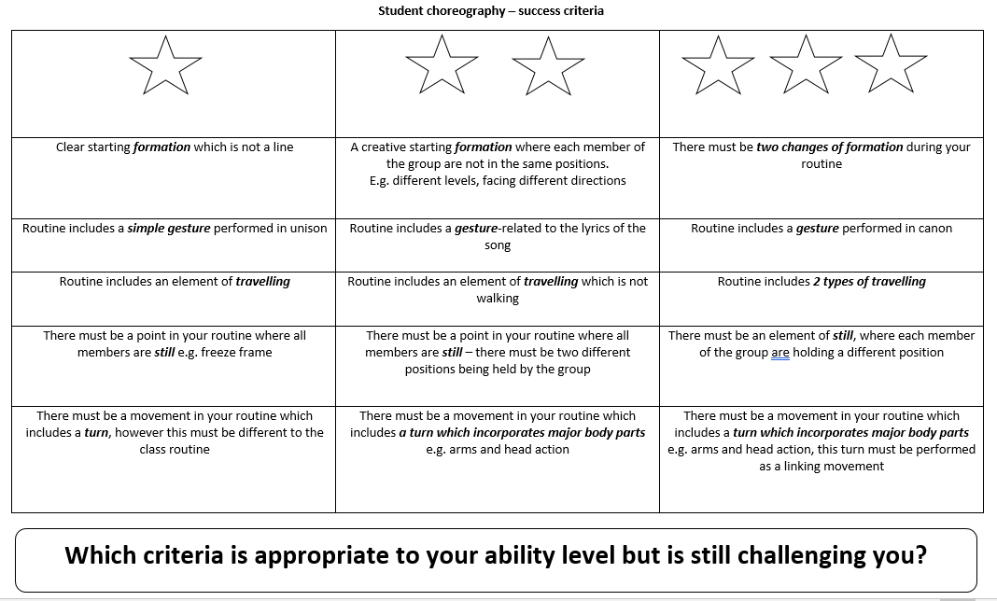
Task 3 - Using the dance success criteria, create a dance to a song of your choice!

