Slide 1
Mid-March Writing Calendar
19th March Rain, rain Write a narrative set in the rain. Make the weather central to the narrative. | 20th March Find the Future Write a diary of your day on March 20th in 25 years time. | 21st March is Memory Day Write a memory, make it something you want to remember forever. Write it, keep it.
22nd March Errors and Errands Write a narrative in which a child is sent on an errand that goes terribly wrong. | 23rd March is Near Miss Day Write a short narrative in which a character has a very near miss, it could be small or large. | 24th March Similar and Same Describe the scene as doppelgangers meet in the queue at a coffee shop, include their reactions.
25th March Flatmate Hunt Write a narrative where a character is interviewing for a new flatmate. Keep a record of all the cool and crazy things they discover. | 26th March is Neighbour Day A character helps their neighbor who is trapped in an embarrassing position. Write this. | 27th March Opening Lines Write a short narrative using this opening line: “I said orange…”
28th March Clean, Very Clean Describe a group of people as they attempt to clean a much loved , but run-down public place. | 29th March is Smoke and Mirrors Day Write a short narrative in which a character attempts to deceive another and diverts attention away. | 30th March is Science is A Fact Describe a situation in which science or scientific facts are significant.
31st March Breaking Spring An elderly couple go on Spring Break. Write the story of their experience!

Slide 2
Early April Writing Calendar
1st April is April Fools Day A character from a novel or film plays a practical joke on another character. Write this scene. | 2nd April Opening Lines Write a short narrative using the opening line: “April Fool’s Day: cold and wet…” | 3rd April Oops I Did It Again Write a memory, make it something you want to remember forever. Write it, keep it.
4th April Action Writing 1 Describe the following scene: Your parents are eating at an expensive restaurant. Your mom spots a cockroach. | 5th April Remember Me Describe a dramatic memory from your childhood but change one key detail – the setting, or perhaps those present. | 6th April Hiding In Plain Sight Write the description of a well-known celebrity as they shop for food and attempt to avoid detection.
7th April – Colour Writing Write a short description where the colour “pink” is central to the scene or setting. | 8th April is Bird Day Create a detailed observational description of a bird that you see in your neighborhood. | 9th April Random Acts of Kindness Describe a Random Act of Kindness being carried out by the following character: a mad cat lady.
10th April is Sibling Day Write a letter to a real or imagined sibling – tell them a truth you wished they had always known. | 11th April Writing Emotions Write a scene that accurately portrays the emotion of: Grief. | 12th April Street Life Describe your street or neighbourhood but imagine there are no people, cars. No life at all.
13th April Opening Lines Write a short narrative using the opening line: “I covered my eyes but nothing …” | 14th April Writing Action Describe the moment when a sportsperson becomes injured. Avoid using words that are usually linked to pain. | 15th April Silence Write the conversation between two brothers who haven’t spoken to each other in four years. What is said and how?

Slide 3
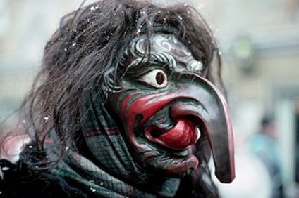
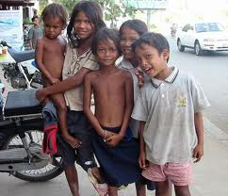


Story origins
It is said that every story can fit
into 7 different storylines.
Date completed:
3
1
4
6
2
5
7
Task 1: Overpowering the monster (Star Wars, Transformers etc) Write a ONE PAGE story in which your main character meets a monster and overpowers it.
Help – when and where does it happen, who is involved, what happens?
Task 2: A rags to riches story (Cinderella) Give these street kids from India their own rags to riches story. Write it in ONE PAGE.
Help – what is their life like before? How do they get rich? What do they do next?
Task 3: The Adventure (The Lord of the Rings, The Hobbit)
Write a ONE PAGE adventure story using each of the items shown here.
Help – you don’t have to use the items in order.
Task 4: The Hero returns (Wizard of Oz)
Your hero has an ordinary life. A crisis happens and he/she escapes to a foreign land. There the hero discovers they have a hidden talent which helps them return home and overcome the crisis. Write your own version of this story in ONE PAGE.
Help – who is your hero? What is the crisis? Where do they escape to? How do they discover the talent and what is it? What happens when they return home?

Slide 4

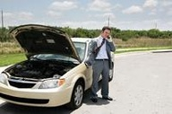
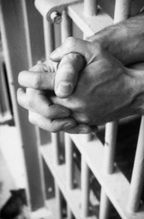
Story origins
It is said that every story can fit
into 7 different storylines.
Task 5: The Comedy (Bridesmaids, Dodgeball)
Write a ONE PAGE story. This family leave home for picnic, everything is normal. Later they return home looking like this. What hilarious things could have happened during the day?
Help – where did they go? Think of 3 different accidents that could happen to them. How did they react? What do they say, do and feel?
Task 6: The Tragedy (Romeo & Juliet)
The car has broken down. As a result disaster happens. Write a ONE PAGE story showing the tragedy that follows.
Help – where is he when it happens? Where should he be? What is the disaster? Does it happen to the man or someone else?
Task 7: The Return (The Odyssey)
Your hero is captured, trapped or prisoner. It seems there is no hope and no escape when something miraculous happens and he/she is freed. Write your own version of this story in ONE PAGE.
Help – who is your hero? How is he/she trapped? What does he/she do to try to escape?
What happens to set her/him free? What happens when he/she return home?
Agree or disagree reflection
Do you agree or disagree with the idea that all stories ever can be categorised into these 7 areas?
Take 5 stories (either books or films) that you know well. Try and place them into the above categories. For each story – explain why they do or do not fit into the category.

Slide 5
Letters of distinction
choice board #1
Instructions…
Below is a selection of letters that you can write to your teacher. Each week you will write one – but you can choose which one you write when.
A letter to my future self
Date completed:
___________
This is me
Date completed:
___________
Instructions…
Write a letter to yourself in 10 years time, tell yourself about all of things you want to remember from the age you are now. It could be: important memories, funny things, the dreams and goals you have right now, what’s important in your life right now. Tell it all.
Instructions…
Write a letter to your teacher. This is your opportunity to tell them everything they need to know about you: what makes you laugh, what annoys you. Tell the things you have done that are cool, the things you want to do. Tell it all.
Love is…
Date completed:
___________
Business Talk
Date completed:
___________
Instructions…
Write a letter to your teacher on the topic of love. It can be about any kind of love at all. All you need to do is answer the question “what is love” for you?
Instructions…
Write a letter to your teacher answering this question “if you could set up just one business – of any kind – what would it be?” Describe this business and everything it would do. Will it make you rich, will it change the world? Tell it all.
Man vs Food
Date completed:
___________
Music makes me
Date completed:
___________
Instructions…
Write a letter to your teacher on the topic of food. Ask yourself the question – if you could persuade your teacher to try or cook any meal out there – what would it be? Tell your teacher all about this amazing meal.
Instructions…
Write a letter to your teacher on the topic of music. Your teacher loves opera and classical music – it’s time for you to drag them into the modern music age. So choose one song, just one song and persuade your teacher to listen to it.
Equality
Date completed:
___________
Travel
Date completed:
___________
Instructions…
Write a letter to your teacher on the topic of equality. You can tackle this issue on a local level, national or global but you must explain your thoughts on equality in as much detail as possible. You can use examples – personal or from the news.
Instructions…
Write a letter to your teacher about all the places you would like visit and why. Be creative – everybody wants to go to New York or Paris. Think different. Where in the world would you love to visit and why?
Just one picture
Date completed:
___________
One idea
Date completed:
___________
Instructions…
Write a letter to your teacher: choose one moment in all of time (current, future, past) – you get to go there and take one photograph. What would you photograph and why? Describe the moment, the image and why you would photograph it.
Instructions…
Write a letter to your teacher describing one idea that could change the world. Think small or think big – what one single idea could transform the world as we know it. Explain it to your teacher – convince them it is a game changer.

Slide 6
Letters of distinction
choice board #2
Instructions…
Below is a selection of letters that you can write to your teacher. Each week you will write one – but you can choose which one you write when.
You’re banned
Date completed:
___________
Desert Island
Date completed:
___________
Instructions…
Write a letter to your teacher explaining one thing you would ban. What would it be and why would you ban it? Explain your idea and all your thinking.
Instructions…
Write a letter to your teacher explaining what one thing you would want with you if you were stranded on a desert island. The only rule: it must link to you as a person. It could be a pet, a music instrument, a favourite book. Name it and explain it.
Road Trip
Date completed:
___________
Coffee Date
Date completed:
___________
Instructions…
Write a letter to your teacher on the topic of road trips. You have unlimited funds and unlimited time – describe your ultimate road trip. Where would you go? What would you do? Plan your ultimate road trip and write it all.
Instructions…
Write a letter to your teacher outlining the best over-coffee-chat ever. Pick any person in history, have a cup of joe with them and then write everything that you chat about. Would you get Einstein to help you with your math homework? Meet the Queen? Coffee at the White House?
Just one minute
Date completed:
___________
Ideal Homes
Date completed:
___________
Instructions…
Write a letter to your teacher explaining what one minute is the most important in human history. If you had to choice – just one minute in all time to say is the most important minute – what would it be? Explain the minute and why in your letter.
Instructions…
Write a letter to your teacher about your perfect home. It can be as realistic or fantastical as you like but you need to build a picture in your letter so your teach can visualize it exactly. Include as many details and specifics as you can.
Animal Testing
Date completed:
___________
Appreciation #1
Date completed:
___________
Instructions…
Write a letter to your teacher on the topic of animal testing. You can choose any angle you like but you need to explain your understanding of the topic and what you think and feel about it. It could be testing for make up, or drugs, or alternatives to animal test. Write all of it.
Instructions…
Okay – this is a special letter today. Write a letter of appreciation to someone who works in a doctor’s surgery or hospital. Describe the situation that you would to thank them for – let them know what they did that made a big difference to you.
School Rules
Date completed:
___________
Dicey
Date completed:
___________
Instructions…
Write a letter to your teacher on the topic of school rules. You are in charge of rewriting your school rules, yep, you. What are your rules going to be? Explain them and why you think they are going to be needed and important.
Instructions…
Write a letter to your teacher on the topic of risks. What is the biggest risk you have ever taken? What happened? Was it worth it? How do you feel about risks?

Slide 7
Letters of distinction
choice board #3
Instructions…
Below is a selection of letters that you can write to your teacher. Each week you will write one – but you can choose which one you write when.
Living books
Date completed:
___________
Best years
Date completed:
___________
Instructions…
Write a letter to your teacher answering the question “If you could climb inside any book, which book would you like to live in and why?” Explain your thinking in your letter.
Instructions…
Write a letter to your teacher explaining what was the best year of your life. What happened? Why was it so good?
Animal Emotions
Date completed:
___________
Human future
Date completed:
___________
Instructions…
Write a letter to your teacher on the topic of animals’ thoughts and emotions. Do you believe animals have thoughts and emotions in the same way that humans do? What examples do you have? Do you think it’s important?
Instructions…
Write a letter to your teacher explaining what you think the future of human evolution might be. What will humanity be like in 100,000 years? Will we be the same? Will we look and act differently?
What is the point?
Date completed:
___________
Teen Power
Date completed:
___________
Instructions…
Write a letter to your teacher on the topic of “the point of life”. What is the point of life as far as you are concerned? It doesn’t have to be big or deep, it just has to be truthful for you. What is the point of it all?
Instructions…
Write a letter to your teacher on the topic of teen power. Teenagers are often maligned in the press. Your letter is going to be a statement about everything that is awesome about teenagers and why you should be proud to be who you are.
Just one call
Date completed:
___________
So Wrong
Date completed:
___________
Instructions…
Write a letter to your teacher describing the one phone call you would most like to make. You get the chance to call any human at any point in history. Who would you call and what would you talk about?
Instructions…
Write a letter to your teacher about being wrong. Describe a time when you have been wrong – it can be big or small – what were you wrong about? What was the consequence?
Dystopia
Date completed:
___________
British means
Date completed:
___________
Instructions…
Write a letter to your teacher answering the question “is our country a dystopia?” Consider what does it mean? Why might some people believe it is a dystopia? What are your thoughts and feelings?
Instructions…
Write a letter to your teacher on the topic “what does it mean to be British?” Talk through all your thoughts and different ideas about what it means to be British today. Then what does it mean to you?

Slide 8
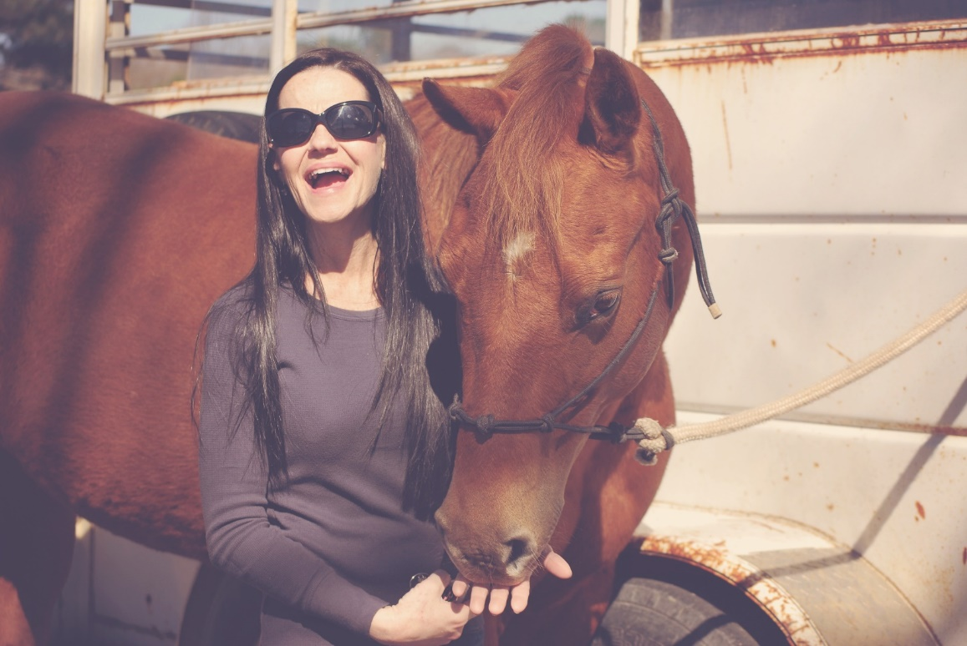
Writing humanity #1
Good description often comes from precise observation.
First – list at least 10 precise adjectives to describe this scene. Only include adjectives that add detail to shape, size, texture, age, color. No emotive words allowed.
Write your answer here
Now write a scientific, observational description of this scene.
Write your answer here

Slide 9

Writing humanity #2
Good description often comes from precise observation.
First – list at least 10 precise adjectives to describe this man. Only include adjectives that add detail to shape, size, texture, age, color. No emotive words allowed.
Write your answer here
Now write a scientific, observational description of this scene.
Write your answer here

Slide 10
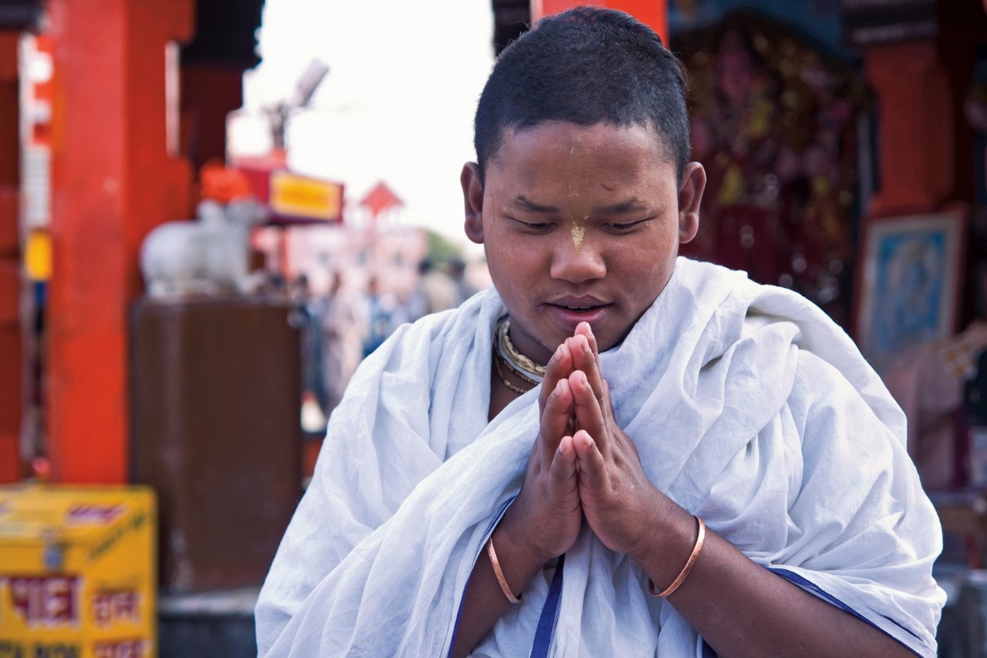
Writing humanity #3
Good description often comes from precise observation.
First – list at least 10 precise adjectives to describe this scene. Only include adjectives that add detail to shape, size, texture, age, color. No emotive words allowed.
Write your answer here
Now write a scientific, observational description of this scene.
Write your answer here

Slide 11
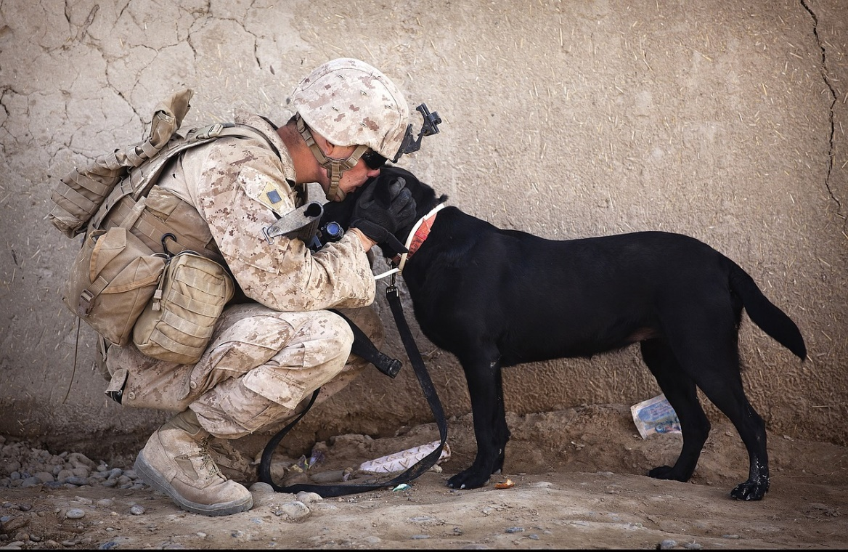
Writing humanity #4
Good description often comes from precise observation.
First – list at least 10 precise adjectives to describe this scene. Only include adjectives that add detail to shape, size, texture, age, color. No emotive words allowed.
Write your answer here
Now write a scientific, observational description of this scene.
Write your answer here

Slide 12
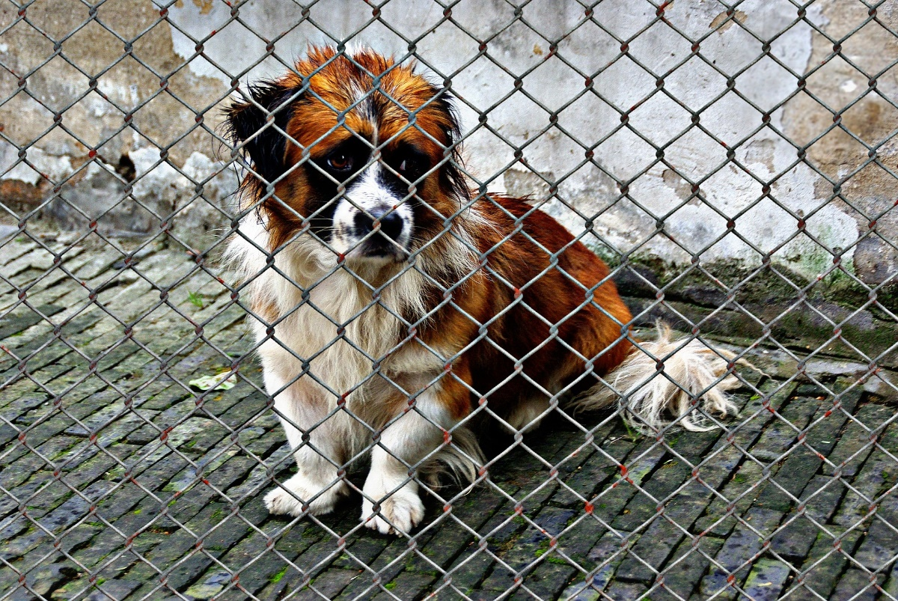
Writing the future #1
This dog deserves a new home. Describe how it is rescued and given a new home.
Type your answer here

Slide 13
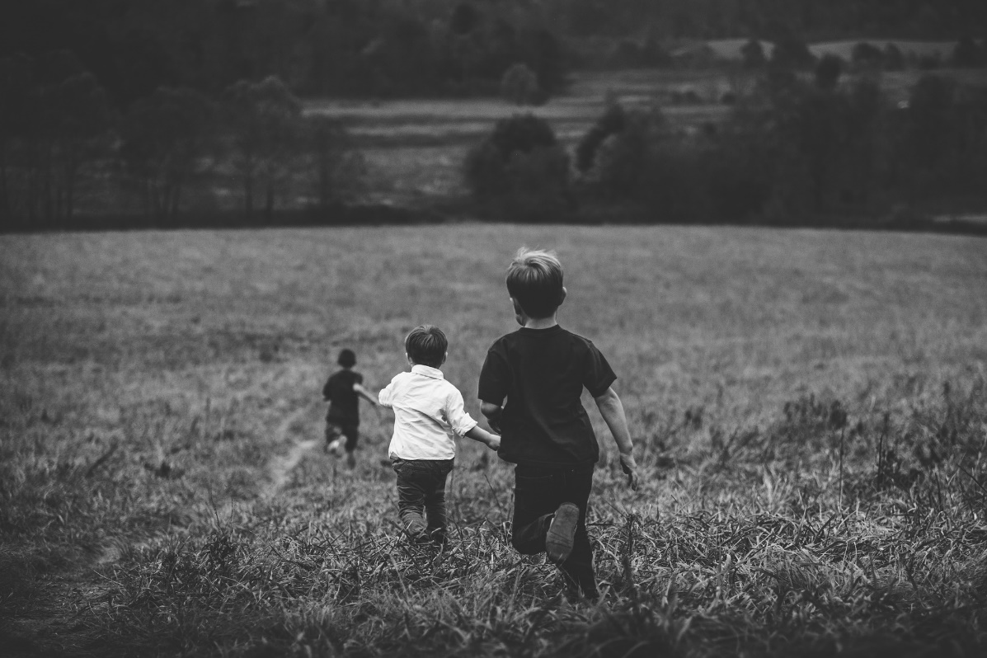
Writing the future #2
Imagine these three boys meet up again in their old age. Write one of their memories as they look back on their childhood.
Type your answer here

Slide 14
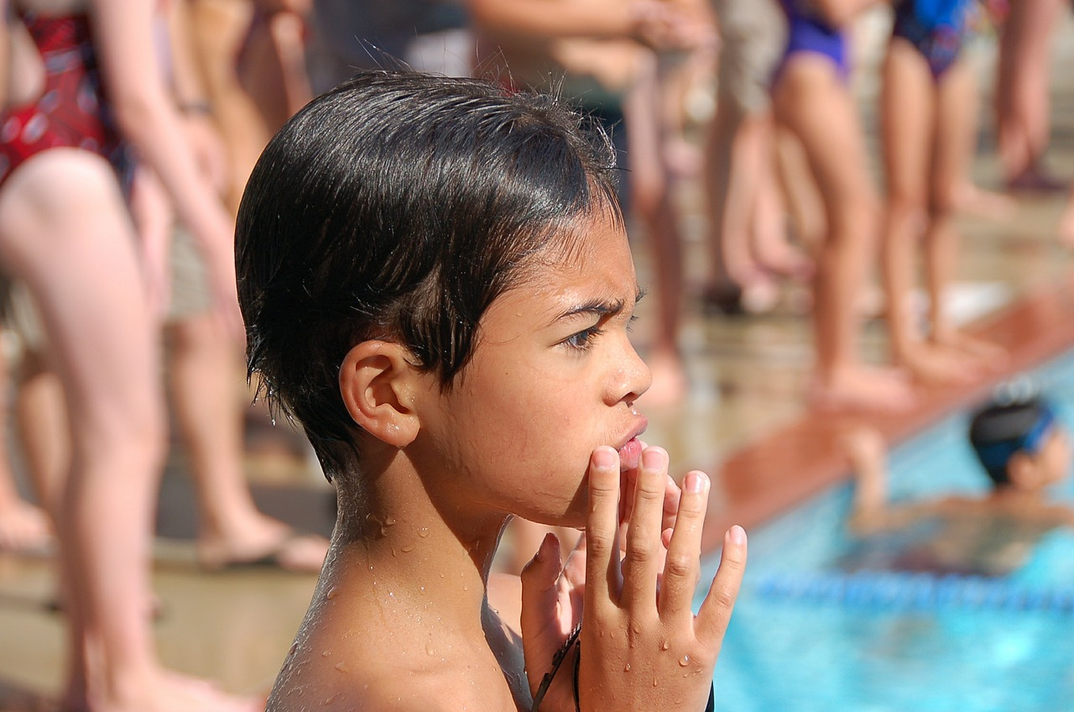
Writing the future #3
Imagine what happens next.
Describe the events and the thoughts and feelings of the boy.
Type your answer here

Slide 15
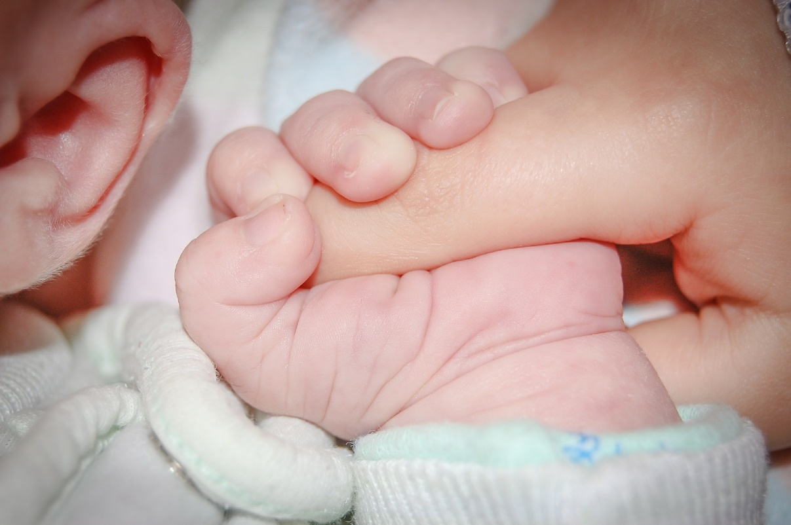
Writing the future #4
Describe this mother’s hopes and dreams for her new born baby.
Type your answer here

Slide 16
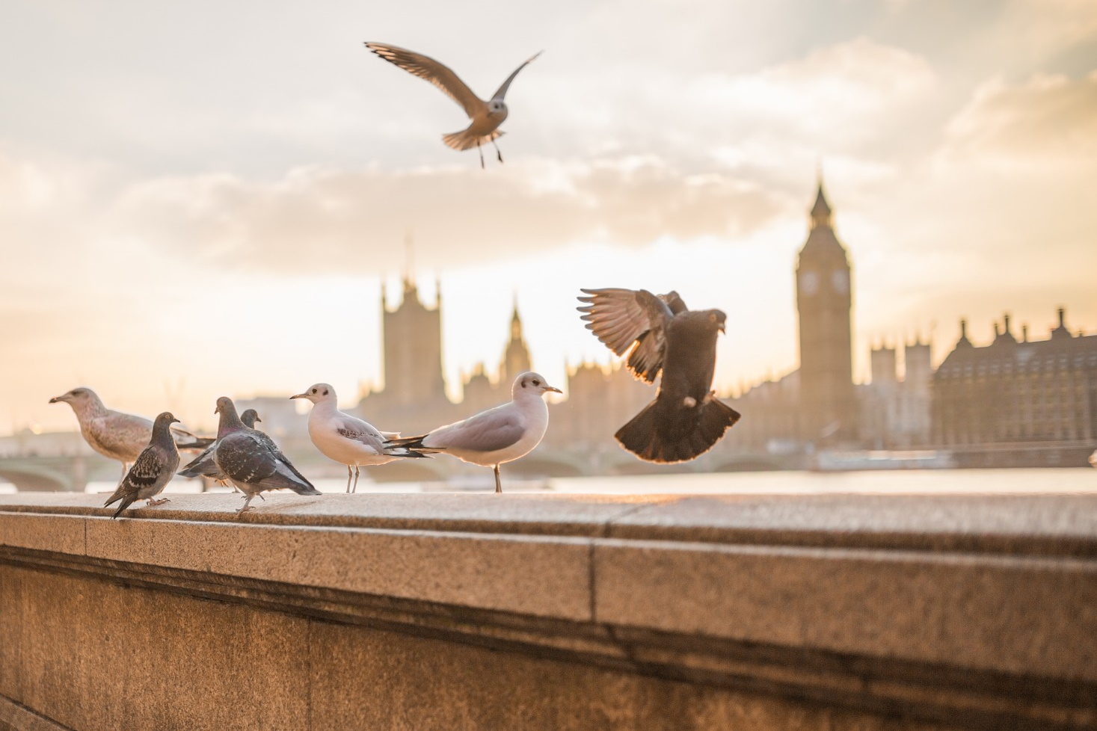
Writing atmosphere #1
Write a description of this scene – BUT only the cityscape itself.
Type your answer here
Now you can describe the pigeons.
Type your answer here

Slide 17
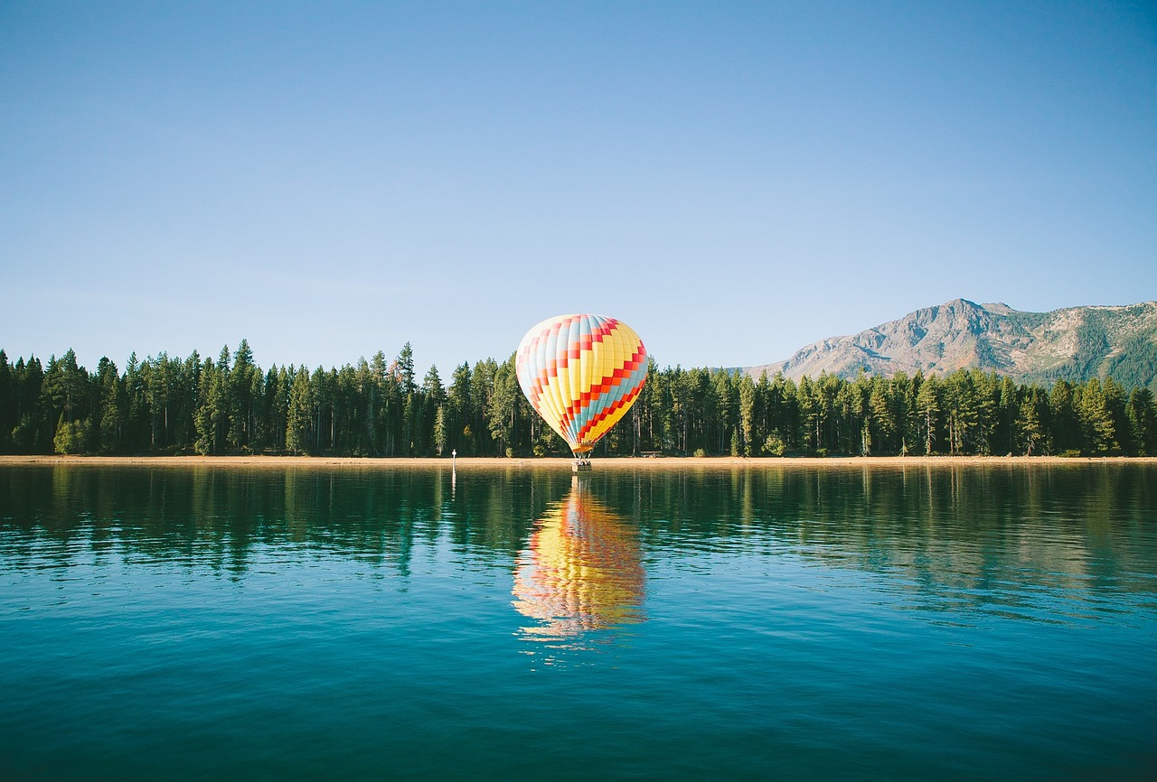
Writing atmosphere #2
Write a description of this scene – BUT only the landscape.
Type your answer here
Now you can describe the hot air balloon.
Type your answer here

Slide 18
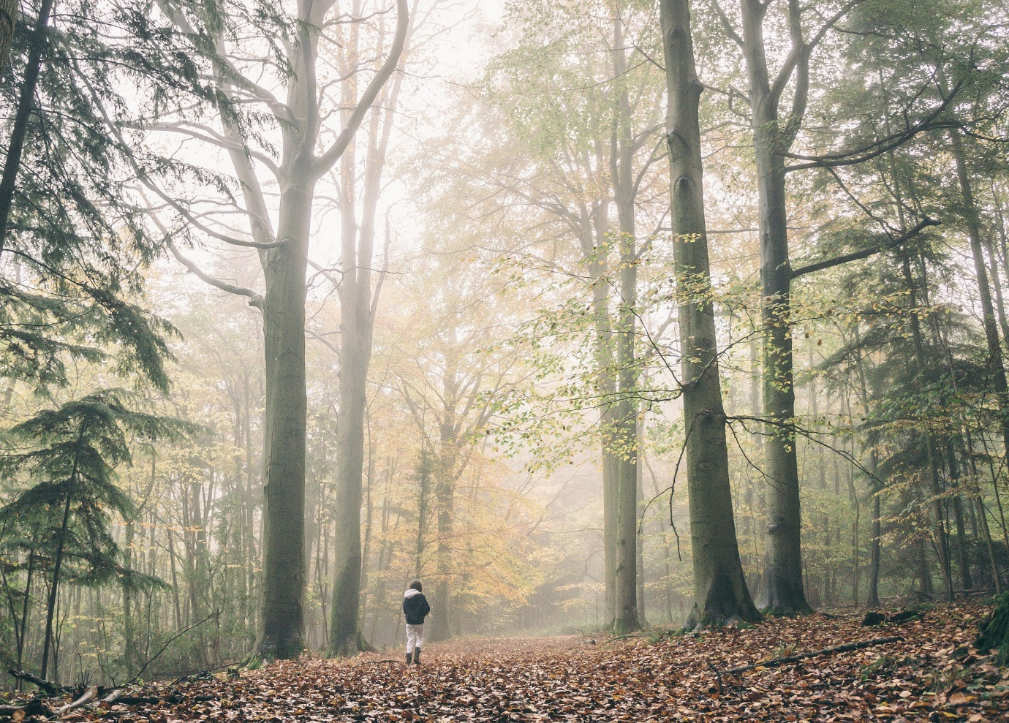
Writing atmosphere #3
Write a description of this scene – BUT only the forest.
Type your answer here
Now you can describe the walker.
Type your answer here

Slide 19
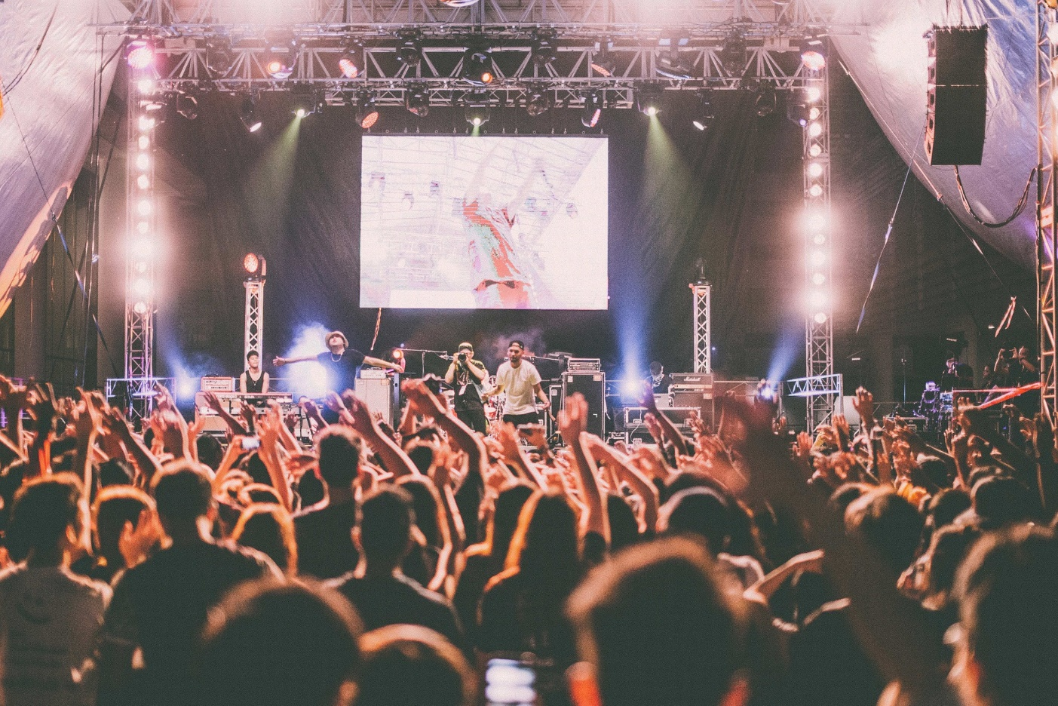
Writing atmosphere #4
Write a description of this scene – BUT only the crowd and arena.
Type your answer here
Now you can describe the performers.
Type your answer here

Slide 20
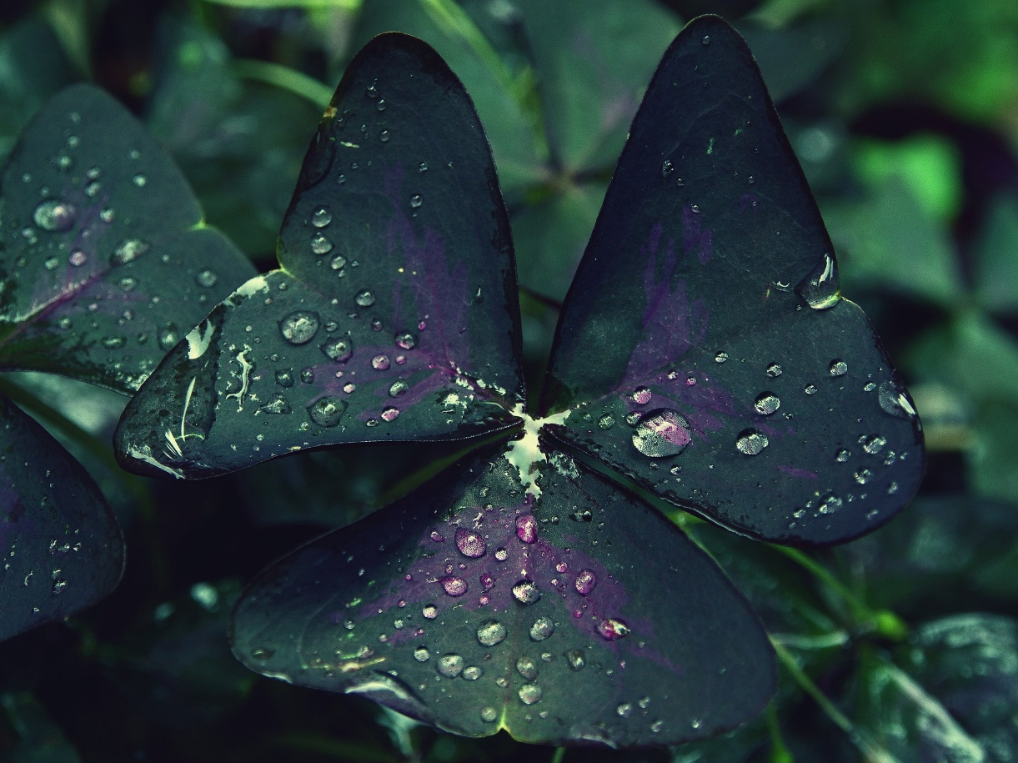
Write like a scientist #1
Good description often comes from precise observation.
First – list at least 20 nouns in this image. Be precise.
Type your answer here
Now write a scientific, observational description of this leaf.
Type your answer here

Slide 21
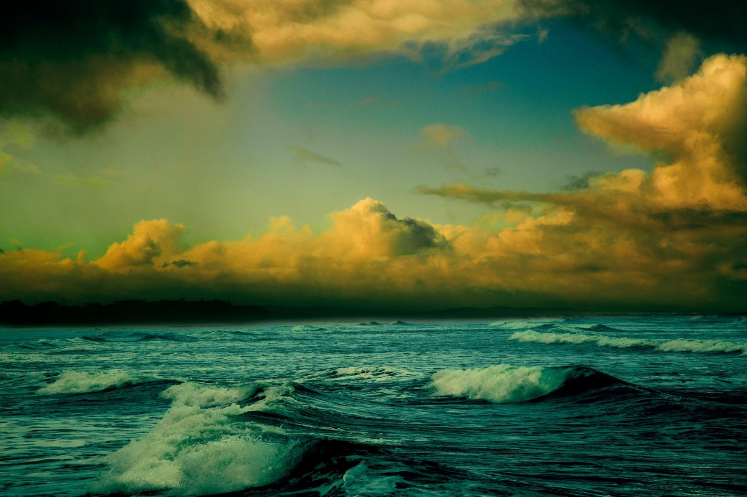
Write like a scientist #2
Good description often comes from precise observation.
First – list at least 20 nouns in this image. Be precise.
Type your answer here
Now write a scientific, observational description of this insect.
Type your answer here

Slide 22
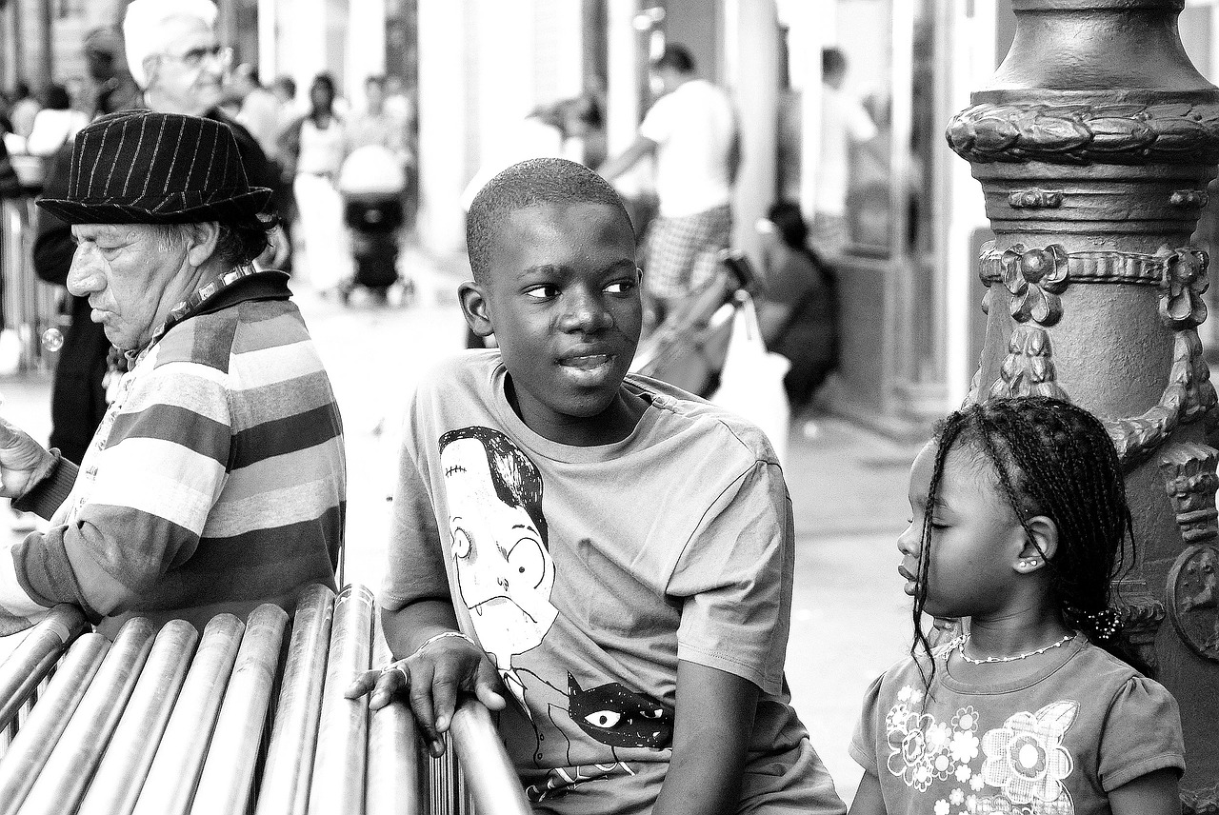
Write like a scientist #3
Good description often comes from precise observation.
First – list at least 20 nouns in this image. Be precise.
Type your answer here
Now write a scientific, observational description of this scene.
Type your answer here

Slide 23
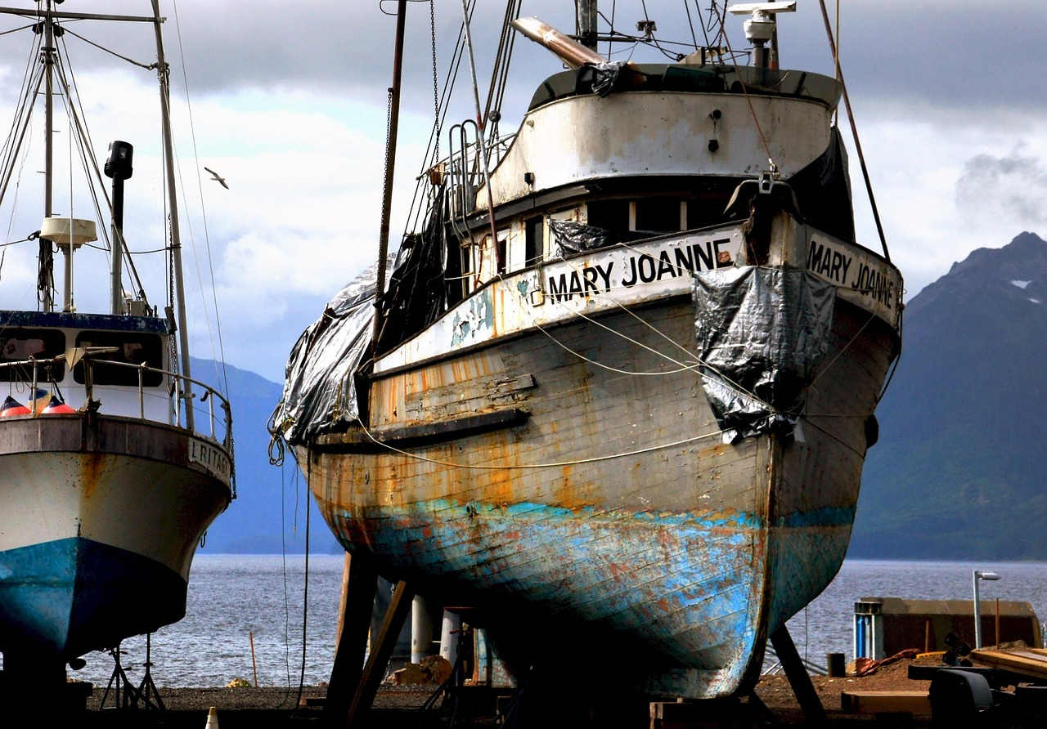
Write like a scientist #4
Good description often comes from precise observation.
First – list at least 20 nouns in this image. Be precise.
Type your answer here
Now write a scientific, observational description of this scene.
Type your answer here

Slide 24
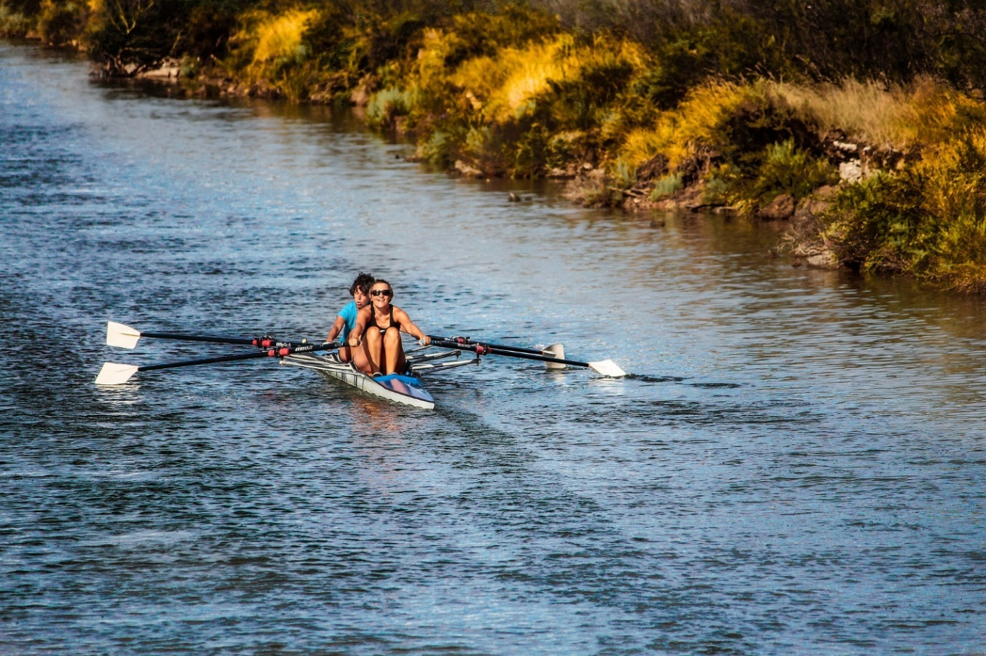
Action Write! #1
Good description often comes from precise observation.
First – list at least 10 verbs in this image. Be precise.
Type your answer here
Now write a scientific, observational description of this scene.
Type your answer here

Slide 25
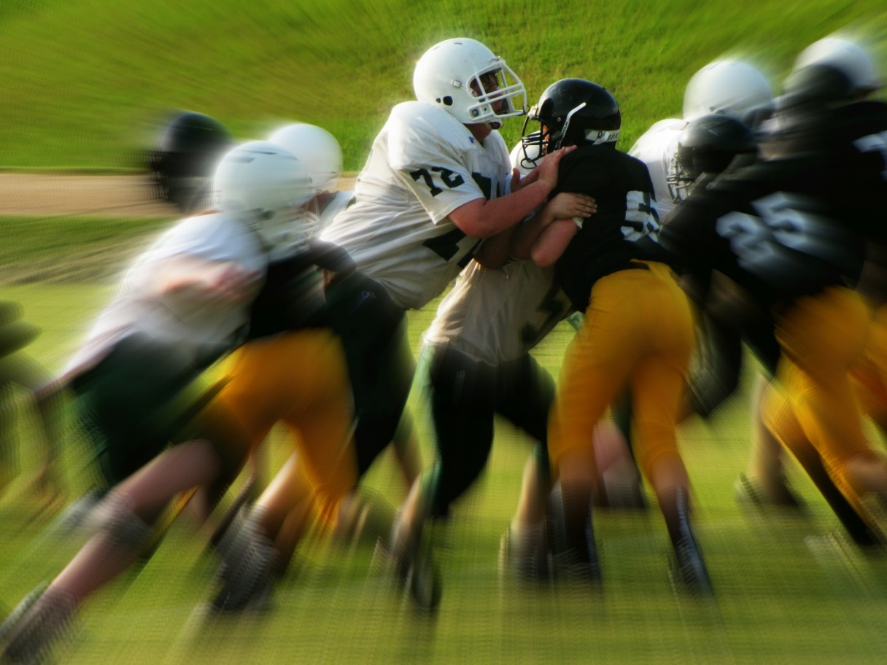
Action Write! #2
Good description often comes from precise observation.
First – list at least 10 verbs in this image. Be precise.
Type your answer here
Now write a scientific, observational description of this scene.
Type your answer here

Slide 26
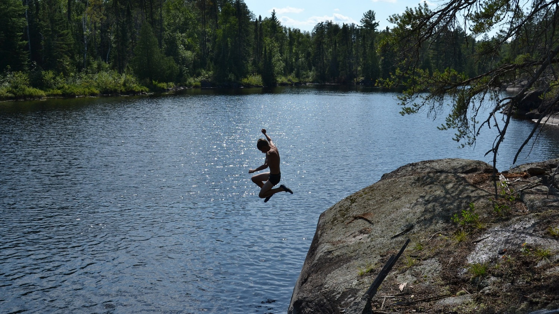
Action Write! #3
Good description often comes from precise observation.
First – list at least 10 verbs in this image. Be precise.
Type your answer here
Now write a scientific, observational description of this scene.
Type your answer here

Slide 27
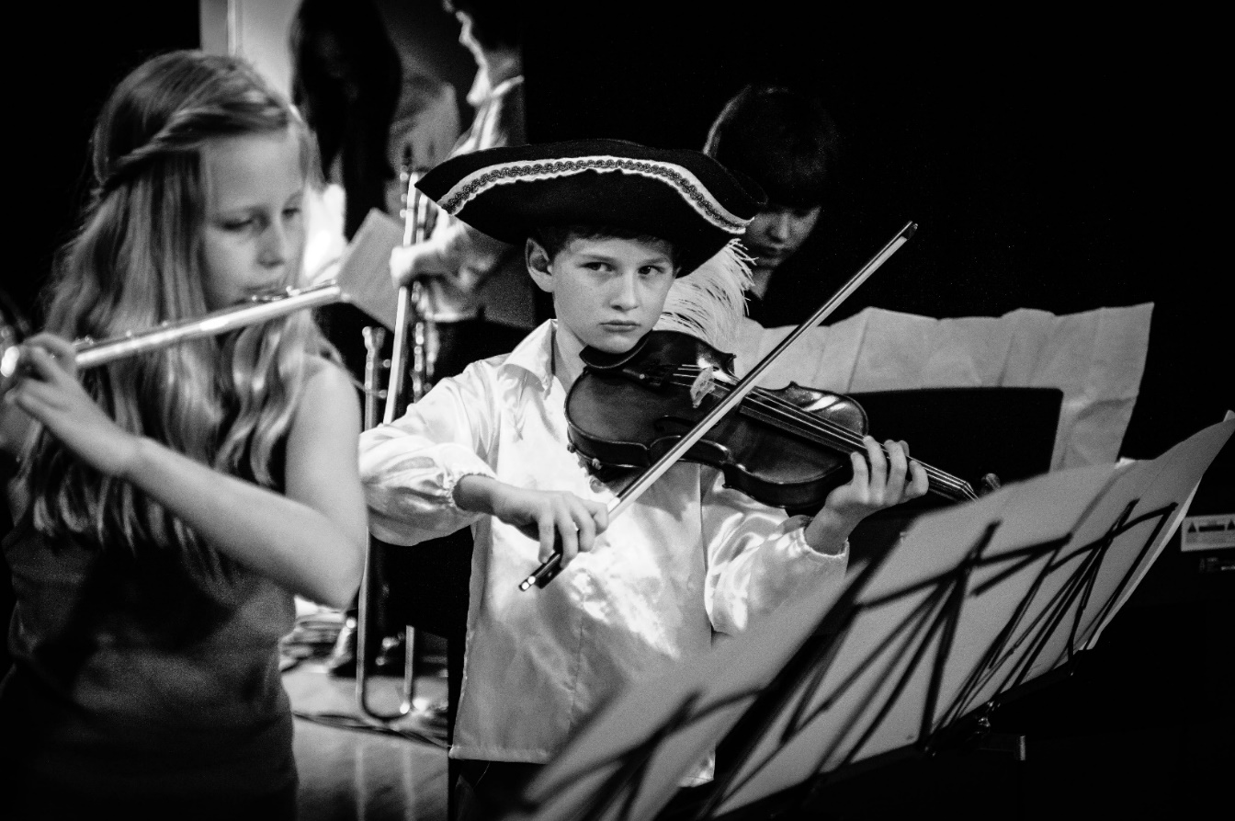
Action Write! #4
Good description often comes from precise observation.
First – list at least 10 verbs in this image. Be precise.
Type your answer here
Now write a scientific, observational description of this scene.
Type your answer here

Slide 28
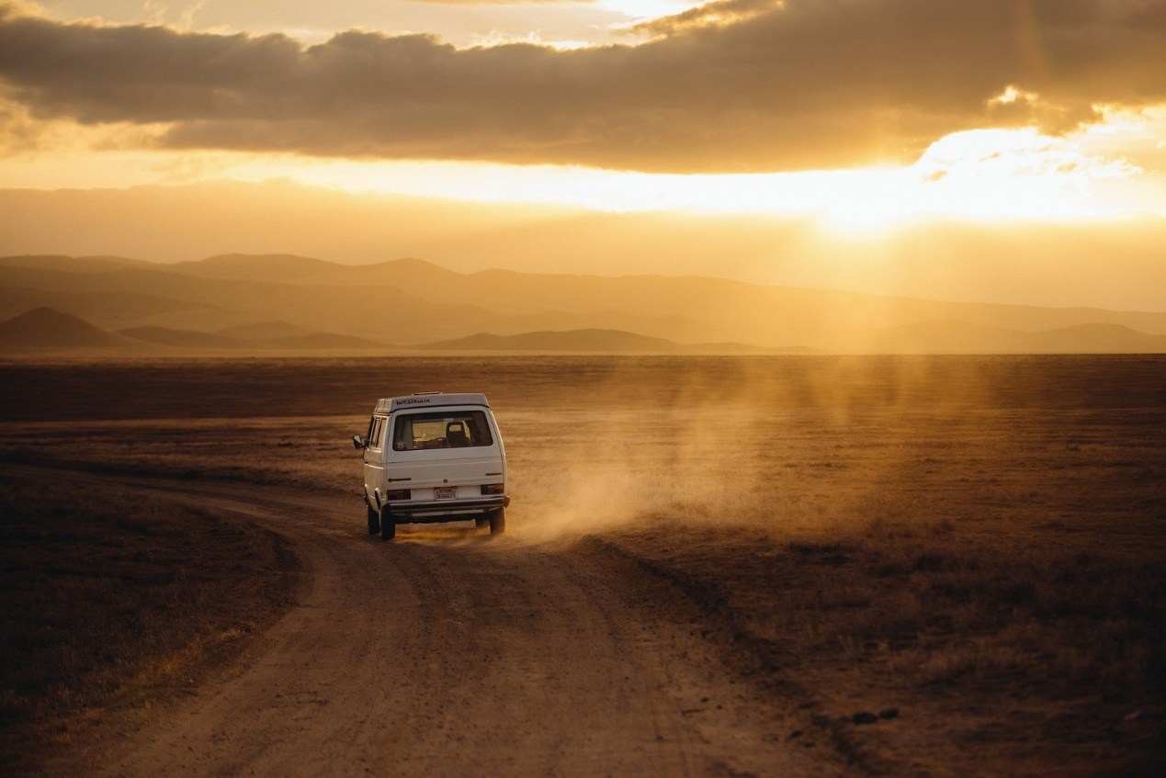
Perspective and places #1
Describe the scene presented in this image.
Describe first the landscape and the sky.
Finally describe the road and the camper van.
Write your answers here

Slide 29
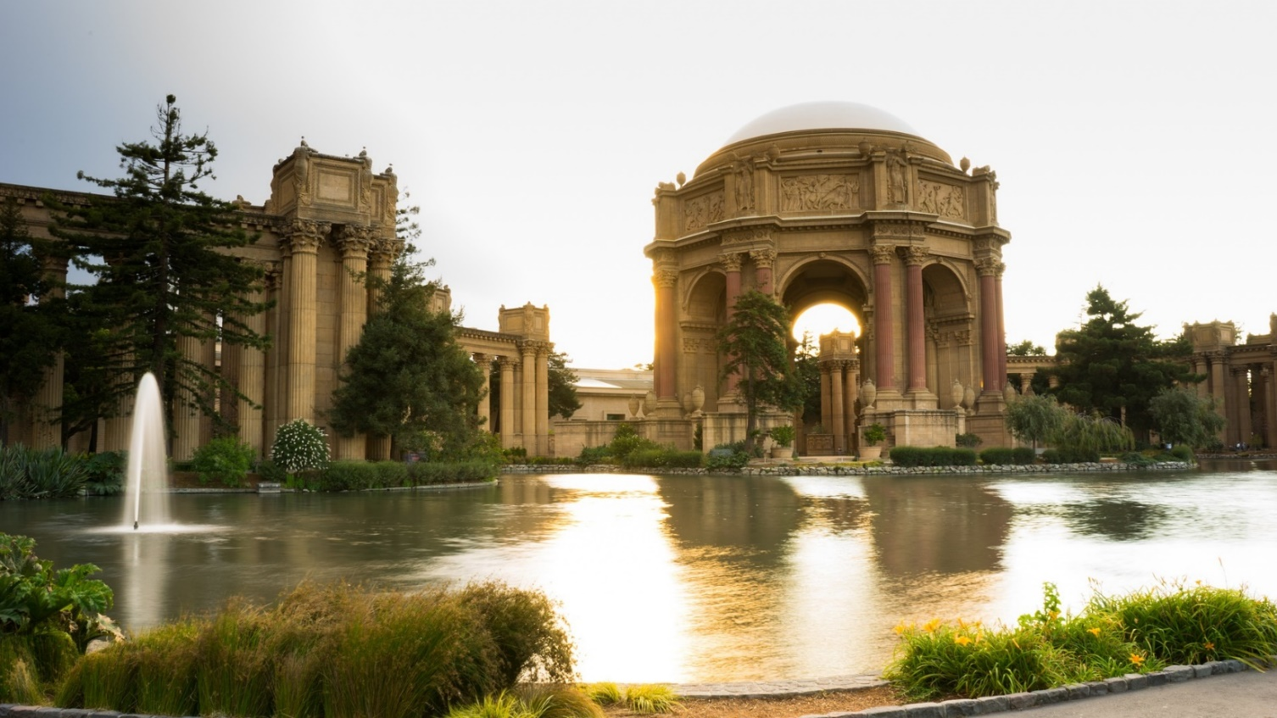
Perspective and places #2
Describe the scene presented in this image.
Describe first the lake and the surrounding greenery.
Finally describe the buildings.
Write your answers here

Slide 30
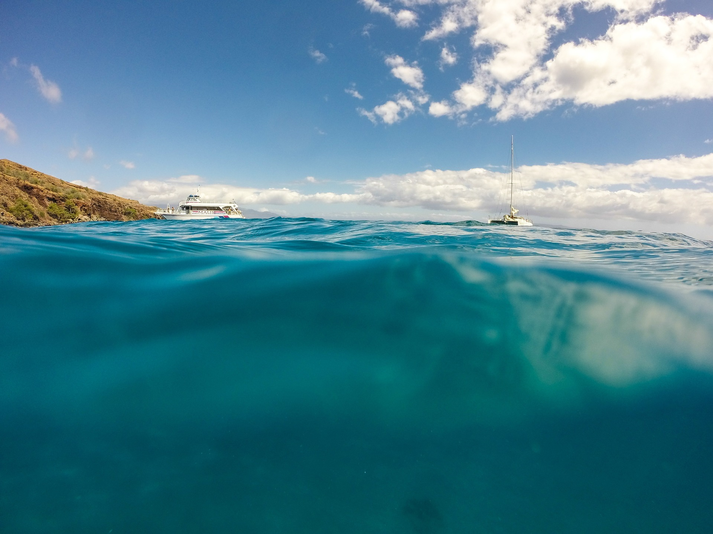
Perspective and places #3
Describe the scene presented in this image.
Describe first the water and coastline.
Finally describe the two boats.
Write your answers here

Slide 31
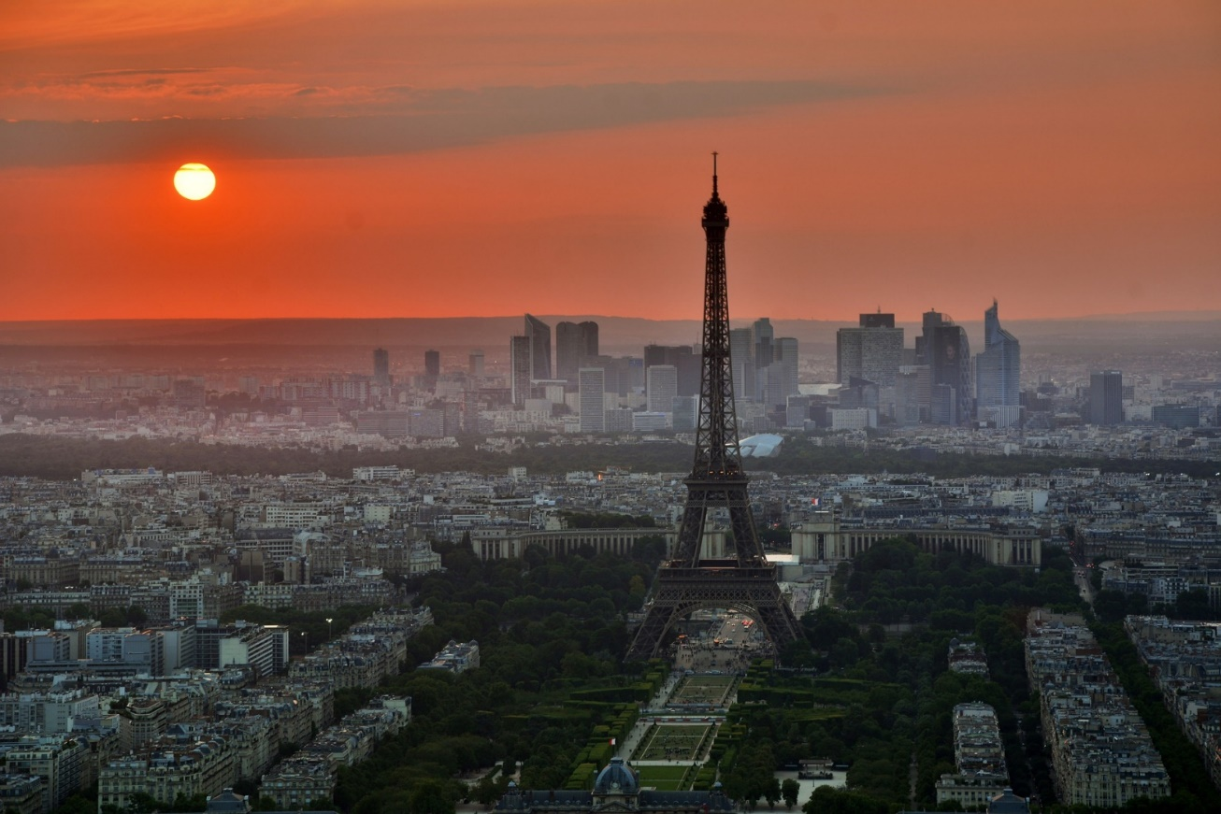
Perspective and places #4
Describe the scene presented in this image.
Describe first the buildings and streets.
Finally describe sky and the setting sun.
Write your answers here

Slide 32
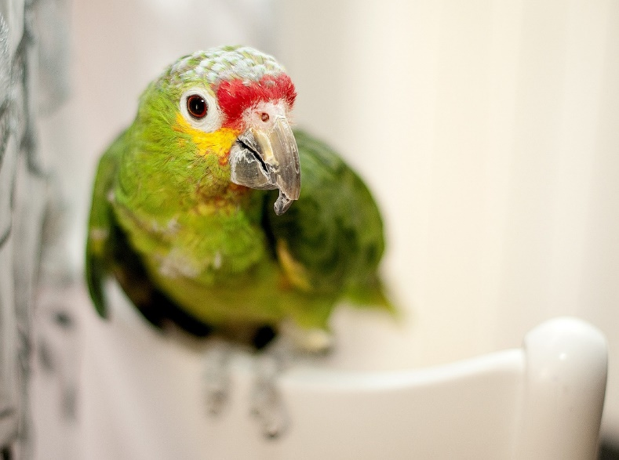
Writing nature #1
Make notes on how you could describe this parrot. Consider the shape, shades of color and texture.
Write your answers here
Now write out your description.
Write your answers here

Slide 33
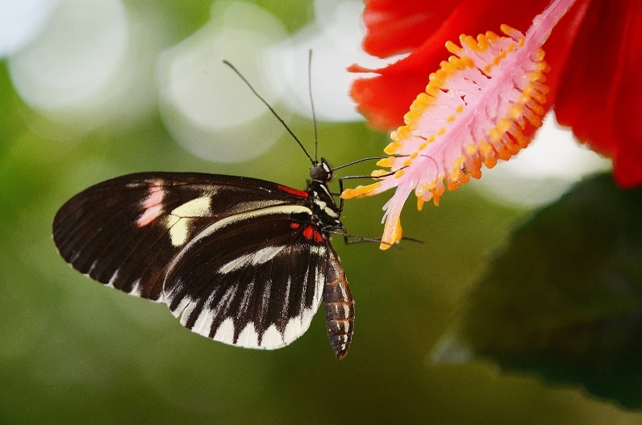
Writing nature #2
Make notes on how you could describe this butterfly. Consider the shape, shades of color and texture.
Write your answers here
Now write out your description.
Write your answers here

Slide 34
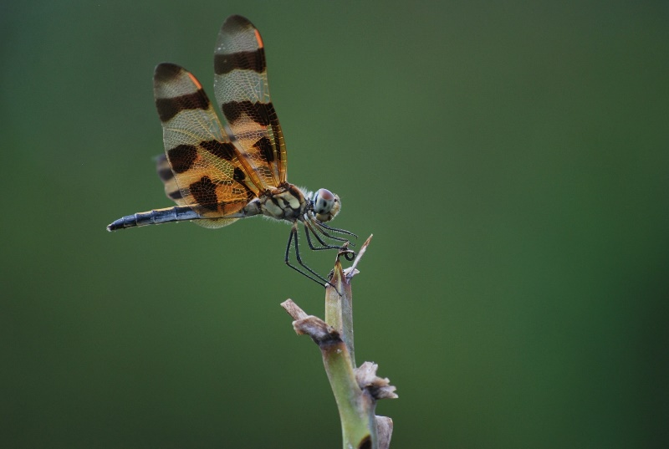
Writing nature #3
Make notes on how you could describe this dragonfly. Consider the shape, shades of color and texture.
Write your answers here
Now write out your description.
Write your answers here

Slide 35
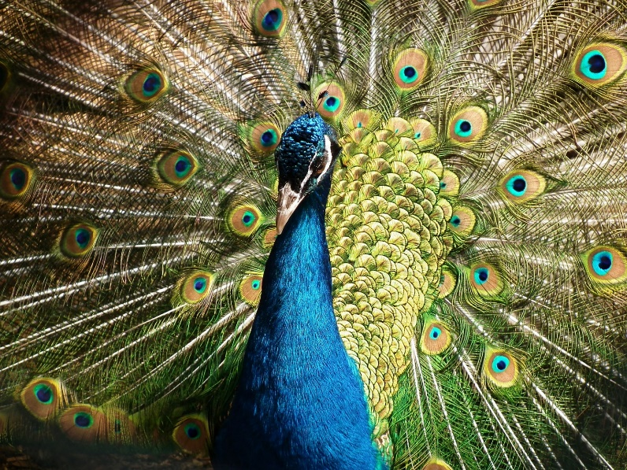
Writing nature #4
Make notes on how you could describe this peacock. Consider the shape, shades of color and texture.
Write your answers here
Now write out your description.
Write your answers here

Slide 36

BINGO
Creative Writing
1
Instructions: This choice board of writing prompts is set up like a BINGO board. You will be given extra “credit” for a “bingo” which is one complete line up or down. And extra, extra “credit” for a blackout which is completing all the tasks.
Write a short story in which a key and a burger are significant objects.
Describe a group of friends enjoying a summer day.
You teach an alien how to make a sandwich. Describe this process in precise detail.
Write a description of your “best day ever”. Relive the day in detail.
Write a short narrative based on the title “Late”
Invent a job that doesn’t exist yet. Write a job description for it, include a personality profile for candidates.
Write a short narrative based on the title “Jump”
Write a narrative set in a cafe / diner
Describe your bedroom in scientific detail, recreate every item in specific detail.
Write a short narrative in which a fictional character gets lost in your town.
Imagine life in the WW1 trenches. Write a description of it and the conversations between the men there.
Write a short narrative using the opening line: “Run!...”
Write a short narrative based on the title “Rain”
Write a short narrative using this opening line:
“Water gushed through the open window…”
Imagine yourself or a character who is adrift at sea, describe the experience.
Describe a character as they drop something precious and watch it roll beyond their reach.
Write a thought monologue from the point of view of a toy (either in a shop or at home).
Write a short narrative using the opening line: “The ticking began again, faster this time…”
You and your friends turn eating a bag of chips into an extreme sport. How? Describe it.
Write a short narrative based on the title “Tomorrow”
Write a short story in which you save the world – but no one notices.
Write a short narrative using the opening line: “Darkness, complete darkness…”
A group of friends goes to a paint-ball park. Write their ‘game’ from 4 different points of view.
Writing a precise description of someone trying to escape a wasp.
Don’t forget your best writing skills!

Slide 37


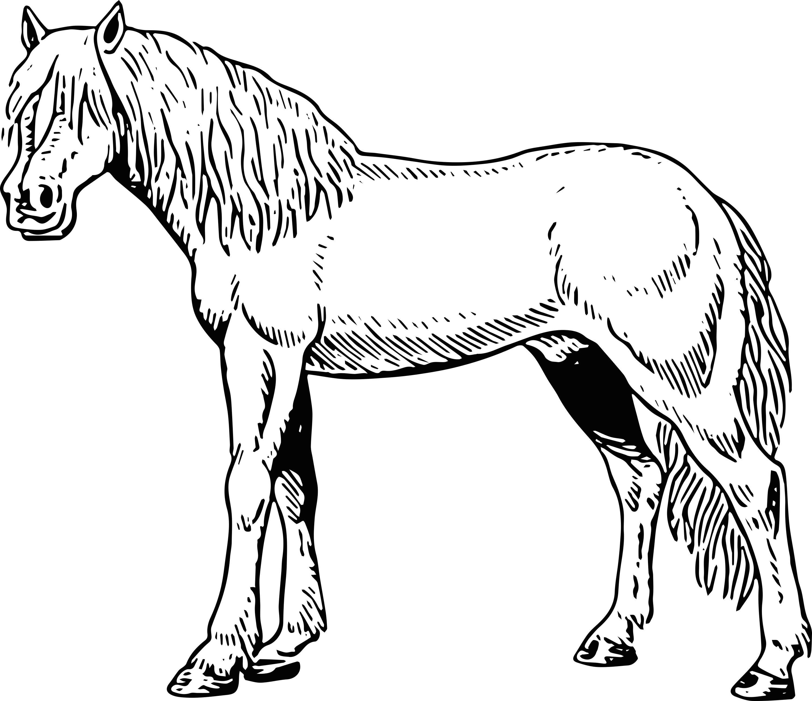




BINGO
Creative Writing
2
Instructions: This choice board of writing prompts is set up like a BINGO board. You will be given extra “credit” for a “bingo” which is one complete line up or down. And extra, extra “credit” for a blackout which is completing all the tasks.
Write a narrative where this creature plays a significant role
Write a narrative where this creature plays a significant role
Write a short story in which a child gets locked in school at night-time.
 |  | xx
Take a character from a Disney film and put them in a real-life job. Describe their day
Write a short story set in a lift.
Write a short narrative based on the title “Croissant”
Write a narrative where this creature plays a significant role
Describe a family as they set up a tent ready for a camping trip.
Write a short story about a hand-made gift
Write a narrative where this creature plays a significant role
Write a narrative that describes 6 months worth of mail sent by one avid letter writer
Write a conversation between siblings who are trying to wind each other up.
Write a short narrative based on the title “Lift Off”
Write a short story that begins with the words “You have no right…”
You need to borrow a $100 off your parents – write the story you will tell them to persuade them.
Write a short story about an older couple who take up dancing.
Write a narrative where this creature plays a significant role
Write a short story that contains a police officer, an accident, and an ice-cream.
Write a narrative set in a hospital waiting room.
Write a narrative where this creature plays a significant role
Write a short narrative based on the title “Plastic”
Write a conversation between long lost friends who meet at a petrol station
Write a narrative where this creature plays a significant role
Write a short narrative based on the title “The Gamble”
Don’t forget your best writing skills!

Slide 38
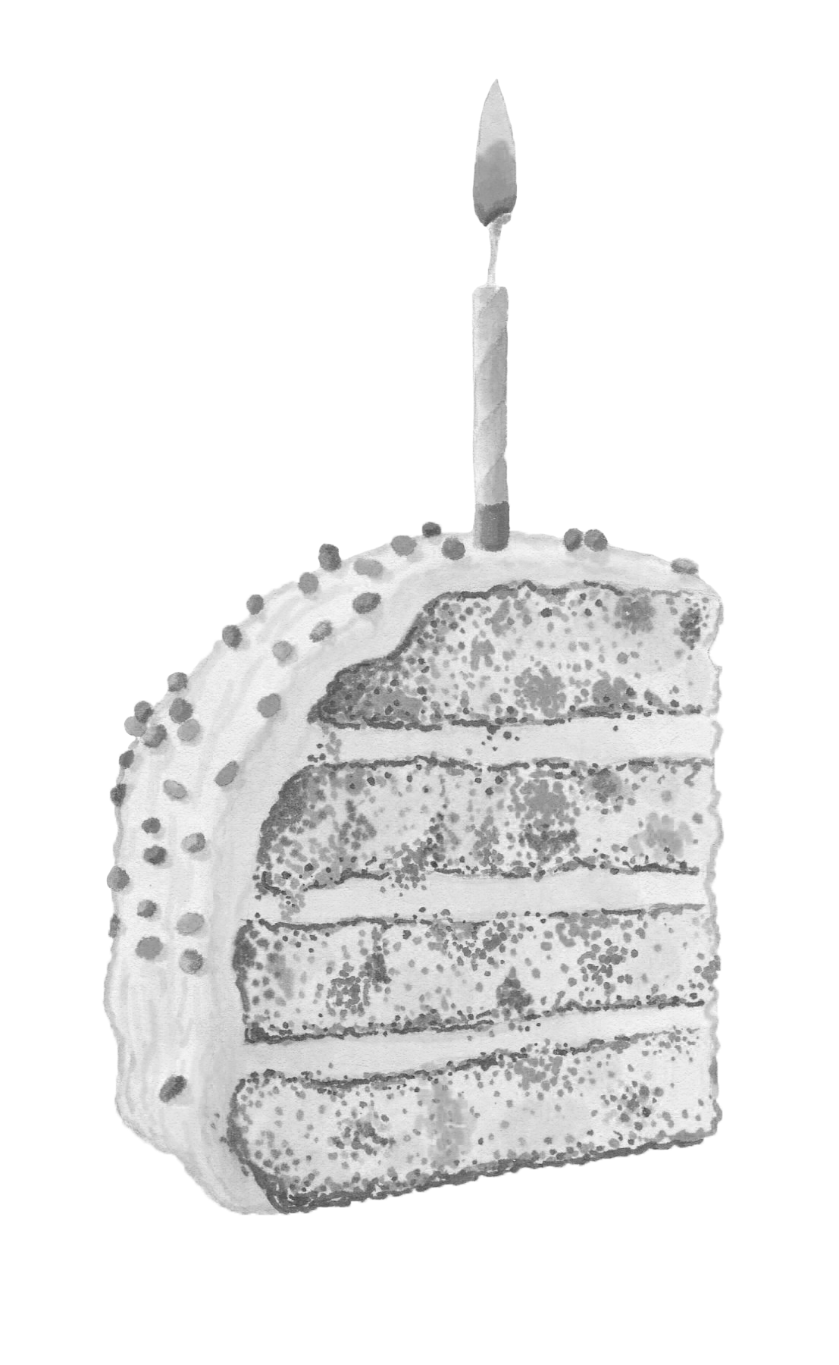
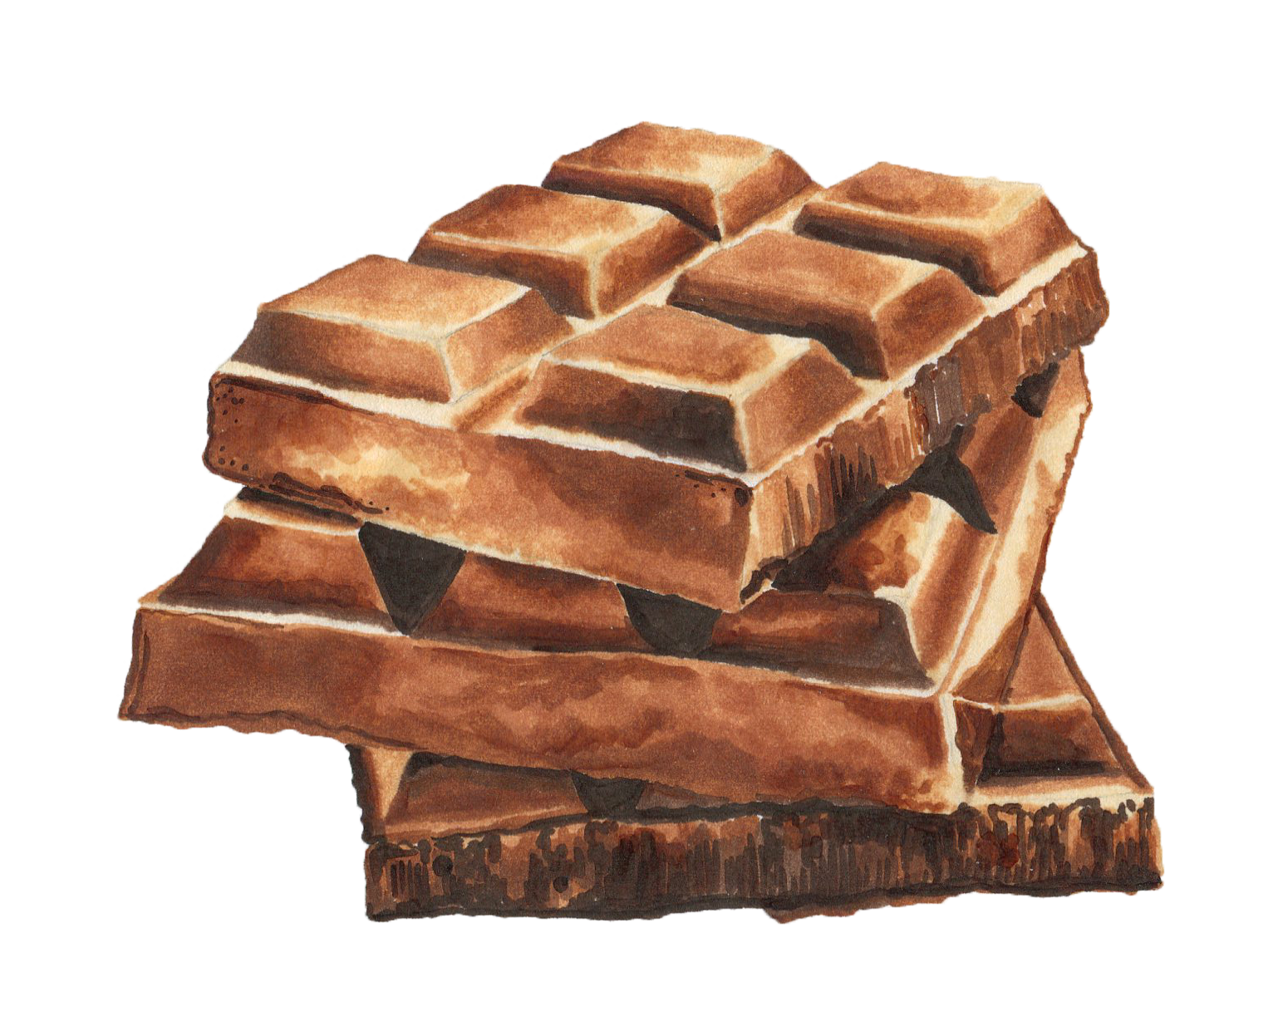
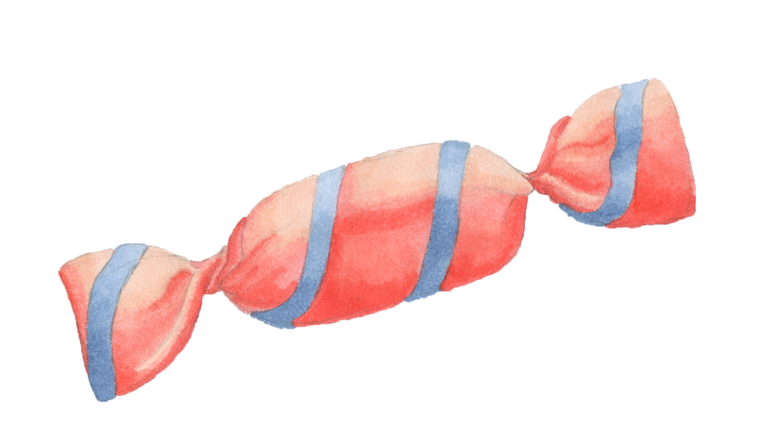
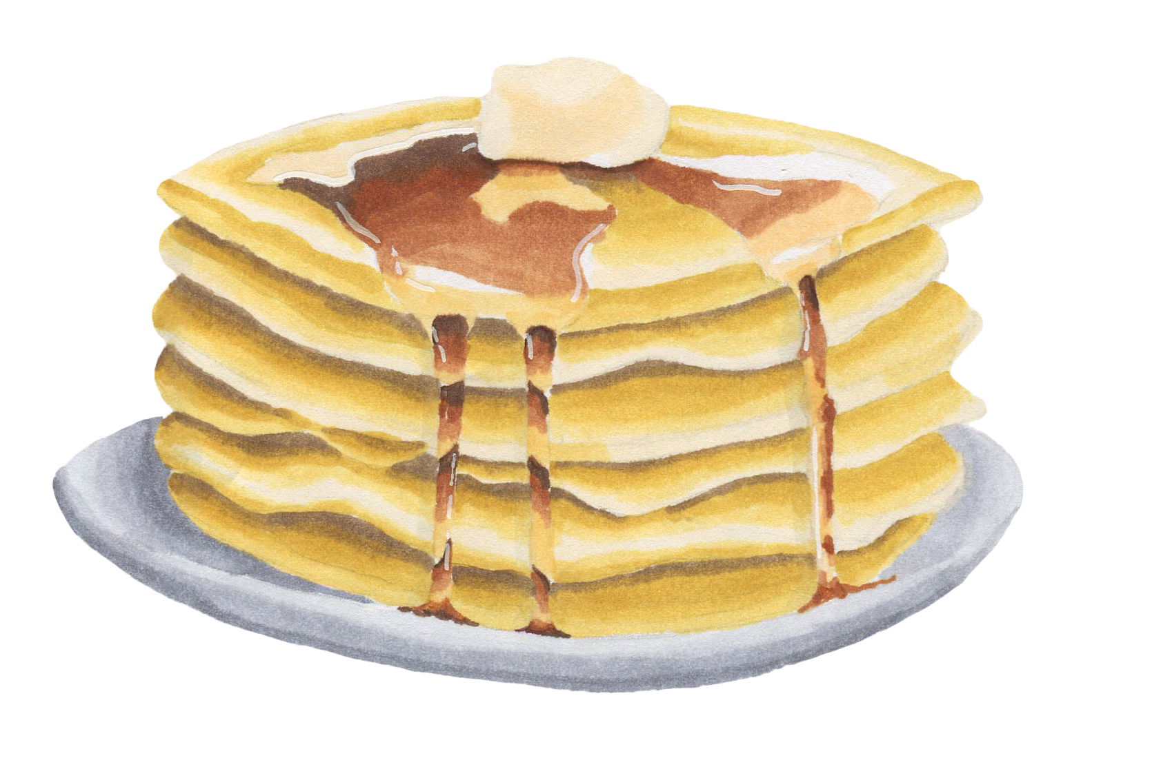


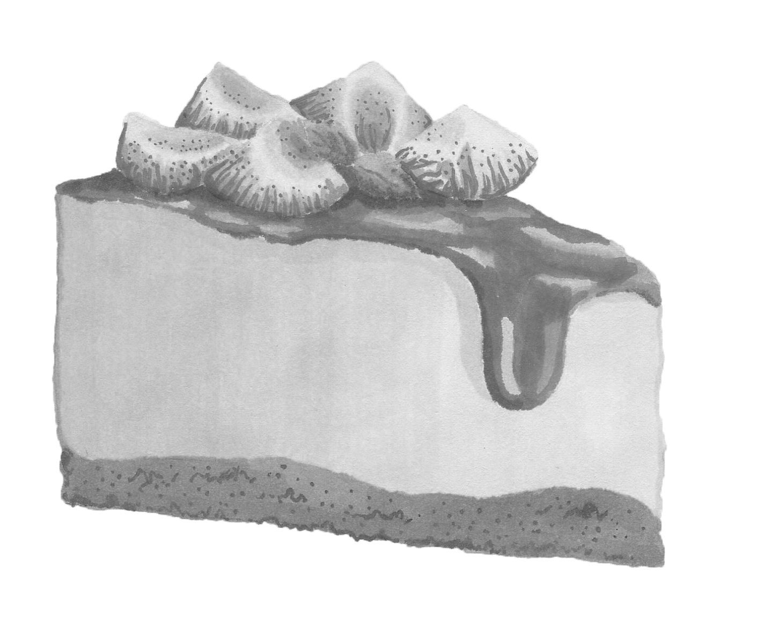
BINGO
Creative Writing
3
Instructions: This choice board of writing prompts is set up like a BINGO board. You will be given extra “credit” for a “bingo” which is one complete line up or down. And extra, extra “credit” for a blackout which is completing all the tasks.
Write a narrative where this food plays a significant role
Write a narrative where this food plays a significant role
Write a short story where one of the character can foresee the future
 |  | xx
Write a narrative where the character Baloo from the Jungle Book plays a role
Write a short story in which a desktop computer is thrown out of a window
Write a short narrative based on the title “Replicant”
Write a narrative where this food plays a significant role
Write everything that is spoken by two characters on their 5 hour car journey
Write a short story about an unexpected discovery of a million Rubles
Write a narrative where this food plays a significant role
Write a short story in which a character forgets to make an important reservation
Write a short narrative based on the title “Jellyfish”
Write a short narrative based on the title “Orange”
Write a short story that begins with the words “Just hang on…”
Write a narrative in which giants are real and they decide to take over your town
Write the short diary entries for a person from the ages of 22 to 42 years
Write a narrative where this food plays a significant role
Write a narrative set in a DIY store
Write a short narrative based on the title “Stay Hydrated”
Write a narrative where this food plays a significant role
Write a short narrative based on the title “Plastic”
Write a conversation between long lost friends who meet at a petrol station
Write a narrative where this food plays a significant role
Write a short narrative based on the title “The Gamble”
Don’t forget your best writing skills!

Slide 39







BINGO
Creative Writing
4
Instructions: This choice board of writing prompts is set up like a BINGO board. You will be given extra “credit” for a “bingo” which is one complete line up or down. And extra, extra “credit” for a blackout which is completing all the tasks.
Write a narrative where this object plays a significant role
Write a narrative where this object plays a significant role
Write a narrative where something important is left unopened
 |  | xx
Write a short story based on your favourite playlist or CD
Write a short story about going out to buy milk
Write a short narrative based on the title “Leftovers”
Write a narrative where this object plays a significant role
Write a short story in which a character experiences panic
Write a short story that involves the unexpected use of nerf guns
Write a narrative where this object plays a significant role
Write a short story about a bike ride that has a surprise ending
Write a short narrative based on the title “Countdown”
Write a short narrative based on the title “Untoward”
Write a short story that begins with the words “Big hair, don’t care…”
Write a narrative where a character named Maria saves the day
Write a short story that takes place in a tunnel
Write a narrative where this food plays a significant role
Write a narrative in a children discovers treasure in the garden hedge
Write a short narrative based on the title “He Knows”
Write a narrative where this object plays a significant role
Write a short narrative based on the title “Blackest Friday”
Write a conversation between two people that begins with the line “It has to be a two way street”
Write a narrative where this object plays a significant role
Write a short narrative based on the title “In Captivity”
Don’t forget your best writing skills!

Slide 40







BINGO
Creative Writing
5
Instructions: This choice board of writing prompts is set up like a BINGO board. You will be given extra “credit” for a “bingo” which is one complete line up or down. And extra, extra “credit” for a blackout which is completing all the tasks.
Write a narrative where this object plays a significant role
Write a narrative where this object plays a significant role
Write a short story that involves a game of duck, duck, duck, goose
 |  | xx
Write a short story with the opening line “Same old, same old”
Write a short story in which a flat tyre plays a significant role
Write a short narrative based on the title “Bungled”
Write a narrative where this object plays a significant role
Write a short story in which Tom Cruise visits your home town
Write a short story where sunscreen plays an important role
Write a narrative where this object plays a significant role
Write a short narrative about a locked door
Write a short narrative based on the title “Mixtape”
Write a short narrative based on the title “Zombies”
Write a short story that begins with the words “I’m begging you…”
Write a short story in which a child is given a pet hamster in unexpected circumstances
Write a short story that begins with the words “I don’t get it…”
Write a narrative where this object plays a significant role
Write a short narrative set in a treehouse
Write a short narrative based on the title “The Queen”
Write a narrative where this object plays a significant role
Write a short narrative based on the title “Good intentions”
Write a conversation between two characters in which one of them has misjudged the other
Write a narrative where this object plays a significant role
Write a short narrative based on the title “Wasteful”
Don’t forget your best writing skills!

Slide 41
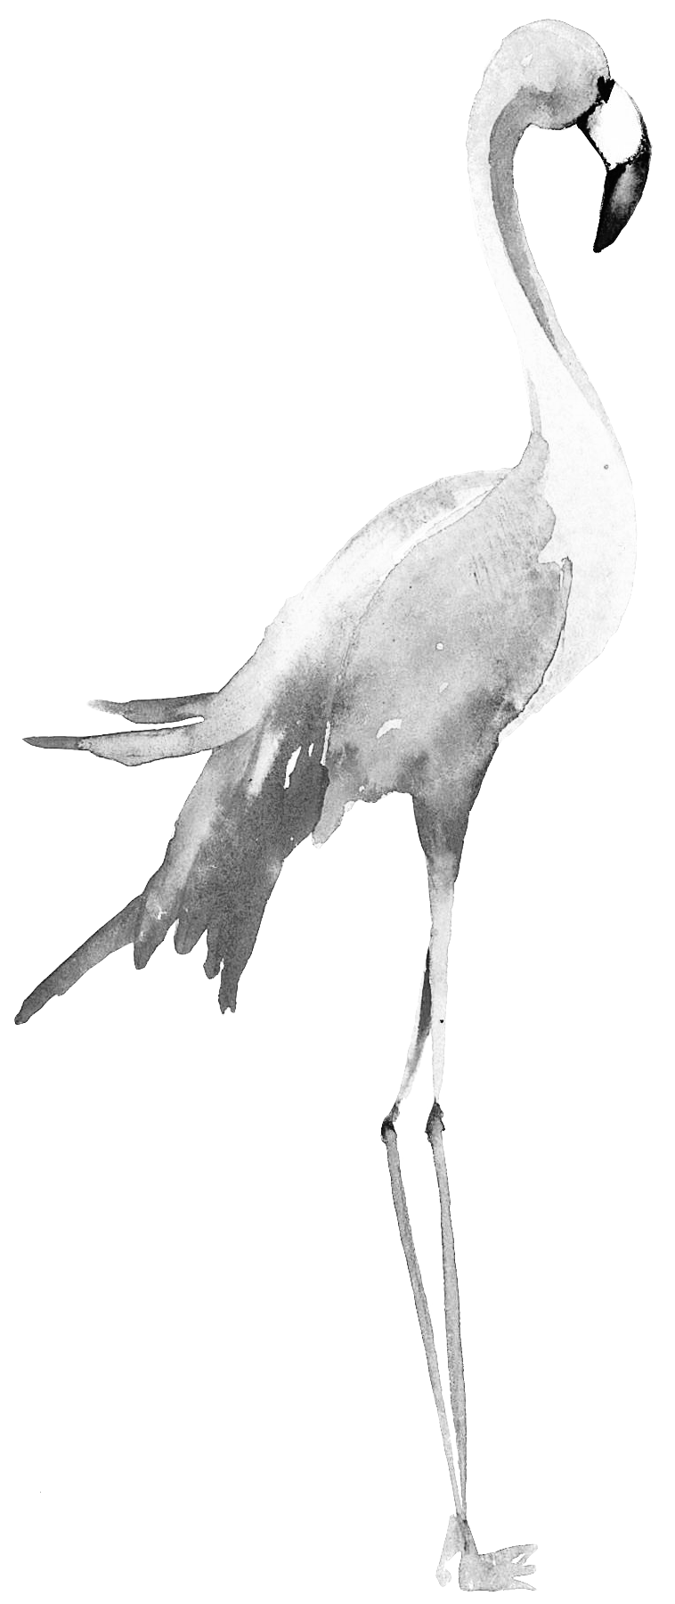
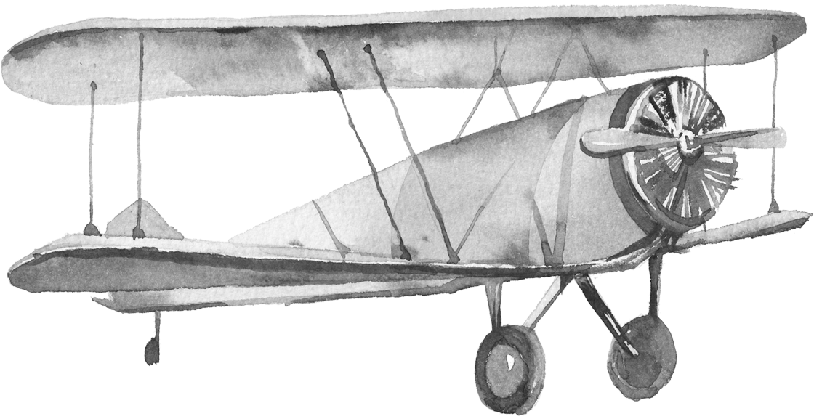
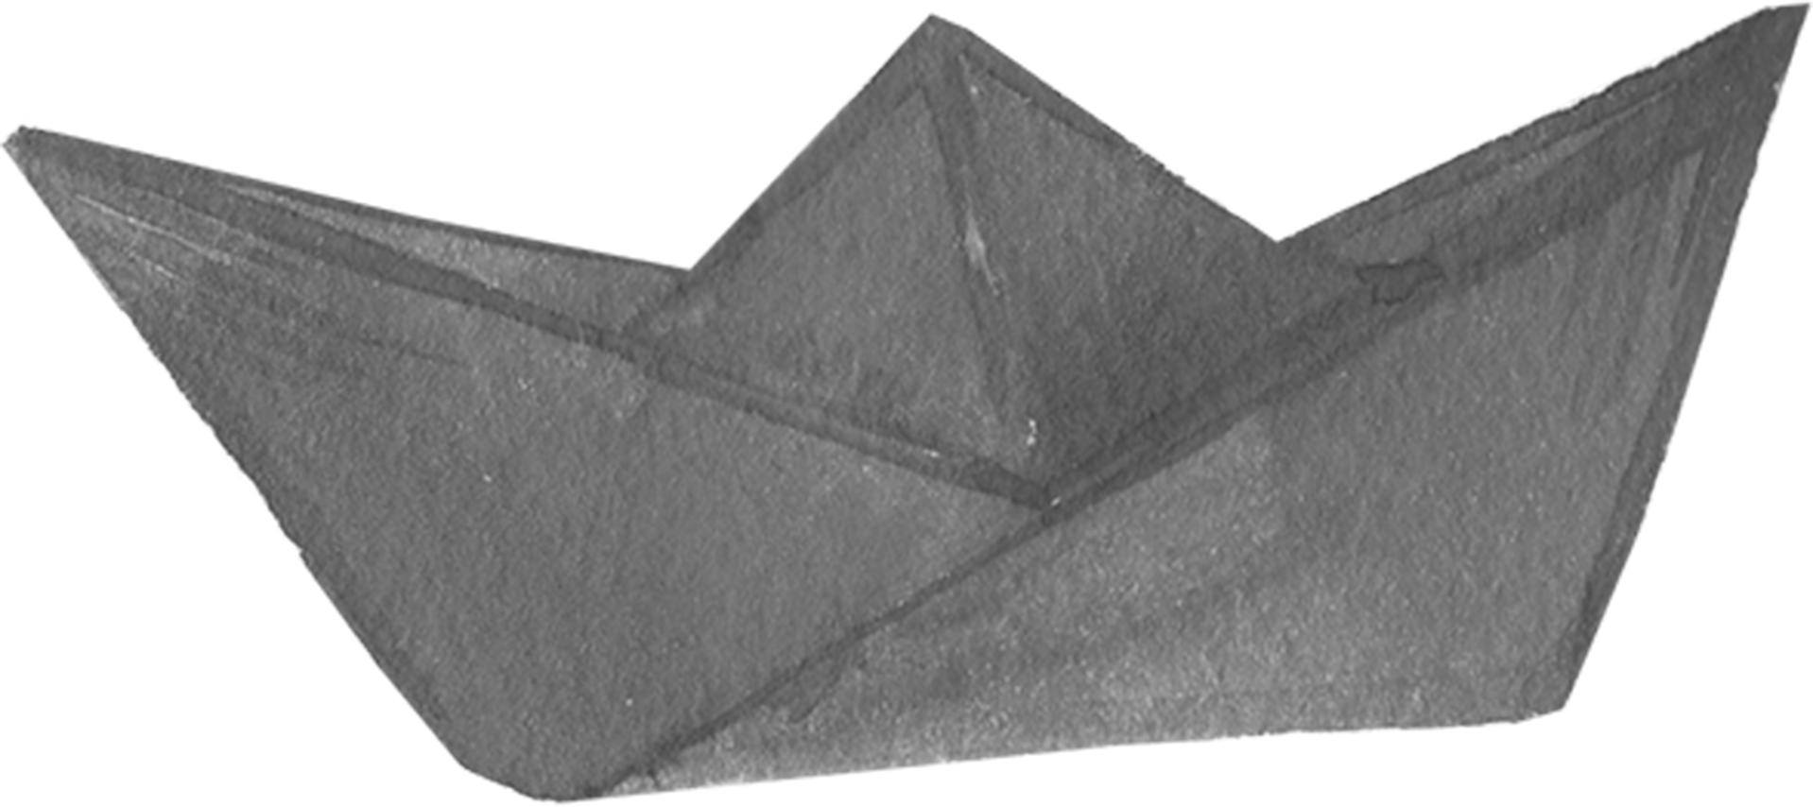

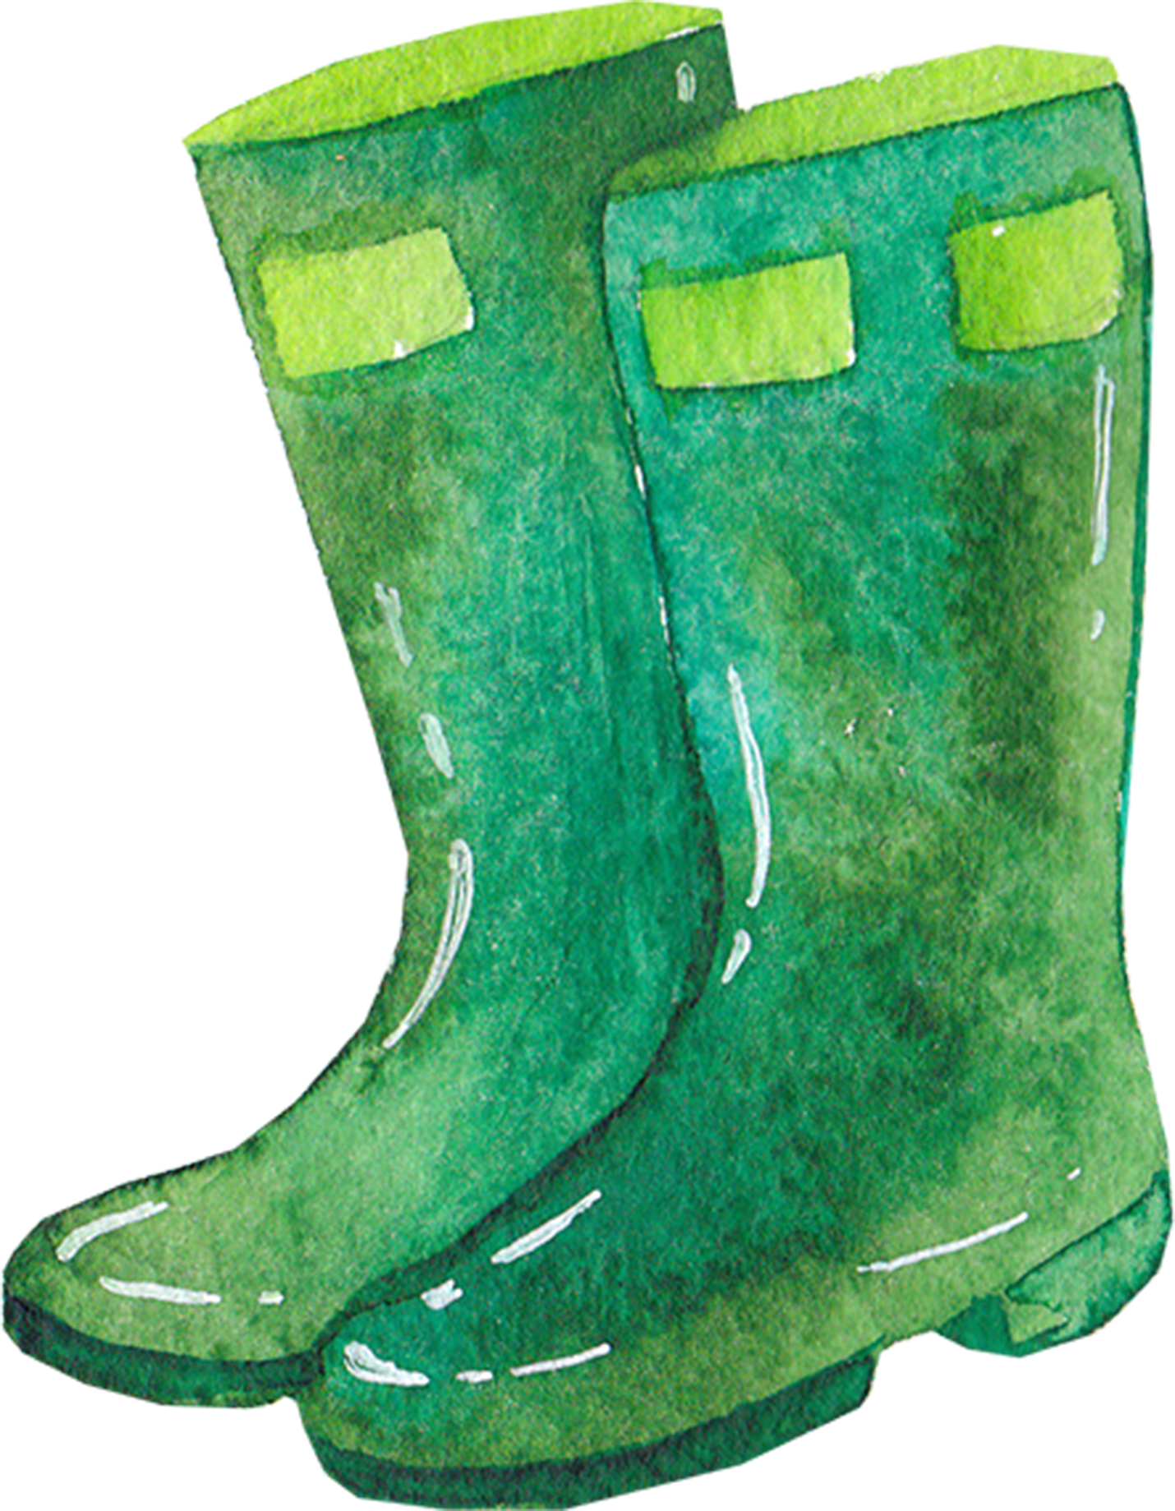
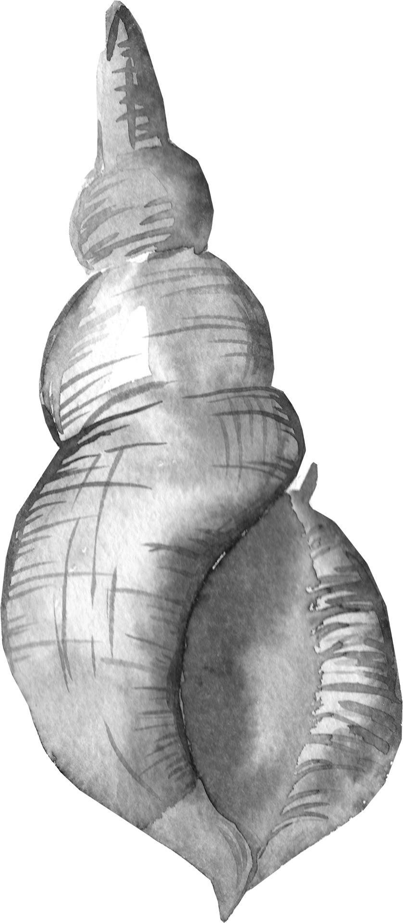
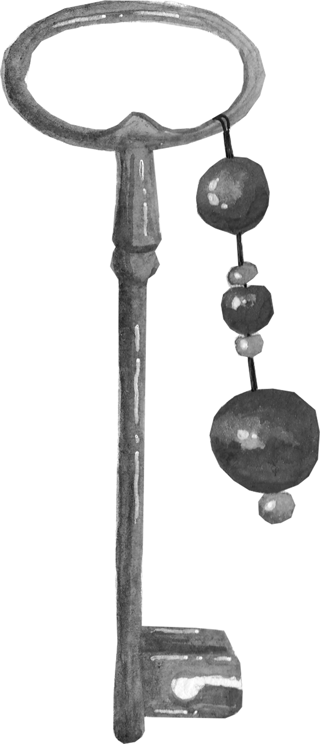
BINGO
Creative Writing
6
Instructions: This choice board of writing prompts is set up like a BINGO board. You will be given extra “credit” for a “bingo” which is one complete line up or down. And extra, extra “credit” for a blackout which is completing all the tasks.
Write a narrative where this object plays a significant role
Write a narrative where this animal plays a significant role
Write a short story in which someone writes their name on a napkin
 |  | xx
Write a short story with the opening line “He had wings…”
Write a short narrative set in an orchard
Write a short narrative based on the title “The Macarena”
Write a narrative where this object plays a significant role
Write a short story about a blank page that contains a hidden message
Write a conversation between two characters, one of whom is telepathic
Write a narrative where this object plays a significant role
Write a short story about a person’s regrets
Write a short narrative based on the title “Hustle”
Write a short narrative based on the title “The pastry chef”
Write a short story that begins with the words “You’re invited…”
Write a short narrative in which a character needs a new phone
Write a short story that begins with the words “I don’t get it…”
Write a narrative where this object plays a significant role
Write a short narrative set on a staircase
Write a short narrative based on the title “Pigsty”
Write a narrative where this object plays a significant role
Write a short narrative based on the title “Bad Idea”
Write a short story that involves accidental electrocution
Write a narrative where this object plays a significant role
Write a short narrative based on the title “Survival”
Don’t forget your best writing skills!

