Slide 1
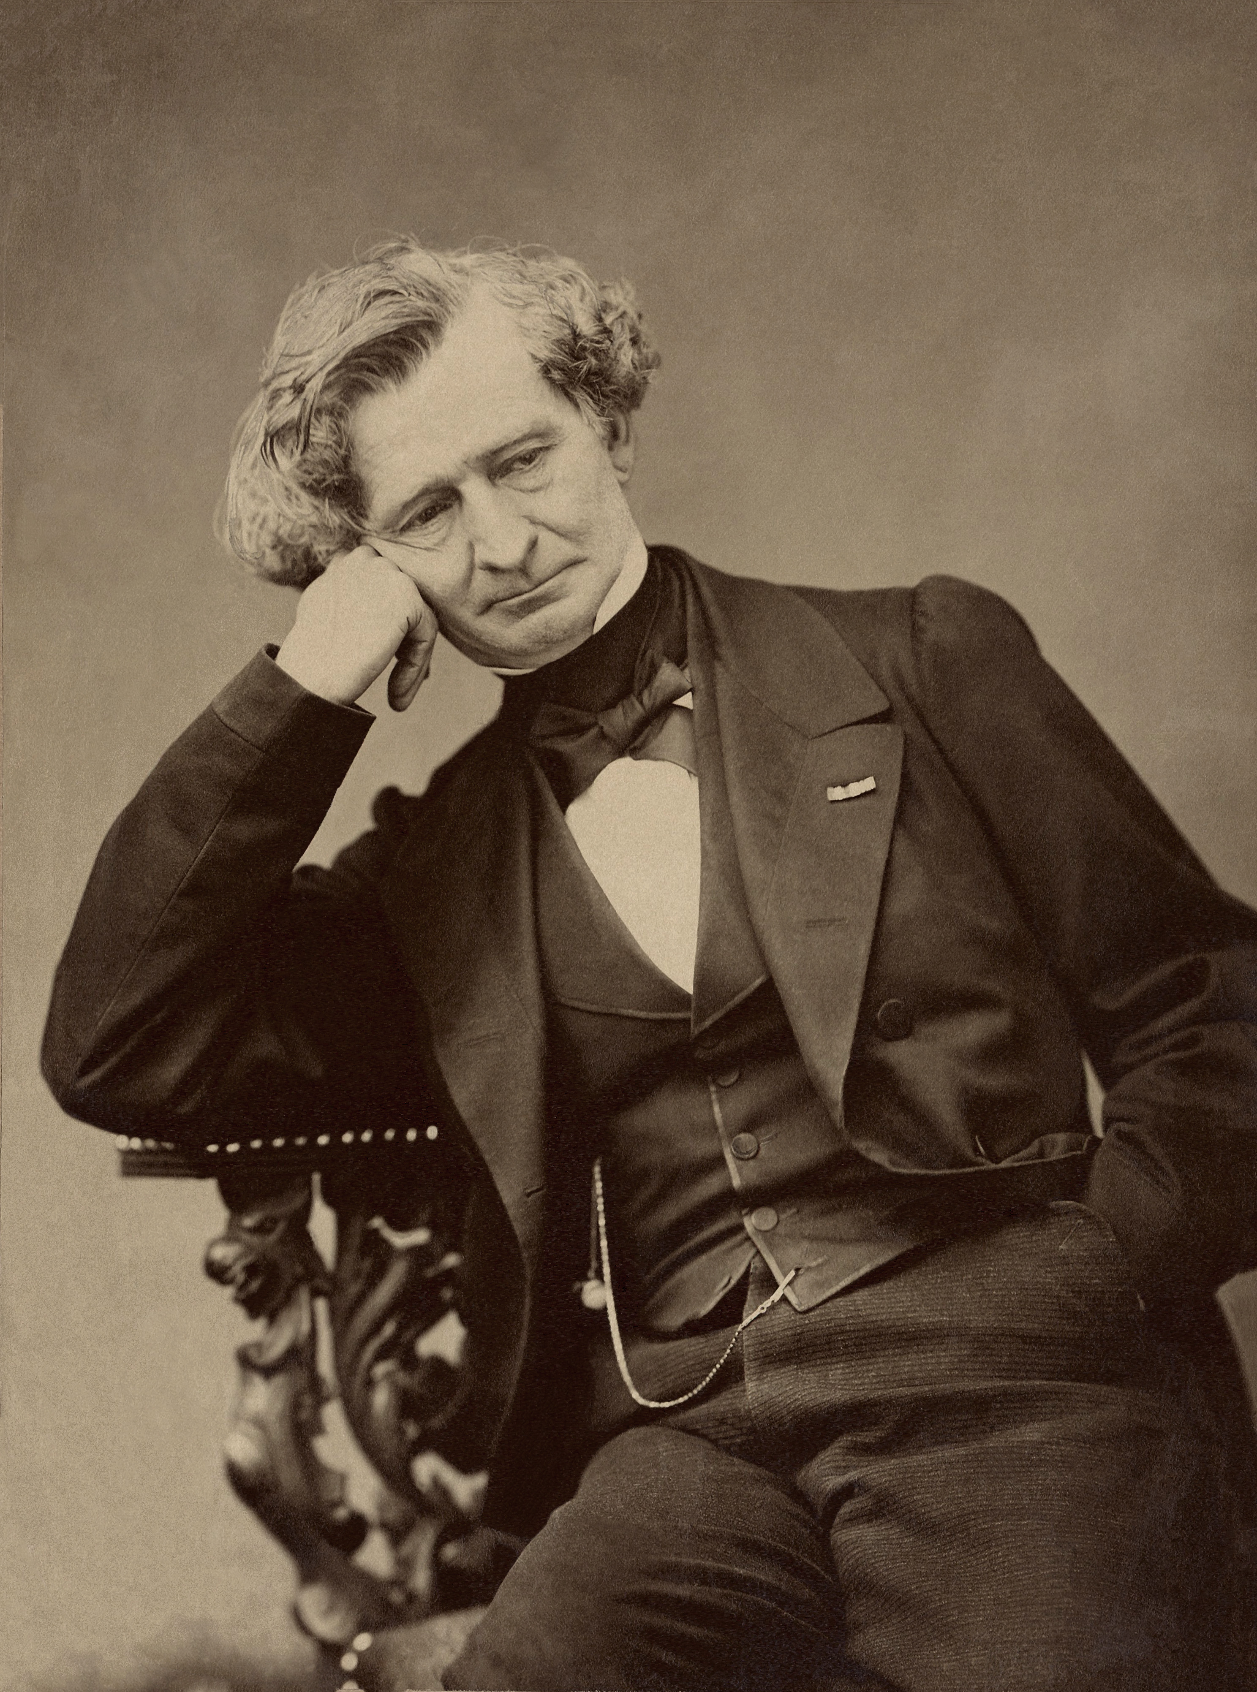
Hector Berlioz
Symphonie Fantastique: Movement, I

Slide 2
Background
Hector Berlioz (1803–69) was a French composer who was highly influential in the development of Romantic music. He wrote on a large scale, increasing the size of the orchestra but showing innovative methods of orchestration as well as through his melodic and harmonic ideas. He was born in La Côte Saint-André, a small town near to Grenoble. He began studying music at the age of 12 and, unusually, did not learn the piano, which he was said to later describe as beneficial and detrimental.
He was very much self-taught and learnt from textbooks. In 1821, at the age of 18, he was sent to Paris to study medicine, a subject for which he had no interest. He started to visit the Paris Conservatoire and within a few years, much to his parents’ disgust, had left his medical studies to pursue a career in music. In 1826 he enrolled at the Conservatoire to study composition. It was here that he became familiar with the symphonies, string quartets and piano sonatas of Beethoven and this was an inspiration for his compositions. After numerous attempts, he became a winner of the prestigious Prix de Rome.

Slide 3
Compositional output
His compositional output was large, and in addition to the highly renowned Symphonie Fantastique, other key works include the symphony for viola and orchestra, Harold in Italy.
He wrote large-scale choral works such as Grand Messe des Morts (Requiem) and operas which include Benvenuto Cellini and Les Troyens.
He also wrote his Treatise on Instrumentation, which had significant impact on the development of orchestral music throughout the Romantic period.

Slide 4
Background
The Symphonie Fantasique was first composed in 1830 (but later revised) and is an example of programme music which tells the story of a talented artist with a lively imagination who has poisoned himself with opium in the depths of despair because of hopeless love. Berlioz provided his own programme notes for each movement of the work. He writes:
‘The composer’s intention has been to develop various episodes in the life of an artist, in so far as they lend themselves to musical treatment. As the work cannot rely on the assistance of speech, the plan of the instrumental drama needs to be set out in advance.’
The following programme must therefore be considered as the spoken text of an opera, which serves to introduce musical movements and to motivate their character and expression.’

Slide 5
The idée fixe
The Symphonie Fantastique is a highly original work of its time in terms of both its treatment of melody, rhythms and harmony and Berlioz’s ability to express moods and drama through music. The symphony shows unity through the use of an idée fixe, a recurring theme, which acts as a structural foundation of the work. The piece is said to be autobiographical and represents Berlioz’s love of and obsession with the actress Harriet Smithson.
There are five movements, instead of the usual four movements that were conventional for symphonies at the time. Each movement is given a descriptive title by the composer.
  Rêveries – Passions (Reveries – Passions)
  Un bal (A Ball)
  Scène aux champs (Scene in the Fields)
  Marche au supplice (March to the Scaffold)
  Songe d’une nuit du sabbat (Dream of the Night of the Sabbath)

Slide 6
Performance forces
The Symphonie Fantastique requires a large symphony orchestra, which was groundbreaking for its time (1830), and numerous instrumental additions to that of the standard orchestra.
Woodwind Two flutes (one doubling piccolo) Two oboes Two clarinets in B♭ Four bassoons. | Brass Four horns: horns I and II in E♭ (down a major sixth) and horns III and IV in C Two trumpets in C Two cornets à pistons in G
Strings First and second violins (at least 15 each) Violas (stating at least 10) Cellos (he specifies at least 11) Double basses (at least 9). | Percussion Timpani (C and G : tonic and dominant)

Slide 7
Texture
The texture is highly varied throughout and changes frequently.
The orchestration is imaginative for its time and gives much independence to the wind section. For example, the entire piece starts with just flutes and clarinets in octaves and they are joined by oboes, bassoons and horns to create a homophonic texture.
There are moments of monophonic texture (e.g. bar 7) or a more extended solo line at bar 505.
There is unison writing with the idée fixe presented in the flute and first violins (bar 72).
There are octaves in the second time bar at bar 166 (lower strings).
Dialogue/exchanges as the melody is passed from first violins to lower strings at bar 36.
Melody-dominated homophony. The strings accompany the melody with repeated quaver chords on beats 1 and
There is an on/off beat accompanying figure at bar 63.
A homophonic chordal texture is presented in the Religiosamente ending (bar 511).

Slide 8
Melody: Idée Fixe
Central to the melodic writing of Symphonie Fantastique is the idée fixe (a recurring theme which serves as a structural device). This theme is heard in all five movements of the work. It is first presented in bar 72 of the first movement as the first subject at the start of the exposition.
It starts on the dominant with expanding leaps of a perfect fourth, followed by a major sixth. It descends in a conjunct manner with descending notes forming a ‘sigh’-like musical motif. It is then repeated, altered down a fourth in bar 80. The descending ‘sigh’ motif is then heard in an ascending sequence as the levels of tension increase.

Slide 9

Melody: Second Subject
The questionable second subject heard in bar 150 is presented below.
It is interesting to note that it shares similarities with the idée fixe: starting with the long note followed by a leap of a perfect fourth and then a sixth before descending with two-note ‘sigh’ effects often using semitones.

Slide 10
Melody: Idée Fixe cont.
Elements of the idée fixe are used throughout – for example, the repeated ascending interval of the fourth at bar 234.
  Melodies are based on ascending and descending arpeggios (bars 30–34).
  The idée fixe is presented as an ascending sequence at bar 94.
  Melodies are often chromatic (bar 107).
  Melodies sometimes contain repetition for heightened emphasis (bar 146).
  Melodies are often based on scales. There are examples of ascending and descending chromatic scales (bar 198).
  Most of the melodic material in the first half is quite high until the cello takes the lead between bars 359 and 404.
  Ornamentation occurs (e.g. bar 19, acciaccatura and a trill).
  Some extreme leaps are used (e.g. bars 226–227, violin I).

Slide 11
Structure: introduction & Exposition
Typical of the time, the structure is sonata form preceded by a slow introduction.
Slow Introduction Bars 1–63 | The wind section starts with triplet-dominant notes followed by a chromatic scale leading into a C minor chord. The strings then take the melody fragmented by rests. At bar 17 the key of C major is established as the violins play a lively sextuplet scalic melody.
Bars 64–71 | Link to sonata form section of the piece. Homophonic and reinforcing the key of C major. The two-quaver motif which will later become an important accompanimental figure is introduced.
Exposition (repeated) Bars 714–167 | The first subject (the idée fixe) is introduced in the key of C major. At bar 111 vibrant ascending scale and descending broken chords appear. Bar 133: transition passage contains chords and triplet crotchet melodies. The questionable second subject appears at bar 160.

Slide 12
Structure: Recapitulation
Recapitulation Bars 232–end | The recapitulation is really more like a series of development sections or codas, playing with former material. A dominant pedal in the third horn starts this section as repeated rising fourths appear in the violins. The idée fixe is heard in the woodwind in the key of G major, breaking with the traditions of sonata form, as the strings accompany with continuous leaping quavers. This theme is developed and becomes even more chromatic. At bar 291 excited descending appoggiatura scales appear in the strings. At bar 311 the second subject appears in the cello and is passed in imitation through the strings. Further development of the theme continues.

Slide 13
Structure: Coda
Coda: bars 475– end | Repeated descending arpeggios, with accented off-beats. Final statement of the idée fixe over a C major chord and becoming monophonic. Religiosamente section with three plagal cadences and concluding on a paused C major chord. The final section gives a feeling of symmetry to the movement, balancing with the Largo in the opening section.

Slide 14
Tonality:
The movement starts in C minor.
At bar 17 it changes to the tonic major, C major, returning to C minor in bar 24.
The tonality is frequently obscured by chromaticism in the melody and harmony.
In bar 42 the piece modulates to A♭major and this is followed by a long tonic pedal in bar 46.
After much chromatic movement, C major is reached in bar 61 as the key signature formally changes in bar 64. Although the melodic line is highly chromatic with semitone movement, perfect cadences establish the key (e.g. bars 110–111).
The bridge passage/transition (bar 133) is in the key of A♭major, although moves towards G major, the dominant, for the second subject in this key at bar 150. It briefly passes through E minor at bar 155.
The development section starts in G major, although this is a particularly chromatic section of the piece, which obscures the tonality. There is much semitone movement in the thematic material and passages of chromatic scales.
The recapitulation section starts in G major. After much chromatic movement, G major is again established with V7–I progressions at bar 291.
The piece draws to a close in the original tonic major key of C major.

Slide 15
Harmony:
Chords are often diatonic and functional but with considerable emphasis on chromatic harmony.
Chromatic harmony includes diminished seventh chords (e.g. bar 224).
Perfect cadences are frequent are often used to confirm the modulation to a new key.
There is an example of a tonic pedal note in bar 46.
There is a dominant pedal note in bar 232.
Dissonance is used occasionally with a 4-3 suspension (e.g. in bar 123).
Dominant seventh chords, bar 146.
The exposition section ends with a V7 in C major (bar 167 first time bar).
The movement ends with a series of IV–I plagal cadences.

Slide 16
metre
The time signature of the largo Introduction is , common time, otherwise known as simple quadruple.
The time signature changes at bar 64 to known as alla breve or cut common time, simple duple.
The tempo changes frequently throughout. The piece starts at a slow largo tempo, although becoming more lively from bar 17. A new tempo of Allegro agitato e appassionto assai is established at bar 64.

Slide 17
Rhythm
The rhythms are highly varied throughout.
The piece starts with a bar entirely made up of quaver triplets.
Crotchet triplets appear at bar 380.
Sextuplet semiquavers are present at bar 22.
The idée fixe begins with an anacrusis, bar 714.
Rests and rests with pauses are used in the Introduction to fragment the melodic line with silence and to create a feeling of uncertainty. At bar 229 there are over three bars of silence before starting the recapitulation section.
The movement concludes with rhythms of longer duration – tied semibreves, bar 511.
Examples of cross-rhythms (e.g. bar 29 or bar 60).
Syncopation is added for dramatic effect (e.g. bars 43–45).
Moto perpetuo crotchets are a feature in bars 198–227.

