Slide 1
Badminton
Task list:
Students write down how to carry out at least 3 key skills within the sport/activity they are currently doing in Core PE.
Students create a poster which outlines the main rules and regulations of the sport/activity they are currently completing in Core PE.

Slide 2
Badminton
Short serve - https://www.youtube.com/watch?v=yaEfnpA9rus
Long serve - https://www.youtube.com/watch?v=mvdIh5E_opU
Over head clear - https://www.youtube.com/watch?v=S2brZPqx288
Smash - https://www.youtube.com/watch?v=8QlW8_PdYbw
Drop shot - https://www.youtube.com/watch?v=31O_WuhVbKw
Underarm clear - https://www.youtube.com/watch?v=in24YZmG9ys
These can all be performed via backhand and forehand.

Slide 3
TASK 1
For the sport/activity that you are currently completing within your Core PE lessons. You must research HOW to carry out at least 3 key skills within this sport/activity.
CHALLENGE: Complete this task for the 3 most important skills/techniques within the sport/activity. You must justify WHY you have selected them as the 3 most important skills/techniques.

Slide 4
Skill/technique 1

Slide 5
Skill/technique 2

Slide 6
Skill/technique 3

Slide 7
Task 2
Task 2: Create a poster which outlines the main rules and regulations of the sport/activity that you are currently completing within your Core PE lessons.
CHALLENGE: What are the 3 most important rules/regulations within this sport/activity? Justify your response.

Slide 8
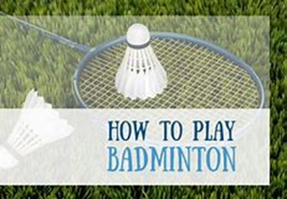
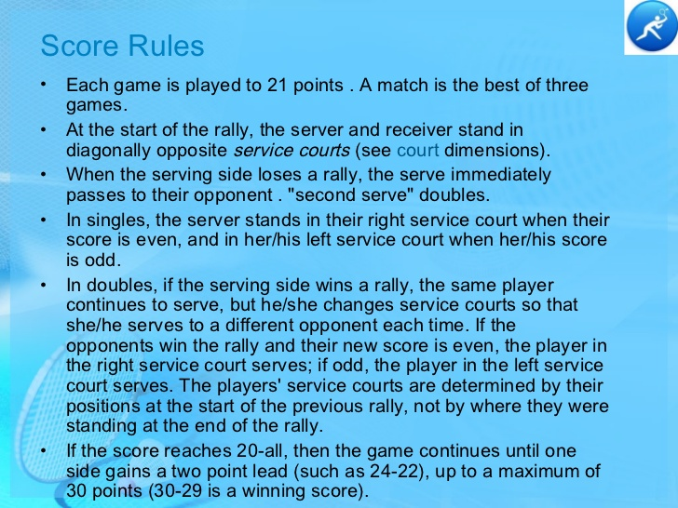
Badminton – Rule card
Basic rules:
Serve - Start the game with a serve (usually hit diagonally/into a service box).
Match play - Points are awarded if you force your opponent to hit the shuttlecock out of court area or into the net.
Court areas for Match Play – Singles court - long and thin/Doubles court - short and wide.
Advanced rules:
If your score is odd - serve from the left service box/if score is even - serve from right service box.
You must not touch the net during a rally.
The basics of the game:

Slide 9
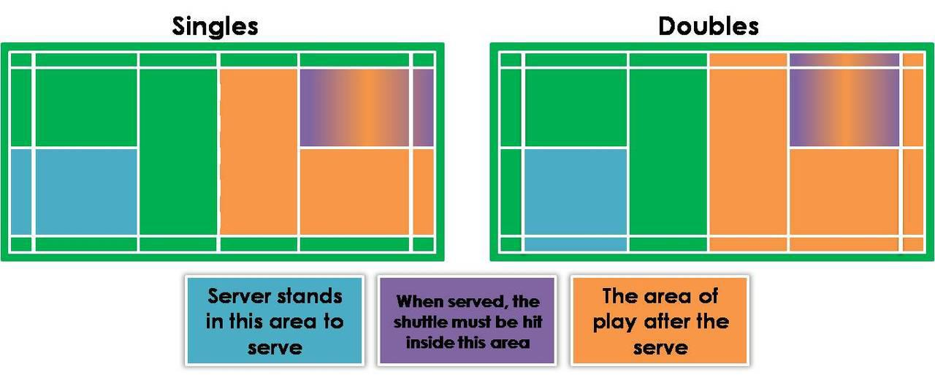
Badminton – Rule card
Match Play – Court Playing Area

Slide 10
Poster - https://www.rulesofsport.com/sports/badminton.html
Notes:
https://www.rulesofsport.com/sports/badminton.html

